Slide 1
BMEG - BioMedical Evidence Graph
Demonstration of BMEG Resource
Kyle Ellrott, UCSC
Josh Stuart, UCSC

Slide 2
BMEG
DREAM Challenges
SMC-DNA
SMC-RNA
SMC-HET
Predicted Drivers
Pathway Activities
Variant Calls
Expression Levels
Aligned Reads
DNA
RNA
Raw Reads
DNA
RNA
Clinical Correlation

Slide 3
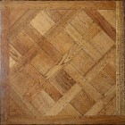
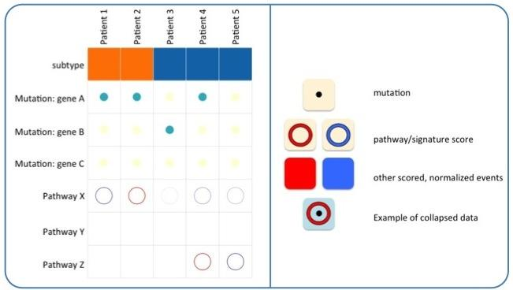
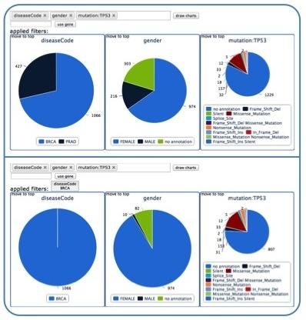
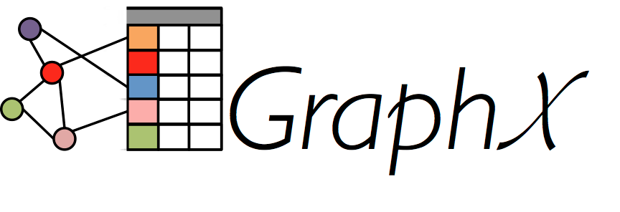
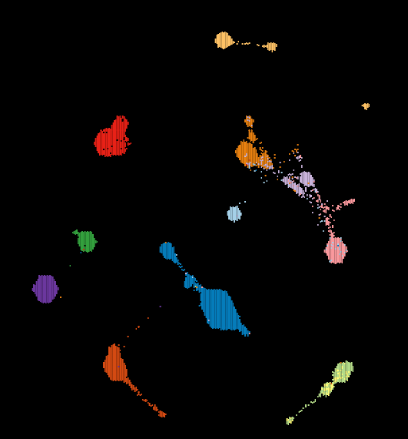
BMEG Architecture
Primary Data
Secondary Analysis
Biomedical Evidence Graph
Phase 1, 2, ...
Recognizers
CGHub Sequences
Aligned BAMs
Variant Calls
Clustering
TCGA Data
Interactive Analysis
CCLE Data
BMEG
Observation
Deck
- Graph Theoretic Analysis
- Automated learning system
Pathway
Commons
BMEG
Facet
Viewers
GO

Slide 4
Demonstration Overview
Organize crowd-source challenges to develop best-of-breed methods
Overview of current DREAM projects, living benchmarks
Enable cloud ready methods for mass compute
Alignments and somatic variant detectors
Establish methods to link genetic variants to cellular-, tissue-, and patient-level outcomes
GA4GH Genotype-to-Phenotype API
Create a queryable graph of evidence from abstracted evidence and inferences.
TumorMap visualization to view tumor samples across cancer types.

Slide 5
Demonstration Overview
Organize crowd-source challenges to develop best-of-breed methods
Overview of current DREAM projects, living benchmarks
Enable cloud ready methods for mass compute
Alignments and somatic variant detectors
Establish methods to link genetic variants to cellular-, tissue-, and patient-level outcomes
GA4GH Genotype-to-Phenotype API
Create a queryable graph of evidence from abstracted evidence and inferences.
TumorMap visualization to view tumor samples across cancer types.

Slide 6
Demonstration Overview
Organize crowd-source challenges to develop best-of-breed methods
Overview of current DREAM projects, living benchmarks
Enable cloud ready methods for mass compute
Alignments and somatic variant detectors
Establish methods to link genetic variants to cellular-, tissue-, and patient-level outcomes
GA4GH Genotype-to-Phenotype API
Create a queryable graph of evidence from abstracted evidence and inferences.
TumorMap visualization to view tumor samples across cancer types.

Slide 7
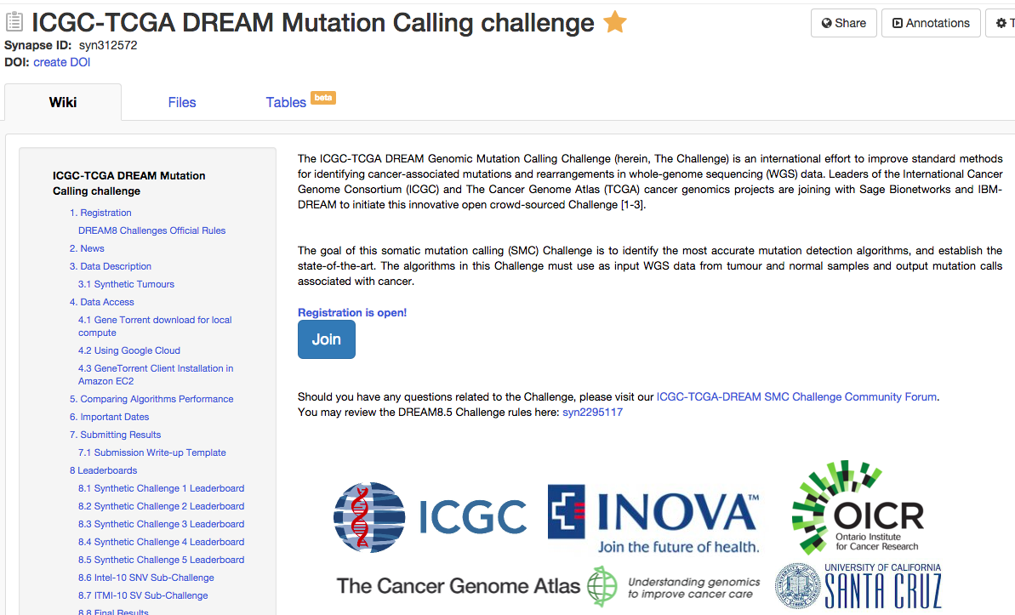
DREAM SMC Complete
Live Benchmark for each Sub-Challenge

Slide 8
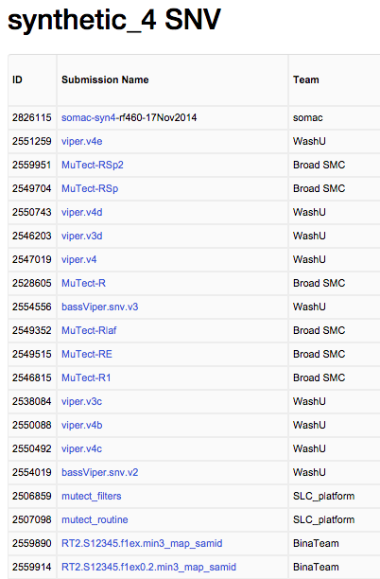
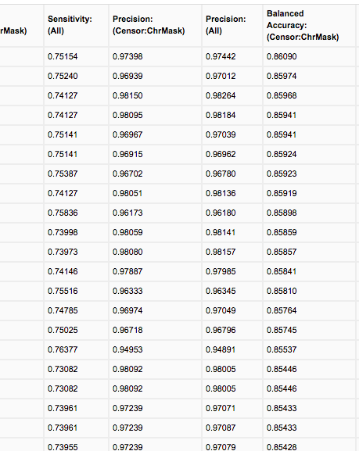
DREAM SMC Complete
Live Benchmark for each Sub-Challenge

Slide 9
DREAM Leaderboards
https://www.synapse.org/#!Synapse:syn312572/wiki/61509

Slide 10
Demonstration Overview
Organize crowd-source challenges to develop best-of-breed methods
Overview of current DREAM projects, living benchmarks
Enable cloud ready methods for mass compute
Alignments and somatic variant detectors
Establish methods to link genetic variants to cellular-, tissue-, and patient-level outcomes
GA4GH Genotype-to-Phenotype API
Create a queryable graph of evidence from abstracted evidence and inferences.
TumorMap visualization to view tumor samples across cancer types.

Slide 11
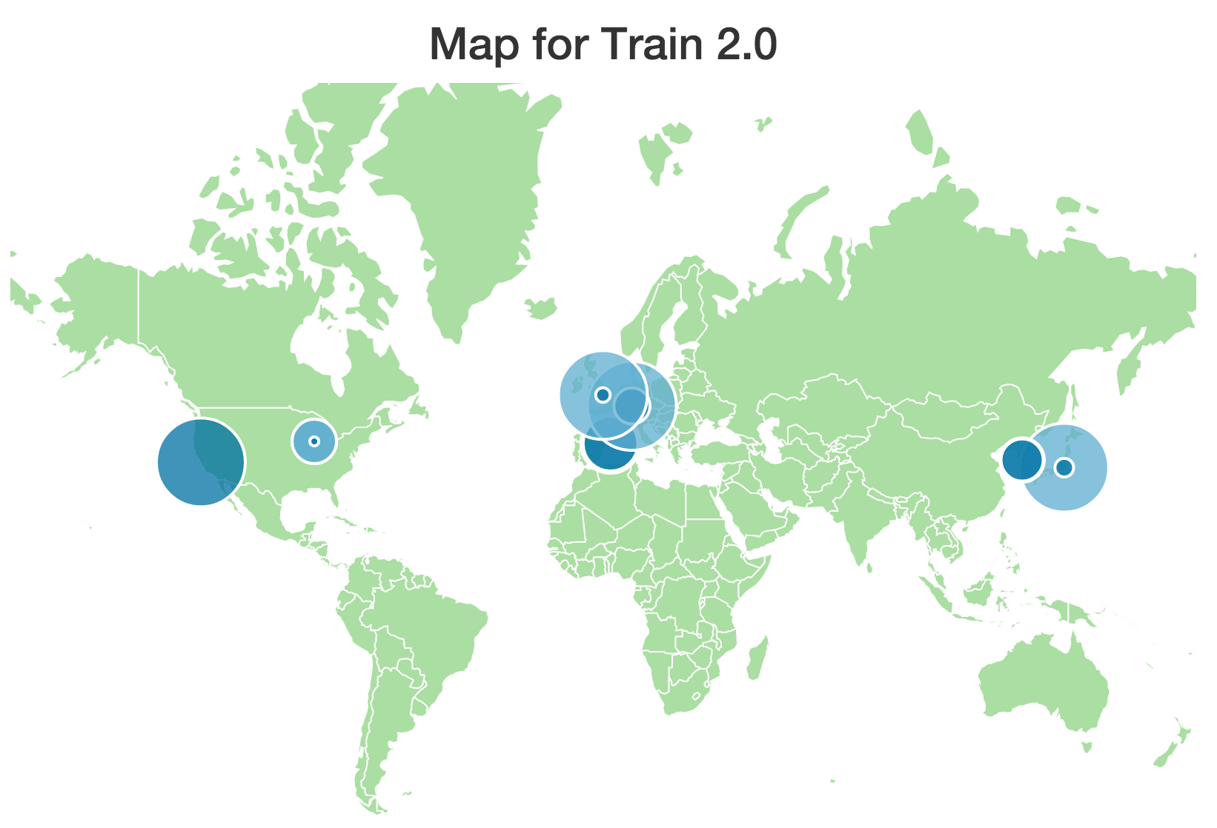
Applying Common Alignment Protocol Across the World
http://pancancer.info

Slide 12
Moving DREAM challenges to the cloud
First Container based Dream Challenge
Contestants are invited to work on the cloud, with Google sponsoring with Cloud Credit Coupons
All entries must provide docker container and Galaxy tool descriptions

Slide 13
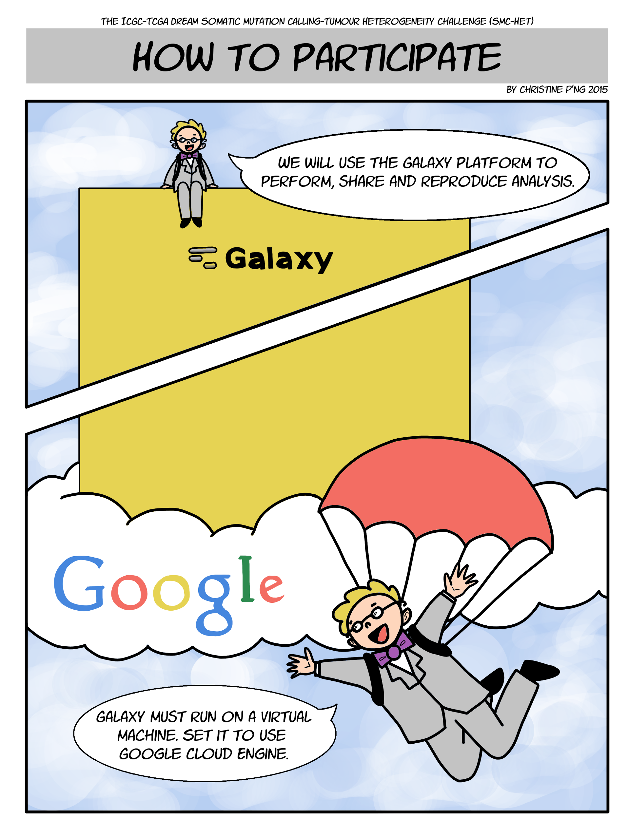

Slide 14
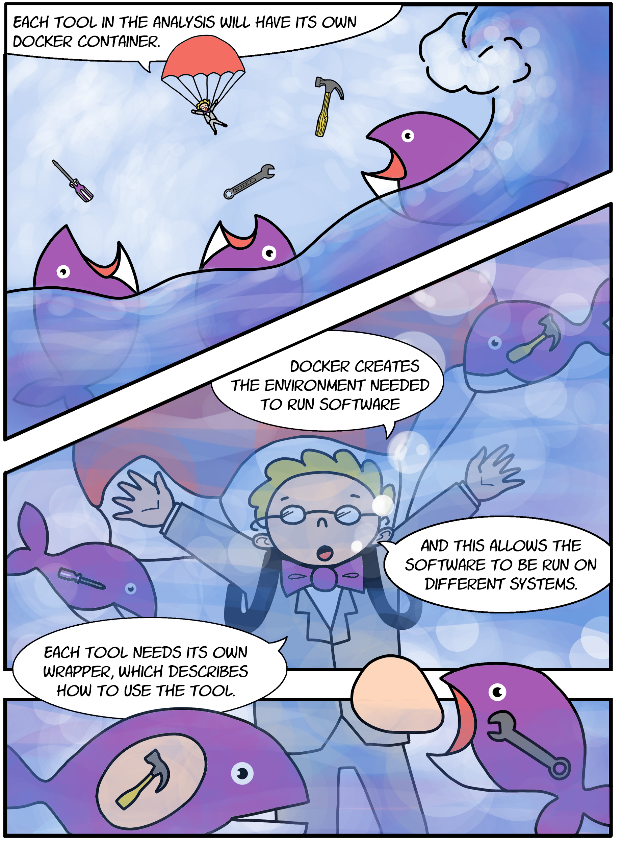

Slide 15
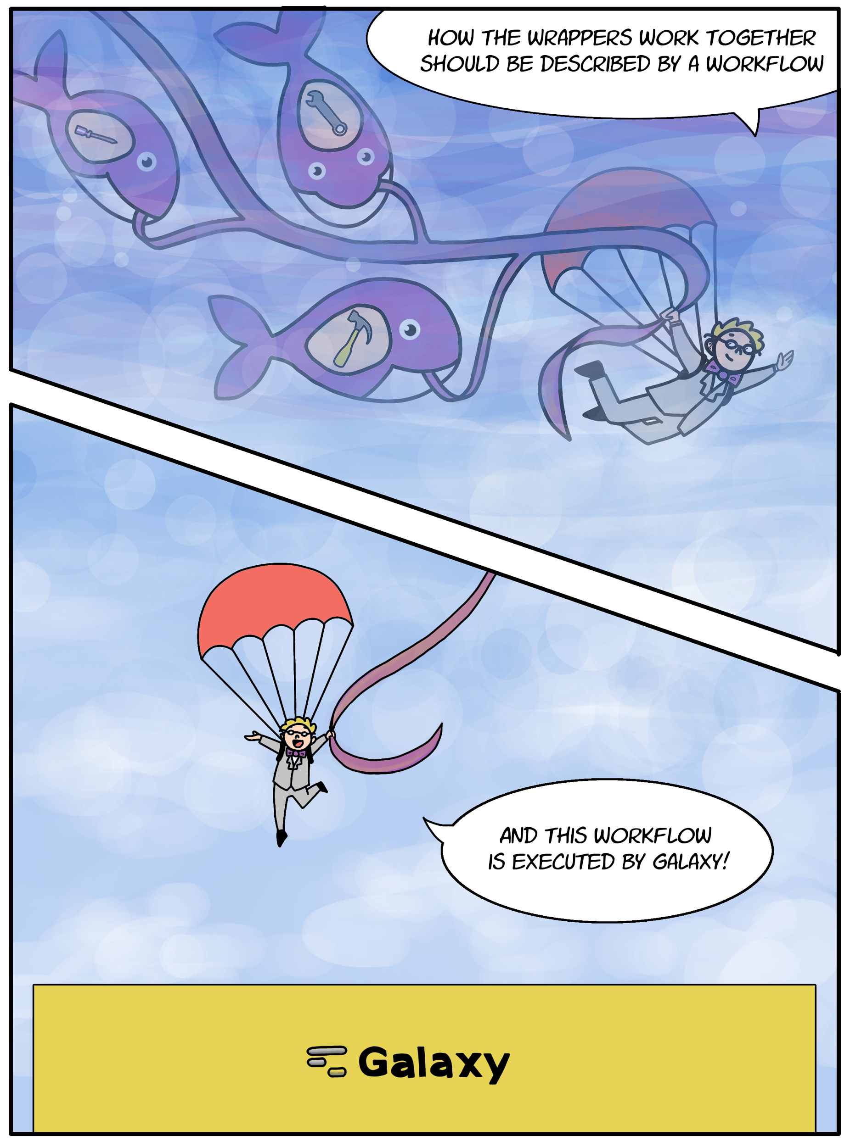

Slide 16
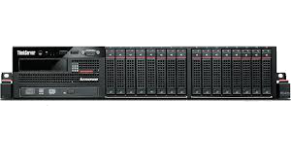
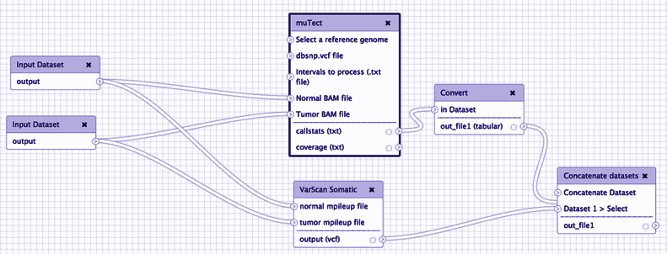
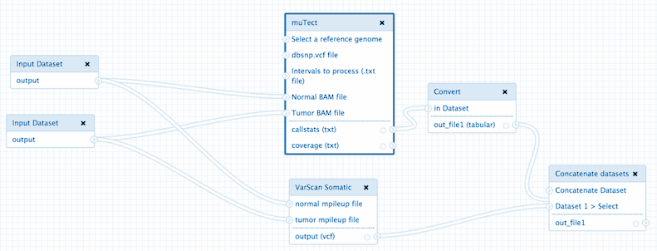
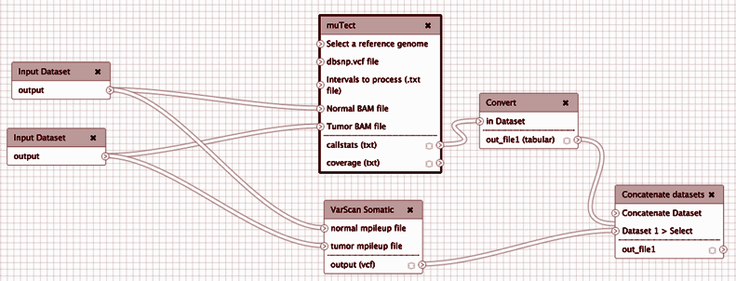
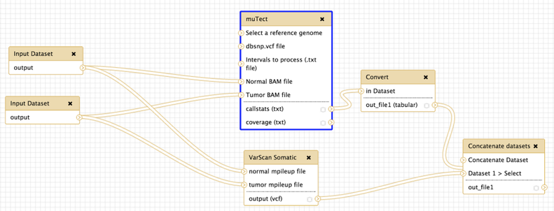
Running the SMC Het
Contestant
Evaluation System
Launching This Summer

Slide 17
SMC-Het: Obtaining Portable, Reproducible Analysis from Diverse Groups
User develops algorithm
Submits code to Synapse
Stored as packaged code
Third party can download, run on new system.

Slide 18
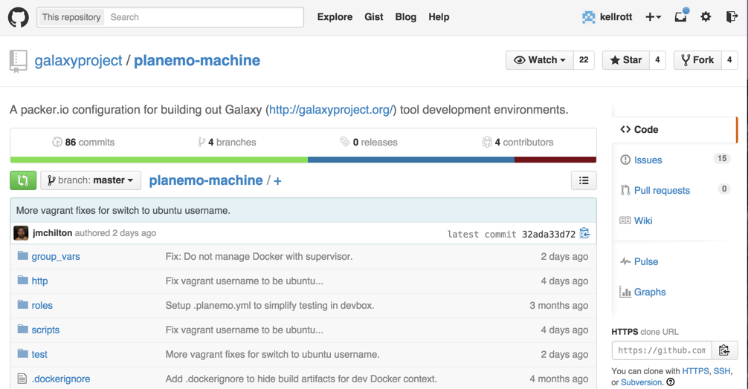
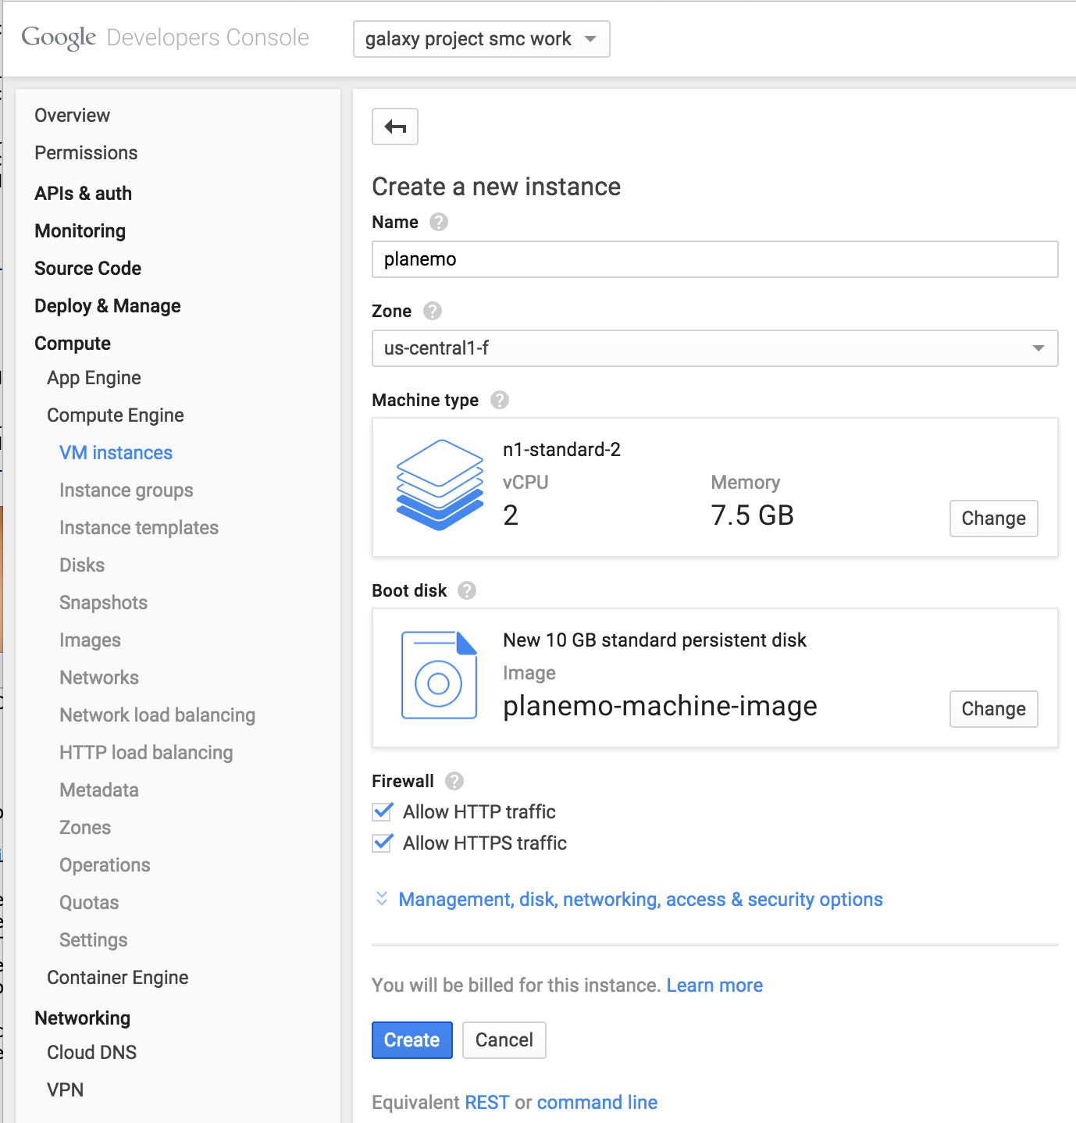
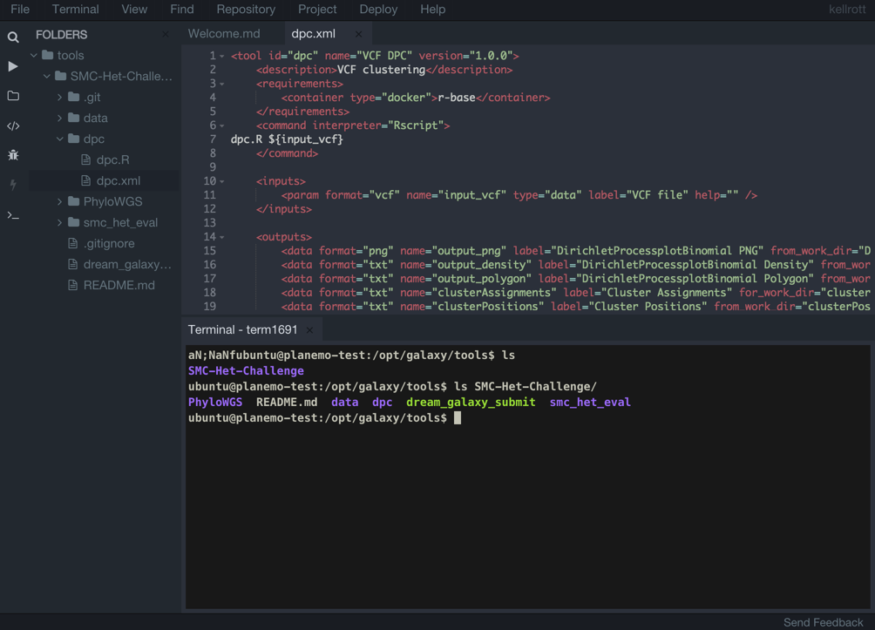
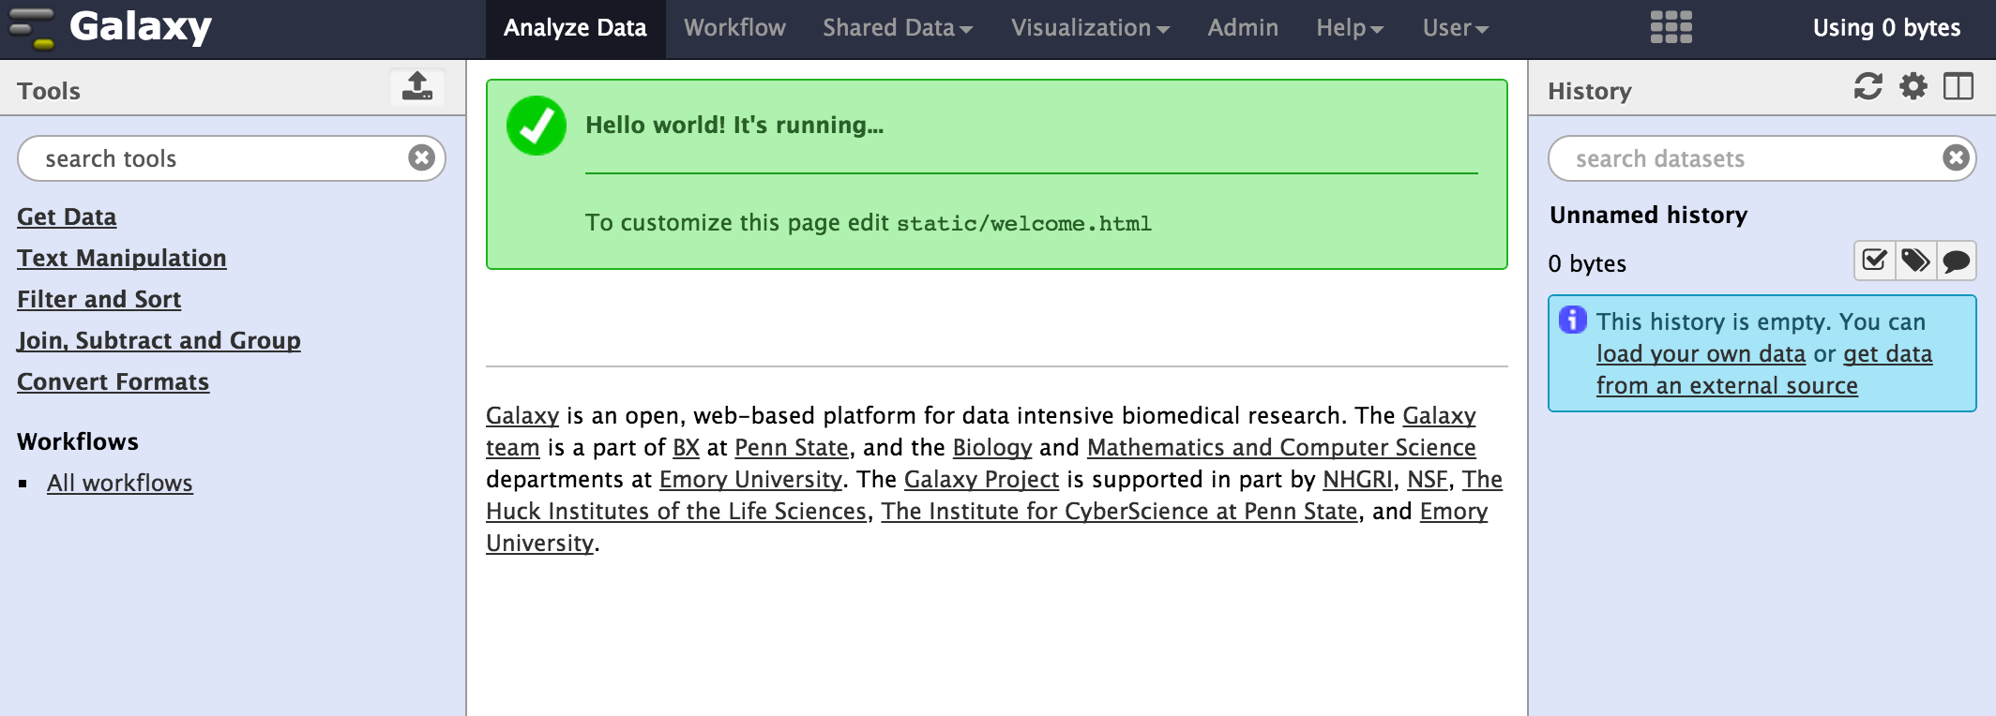
Developing Galaxy Tools
http://<IP address>/ide/

Slide 19
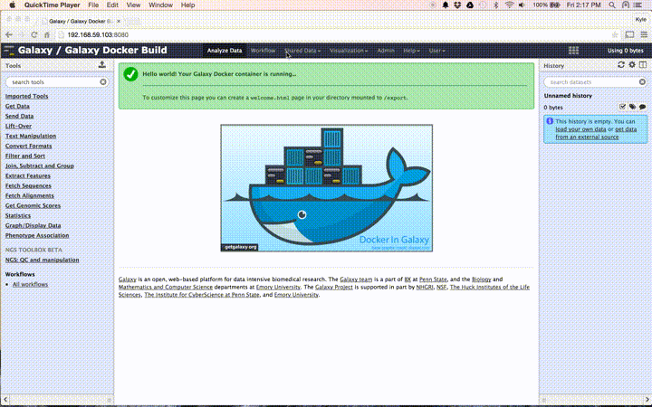
Submitting The Challenge Entry
./dream_galaxy_submit --workflow http://192.168.59.103:8080/u/admin/w/test --apikey admin --project-id syn2751753 --name Submission1 --team-name KylesTeam

Slide 20
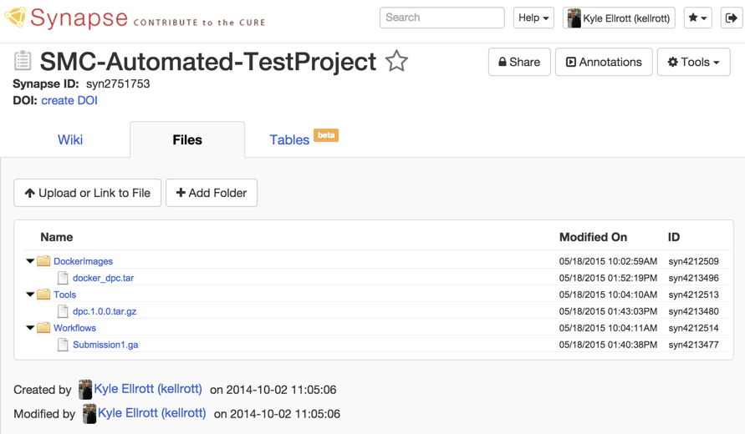
Storing Workflow Components on Synapse

Slide 21
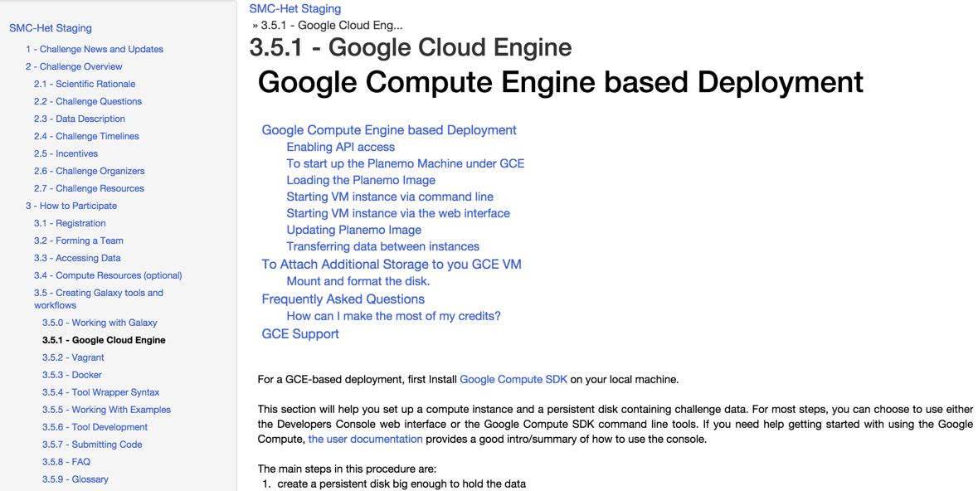
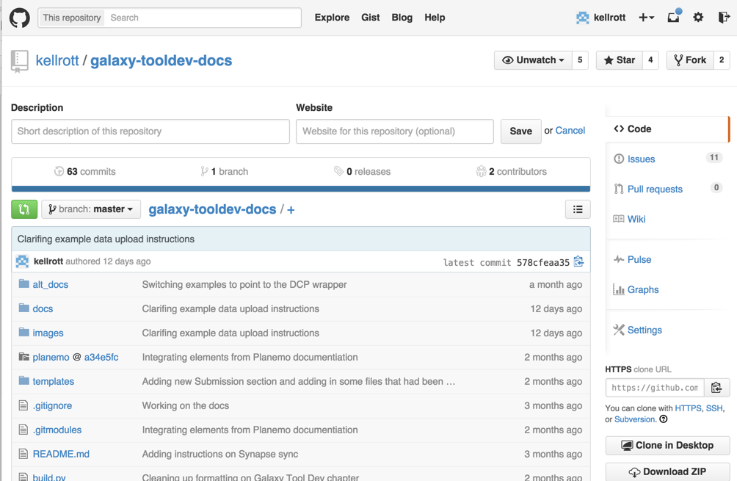
Documentation for the Challenge
To be released with Challenge Launch ( but the source is already open on Github)

Slide 22
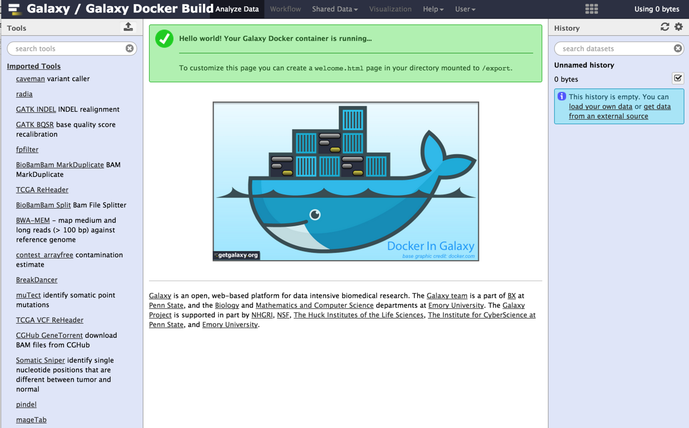
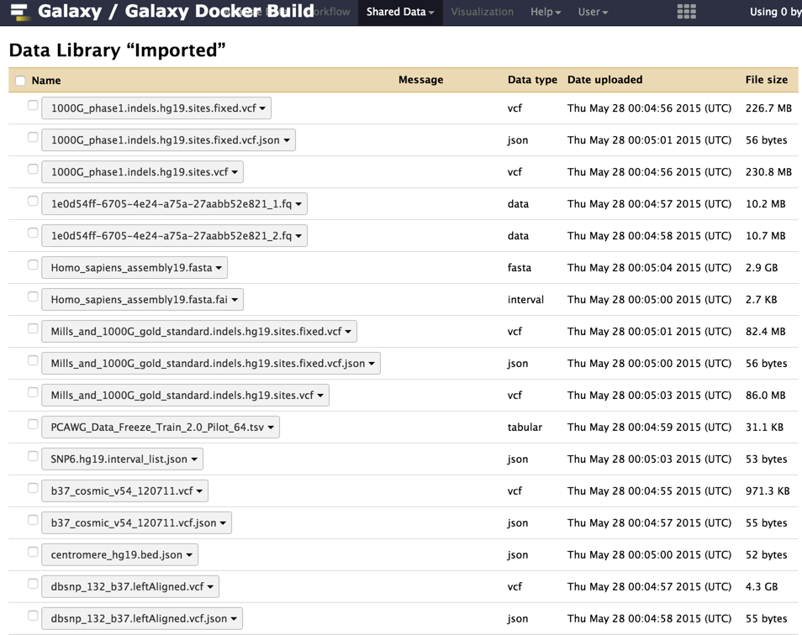
Running multiple Variant Callers in Galaxy
(w/ Nebula)
Deploy New Galaxy Server:
warpdrive.py up -t tools -l data -a -p 8080 --sudo -c run_config.yaml -td tool_data -f -d
< One Minute Later: New instance loaded, with tools and data library populated

Slide 23
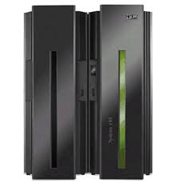
Traditional Galaxy Setup: Monolithic, static install.
Jobs
Shared Filesystem and Queue

Slide 24
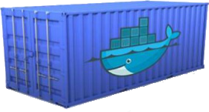
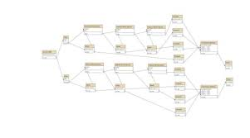
New Galaxy Setup:
Modularity for Cloud Compatibility
Nebula
Input Requests
Containers
Workflows

Slide 25
Example of setting up a Variant Callers as Galaxy Modules
Declare a workflow
Declare a Service
input_file_1 = Target(uuid="c39ded10-6073-11e4-9803-0800200c9a66") input_file_2 = Target(uuid="26fd12a2-9096-4af2-a989-9e2f1cb692fe") task = nebula.tasks.GalaxyWorkflowTask("workflow_test", workflow, inputs={ 'input_file_1' : input_file_1, 'input_file_2' : input_file_2 }, "parameters" : { "tail_select" : { "lineNum" : 3 } } )
service = GalaxyService( docstore=doc, galaxy="bgruening/galaxy-stable:dev", tool_data=os.path.abspath("tool_data"), tool_dir=os.path.abspath("tools"), smp=[ ["MuSE", 8], ["pindel", 8], ["muTect", 8], ["delly", 4], ["gatk_bqsr", 12], ["gatk_indel", 12], ["bwa_mem", 12], ["broad_variant_pipline", 28] ] )

Slide 26
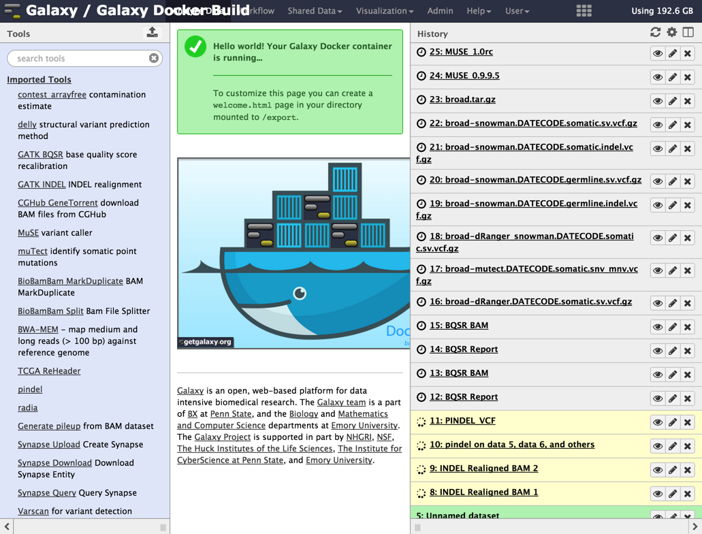
Example: Deploying Variant Callers as Modularized Galaxy Jobs

Slide 27
Demonstration Overview
Organize crowd-source challenges to develop best-of-breed methods
Overview of current DREAM projects, living benchmarks
Enable cloud ready methods for mass compute
Alignments and somatic variant detectors
Establish methods to link genetic variants to cellular-, tissue-, and patient-level outcomes
GA4GH Genotype-to-Phenotype API
Create a queryable graph of evidence from abstracted evidence and inferences.
TumorMap visualization to view tumor samples across cancer types.

Slide 28
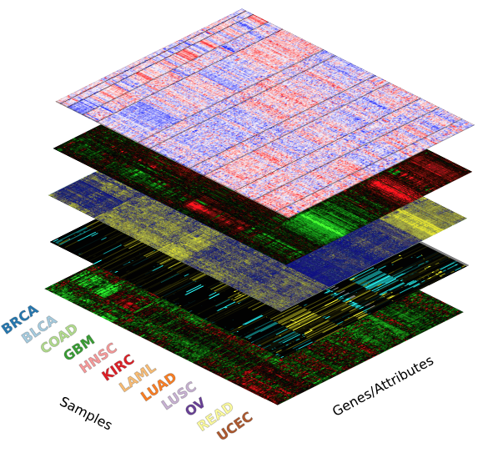
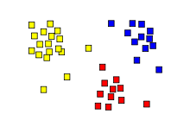
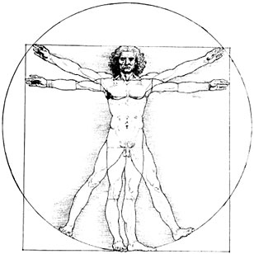
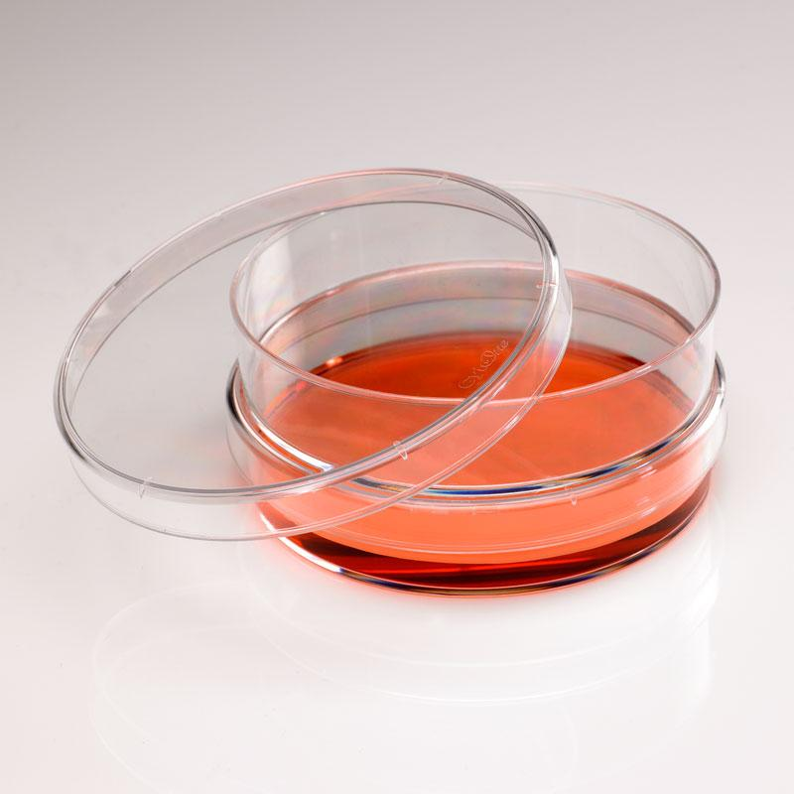
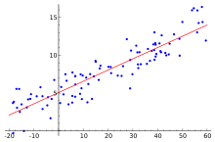
The Evidence Graph
Variant Data
Feature Data
Genes
Clustering
Individual Data
Sample Data
Gene Information
Prediction Models
Phenotypes
Pathway Connections

Slide 29
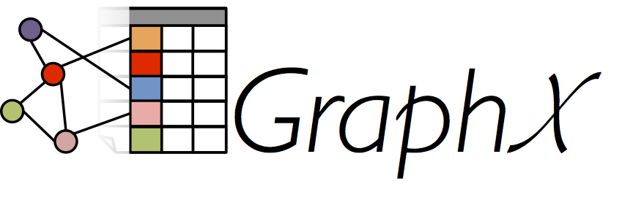
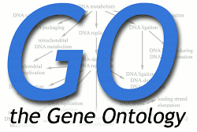
Building the Evidence Graph
Import Data
Run The Best Analysis Methods
Standardize the Data to make ready for large scale analysis

Slide 30
Connecting Genotypes and Phenotypes
Variants
Association
Features
Evidence
Observation
Literature
Prediction
Context
Environmental Association
Model
If a prediction, what model did the prediction
Weight
What is the weight of the prediction
Samples
Phenotype
Individuals

Slide 31
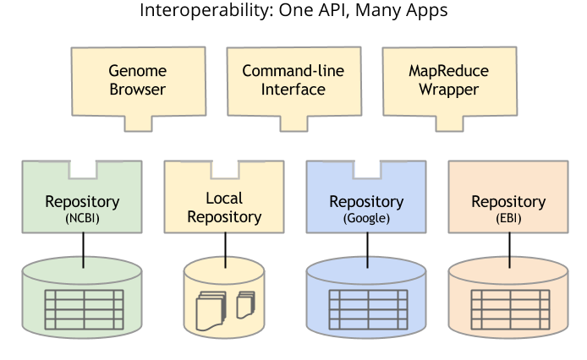
Global Alliance for Genomics and Health (GA4GH)
co-leads: Nicole Washington, Adam Margolin

Slide 32
G2P : Genotype 2 Phenotype
Association
Genotype Features
Phenotype
Evidence
Environmental Context
co-leads: Nicole Washington, Adam Margolin

Slide 33
G2P : Genotype 2 Phenotype
Association
Genotype Features
Phenotype
Genes
Variants
Rearrangements
Regions of interest
...or sets of the above
Evidence
Environmental Context
co-leads: Nicole Washington, Adam Margolin

Slide 34
Association Elements
Association
Genotype Features
Phenotype
Evidence
Environmental Context
id
featureType
description
region
attributes
id
type
description
id
type
description
onset
co-leads: Nicole Washington, Adam Margolin

Slide 35
G2P : Query
Association
Genotype Features
Phenotype
Evidence
Environmental Context
Query
SHH
*
*
*
co-leads: Nicole Washington, Adam Margolin

Slide 36
G2P : Response
Association
Genotype Features
Phenotype
Evidence
Environmental Context
Query
SHH
*
*
*
Response
SHH
sequencing assay
anophthalmia
SHH
experimental
microphthalmia with coloboma 5
SHH
traceable author statement
short philltrum
co-leads: Nicole Washington, Adam Margolin

Slide 37
G2P : Exploration
Association
Genotype Features
Phenotype
Evidence
Environmental Context
Query
*
*
*
anophthalmia
Response
SMOC1
anophthalmia
RARB
anophthalmia
GLI2
anophthalmia
co-leads: Nicole Washington, Adam Margolin

Slide 38
G2P Avro Schema
Found at:
https://github.com/ga4gh/schemas/tree/g2p
record FeaturePhenotypeAssociation {
string id;
array<Feature> features;
array<Evidence> evidence;
PhenotypeInstance phenotype;
union { null, string } description = null;
array<EnvironmentalContext> environmentalContexts;
}
co-leads: Nicole Washington, Adam Margolin

Slide 39
Demonstration Overview
Organize crowd-source challenges to develop best-of-breed methods
Overview of current DREAM projects, living benchmarks
Enable cloud ready methods for mass compute
Alignments and somatic variant detectors
Establish methods to link genetic variants to cellular-, tissue-, and patient-level outcomes
GA4GH Genotype-to-Phenotype API
Create a queryable graph of evidence from abstracted evidence and inferences.
TumorMap visualization to view tumor samples across cancer types.

Slide 40
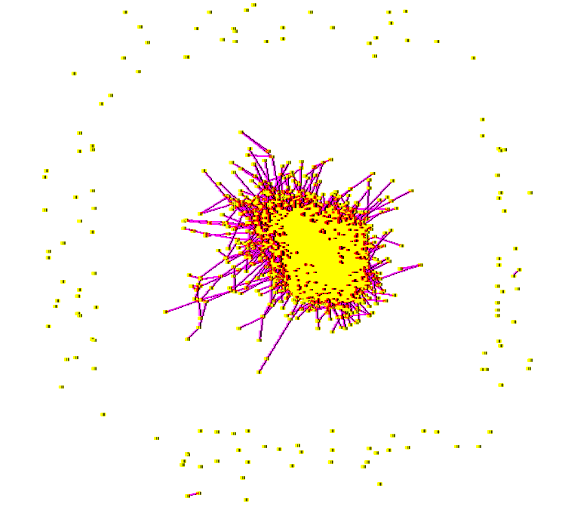
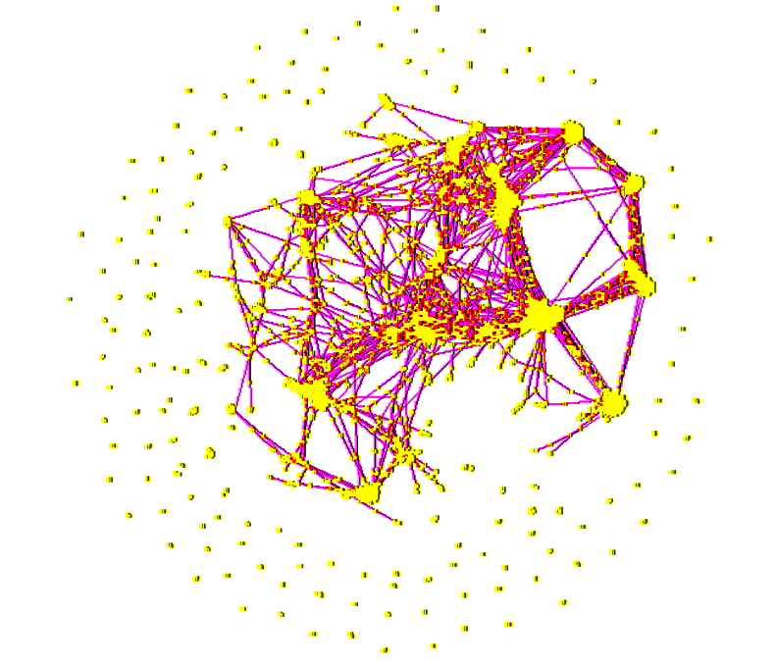
Connecting Signatures to Addresses
Snap to
Grid
Energy
Minimization
Spring Layout: Low energy configuration of competing springs
Snap to grid: Associate one point per hexagon.
Samples w/ similar signatures → same zip code.
Layout Engine: DrL. Sandia National Labs
Adam Novak, Sahil Chopra, Robert Baertsch
Notes:
Spring layout for dimensionality reduction.
Then snap to nearest empty hex.

Slide 41
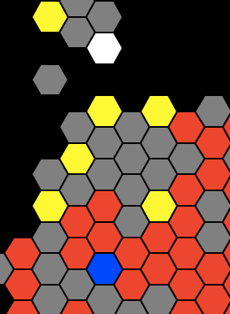
Identify similar samples in the same zip code
I’m not!
Map address reflects molecular similarity
“Zip codes” carry information
like: Russian Hill, Berkeley, Silicon Valley, Bethesda, …
I am
I am
I am
who’s like
me?
I am
I am
Adam Novak, Sahil Chopra, Robert Baertsch
I am

Slide 42
TumorMap Demo
PanCan-12:
http://medbook.ucsc.edu:10020/galaxyfresh/datasets/d2a69b9a6e002659/display/?preview=True#
PanCan-33:
https://medbook.ucsc.edu/galaxyfresh/datasets/9e3fdf5111855fe6/display/?preview=True#

Slide 43
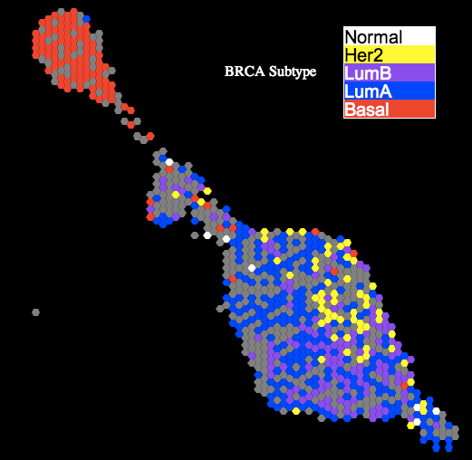
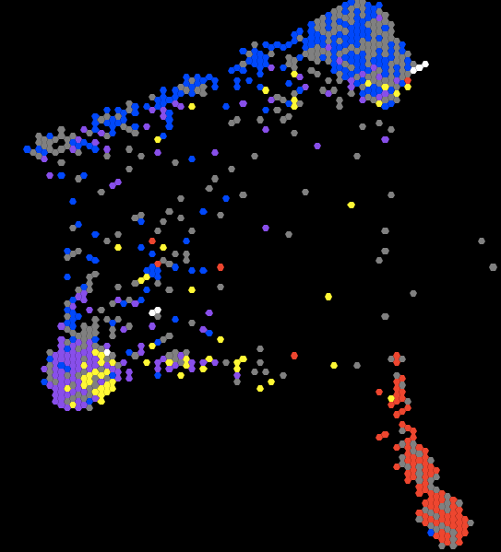
Are disease-specific AWG subtypes recapped in TumorMap?
mRNA Map
PARADIGM Map
lumB separation
BRCA subtypes resolve clearly on mRNA and PARADIGM maps.

Slide 44
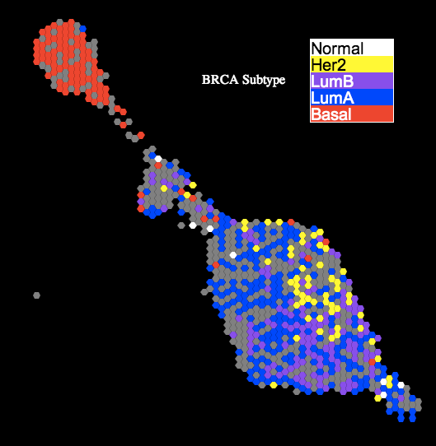
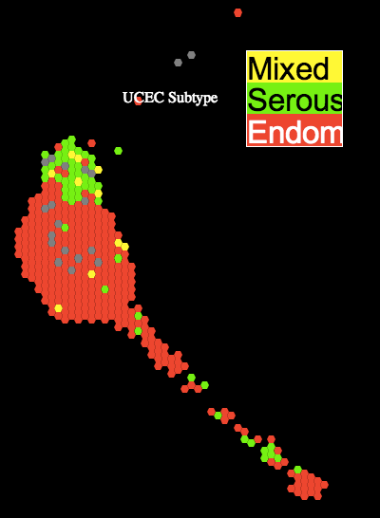
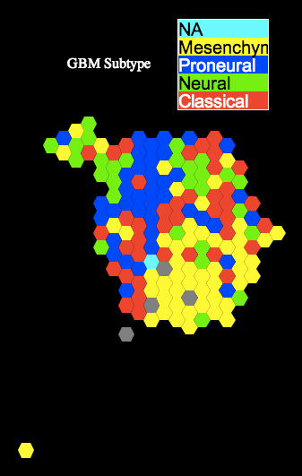
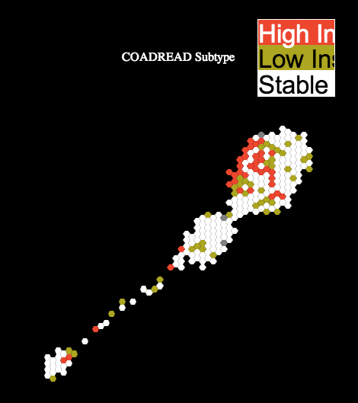
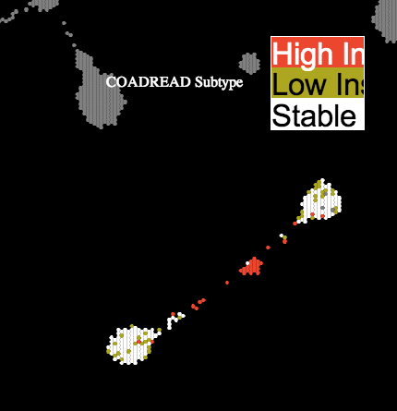
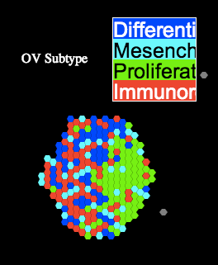
Are disease-specific AWG subtypes recapped in TumorMap?
BRCA
UCEC
GBM
COAD-READ
COAD-READ on
DNA Methylation Map
OV
Pattern on another
molecular map adds
insight.
Good agreement overall.
Newton, Baertsch, UCSC

Slide 45
11 main COCA Subtypes
PARADIGM TumorMap
11 main subtypes found (plus 2 minor)
~90% of samples cluster with their tissue
PARADIGM TumorMap corresponds well to COCA

Slide 46
BLCA divergence in Pan-Can-12
LUAD-enriched
Map restricted to BLCA
BLCA
BLCA
BLCA-enriched
HNSC-enriched
BLCA diverge into bladder-enriched, squamous, and LUAD-enriched islands

Slide 47
Gene Programs – functionally coupled genes coregulated across PanCan-12
Identified 22 sets of functionally-related genes coregulated in PanCan-12.
Gene Programs can recapitulate the integrated subtypes
Denise Wolf, UCSF

Slide 48
Gene Programs: Surrogates of Integrated Subtypes
COCA Subtypes
90% classification accuracy (LDA)
Denise Wolf, UCSF

Slide 49
Gene Programs: Surrogates of Integrated Subtypes
5-KIRC
HIF1A
Fatty Acid
Denise Wolf, UCSF

Slide 50
Viewing Gene Programs on the TumorMap
HIF1A “Weather Map”
KIRC w/ high hypoxia due to VHL mutations
Denise Wolf, UCSF

Slide 51
Gene Programs: Surrogates of Integrated Subtypes
2-Squamous-Like
Basal signaling
Squamous differentiation
MAPK signaling
90% classification accuracy (LDA)
Denise Wolf, UCSF

Slide 52
Viewing Gene Programs on the TumorMap
Tissue View
Basal Signaling
MYC Amplification Targets
Merge
Subtypes w/ specific
gene programs patterns
Denise Wolf, UCSF

Slide 53
PanCan-33 TumorMap
mRNA Map
Colors reflect
Tissue of origin.
Newton, Baertsch, UCSC

Slide 54
BRCA divergence in Pan-Can-33
BRCA diverge into several more subtypes

Slide 55
BRCA PAM-50 in Pan-Can-33
“Check”
3 Basal Sub-Subtypes
PAM50 still preserved
Further subdividing of basals and luminals
More tumor types accentuate divergence of basals and luminals

Slide 56
BLCA divergence in Pan-Can-33
BLCA diverge into several more subtypes

Slide 57
TREEHOUSE CHILDHOOD CANCER PROJECT
Processed genomic
data flow
Raw genomic
data flow
Treehouse components
Access
Cohorts, data repositories
TARGET
NCI Oncogenomics
MAGIC
PBTC
PCGP
NCI Data Commons
Individual Labs
Arceci Lab
Maris Lab
Sorensen Lab
Lau Lab
Meschinchi Lab
Jones Lab
Collaborations
External data source
GA4GH API
Precision medicine trials
(POG, BASIC3
Hope on Wheels), Stanford)
Treehouse
Open
Repository
TumorMap
Integrative genomic analysis
within and between tumors
Xena
PrecisionImmuno
Open/Embargoed, UCSC Xena Browser
Results reviewed by disease experts
Hospital/Laboratory
Treehouse
Secure
Repository
Pipeline
“container”
Pipeline
“container”
Translational and clinical leads

Slide 58
Combined Maps: POG samples +TCGA + neuroblastoma
Olena Morozova
Yulia Newton

Slide 59
PanCAN30 tumor map
Yulia Newton

Slide 60
WHERE DO Childhood (POG) Samples MAP?
Olena Morozova
Yulia Newton

Slide 61
Analysis of POG samples in the context of other cancers
POG064-PED3
Clusters with Pheochromocytoma and Paraganglioma (pancan30) and with Neuroblastoma (pancan14)
POG062_NBL
Clusters with Lymphoid Neoplasm Diffuse Large B-cell Lymphoma (pancan30) and with Neuroblastoma (pancan14)
POG040_SCC
Clusters with Head and Neck Squamous Cell Carcinoma
POG064_NBL
Clusters with Pheochromocytoma and Paraganglioma (pancan30) and with Neuroblastoma (pancan14)
POG066_NF
Clusters with Breast Invasive Carcinoma
POG067_NBL
Clusters with Neuroblastoma
POG079_SARC
Clusters with or near Neuroblastoma
Olena Morozova
Yulia Newton

Slide 62
POG-66 clusters with BRCA (near HER2 by PAM50)
Olena Morozova
Yulia Newton

Slide 63
High HER2 expression in POG_NF (UCSC Xena Browser: http://xena.ucsc.edu/
POG-66
neurofibroma
clusters with breast
Olena Morozova
Jing Zhu

Slide 64
Analysis of POG samples in the context of other cancers
POG064-PED3
Clusters with Pheochromocytoma and Paraganglioma (pancan30) and with Neuroblastoma (pancan14)
POG062_NBL
Clusters with Lymphoid Neoplasm Diffuse Large B-cell Lymphoma (pancan30) and with Neuroblastoma (pancan14)
POG040_SCC
Clusters with Head and Neck Squamous Cell Carcinoma
POG064_NBL
Clusters with Pheochromocytoma and Paraganglioma (pancan30) and with Neuroblastoma (pancan14)
POG066_NF
Clusters with Breast Invasive Carcinoma
POG067_NBL
Clusters with Neuroblastoma
POG079_SARC
Clusters with or near Neuroblastoma
Olena Morozova
Yulia Newton

Slide 65
WHERE DO Childhood (POG) Samples MAP?
Observation:
POG079 pediatric sarcoma groups
with neuroblastoma ALK-mutant
samples.
Olena Morozova
Yulia Newton

Slide 66
ALK expression in POG_SARC is comparable to ALK-amplified NBL (Xena Browser View)
Olena Morozova
Jing Zhu

Slide 67
A WorkBench for high-level calculations on cancer cohorts.
ObservationDeck: View various integrated evidence across a cohort
https://medbook.ucsc.edu/wb
DataFusion: Quickly calculate stats on a selected cohort
https://medbook.ucsc.edu/fusion

Slide 68
ObservationDeck
https://medbook.ucsc.edu/wb
Chris Wong
Robert Baertsch

Slide 69
ObservationDeck
https://medbook.ucsc.edu/wb
Chris Wong, Robert Baertsch

Slide 70
ObservationDeck
https://medbook.ucsc.edu/wb
Chris Wong, Robert Baertsch

Slide 71
ObservationDeck
https://medbook.ucsc.edu/wb
Chris Wong, Robert Baertsch

Slide 72
DataFusion:
https://medbook.ucsc.edu/fusion
Ted Goldstein
Robert Baertsch

Slide 73
DataFusion:
https://medbook.ucsc.edu/fusion
Ted Goldstein
Robert Baertsch

Slide 74
DataFusion:
https://medbook.ucsc.edu/fusion
Ted Goldstein
Robert Baertsch

Slide 75
DataFusion:
https://medbook.ucsc.edu/fusion
Ted Goldstein, Robert Baertsch

Slide 76
DataFusion:
https://medbook.ucsc.edu/fusion
Ted Goldstein, Robert Baertsch

Slide 77
DataFusion:
https://medbook.ucsc.edu/fusion
Ted Goldstein, Robert Baertsch

Slide 78
DataFusion:
https://medbook.ucsc.edu/fusion
Ted Goldstein, Robert Baertsch

Slide 79
DataFusion:
https://medbook.ucsc.edu/fusion
Ted Goldstein, Robert Baertsch

Slide 80
DataFusion:
https://medbook.ucsc.edu/fusion
Ted Goldstein, Robert Baertsch

Slide 81
DataFusion:
https://medbook.ucsc.edu/fusion
Ted Goldstein, Robert Baertsch

Slide 82
DataFusion:
https://medbook.ucsc.edu/fusion
Ted Goldstein, Robert Baertsch

