Slide 1
DICOM WG 30 Small Animal Imaging
DICOM Training
Enhanced Multi-frame & Quantitation
David Clunie (dclunie@dclunie.com)
PixelMed Publishing

Slide 2
Learning Objectives
Background of DICOM IODs for storage
“Enhanced Multi-frame” family of objects – principles
Performance, compression, organization, attributes
Geometry, coded anatomy, hanging, timing, data type
Functional groups, dimensions, stack, temporal index
Real world value maps and display pipeline
PACS support for Enhanced Multi-frame
Legacy conversion
Quantitation and DICOM non-image objects for ROIs

Slide 3
DICOM IOD History – CT/MR/PT
Single slice per instance (file)
  organized into “series”
  usually one “acquisition” per series
  many technique attributes optional/undefined
  proliferation of private attributes
  no dependency on protocol (e.g., anatomy)
  arose from pre-DICOM practice
Enhanced Multi-frame MR, CT and PET
  faster (?)
  easier (one instance or file per “acquisition”)
  better (information – commonality exposed)

Slide 4
DICOM US IOD History
1993 original DICOM Standard
  contained ultrasound IODs
  single and multi-frame
  quickly retired
1995 Sup 5 Ultrasound
  what is currently used – single and multi-frame
2009 Sup 43 3D Ultrasound
  long time coming – effort started in 2002
  difficulty reaching consensus on scope/complexity
  3D and 4D Cartesian volumes (+/- time)
  “enhanced” family object

Slide 5
Enhanced Family of Images
Enhanced MR Image – Sup 49
Enhanced US Volume – Sup 43
Revised Secondary Capture – Sup 57 + CP 600
Enhanced CT Image – Sup 58
Enhanced XA/XRF – Sup 83
Segmentation – Sup 111
X-Ray 3D – Sup 116
Enhanced PET – Sup 117
Breast Tomosynthesis – Sup 125
Whole Slide Microscopic Image – Sup 145
Intravascular OCT – Sup 151
Breast Projection X-Ray – Sup 165

Slide 6
Performance Opportunities
New multi-frame object does not change
  TCP connection and Association establishment
Common header information is not repeated
  transfer reduction negligible compared to pixel data size
  parsing reduction time may be significant
Reduced latency (delay)
  between storage requests
Fewer database insertions
  one entry in image table versus one per slice
Creates opportunity for inter-slice compression
  3D or motion
  entire volume or slabs of sufficient size
Extremely implementation-dependent

Slide 7
Factor Out Shared Attributes
Shared attributes
Per-frame attributes
Pixel data

Slide 8
A
s
s
o
c
i
a
t
i
o
n
C-Store request
Dataset (attributes+pixels)
C-Store response (acknowledgement)

Slide 9
A
s
s
o
c
i
a
t
i
o
n
DB
UIDs
Store, parse, check
C-Store request
Dataset (attributes+pixels)
C-Store response (acknowledgement)

Slide 10
A
s
s
o
c
i
a
t
i
o
n
DB
DB
UIDs
Store, parse, check
C-Store request
Dataset (attributes+pixels)
C-Store response (acknowledgement)

Slide 11
A
s
s
o
c
i
a
t
i
o
n
DB
DB
DB
UIDs
Store, parse, check
C-Store request
Dataset (attributes+pixels)
C-Store response (acknowledgement)

Slide 12
A
s
s
o
c
i
a
t
i
o
n
DB
DB
DB
DB
UIDs
Store, parse, check
C-Store request
Dataset (attributes+pixels)
C-Store response (acknowledgement)

Slide 14
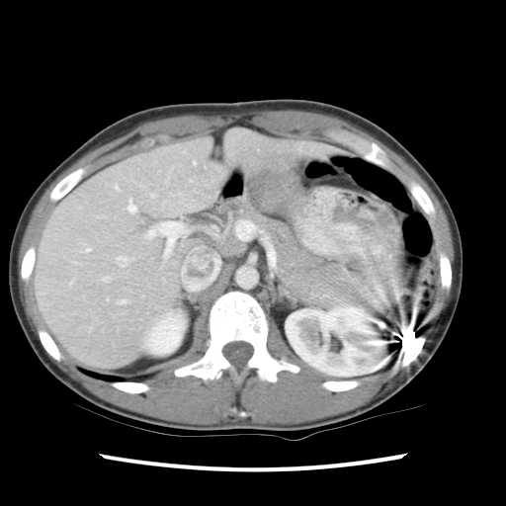
PATIENT TABLE
IMAGE TABLE
0125678
Smith^James
1 mm
1
0125735
Jones^Alan
………..
…………
STUDY TABLE
20051109
2267
20060301
3920
………..
……
SERIES TABLE
1
Localizer
2
Axial C/A/P
DB
…
……

Slide 15
PATIENT TABLE
IMAGE TABLE
0125678
Smith^James
1 mm
1
0125735
Jones^Alan
1 mm
2
………..
…………
STUDY TABLE
20051109
2267
20060301
3920
………..
……
SERIES TABLE
1
Localizer
2
Axial C/A/P
DB
…
……

Slide 16
PATIENT TABLE
IMAGE TABLE
0125678
Smith^James
1 mm
1
0125735
Jones^Alan
1 mm
2
………..
…………
………..
……
STUDY TABLE
………..
……
20051109
2267
………..
……
20060301
3920
………..
……
Potentially thousands of individual per slice database insertion operations
………..
……
………..
……
………..
……
SERIES TABLE
………..
……
1
Localizer
………..
……
2
Axial C/A/P
………..
……
DB
…
……
………..
……
………..
……
………..
……
1 mm
1897

Slide 17
PATIENT TABLE
IMAGE TABLE
0125678
Smith^James
1 mm
1
0125735
Jones^Alan
1 mm
2
………..
…………
………..
……
STUDY TABLE
………..
……
20051109
2267
………..
……
20060301
3920
………..
……
Potentially thousands of individual per slice database insertion operations
………..
……
………..
……
………..
……
SERIES TABLE
………..
……
1
Localizer
………..
……
2
Axial C/A/P
………..
……
DB
…
……
………..
……
………..
……
………..
……
1 mm
1897

Slide 18
PATIENT TABLE
IMAGE TABLE
0125678
Smith^James
1 mm
1
0125735
Jones^Alan
………..
…………
STUDY TABLE
20051109
2267
20060301
3920
Single database insertion - just don’t need per-slice detail in database
………..
……
SERIES TABLE
1
Localizer
2
Axial C/A/P
DB
…
……

Slide 19
Multi-frame compression
“Old” single frame SOP Classes
  compression only possible within a single frame
  lossless - typically 3:1 or 4:1 for CT and MR
Multi-frame objects
  take advantage of redundancy between frames
  spatial redundancy - JPEG 2000 Part 2
    lossless gain modest, lossy gain more substantial
  motion prediction - MPEG-2 and others
  new schemes - H.264/MPEG-4 Part 10
  entire dataset (e.g., 3D volume) or adjacent slabs

Slide 20
Single Frame Lossless

Slide 21
Single Frame Lossless

Slide 26
Not (just) about performance
Greater “inter-functionality”
  browsing
  routing
  hanging
  rendering
Achieved through
  better description of organization of data
  more mandatory attributes
  more standard values (& codes)
  reduced dependence on private attributes

Slide 27
Coded anatomic regions
Original SOP Classes
  incomplete list of optional defined terms
  US at least had optional coded anatomy (unlike CT)
  optional laterality
Enhanced SOP Classes
  mandatory coded anatomic region
  comprehensive & appropriate list of codes
  mandatory laterality
  per-frame or for entire object
E.g.
  (T-D3000,SRT,“Chest”)
  rather than free text “CHEST”, etc.

Slide 28
CT Image Type Value 3
Original SOP Classes
  AXIAL or LOCALIZER
Enhanced SOP Classes
  common to CT and MR
    ANGIO, FLUOROSCOPY, LOCALIZER, MOTION, PERFUSION, PRE_CONTRAST, POST_CONTRAST, REST, STRESS, VOLUME
  CT-specific
    ATTENUATION, CARDIAC, CARDIAC_GATED, REFERENCE

Slide 29
MR Acquisition Contrast
Original SOP Classes
  guess from echo and repetition time, etc.
  recognize proprietary Protocol Name
Enhanced SOP Classes
  new mandatory frame level attribute
  Acquisition Contrast
    DIFFUSION, FLOW_ENCODED, FLUID_ATTENUATED, PERFUSION, PROTON_DENSITY, STIR, TAGGING, T1, T2, T2_STAR, TOF

Slide 30
Enhanced Contrast/Bolus
Original SOP Classes
  plain text description
  difficult to determine presence/absence
    e.g., description value of “None”
  single agent (did not distinguish oral/iv)
  codes optional and never used
Enhanced SOP Classes
  mandatory codes only
  multiple items with separate coded routes & timing
  presence or absence per-frame can be described

Slide 31
Technique Attributes & Terms
 | CT |  | MR
SOP Class | Original | Enhanced | Original | Enhanced
Attributes (Mandatory) | 18 (0) | 41 (39) | 44 (2) | 103 (94)
Terms (Enumerated) | 4 (2) | 86 (18) | 38 (9) | 228 (47)

Slide 32
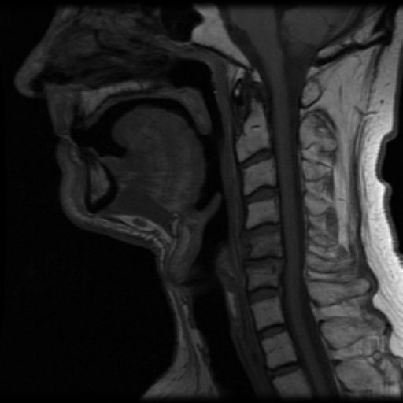
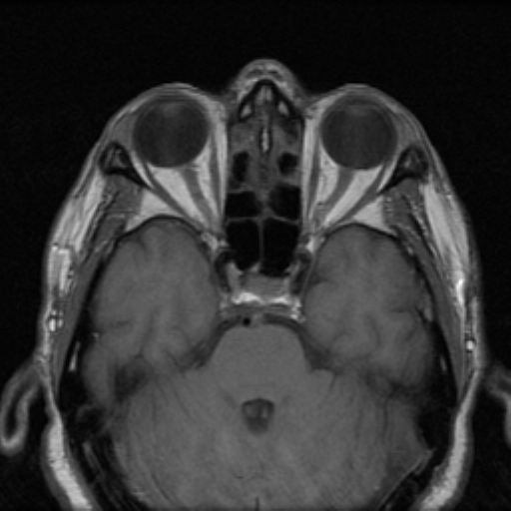
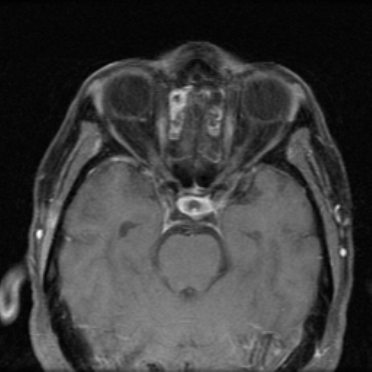
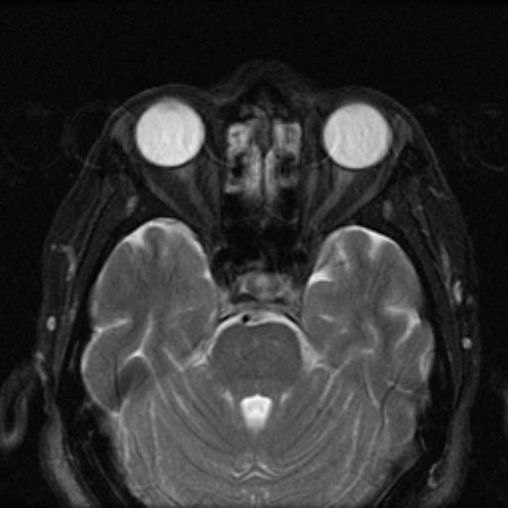
Hanging protocol rule impact
T1 SAG
PRE GD
T1 AXIAL
PRE GD
T2 AXIAL
T1 AXIAL
POST GD

Slide 33
Hanging protocol rule impact
T1 SAG
PRE GD
T1 AXIAL
PRE GD
T2 AXIAL
T1 AXIAL
POST GD
Acquisition Contrast = T1

Slide 34
Hanging protocol rule impact
T1 SAG
PRE GD
T1 AXIAL
PRE GD
T2 AXIAL
T1 AXIAL
POST GD
Acquisition Contrast = T1

Slide 35
Hanging protocol rule impact
T1 SAG
PRE GD
T1 AXIAL
PRE GD
T2 AXIAL
T1 AXIAL
POST GD
Acquisition Contrast = T1
Image Orientation ≈ 0\1\0\0\0\-1

Slide 36
Hanging protocol rule impact
T1 SAG
PRE GD
T1 AXIAL
PRE GD
T2 AXIAL
T1 AXIAL
POST GD
Acquisition Contrast = T1
Image Orientation ≈ 0\1\0\0\0\-1

Slide 37
Hanging protocol rule impact
T1 SAG
PRE GD
T1 AXIAL
PRE GD
T2 AXIAL
T1 AXIAL
POST GD
Acquisition Contrast = T1
Image Orientation ≈ 0\1\0\0\0\-1
Contrast Agent #1
Administered = NO
Route = (G-D101,SNM3, “IV”)
Ingredient = (C-17800,SRT, “Gd”)

Slide 38
Hanging protocol rule impact
T1 SAG
PRE GD
T1 AXIAL
PRE GD
T2 AXIAL
T1 AXIAL
POST GD
Acquisition Contrast = T1
Image Orientation ≈ 0\1\0\0\0\-1
Contrast Agent #1
Administered = NO
Route = (G-D101,SNM3, “IV”)
Ingredient = (C-17800,SRT, “Gd”)

Slide 39
Hanging protocol rule impact
T1 SAG
PRE GD
T1 AXIAL
PRE GD
T2 AXIAL
T1 AXIAL
POST GD
Acquisition Contrast = T1
Image Orientation ≈ 1\0\0\0\1\0
Contrast Agent #1
Administered = NO
Route = (G-D101,SNM3, “IV”)
Ingredient = (C-17800,SRT, “Gd”)

Slide 40
Hanging protocol rule impact
T1 SAG
PRE GD
T1 AXIAL
PRE GD
T2 AXIAL
T1 AXIAL
POST GD
Acquisition Contrast = T1
Image Orientation ≈ 1\0\0\0\1\0
Contrast Agent #1
Administered = NO
Route = (G-D101,SNM3, “IV”)
Ingredient = (C-17800,SRT, “Gd”)

Slide 41
Hanging protocol rule impact
T1 SAG
PRE GD
T1 AXIAL
PRE GD
T2 AXIAL
T1 AXIAL
POST GD
Acquisition Contrast = T1
Image Orientation ≈ 1\0\0\0\1\0
Contrast Agent #1
Administered = NO
Route = (G-D101,SNM3, “IV”)
Ingredient = (C-17800,SRT, “Gd”)

Slide 42
Hanging protocol rule impact
T1 SAG
PRE GD
T1 AXIAL
PRE GD
T2 AXIAL
T1 AXIAL
POST GD
Acquisition Contrast = T2
Image Orientation ≈ 1\0\0\0\1\0

Slide 43
Hanging protocol rule impact
T1 SAG
PRE GD
T1 AXIAL
PRE GD
T2 AXIAL
T1 AXIAL
POST GD
Acquisition Contrast = T2
Image Orientation ≈ 1\0\0\0\1\0

Slide 44
Hanging protocol rule impact
T1 SAG
PRE GD
T1 AXIAL
PRE GD
T2 AXIAL
T1 AXIAL
POST GD
Acquisition Contrast = T2
Image Orientation ≈ 1\0\0\0\1\0

Slide 45
Hanging protocol rule impact
T1 SAG
PRE GD
T1 AXIAL
PRE GD
T2 AXIAL
T1 AXIAL
POST GD
Acquisition Contrast = T1
Image Orientation ≈ 1\0\0\0\1\0
Contrast Agent #1
Administered = YES
Route = (G-D101,SNM3, “IV”)
Ingredient = (C-17800,SRT, “Gd”)

Slide 46
Hanging protocol rule impact
T1 SAG
PRE GD
T1 AXIAL
PRE GD
T2 AXIAL
T1 AXIAL
POST GD
Acquisition Contrast = T1
Image Orientation ≈ 1\0\0\0\1\0
Contrast Agent #1
Administered = YES
Route = (G-D101,SNM3, “IV”)
Ingredient = (C-17800,SRT, “Gd”)

Slide 47
Hanging protocol rule impact
T1 SAG
PRE GD
T1 AXIAL
PRE GD
T2 AXIAL
T1 AXIAL
POST GD

Slide 48
Hanging protocol rule impact
T1 SAG
PRE GD
T1 AXIAL
PRE GD
T2 AXIAL
T1 AXIAL
POST GD
Same rules, independent of whether:
one single multi-frame image
one multi-frame image per acquisition
one slice per single frame image
one series or multiple

Slide 49
Hanging Protocol Support
A productivity advantage of the enhanced objects
Should not have to tailor hanging protocol rules to specific vendors or devices or versions
Reliable and standard information
  mandatory and standard places (attributes)
  mandatory and standard values
As technology evolves, yet more standard values are added to the DICOM standard
Eliminate dependence on site configured Series Number or Series Description, whether pre-populated from acquisition protocol or manually typed by operator
Not dependent on DICOM Hanging Protocol IOD

Slide 50
Geometry Unchanged
Same as original SOP Classes
Image Position and Orientation (Patient)
Still need to compute AXIAL, SAGITTAL or CORONAL from orientation vector
Still need to compute edge labels (A/P etc) from orientation vector
May still need to compare orientation vectors to determine if slices are parallel, but Dimensions minimize the burden
For US Volume, new (Volume) vs. (Patient)

Slide 51
Acquisition Timing Information
Original SOP Classes
  inconsistent use of
    Content (Image) Time
    Acquisition Time
    Frame Time (+/- Frame Time Vector)
  contrast timing information never used
Enhanced SOP Classes
  unambiguous definition of acquisition timing
  explicit relationships with contrast & cardiac timing

Slide 52
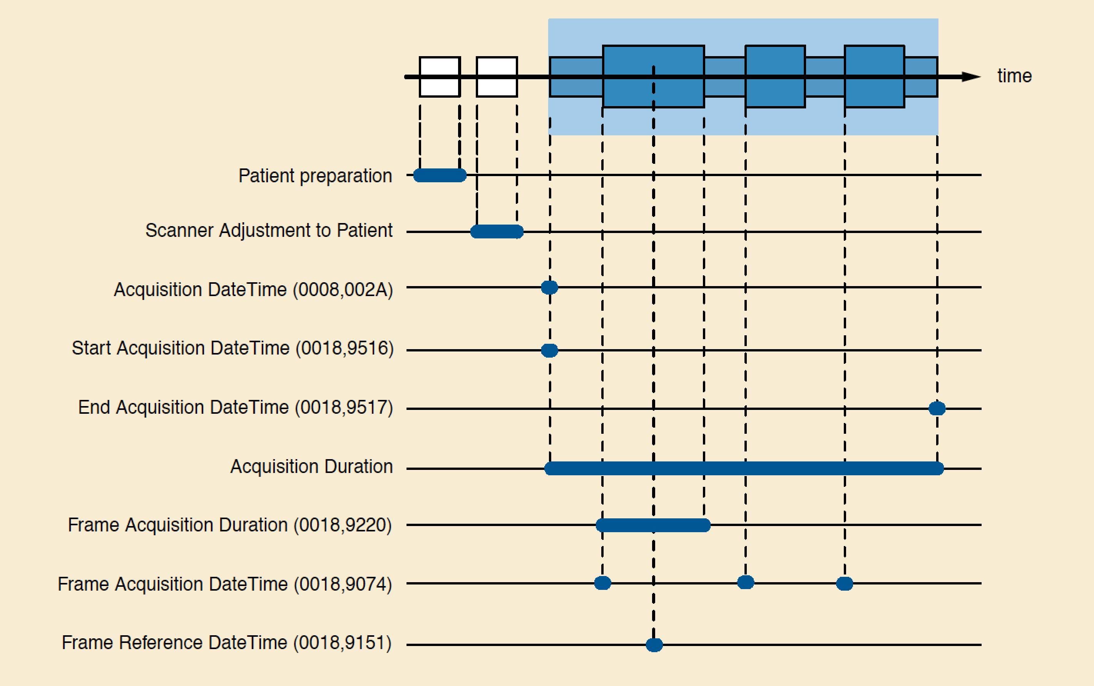
Timing Information

Slide 53
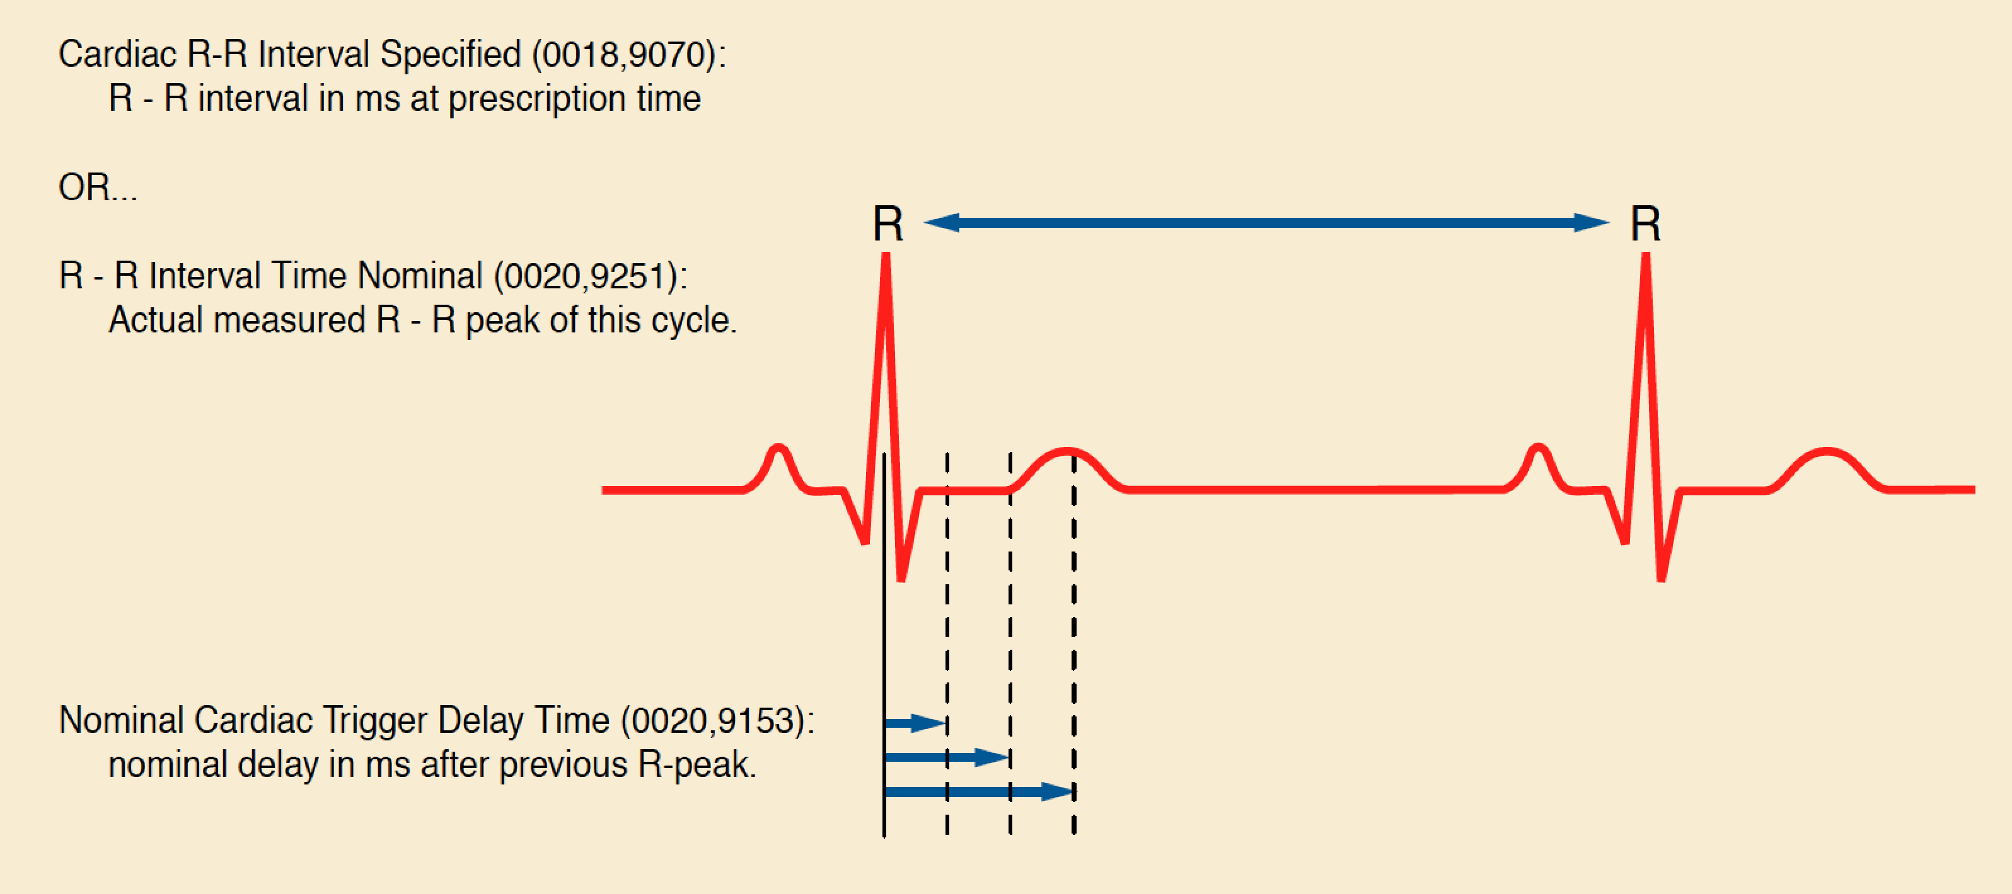
Cardiac Timing Information

Slide 54
Organizational Features
Shared and Per-frame Functional Groups
  a Functional Group has Attributes that vary as a group
  e.g., Pixel Measures, Plane Orientation
  compact & makes explicit what doesn’t change
Dimensions
  a priori hints as to how the frames are organized
  specify intended order of traversal, such as space, then time (e.g., for cardiac cine loops)
Stacks
  groups of spatially-related slices, repeatable
Temporal positions
  “time slots” or “bins”

Slide 55
Organizational Features
Goal is to reduce the work that the receiving application has to do to “figure out”
  how the data is organized
  why it is organized that way
Without preventing use of the data in unanticipated ways
  e.g. 3D on a dataset not intended as a volume
Two “levels”
  detailed: shared & per-frame attributes
  overall: dimensions, stacks and temporal positions

Slide 56
Multi-frame Functional Groups
Shared attributes
Per-frame attributes
Pixel data

Slide 57
What is a Functional Group?
“A set of logically related Attributes that are likely to vary together”
Examples:
  position related
  orientation related
  spacing related
  timing related
May be “shared” (all same) or “per-frame”
  Shared Functional Group Sequence – one item
  Per-Frame FGS – one item per frame (vector)

Slide 58
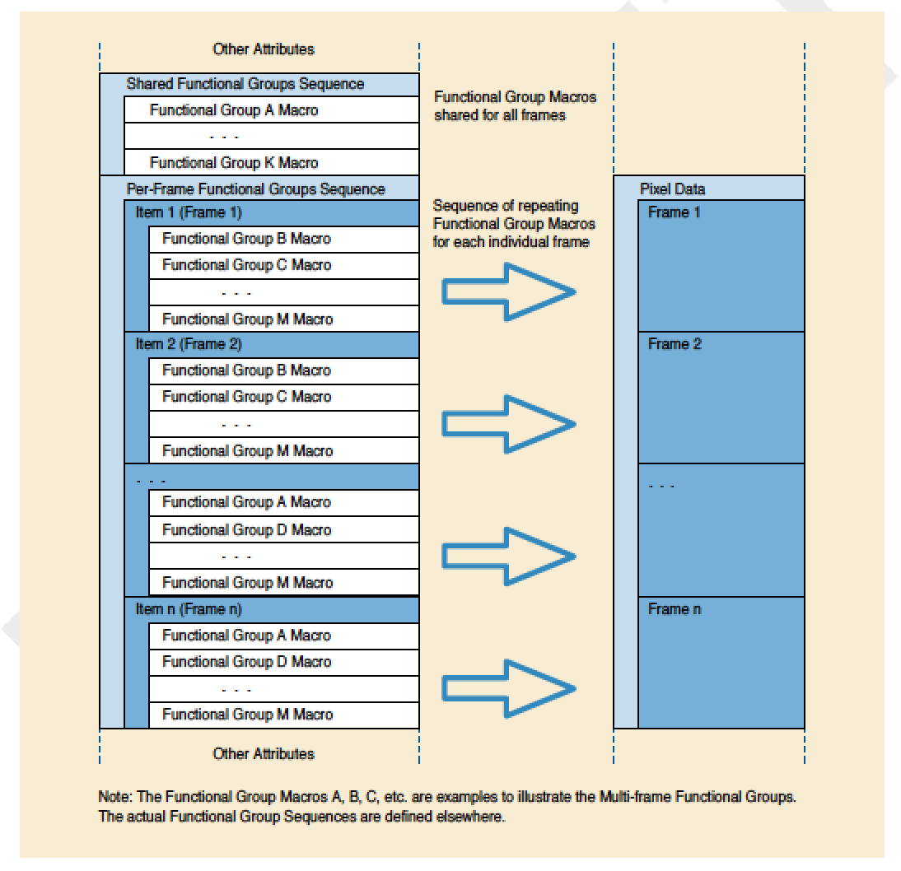
Functional Group Encoding

Slide 59
Compared to the “old way”
Frame Increment Pointer (used previously)
  m values, where m is number of varying attributes
  each value is tag of an attribute
  each attribute pointed to has n values (n frames)
  special case is Frame Time, which has just one value applicable to all frames
  otherwise, no commonality factored out
Used in
  “old” US Multi-frame, XA/XRF IODs for cine
  still used in NM (no enhanced version yet)
Not used in Enhanced family of IODs
  -> Per Frame Functional Group Sequence (CP 1260)

Slide 60
Functional Groups – Varieties
Common to many IODs, e.g.,
  Pixel Measures
  Frame Anatomy
  Frame VOI LUT
  Real World Value Mapping
Specific to particular IODs, e.g.,
  MR Spatial Saturation
  CT Table Dynamics
  X-Ray Field of View
  PET Frame Correction Factors
  US Image Description

Slide 61
Modules vs. Functional Groups
Still have traditional “Modules” at top level
Modules
  Attributes describing entire acquisition
  e.g., cumulative stuff
Shared functional groups
  Attributes about frames that happen to have the same values for all frames
Per-frame functional groups
  Attributes about frames that have different values for any frame

Slide 62
Stacks
H\

Slide 63
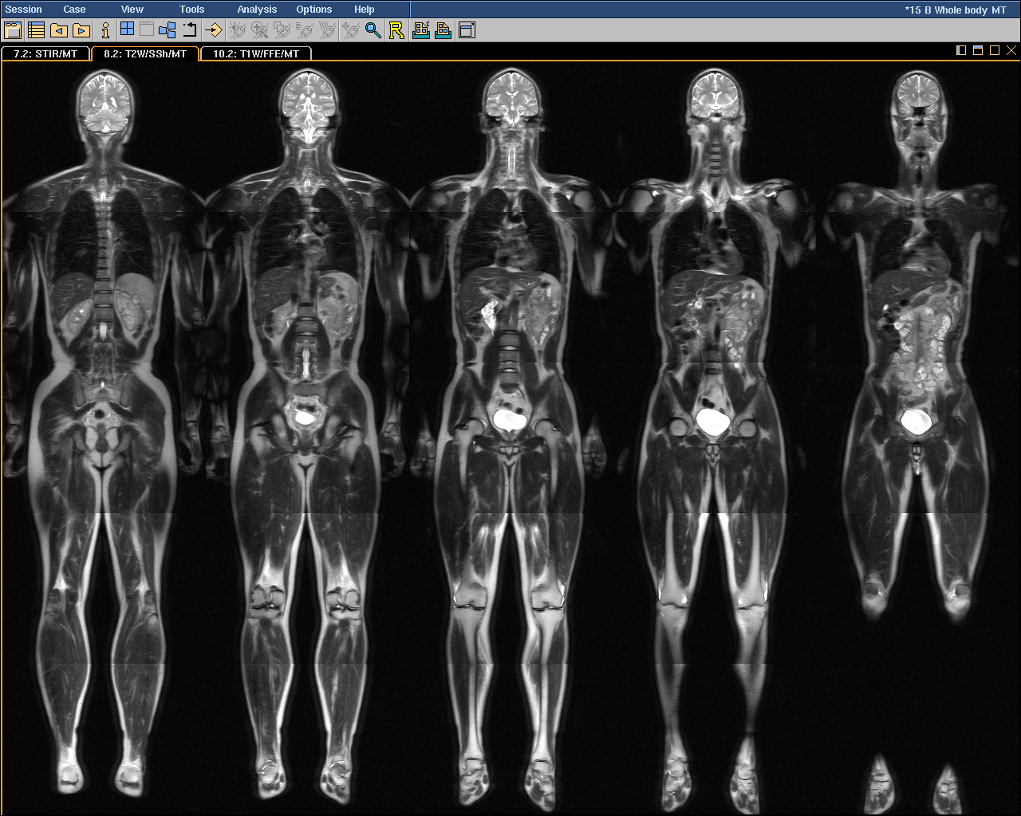
5
4
Stack
ID
3
2
1
1
2
3
4
5
In-Stack Position

Slide 64
Multi-frame Dimensions
Real world (Wikipedia):
  “In physics and mathematics, the dimension of a space or object is informally defined as
    the minimum number of coordinates needed to specify any point within it”
DICOM:
  “A dimension is a set of attributes
    that change on a per-frame basis in a manner that is known before the image is acquired,
    are defined by the generating application and
    are especially intended for presentation”

Slide 65
Multi-frame Dimensions
Multi-frame Dimensions Module
  in top level dataset
  defines an “organization” (set of dimensions)
    with an optional organization “type”
    e.g., “3D” or “3D_TEMPORAL” in Volume US
  defines each dimension
    by reference to a per-frame varying Attribute
    by referenced to Functional Group containing Attribute
For each frame, encode
  numeric “index” of position within each dimension
    starts from 1, increases by 1
    an index, not the value of the referenced Attribute

Slide 66
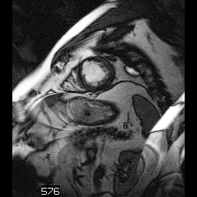
Dimensions
Start with a dimension of space.
A set of contiguous slices through the heart.
Stack ID = 1
5
4
3
2
1
Space
In-Stack Position

Slide 67
Dimensions
Dimension Index Pointers:
Stack ID
In-Stack Position
Stack ID = 1
5
4
3
2
1
Space
In-Stack Position

Slide 68
Trigger
Delay
Time
Temporal
Position
Index
Stack ID = 1
Add dimension of time (delay time from R-wave).
Sets of contiguous slices throughout cardiac cycle.
48 ms
2
5
4
3
2
1
In-Stack Position
Stack ID = 1
Time
0 ms
1
5
4
3
2
1
Space
In-Stack Position

Slide 69
Trigger
Delay
Time
Temporal
Position
Index
Stack ID = 1
48 ms
2
5
4
3
2
1
In-Stack Position
Dimension Index Pointers:
Stack ID
In-Stack Position
Temporal Position Index
Stack ID = 1
Time (2)
0 ms
1
5
4
3
2
1
Space (1)
In-Stack Position

Slide 70
Trigger
Delay
Time
Temporal
Position
Index
Stack ID = 1
Dimension
Index
Values
1
\
5
\
2
48 ms
2
5
4
3
2
1
In-Stack Position
Dimension Index Pointers:
Stack ID
In-Stack Position
Temporal Position Index
Stack ID = 1
Time (2)
0 ms
1
5
4
3
2
1
Space (1)
In-Stack Position

Slide 71
Trigger
Delay
Time
Temporal
Position
Index
Stack ID = 1
Dimension
Index
Values
1
\
5
\
2
48 ms
2
5
1\5\2
4
1\4\2
3
1\3\2
2
1\2\2
1
1\1\2
In-Stack Position
Dimension Index Pointers:
Stack ID
In-Stack Position
Temporal Position Index
Stack ID = 1
Time (2)
0 ms
1
5
1\5\1
4
1\4\1
3
1\3\1
2
1\2\1
1
1\1\1
Space (1)
In-Stack Position

Slide 72
Trigger
Delay
Time
Temporal
Position
Index
Stack ID = 1
Dimension
Index
Values
2
\
1
\
5
48 ms
2
5
2\1\5
4
2\1\4
3
2\1\3
2
2\1\2
1
2\1\1
In-Stack Position
Dimension Index Pointers:
Temporal Position Index
Stack ID
In-Stack Position
Stack ID = 1
Time (1)
0 ms
1
5
1\1\5
4
1\1\4
3
1\1\3
2
1\1\2
1
1\1\1
Space (2)
In-Stack Position

Slide 73
Trigger
Delay
Time
Temporal
Position
Index
Stack ID = 1
Dimension
Index
Values
2
\
1
\
5
48 ms
2
5
2\1\5
4
2\1\4
3
2\1\3
2
2\1\2
1
2\1\1
In-Stack Position
Dimension Index Pointers:
Trigger Delay Time
Stack ID
In-Stack Position
Stack ID = 1
Time (1)
0 ms
1
5
1\1\5
4
1\1\4
3
1\1\3
2
1\1\2
1
1\1\1
Space (2)
In-Stack Position

Slide 74
Dimension Features
Description of dimensions separate from their indices
  dimensions are described once
  indices within dimensions are encoded per-frame
  a dimension may have only a single index value
Receiving application only needs to follow the index values
  does NOT need to “understand” the attribute values
  does NOT need to select or sort by attribute value
  dimensions can be entire functional groups
  can be private attributes or private functional groups

Slide 75
Dimension Applications
Define sort order for simple viewing
  replace dependence on encoded order, Instance #
Partitioning of frames for hanging
  hanging protocol can match pattern of Dimensions
Selection of frames that constitute a
  volume in space
  temporal sequence
  contrast administration phase
  acquisition parameter, e.g. data type
  combinations of the above

Slide 76

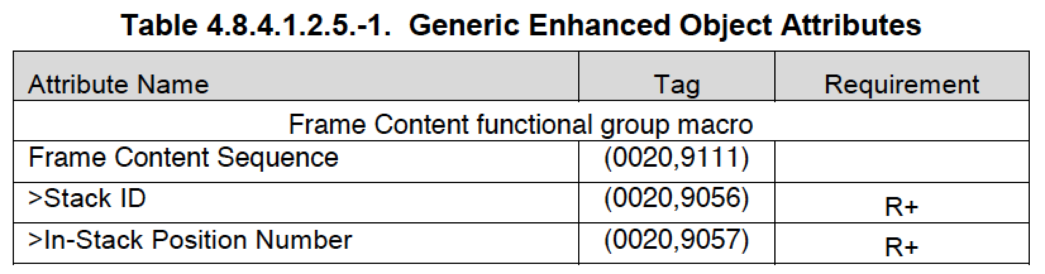
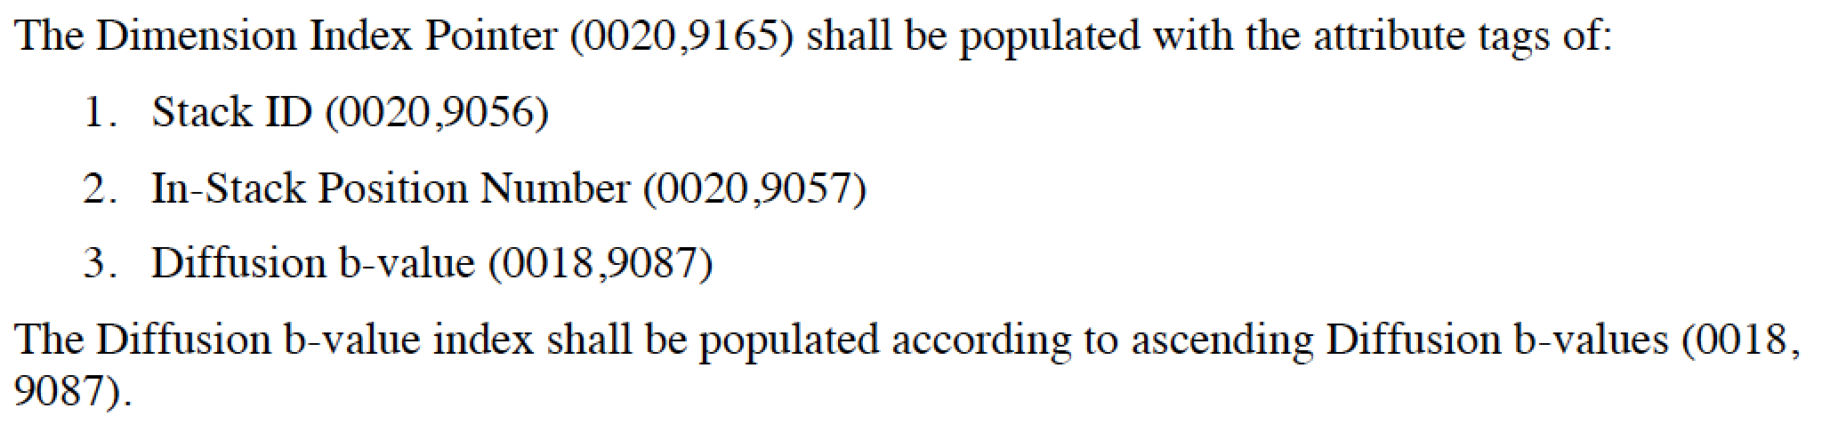
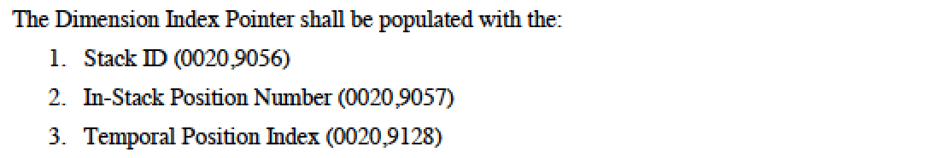
Dimensions in IHE DIFF, PERF

Slide 77
Quantitation of Size and Value
Quantitation of pixel size
  measure distance, area, volume
  Pixel Measures functional group
Quantitation of pixel values
  measure intensity, velocity, etc.
  Real World Value Map functional group
  top level data set Rescale values not used
  separate from rendering pipeline

Slide 78
Real World Value Mapping
Modality
VOI
P
LUT
LUT
Display
LUT
Stored
Values
Real world
Real
value
Value
Value
Unit
LUT
Real World
Real World
Measurement
Value LUT
or
Value Intercept
Units Code
Data
and Slope
Sequence
(0040,9212)
attributes
(0040,08EA)

Slide 79
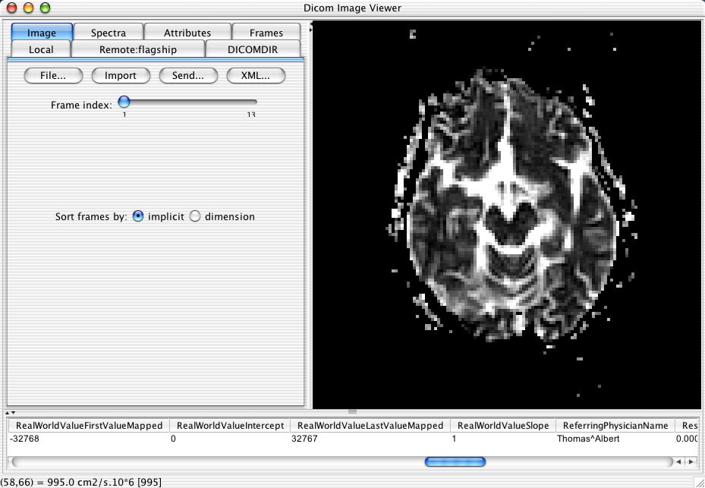
Cursor over pixel
Coordinates of current cursor position
Output of mapping; with
code meaning of units
In this case values included; linear, identity mapping
Stored pixel value

Slide 80
Real World Values
Separate from rendering pipeline
  may be linear or non-linear (LUT)
  may be multiple mappings into different units of different range of values
May be different for each frame
  not different “regions” of same frame
Coded Units
  e.g., ([hnsf'U], UCUM, "Hounsfield unit")
Quantity (CP 1387)
  e.g., (122713, DCM, "Attenuation Coefficient")

Slide 81
Enhanced US Volume
Blending and Display Pipeline

Slide 82
Path for Single Data Type

Slide 83

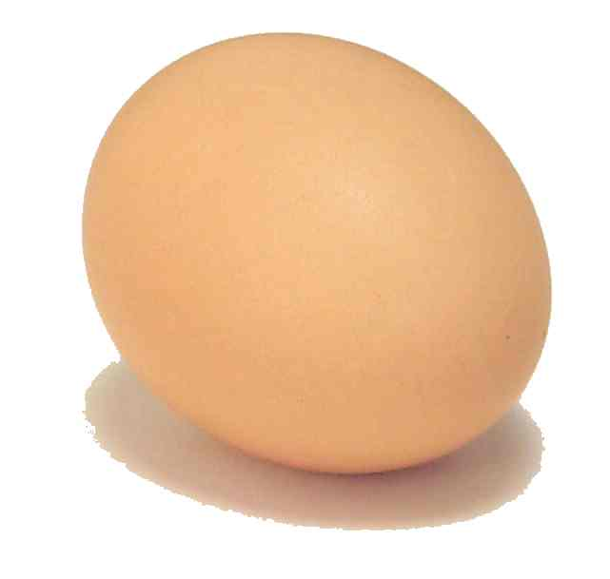
But when ?
Modality
PACS

Slide 84
PACS Enhanced MF Support
Store and regurgitate (and archive) ?
“Basic” display?
  scroll through frames in encoded order
“Advanced” display?
  sort/scroll by dimensions, stacks, temporal positions
  synchronized scrolling
  measure size & intensity using functional groups
“3D” display?
  3D cursors
  MPR
  volume rendering
CD/DVD viewer support (only basic required in IHE BIR)
IHE DIFF, PERF, DBT profile support

Slide 85
PACS to PACS (or VNA) with
Legacy DICOM Object Conversion
PACS
PACS
Modality
Convert
SF -> MF
Convert
SF -> MF
Modality
Convert
MF -> SF
Convert
MF -> SF
Classic SF
Legacy Converted MF
Workstations
True Enhanced MF

Slide 86
Enhanced MF for Research
Easier to keep data for a single “experiment” organized
Slices all together in one object
Standard volume geometry
Can explicitly describe dimensions
  generic: space, time, cardiac cycle position
  specific: standard or private
Supported by secondary capture
  e.g., for novel modalities
  as of CP 600

Slide 87
Enhanced MF Intermediates
To join processing pipeline components
  without loosing “composite context” (patient, …)
Same arguments apply as for acquisition
  private frame descriptions and dimensions
  e.g., real and imaginary frames
Major gap is the absence of floating point pixel data representations
  OF, OD value representation (IEEE float 32, 64)
  not defined for Pixel Data (7FE0,0010)
  not supported by toolkits for Pixel Data
  being addressed in new Sup 172 Parametric Map

Slide 88
DICOM & Quantitative Results
Quantitative analysis need not be proprietary
  standard and interoperable results encoding
Quantitative analysis need not be a “dead end”
  can just transcribe or cut-and-paste numbers into a dictated or plain text report
    but … pre-populated “merge” fields created from structured input provide a productivity and quality gain
  can indeed save pretty tables & graphics as a PDF
    but … much better to be able to re-use structure, numbers, codes next time for comparison, searching, mining and basis for quality improvement metrics
DICOM appropriate when results image-related
  e.g., from Regions of Interest (ROIs)

Slide 89
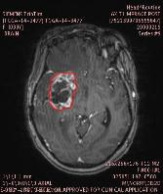
DICOM Encoding of ROIs
Private elements
  evil & must be stopped
Curves in image
  weak semantics, old, retired
Overlays in image
  weak semantics
Presentation States
  weak semantics, PACS favorite
Structured Reports
  best choice, but more work
RT Structure Sets
  coordinates only
Segmentations
  per-voxel ROIs; use with SR
Date | Volume | Auto LD | Auto SD
20021207 | 27080 | 49 | 27
… | … | … | …

Slide 90
DICOM Structured Reports
Hierarchical structure
  codes, numbers, coordinates, image references, etc.
Flexibility is constrained by templates
  just as XML is constrained by DTD or Schema
Standard DICOM binary representation
  easily stored in PACS, though visualization remains challenging
  easily transcoded to XML, JSON, SQL, CSV for processing
Widely used in existing quantitative modalities
  echo-cardiography, obstetric ultrasound

Slide 91
SR – Questions + Answers
Basic structure is name-value pair
  name is the “question” (code)
  value is the “answer” (text, code, numeric, etc.)
Codes leverage external lexicons
  SNOMED, LOINC, … as well as DCM codes
Different style choices possible, e.g.
  (M-54000,SRT,“Necrosis”) = (G-A203,SRT,“Present”)
  (F-00005,SRT,“Finding”) = (M-54000,SRT,“Necrosis”)
Template of questions & value sets
  populated by human (pick lists from value sets)
  image processing (e.g., signal, pattern detected)
  rule based (e.g., too small to measure)

Slide 92
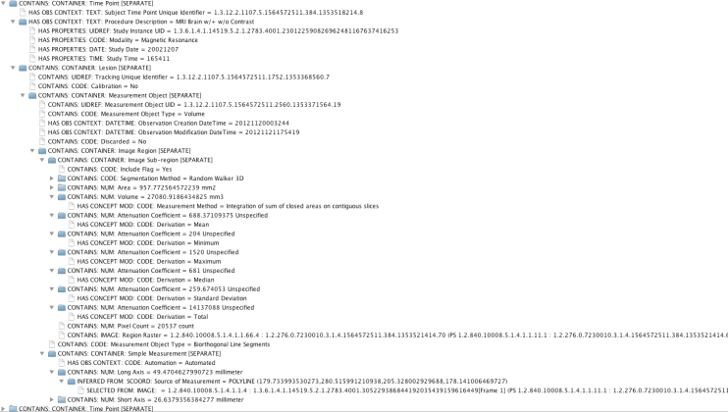
DICOM SR – details inside

Slide 93
DICOM SR – as visualized
Date | Volume | Auto LD | Auto SD
20021207 | 27080 | 49 | 27
… | … | … | …

Slide 94
DICOM RT Structure Sets
Simple structure
  focus is iso-contour 3D coordinates of regions to treat & spare
  very limited semantics
  no standard or extensible measurements beyond simple volume
Standard DICOM binary representation
  easily transcoded to other DICOM objects like SR or PS
  if 3D (patient-relative) to 2D (image-relative) coordinate mapping is available (e.g., via source images or an SR image library)
Widely used in existing RT & non-RT workstations
  also understood by many academic software tools

Slide 95
DICOM Presentation States
Intended to preserve appearance
  grayscale pipeline (window)
  spatial transformation (pan/zoom)
  annotation (text, overlays, vector graphics)
  color and pseudo-color versions
Lack semantics
  what does the text “mean”? (need NLP?)
  which graphic is it associated with?
Overall, a poor choice for quantitative results
  but may be all that is available in many PACS
  (to create & view)

Slide 96
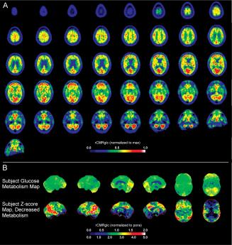
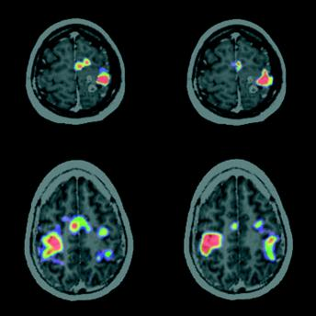
Parametric Maps
Foster N L et al. Brain 2007;130:2616-2635
Meyer P T et al. J Neurol Neurosurg Psychiatry 2003;74:471-478

Slide 97
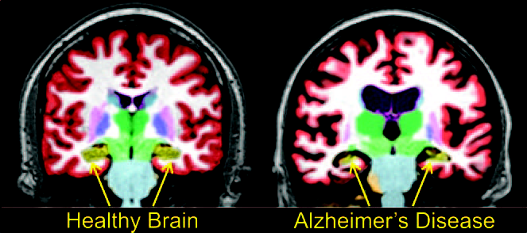
Label Maps & Segmentations
Brewer J et al. AJNR 2009; 30:578-580

Slide 98
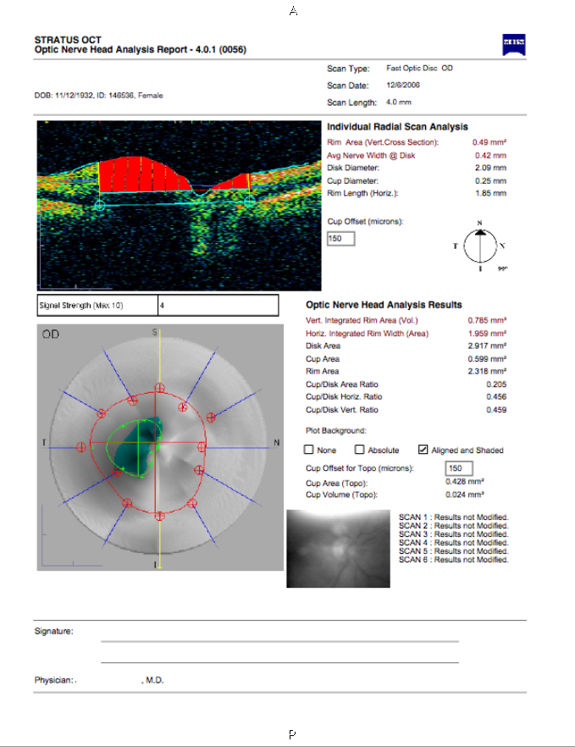
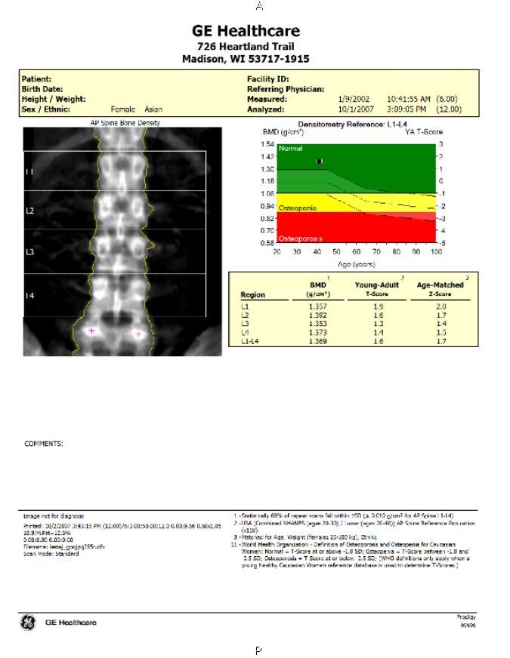
Encapsulated PDF

Slide 99
Parametric & Label Maps
Per-voxel encoding of numeric or label values
Ordinary images but not just “pretty pictures”
  modality-specific or secondary capture; single or multi-frame
  not just a PDF-like “static” secondary capture color screen shot
Segmentations (label maps)
  binary, probability, fractional occupancy
  multiple segments (multiple labels)
Parametric maps currently limited to integer values
  can provide (linear) rescaling to floats (usable by any viewer)
  Sup 172 extension to floating point voxels (or private SOP Class)
Leave “fusion” (superimposition) to application
  Blending Presentation State to specify what to fuse
  e.g., segment/parameter + CT or MR (like PET SUV + CT)

Slide 100
Registration & Fiducials
Mapping between 3D coordinates
  DICOM Registration – rigid matrix
  DICOM Deformable Registration
Location of specific points
  DICOM Fiducial
Used to save manual or automated results
  save application state for further work later
  re-use for other purposes (e.g., sync’d scrolling)

Slide 101
DICOM Real World Value Maps
“Standalone” objects
  i.e., separate from images (not just in them)
Separate pipelines based on pixels
  what to show on the display
  what the pixel (voxel) “means”
e.g., MR pixel values
  signal intensity windowed for display
  mapped to physical unit (e.g. velocity for phase contrast)
DICOM encoding
  linear equation or LUT, applied to all or sub-set of range
  point operation (all voxels) (unlike US Region Calibration)

Slide 102
Quantitative Objects Together
DICOM Segmentation
Previous DICOM SR etc
DICOM Registration
Current DICOM Images from Modality
Analysis Workstation
DICOM SR
PACS Store, Distribute and Review
DICOM Real World Value
Previous DICOM Images from PACS
DICOM Parametric Map Images

Slide 103
Summary
Background of DICOM IODs for storage
“Enhanced Multi-frame” family of objects – principles
Performance, compression, organization, attributes
Geometry, coded anatomy, hanging, timing, data type
Functional groups, dimensions, stack, temporal index
Real world value maps and display pipeline
PACS support for Enhanced Multi-frame
Legacy conversion
Quantitation and DICOM non-image objects for ROIs

