Slide 1
Tools to Analyze Morphology and Spatially Mapped Molecular Data
Joel Saltz MD,PhD
Chair Biomedical Informatics, Stony Brook
Associate Director Stony Brook Cancer Center
October 3, 2014

Slide 2
Consortium
Stony Brook: Joel Saltz, Tahsin Kurc, Allen Tannenbaum, Fusheng Wang, Liangjia Zhu, Ivan Kolesov, Romeil Sandhu
Emory: Adam Marcus, Lee Cooper, Dan Brat, Fadlo Khuri Lee Cooper, Ashish Sharma, Rick Cummings, Roberd Bostick
Oak Ridge National Lab: Scott Klasky, Dave Pugmire
Yale: Michael Krauthammer

Slide 3
Computational Pathology: High Dimensional Fused-Informatics
Anatomic/functional characterization at fine and gross level
Integrate of anatomic/functional characterization, multiple types of “omic” information, outcome
Predict treatment outcome, select, monitor treatments
Integrated analysis and presentation of observations, features analytical results – human and machine generated
Ex-vivo Imaging
“Omic”
Data
Patient Outcome
In vivo imaging

Slide 4
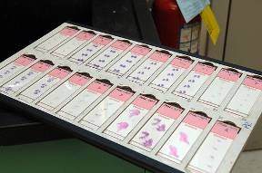
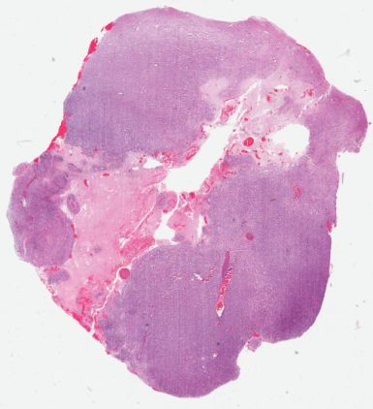
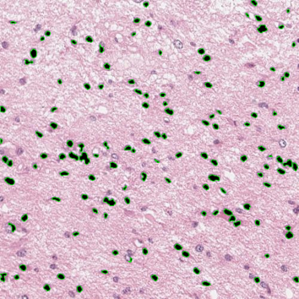
Pathology Analytical Imaging
Glass Slides
Scanning
Whole Slide Images
Image Analysis
Provide rich information about morphological and functional characteristics
Image analysis, feature extraction on multiple scales
Spatially mapped “omics”
Multiple microscopy modalities

Slide 5
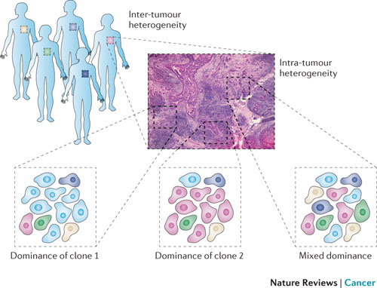
Tumor Heterogeneity
Marusyk 2012

Slide 6
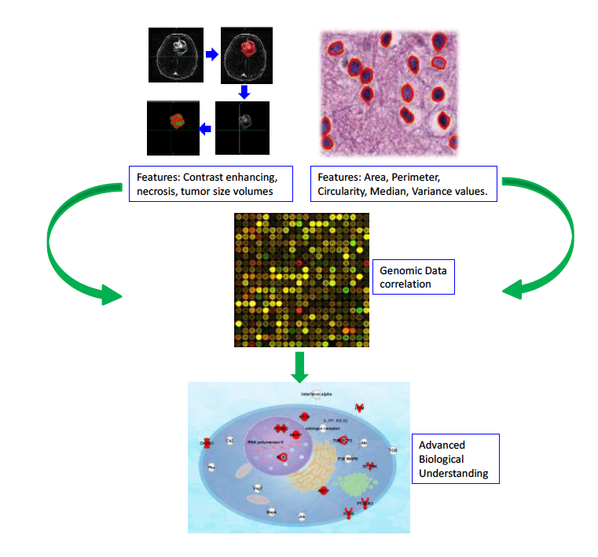
Report: Imaging-Genomics Workshop June 2013

Slide 7
Correlating Imaging Phenotypes with Genomic Signatures: Scientific Opportunities
Imaging Genomics Workshop NCI June 2013
Clinical Approach and Use
Development of imaging+analysis methods to characterize heterogeneity
within a tumor at one time point
evolution over time
among different tumor types
Development of imaging metrics that:
can predict and detect emergence of resistance?
correlates with genomic heterogeneity?
correlates with habitat heterogeneity?
can identify more homogeneous sub-types

Slide 8
Direct Study of Relationship Between Image Features vs Clinical Outcome, Response to Treatment, Molecular Information
Lee Cooper,
Carlos Moreno

Slide 9
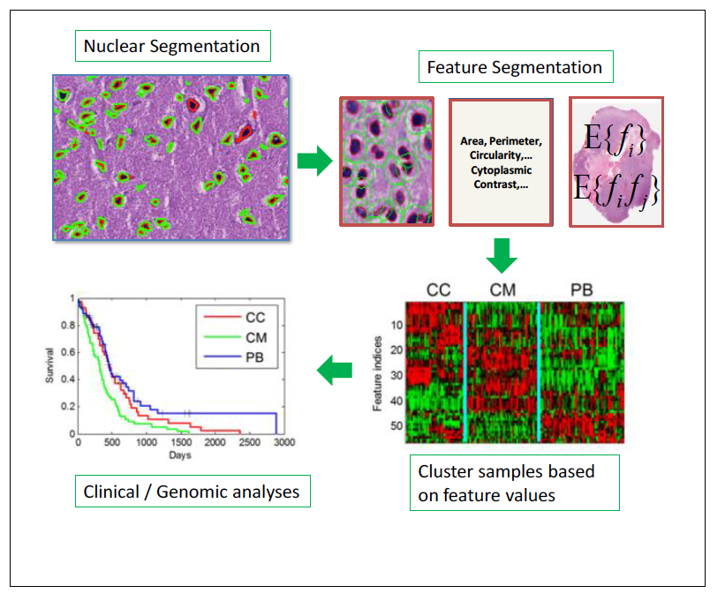
Integrative Morphology/”omics” TCGA -- GBM Studies
Quantitative Feature Analysis in Pathology: Emory In Silico Center for Brain Tumor Research (PI = Dan Brat, PD= Joel Saltz)
NLM/NCI: Integrative Analysis/Digital Pathology R01LM011119, R01LM009239 (Dual PIs Joel Saltz, David Foran)

Slide 10
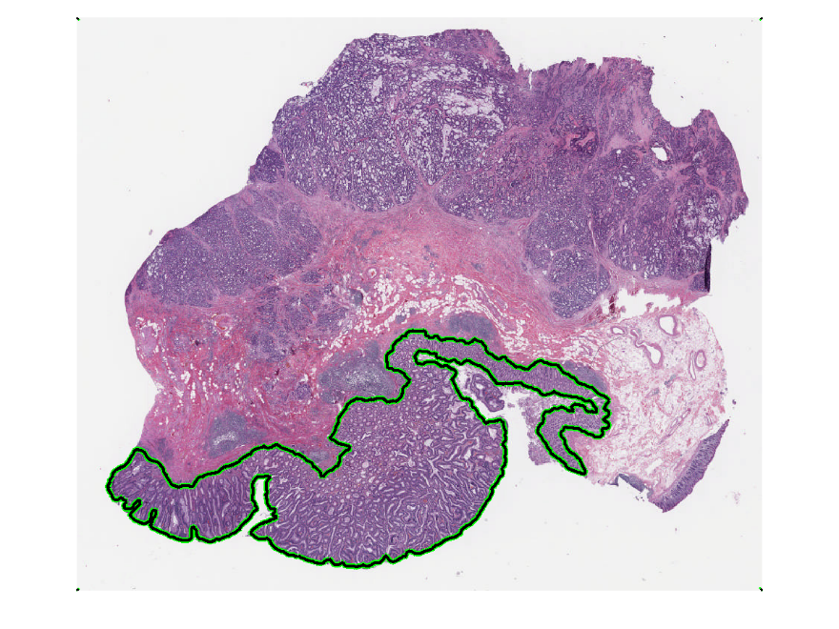
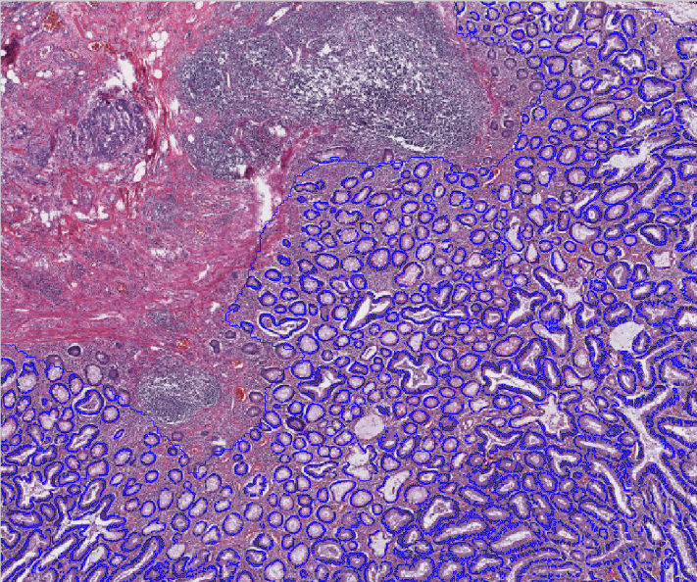
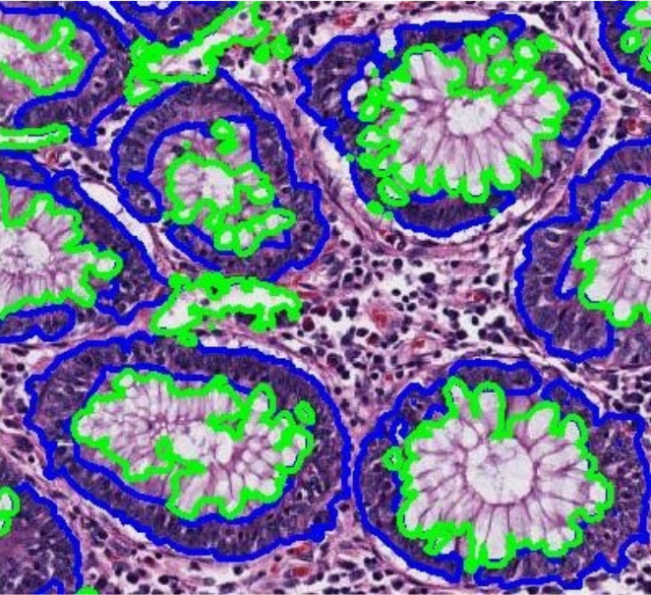
Hierarchical Pipeline (Slicer!)
Liangjia Zhu
Ivan Kolesov
Romeil Sandhu
Allen Tannenbaum

Slide 11
Low Power
Fast GrowCut segmentation
Intensity insufficient: need user guidance
Boundaries are most time consuming for user

Slide 12
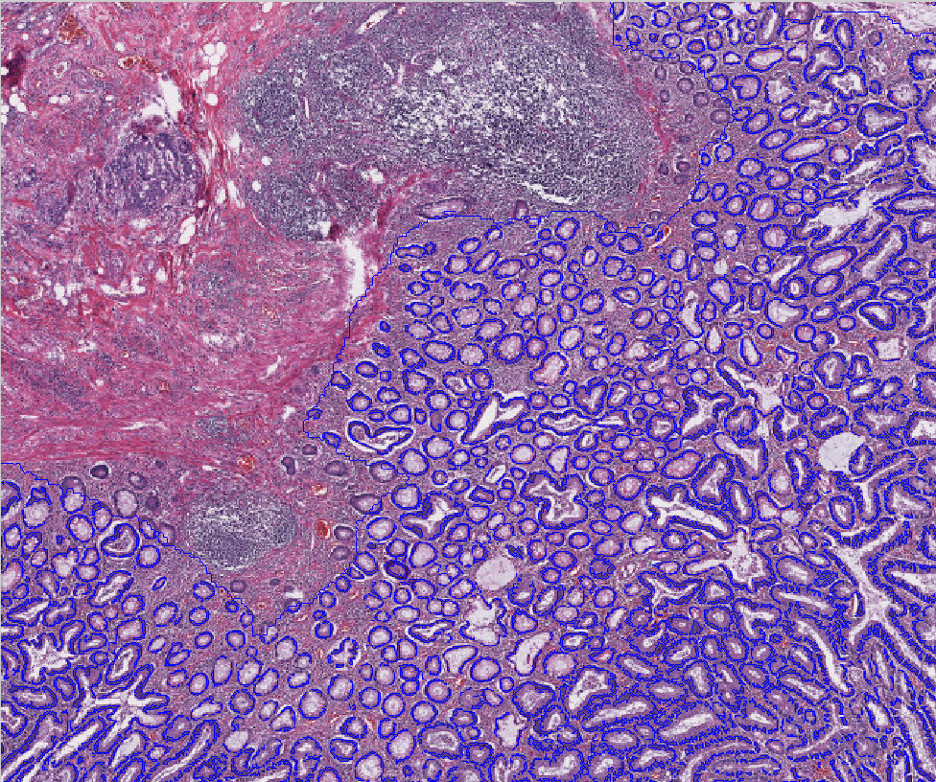
Medium Power
Adaptive thresholding segmentation
Allow for global user input (influence parameter settings)

Slide 13
Crypt/Nuclear Segmentation
Variational active contour
Context is crucial

Slide 14
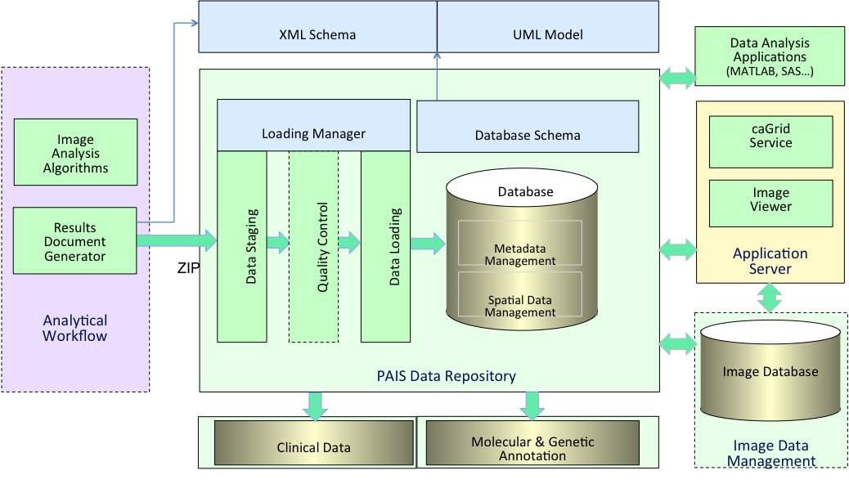
Large Scale Data Management
Data model capturing multi-faceted information including markups, annotations, algorithm provenance, specimen, etc.
Support for complex relationships and spatial query: multi-level granularities, relationships between markups and annotations, spatial and nested relationships
Highly optimized spatial query and analyses
Implemented in a variety of ways including optimized CPU/GPU, Hadoop/HDFS and IBM DB2 (Wang, Saltz, Kurc)
PAIS Database
Implemented with IBM DB2 for large scale pathology image metadata (~million markups per slide)
Represented by a complex data model capturing multi-faceted information including markups, annotations, algorithm provenance, specimen, etc.
Support for complex relationships and spatial query: multi-level granularities, relationships between markups and annotations, spatial and nested relationships
Support for high-level data statistical analysis

Slide 15
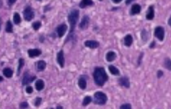
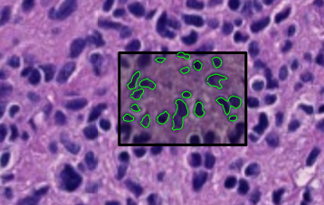
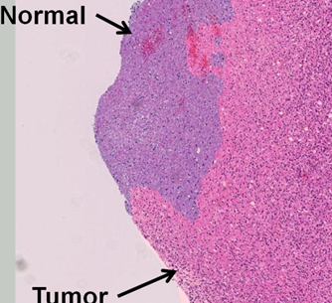
Spatial Centric – Pathology Imaging “GIS”
Point query: human marked point
inside a nucleus
Window query: return markups
contained in a rectangle
.
Containment query: nuclear feature
aggregation in tumor regions
Spatial join query: algorithm
validation/comparison
Fusheng Wang

Slide 16
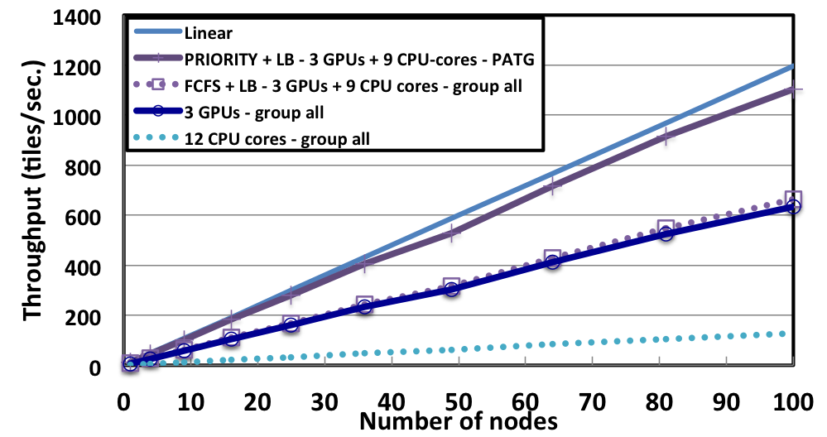
HPC Pipelines (Segmentation and Feature Extraction)
Tony Pan, George Teodoro,
Tahsin Kurc and Scott Klasky

Slide 17
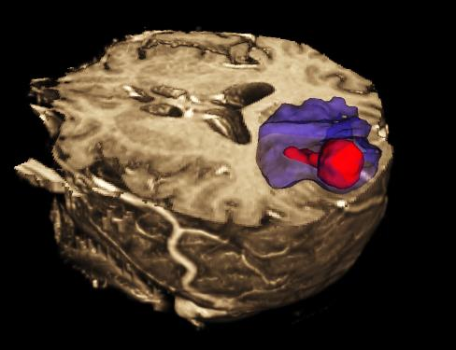
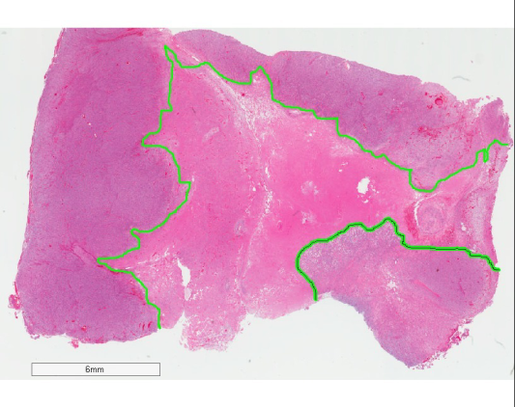
MICCAI 2014 BRAIN TUMOR Classification and Segmentation Challenges
TCGA
TCIA
DIGITAL PATHOLOGY CHALLENGE
IMAGING
CHALLENGE
Phase 1: Training
June 20 - July 31
Phase 2: Leader Board
Aug 1 - Aug 29
Phase 3: Test
Sept 8 - Sept 12
For more information about these challenges and a related workshop
on September 14, 2014 at MICCAI in Boston, see: cancerimagingarchive.net
MICCAI: Medical Image Computing and Computer Aided Interventions - MICCAI2014.org
TCGA: The Cancer Genome Atlas - cancergenome.nih.gov
TCIA: The Cancer Image Archive - cancerimagingarchive.net

Slide 18
Digital Pathology/Brain Tumor Image Segmentation (BRATS)
Used data currently available through data archive resources of the National Institutes of Health (NIH), namely, the Cancer Genome Atlas (TCGA) and the Cancer Image Archive (TCIA)
Digital Pathology challenge used digital slides related to patients whose genomics data are available from TCGA. Similarly, BRATS 2014 Challenge used clinical MRI image data, also from the TCGA study subjects.
Sub-Challenge 1: Classification - Automated classification of LGG and GBM from a collection of 30+ high-resolution digital pathology slides.
Sub-Challenge 2: Segmentation – Automated segmentation of necrotic and normal brain regions on regions of digital pathology slides from a collection of 20+ GBM cases.

Slide 19
Organizers and Major Contributors
Daniel J. Brat, Emory University
Larry Clarke, National Cancer Institute
James Davis, Stony Brook Cancer Center
Keyvan Farahani, National Cancer Institute
John Freymann, Leidos Biomedical Res, Inc.
Carl Jaffe, Boston University
Justin Kirby, Leidos Biomedical Res., Inc.
Tahsin Kurc, Stony Brook Cancer Center
Miguel Ossandon, National Cancer Institute
Joel Saltz, Stony Brook Cancer Center
Roberta Seidman, Stony Brook Cancer Center

Slide 20
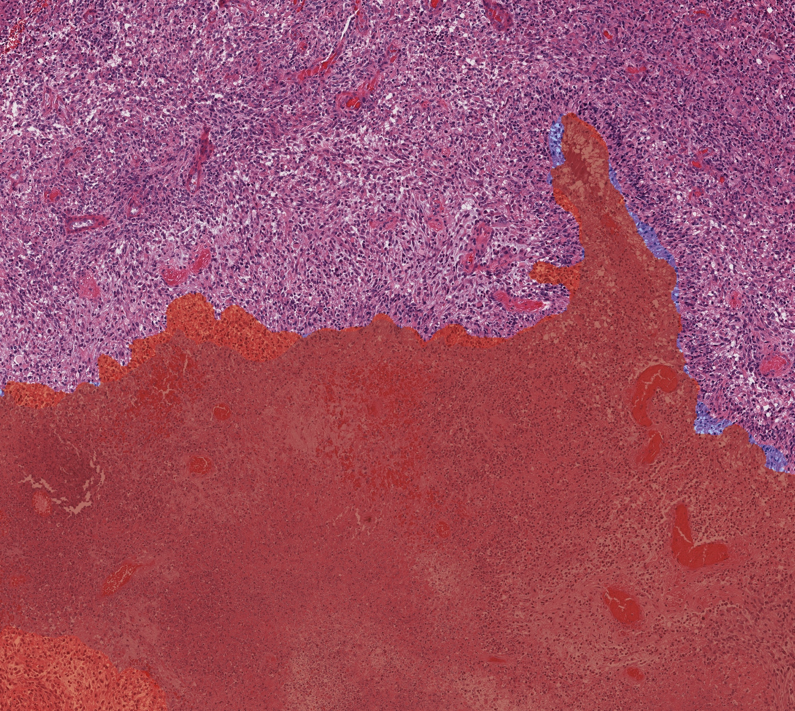
Example of a “good match”

Slide 21
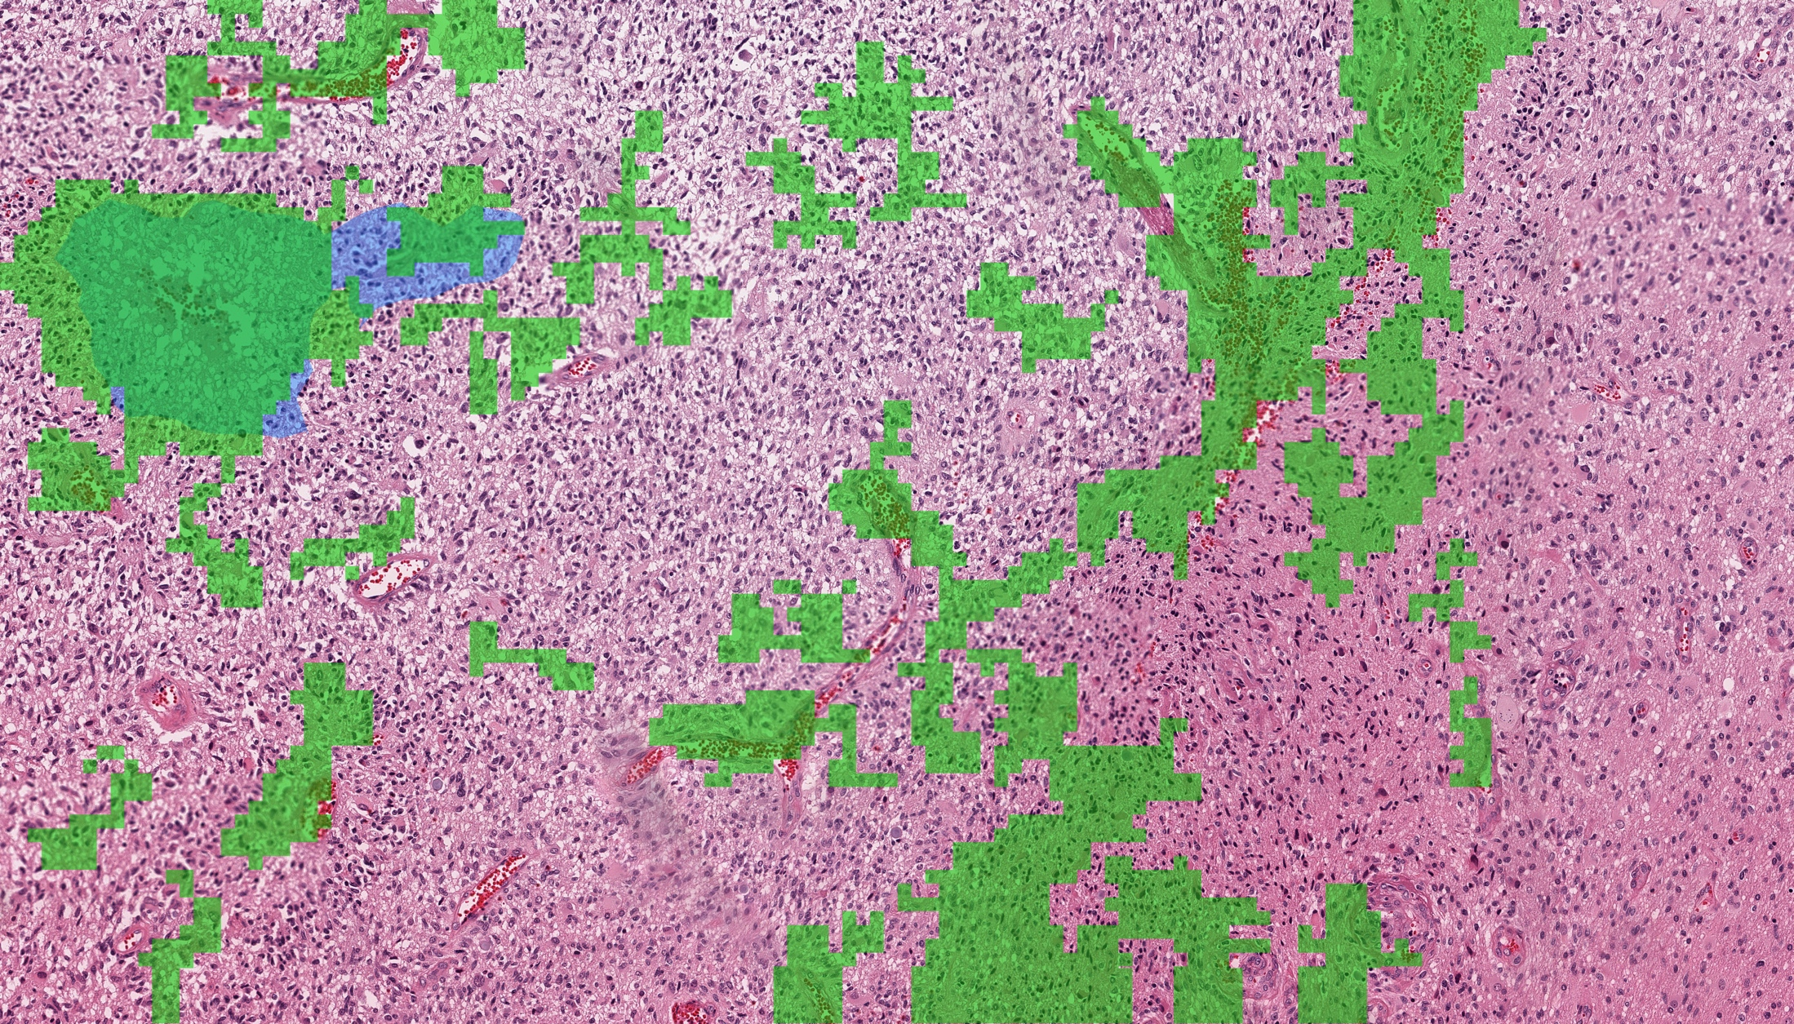
Example of a problematic match

Slide 22
Tools to Analyze Morphology and Spatially Mapped Molecular Data
SPECIFIC AIMS

Slide 23
Pathology Image Analysis
Specific Aim - Develop, deploy, and evaluate robust and scalable methods and analysis pipelines for multi- scale, integrative image analysis.
Aim 1a Develop methods to segment micro-anatomic objects and extract and classify features from whole slide tissue images.
Aim 1b Develop analytic methods to carry out spatially mapped molecular tissue characterizations.
Aim 1c Develop methods to create 3-D reconstructions of multi- scale micro-anatomic features and to characterize changes in morphology over time.

Slide 24
Pipelines, Database, Data modeling, Visualization
Specific Aim 2: Develop database infrastructure to manage and query image data, image analysis results.
Specific Aim 3: Develop high performance software that targets clusters, cloud computing, and leadership scale systems.
Specific Aim 4: Develop visualization middleware for 2D/3D image and feature data and for integrated image and “omic” data.

Slide 25
Driving Cancer Research, Community Support, Challenges and Engagement
Specific Aim 5: Drive continuing development of the tools using a suite of cancer driving biomedical problem, and provide collaborative support and training to the cancer research community.
Aim 5a: Evaluate, demonstrate and drive continuing development of the tools using a suite of cancer driving biomedical problems.
Aim 5b: Provide support to the cancer research community through:
Engagement in NCI Quantitative Imaging Network
support of community digital Pathology image analysis “grand challenges” – initial challenge involving analysis of TCGA whole slide image at MICCAI 2014,
partnerships with collaborative efforts described in letters of support and collaboration, including the National Cancer Imaging Archive, the Mayo Quantitative Imaging Network site, the Colon Cancer Family Registry and the Polyp Prevention Study,
partnerships with cancer microscopy/Pathology shared resources
development of on line resources and workshops to teach users how to employ U24 tools.

Slide 26
Initial Release – 6 months
Integrated compilation of current tools
Analysis library – 2D nuclear segmentation, textures; K-means classification
Database – relational (PAIS Database)
Simple viewer
Project Website

