Slide 1
NCIP Hub Webinar Series: Collections
April 24, 2014

Slide 2
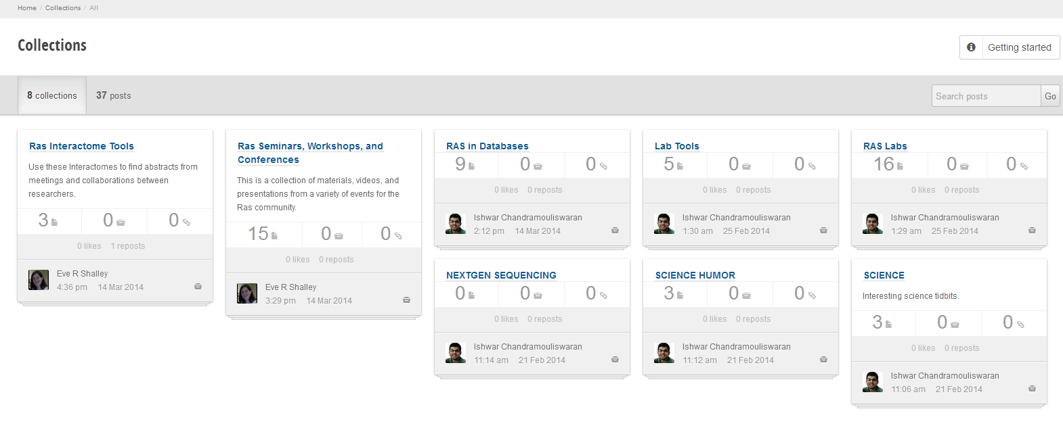
What are collections in NCIP Hub?
Quick catalog of bookmarks/pins
‘Collect’ notes, web sites, images, files etc.
Organized by topic/subject/theme
Community driven and social

Slide 3
How did it come about?

Slide 4
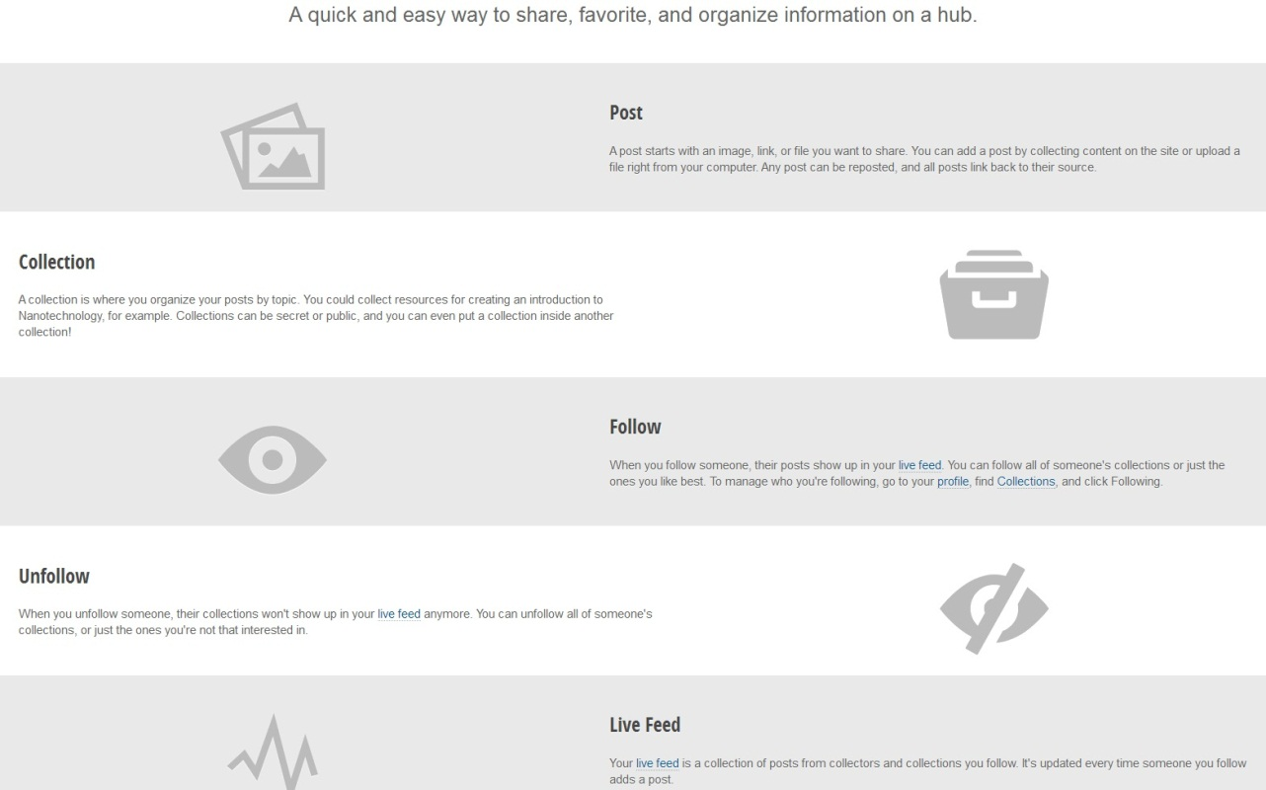
Basics of Collections on NCIP Hub
Browse public collections and posts on NCIP Hub
Like, comment or collect a post
Collect, follow/unfollow a collection

Slide 5
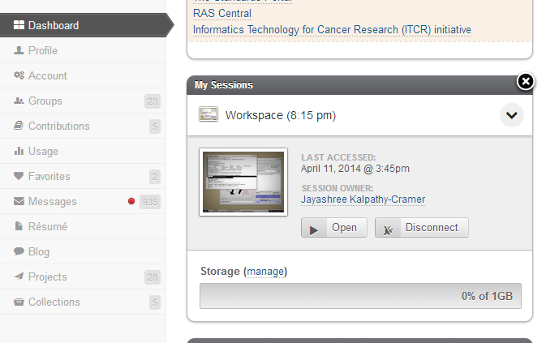
Personal Collections
Collections can be created by an individual Hub user
Create from personalized dashboard
Access level can be public/private

Slide 6
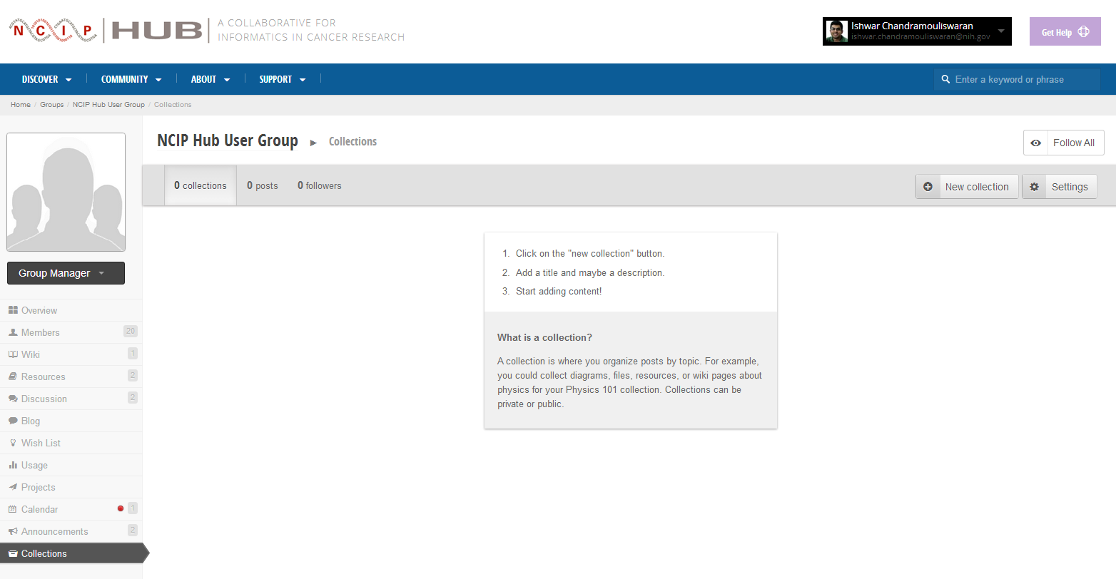
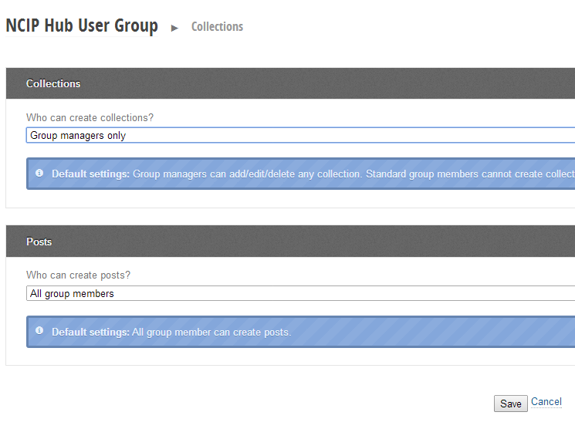
Group Collections
Collections can be created inside a group
Access level of the group
Configurable between manager & member

Slide 7
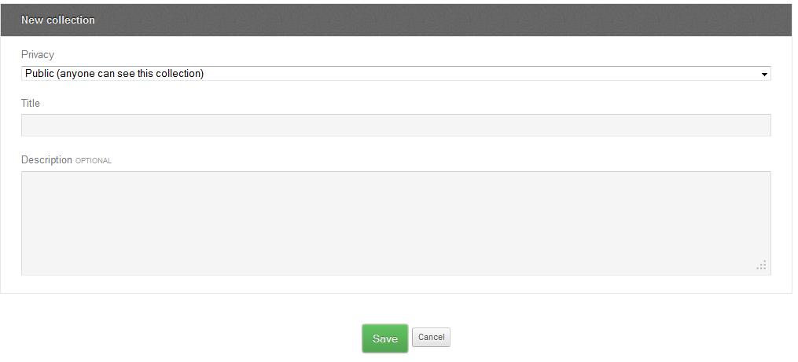
Basics of Collections – Create a Collection
Step 1: Create the collection – Folder/Container
From inside group or from personal dashboard

Slide 8
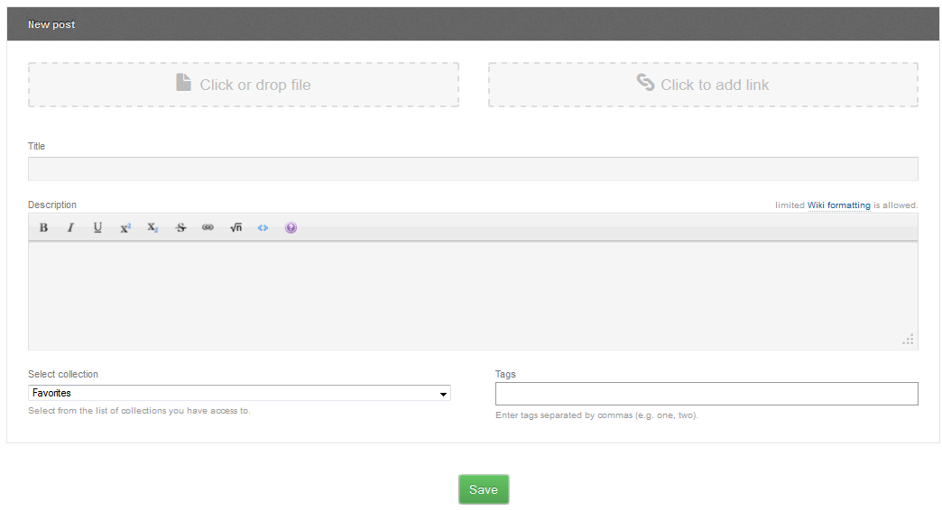
Basics of Collections – Create a Collection
Step 2: Create a post with images, links, docs, etc.

Slide 9
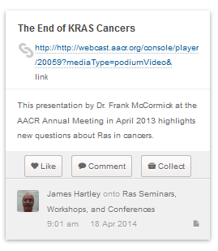
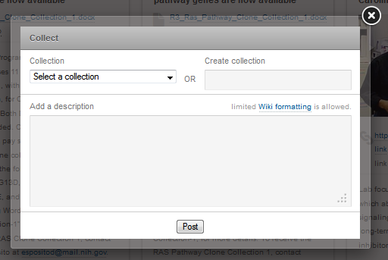
Basics of Collections – Create a Collection
Step 3: Collect posts or other collections to add to your collection!

Slide 10
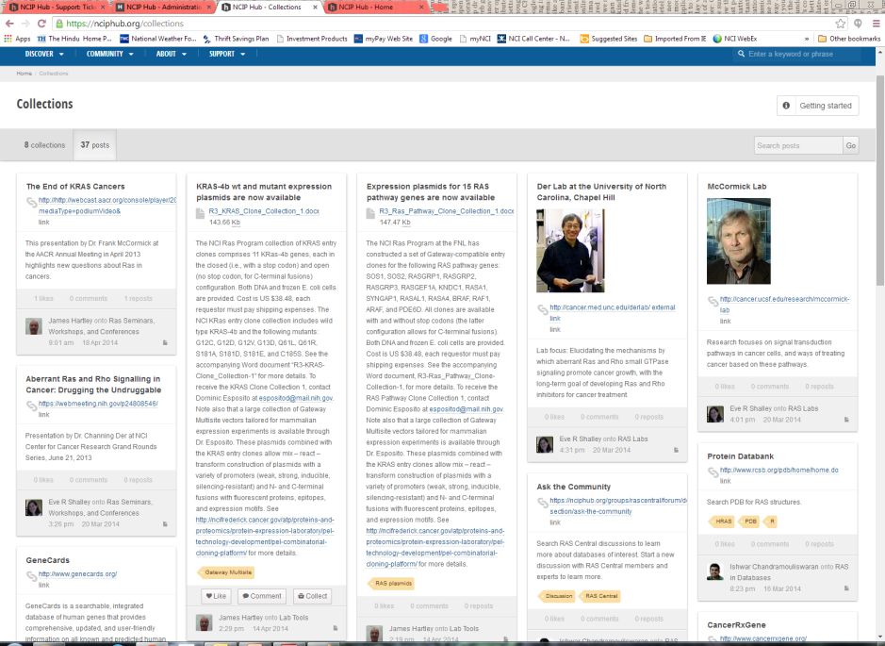
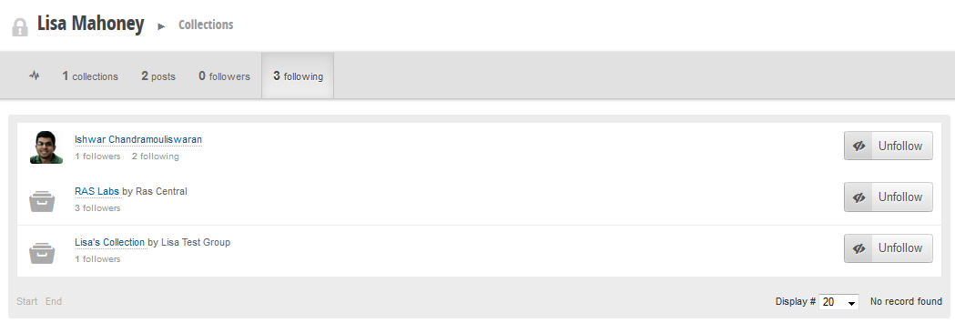
Collections on NCIP Hub
Browse public collections
Follow a single collection(s)/users/group

Slide 11
When do you use Collections?
Share (external) content easily & quickly
Easy viewing of images
Comment on content and exchange thoughts

Slide 12
Start collections
Start one from your dashboard
Collections
New Collection
Set Privacy
Name your collection
Enter a description if you want
Save and add posts

Slide 13
Adding a post to a collection
New Post
Add file, link or both
Enter a title
Enter description if you want
Set a collection for the files to be added to
Enter any tags
Save

Slide 14
Deleting a post from a collection
If you added the post to the collection:
Delete it from the collection
Gets deleted from the Hub
If you collected the post from another collection:
Remove it from the collection
The post will remain in the original collection but will no longer be in your collection

