Slide 1
Research Data Management At the Smithsonian Using SIdora Nano Tech Working Group May 15, 2014

Slide 2
The Smithsonian Institution
Founded to “increase and diffuse knowledge”
19 museums, 9 research centers, 8 advanced study centers, 22 libraries, 2 major archives and a zoo
Long-term baseline research, especially in biodiversity, environmental studies and astronomy
Lots of research in cultural heritage areas
No systematic data management for individual, creative research projects

Slide 3
The Problem
We must capture research information as it is created and make it “durable” and “trusted”
The digital information created by a project is usually complex and numerous
Capturing the intellectual model to provide a context for the research content is necessary
Content should be able to be re-used and re-purposed
Researchers must describe their own data from their point of view

Slide 4
The Solution
Researchers will have a workspace, not an archive, curators will make sense of it later
Primary goal is to enhance research capabilities, leaving trusted data as a legacy
Maintain complete control of the content for as long as appropriate
Software tools will be integrated with the repository
Appropriate levels of security that do not get in the way of research

Slide 5
The Web is the model
A network of nodes that are units of content, connected by arcs that are relationships
Increasingly, content will not be sustainable as discrete packages
We will be maintaining our part of the formalized world-wide web of content
Each project is a set of related digital objects that stands alongside the publications

Slide 6
A data object is one unit of content
Persistent ID
DC
RELS-EXT
Reserved Datastreams
AUDIT
POLICY
1
2
Custom Datastreams
(any type, any number)
n

Slide 7
A project can be represented as a web/graph of related objects
Like a file system built on two types of object:
Concept objects which describe the nodes of the structure and create context for the resources
Resource objects are the digital artifacts
The concepts are metadata that creates the descriptive framework that is also a “database”
The resources hold the digital content, like images, tabular data, video and audio

Slide 8
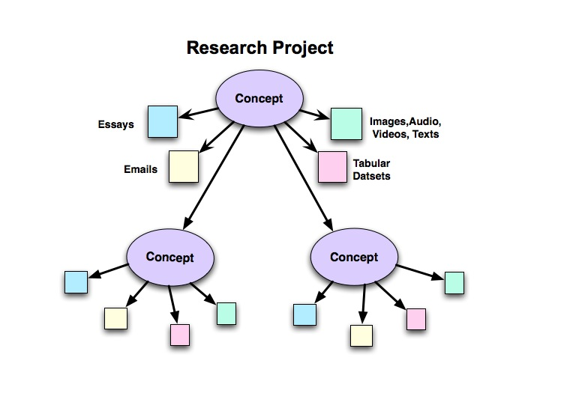

Slide 9
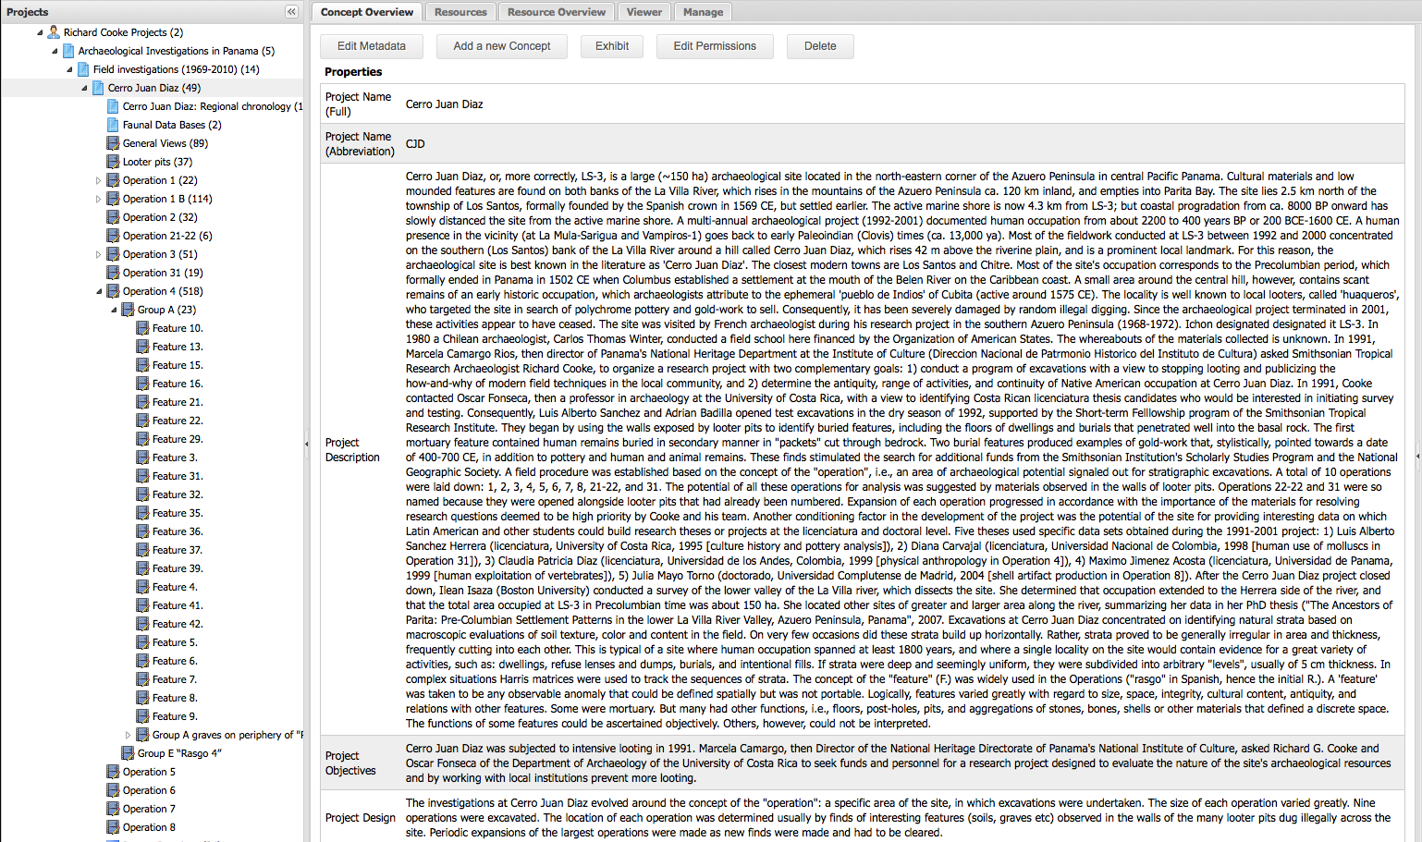

Slide 10
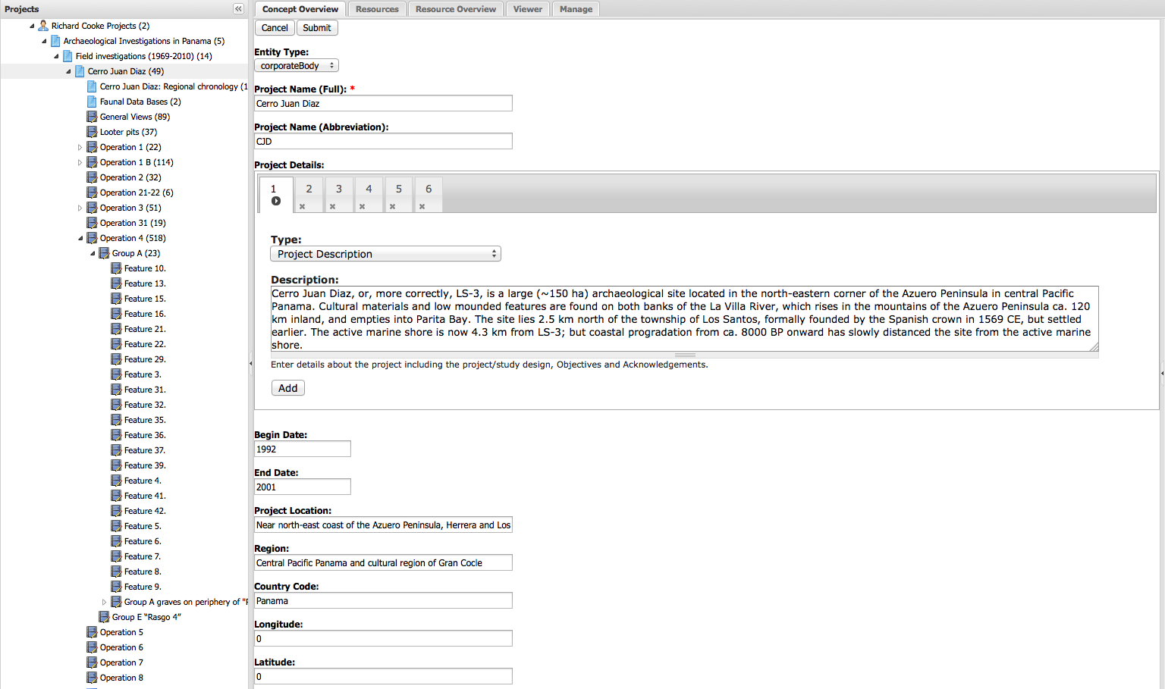

Slide 11
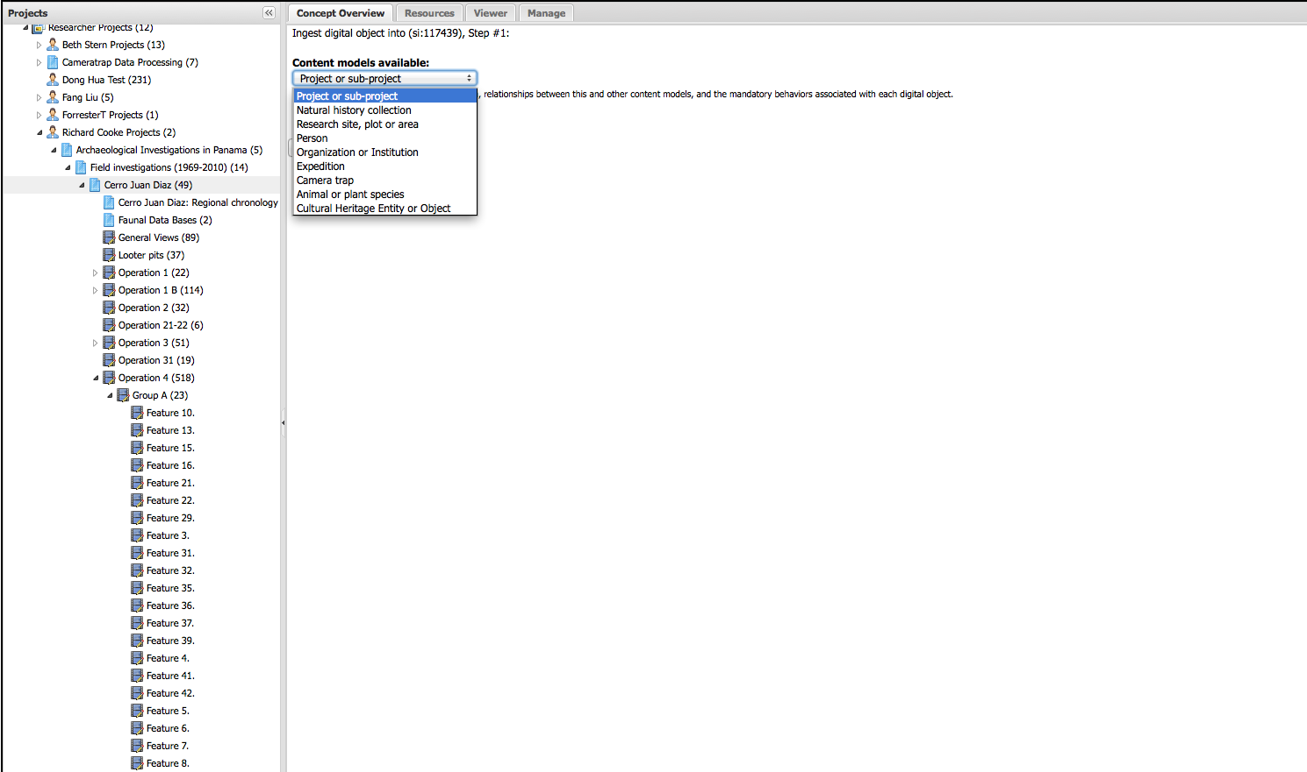

Slide 12
Ontology of Concepts
Researcher
Project
Collection
General Collection
Natural History Collection
General Concept or Idea
Place
General Place
Research Site
Archaeologic excavation
Person
Dataset
Organization
Institution
Expedition
Animal or plant
Species
Specimen
Component(?)
Event
General event
Instrument deployment
Experiment
Textual Creation
Object (or Physical Entity)
Cultural Heritage Object or Entity
Archaeologic feature

Slide 13
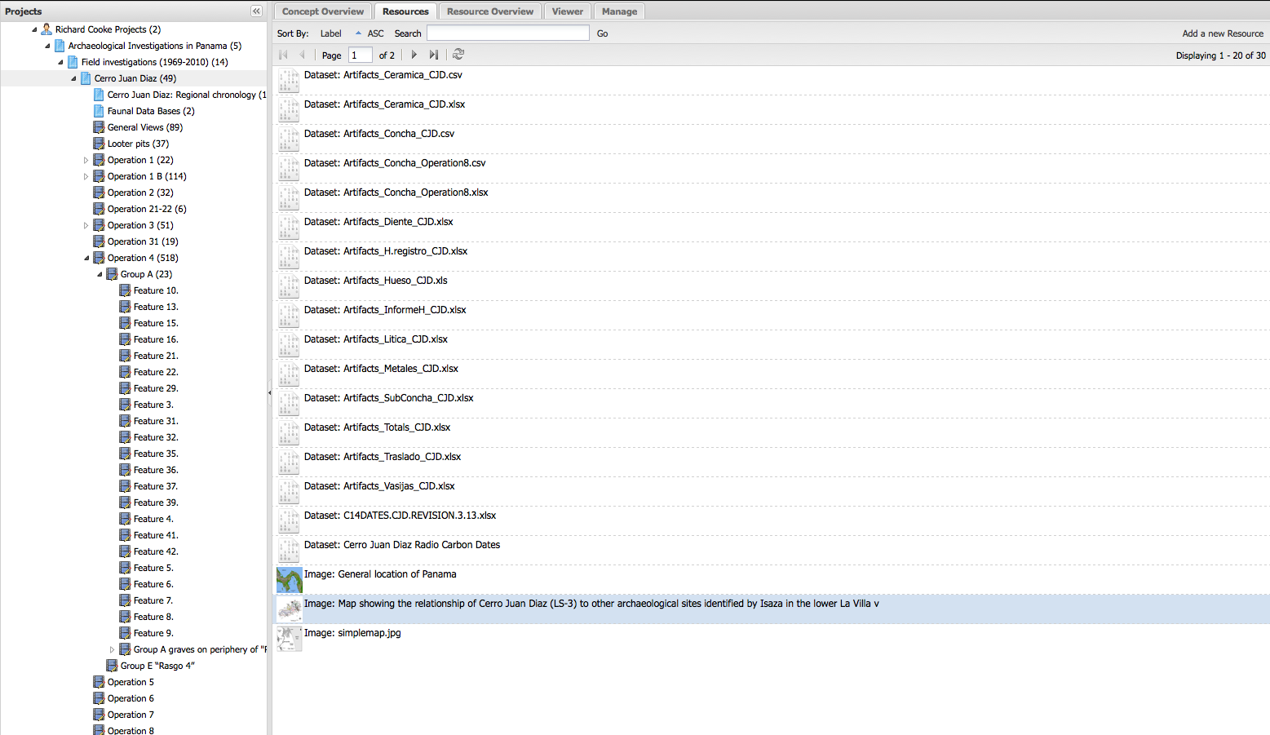

Slide 14
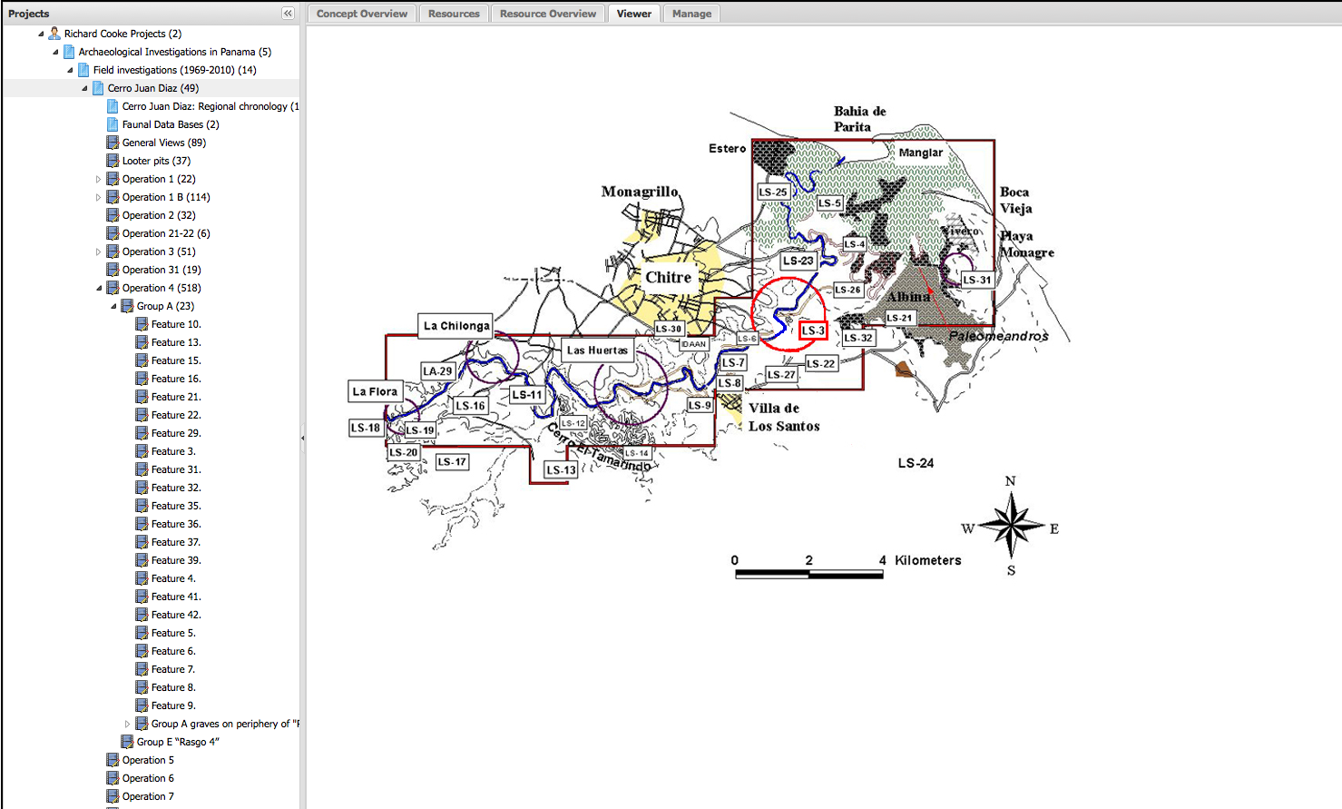

Slide 15
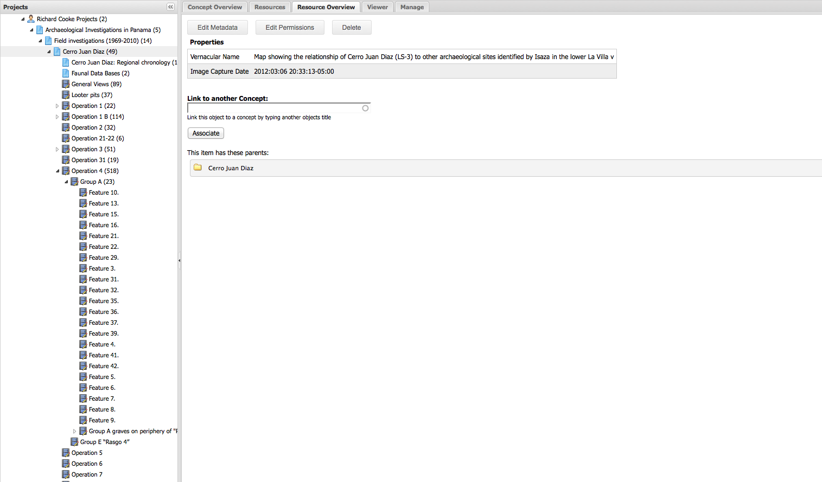

Slide 16
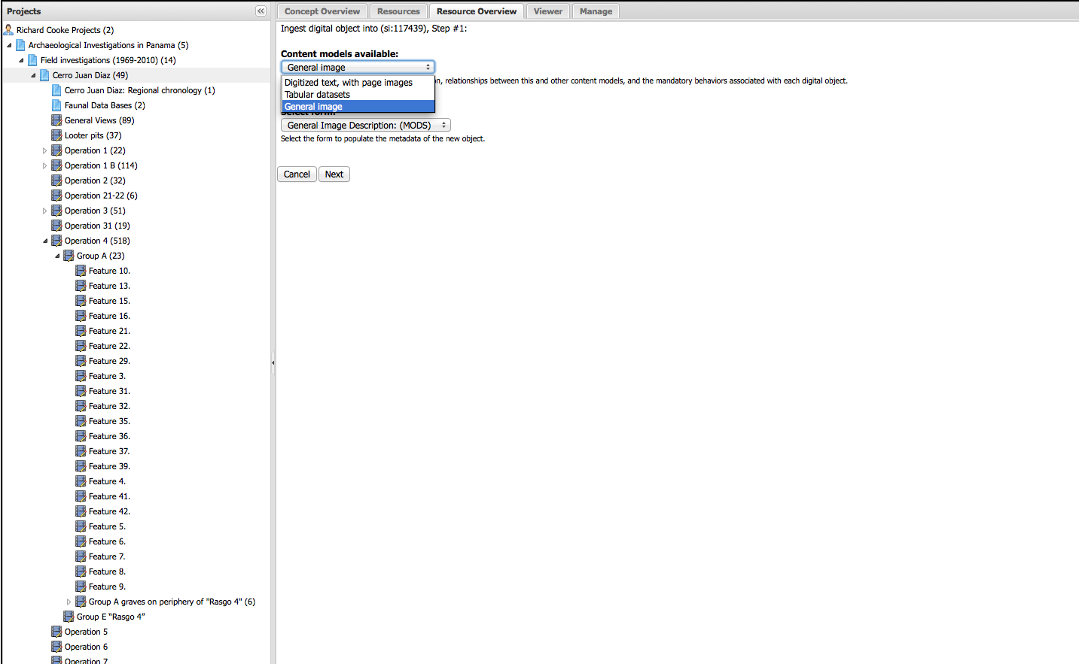

Slide 17
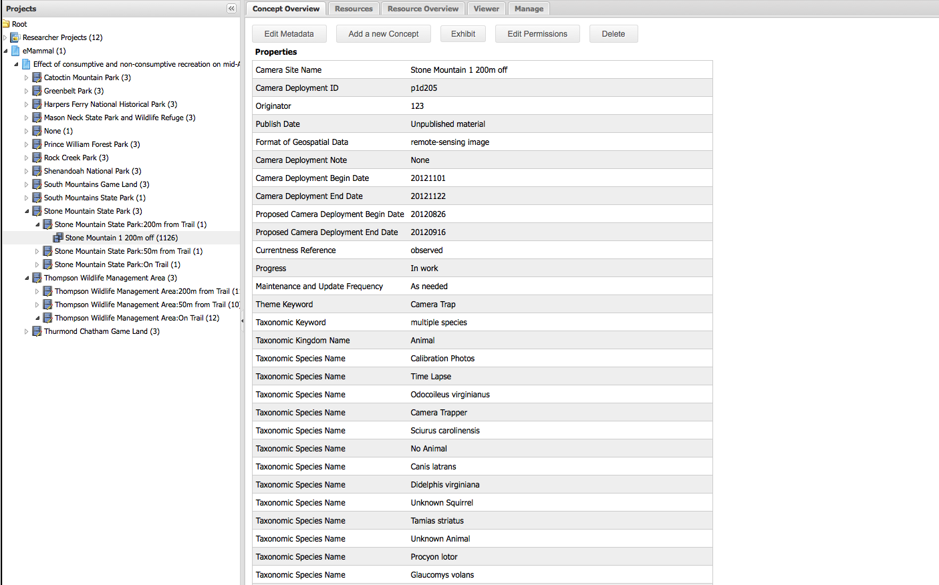

Slide 18
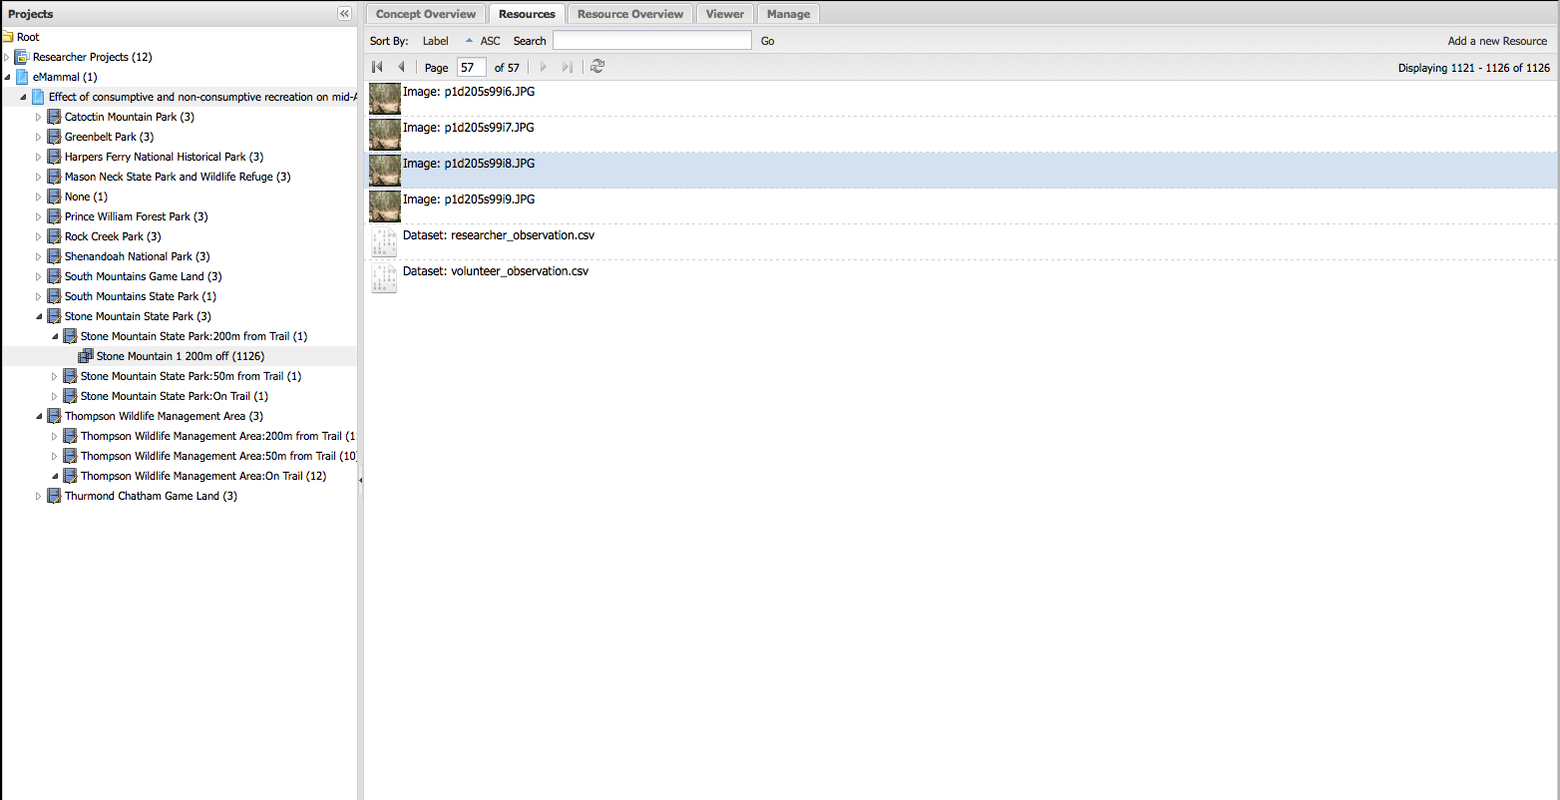

Slide 19
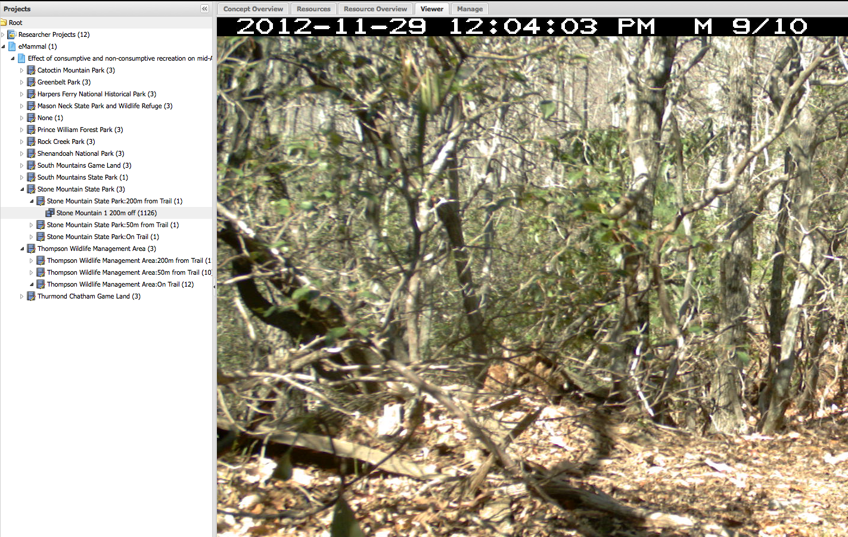

Slide 20
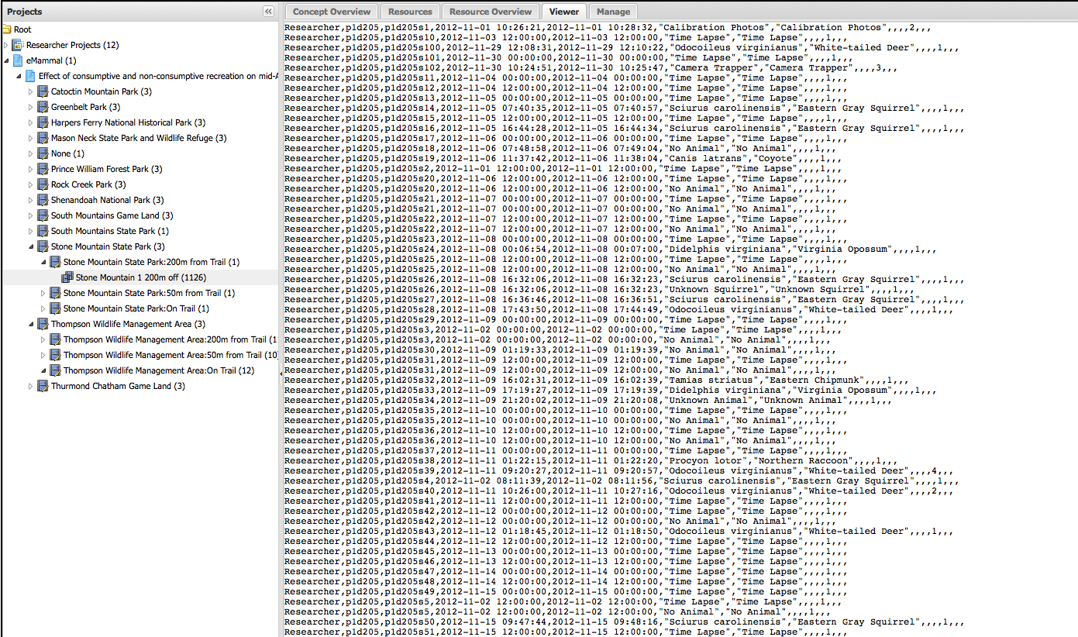

Slide 21
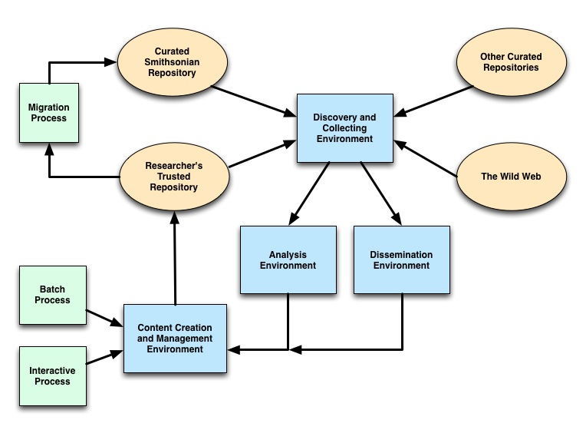

Slide 22
Analysis Environment
Discovery and Collecting Environment
Galaxy
Galaxy Set
Dataset
Concept
Local Filesystem
Taverna Set
Taverna

Slide 23
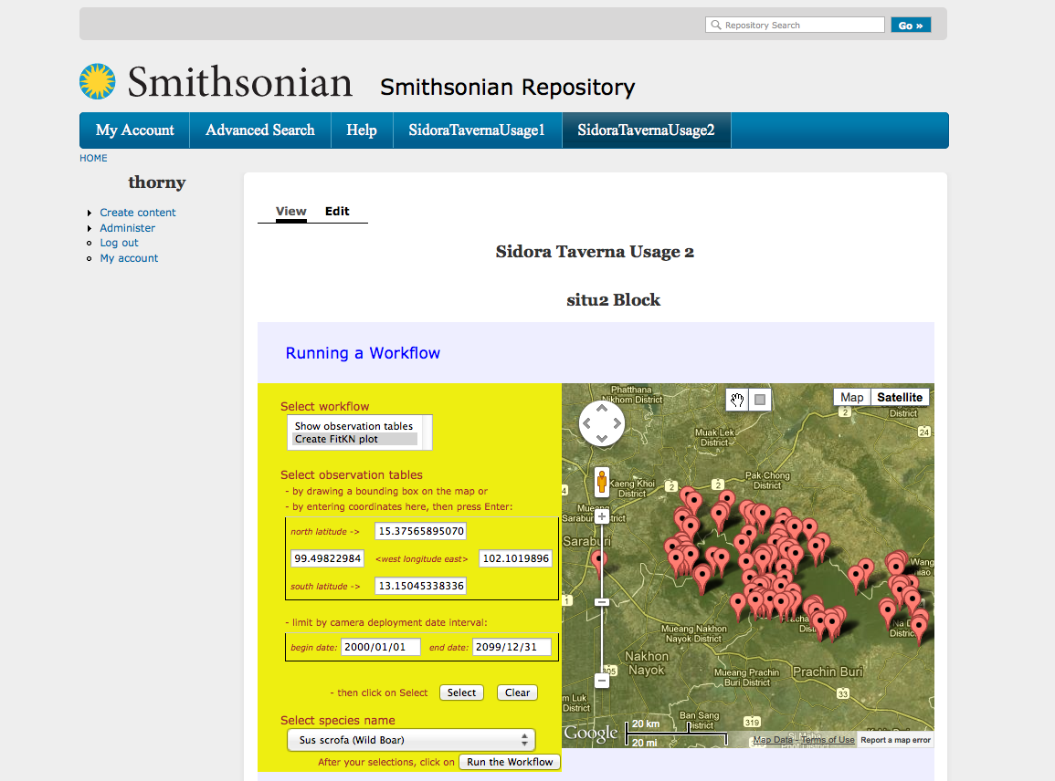

Slide 24
