Slide 1
BioCompute Objects as a Framework for Uniting Advances in Workflow Portability and Reproducibility
Dennis A. Dean, II, PhD,
Nan Xiao, Soner Koc, MS
Containers and Workflows Interest Groups
August 9, 2019

Slide 2
Agenda
Introduction and Overview
Merging BCO and Public Program Perspectives
Core BioCompute Object Implementation
Libraries and Interfaces
Recent Advances and Real World Use Cases
Public Programs
Current Tool Development
Outcomes, Goals, and Milestones

Slide 3
Introduction and Overview

Slide 4
BioCompute Objects

Slide 5
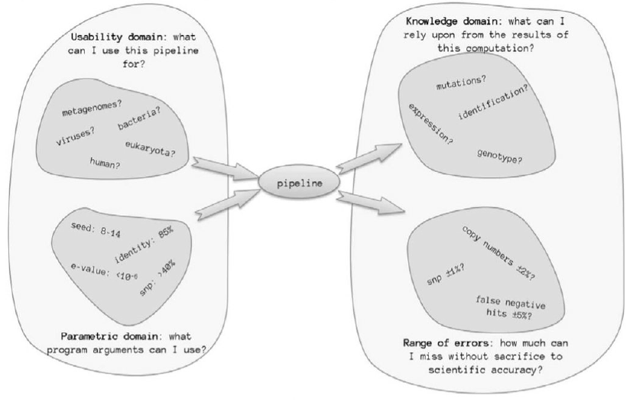
Bringing Experimental Rigor to Bioinformatics
Simonyan et al 2017

Slide 6
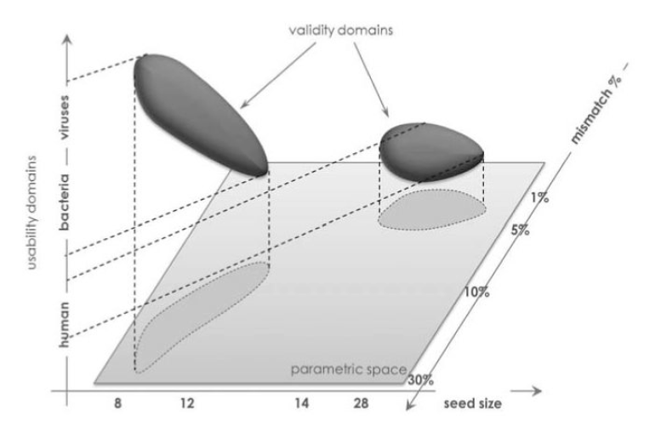
Specify Appropriate Parameter Set
Simonyan et al 2017

Slide 7
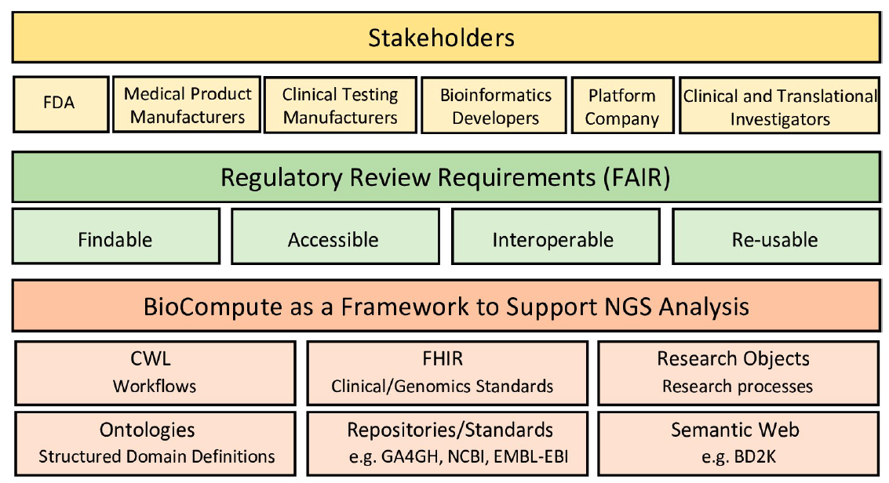
BioCompute Object Standard Aims to be Inclusive, Extendable with a Low Barrier to Entry
Alterovitz et al 2019

Slide 8
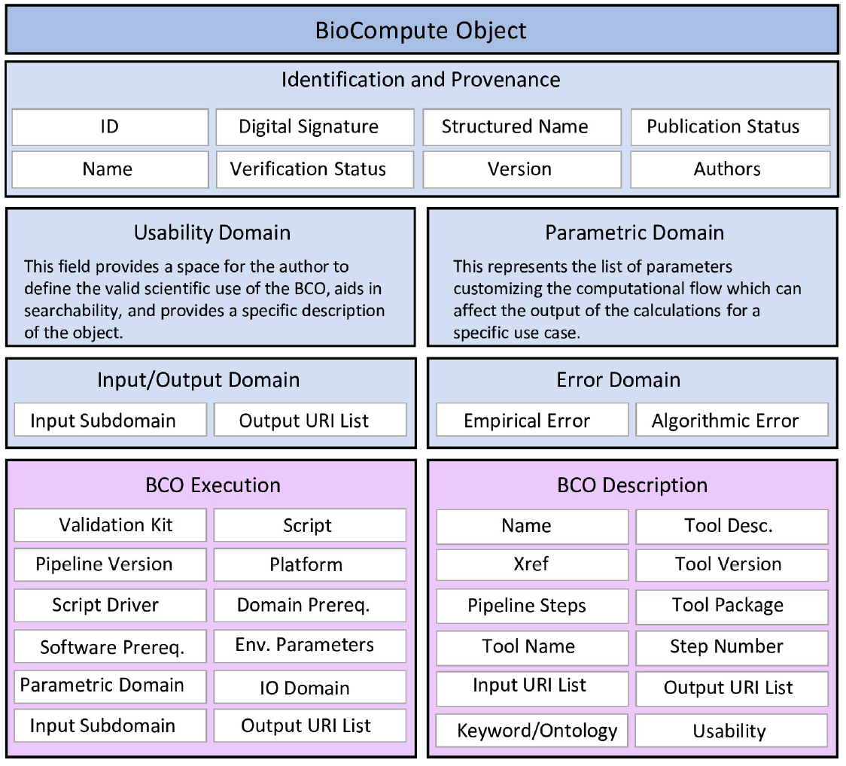
BioCompute Object Standard Aims to be Inclusive, Extendable with a Low Barrier to Entry
Alterovitz et al 2019

Slide 9
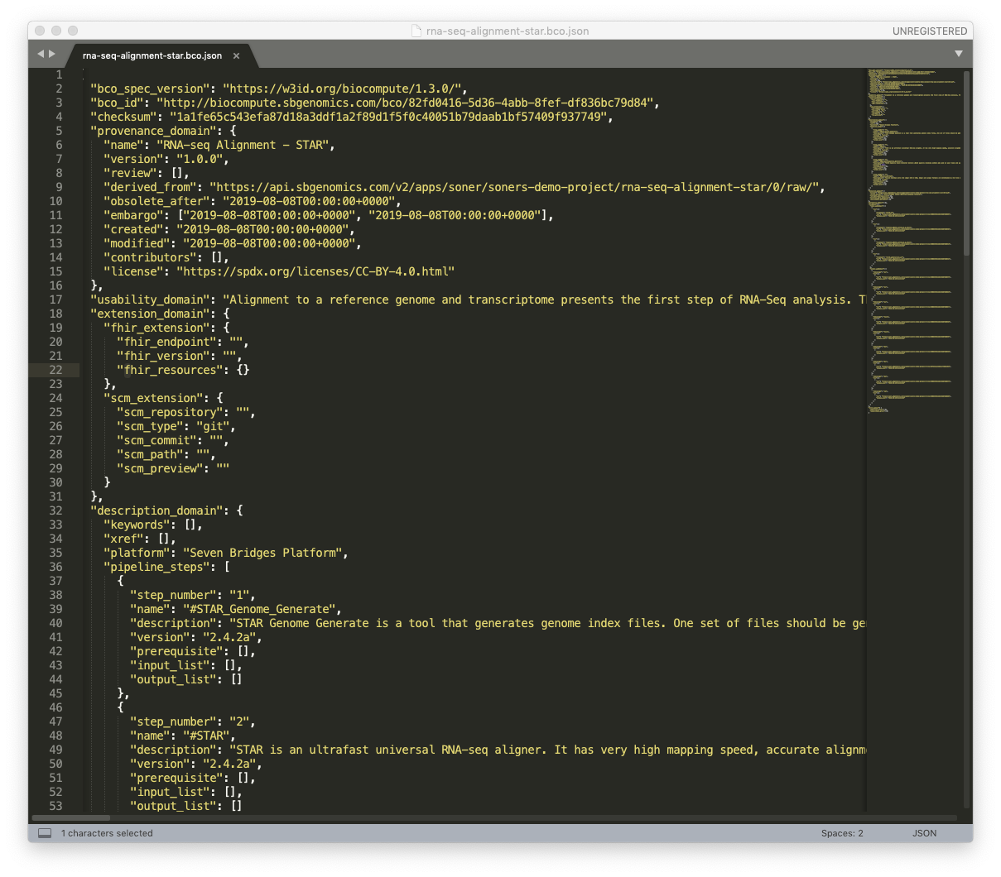
BioCompute Object Success Rests on Integrated Solutions
BioCompute Object JSON in Sublime Text Window

Slide 10
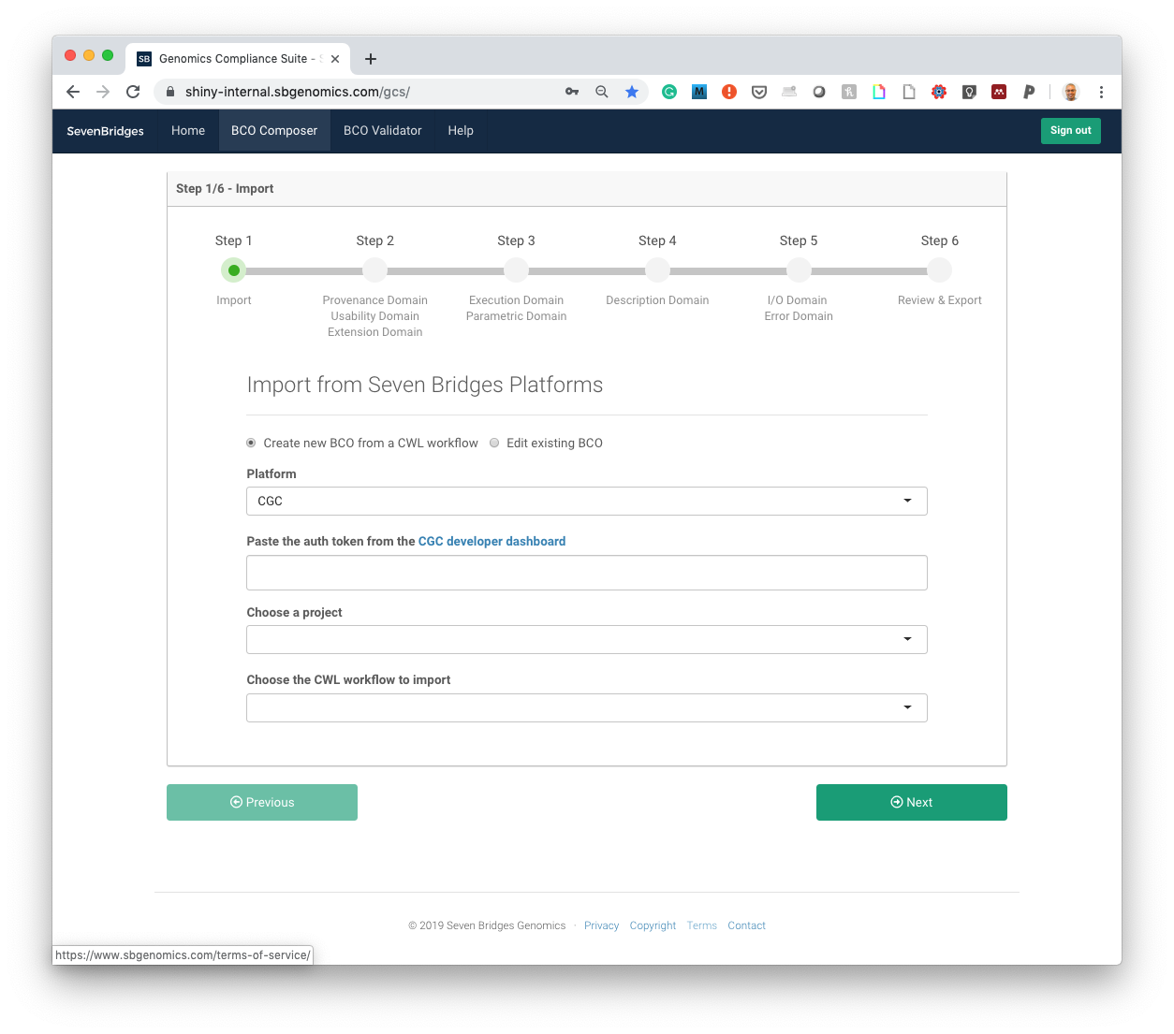
BioCompute Object Success Rests on Integrated Solutions
BioCompute Object JSON in Sublime Text Window
BioCompute Object Generator for Seven Bridges Platforms

Slide 11
Cancer Genomics Cloud

Slide 12
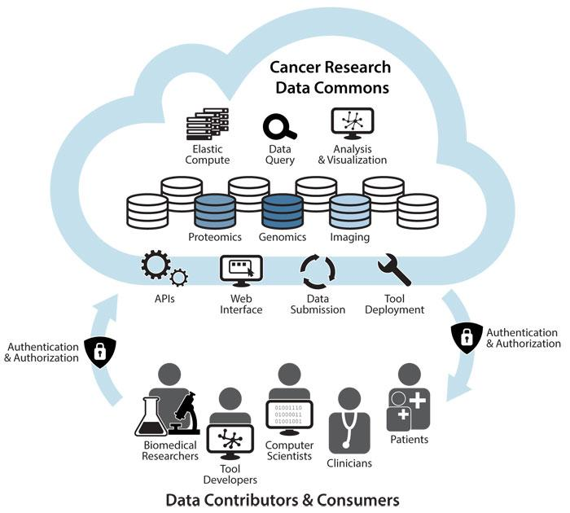
The Seven Bridges Cancer Genomics Cloud (CGC)
A Cloud Resource within the NCI Cancer Research Data Commons for secure storage, sharing & analysis of petabytes of public, multi-omic cancer datasets
The Seven Bridges Cancer Genomics Cloud has been funded in whole or in part with Federal funds from the National Cancer Institute, National Institutes of Health, Contract No. HHSN261201400008C and Task Order No. 17X146 under Contract No. HHSN261201500003I.
Notes:
Funded by the NCI, growing with the community for the last five years
SEG: how has that cloud grown?

Slide 13
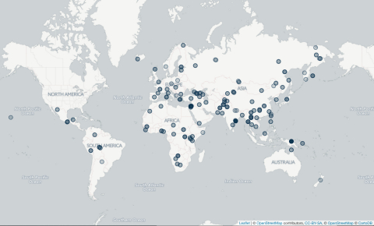
Growth of the Cancer Genomics Cloud
TCGA Pilot Program announced
Awarded NCI Cancer Genomics Cloud (CGC) Pilot contract
Partnered with JAX to build NCI’s PDXNet Data Commons
Integrated data with the Genomics Data Commons
...
2006
2014
2015
2016
2017
2018
2019
Launched the CGC
Integration with other Cloud Resources
Registered 1000th CGC user
Logged 3000th user & 450th year of compute time on the CGC
Logged 4000th user & 850th year of compute time on the CGC
Notes:
As community grew, brought in more datasets
TCGA was a motivating use case for the cloud resources, because TCGA became inaccessible to most researchers
Emphasize 3 years of continuing to grow and improve based on needs of community- adding in datasets and features
Now that we’re integrated with GDC, data updated monthly- best and most up to date data
SEG: Main values

Slide 14
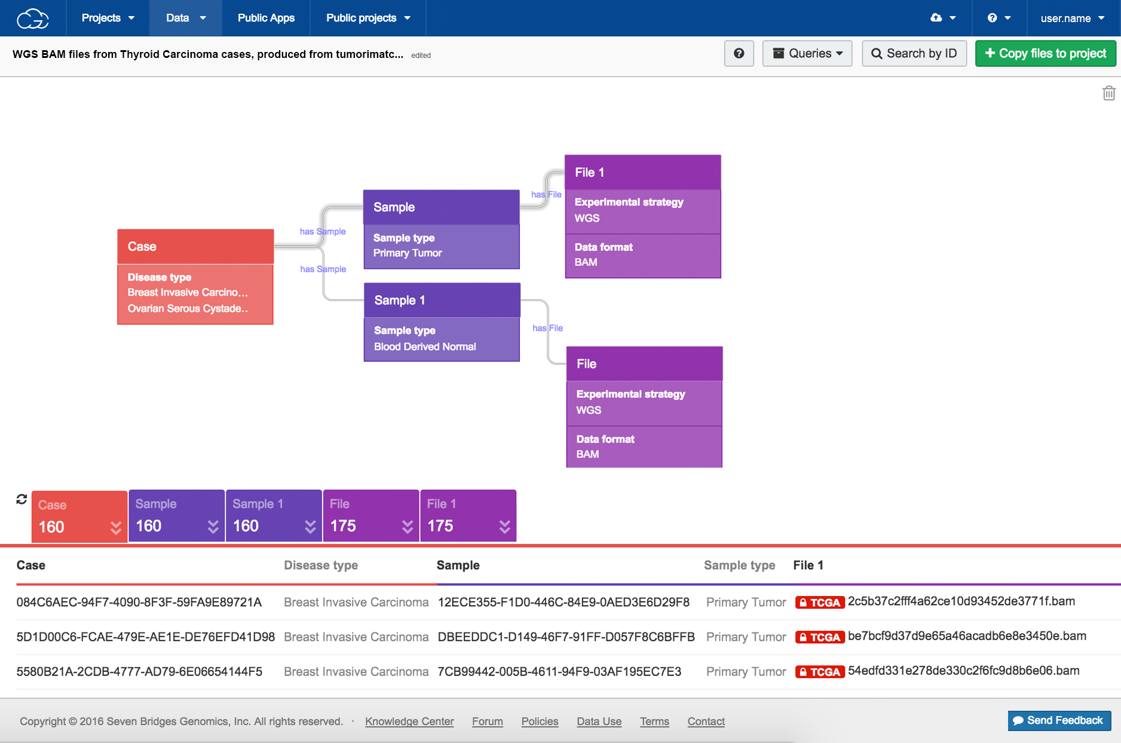
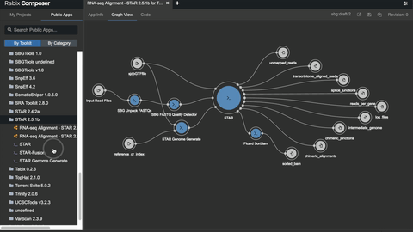
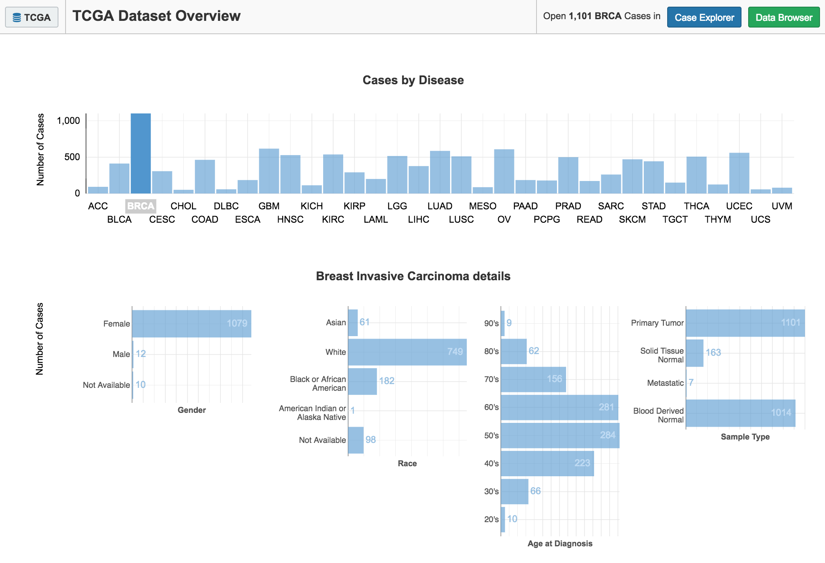
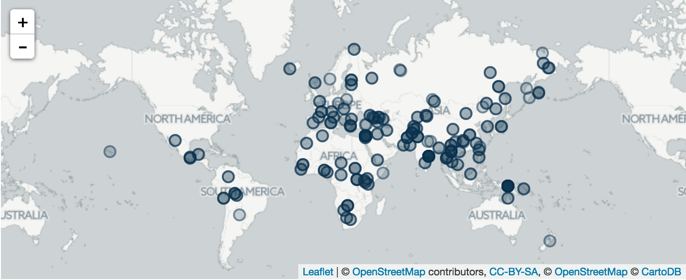
CGC users have immediate access to tools, compute, and data
Access 3⁺ PB of multi-omic public data through interactive query tools & APIs.
Upload private data for analysis.
Collaborate securely with colleagues anywhere.
Use the 400⁺ cloud- and cost-optimized tools in our Public Apps library.
Deploy custom tools using our SDK (Rabix) & Jupyter notebook (Data Cruncher).
Consult with our 200⁺ expert support staff.

Slide 15
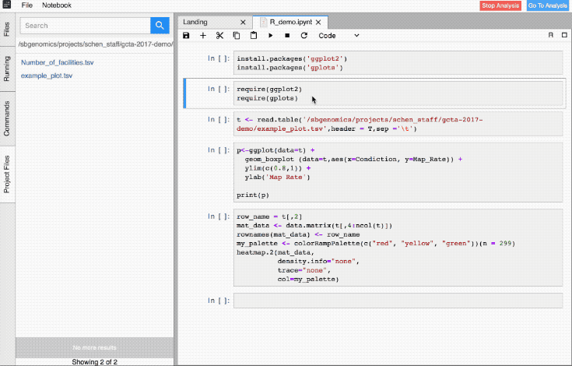
Powerful, collaborative, & reproducible interactive analysis
Users create interactive analysis sessions within a project - all files are available and over 50 instances can be used (c3.2xlarge to x1.32xlarge on AWS)
Files
Project
Instance

Slide 16
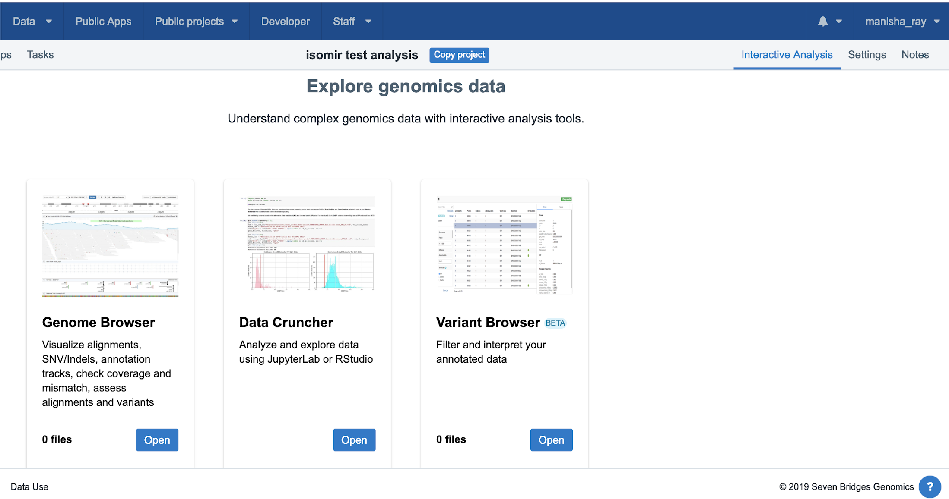
Quantify and visualize isomiR differences in RStudio
Notes:
Emphasize this is all still in the cloud

Slide 17
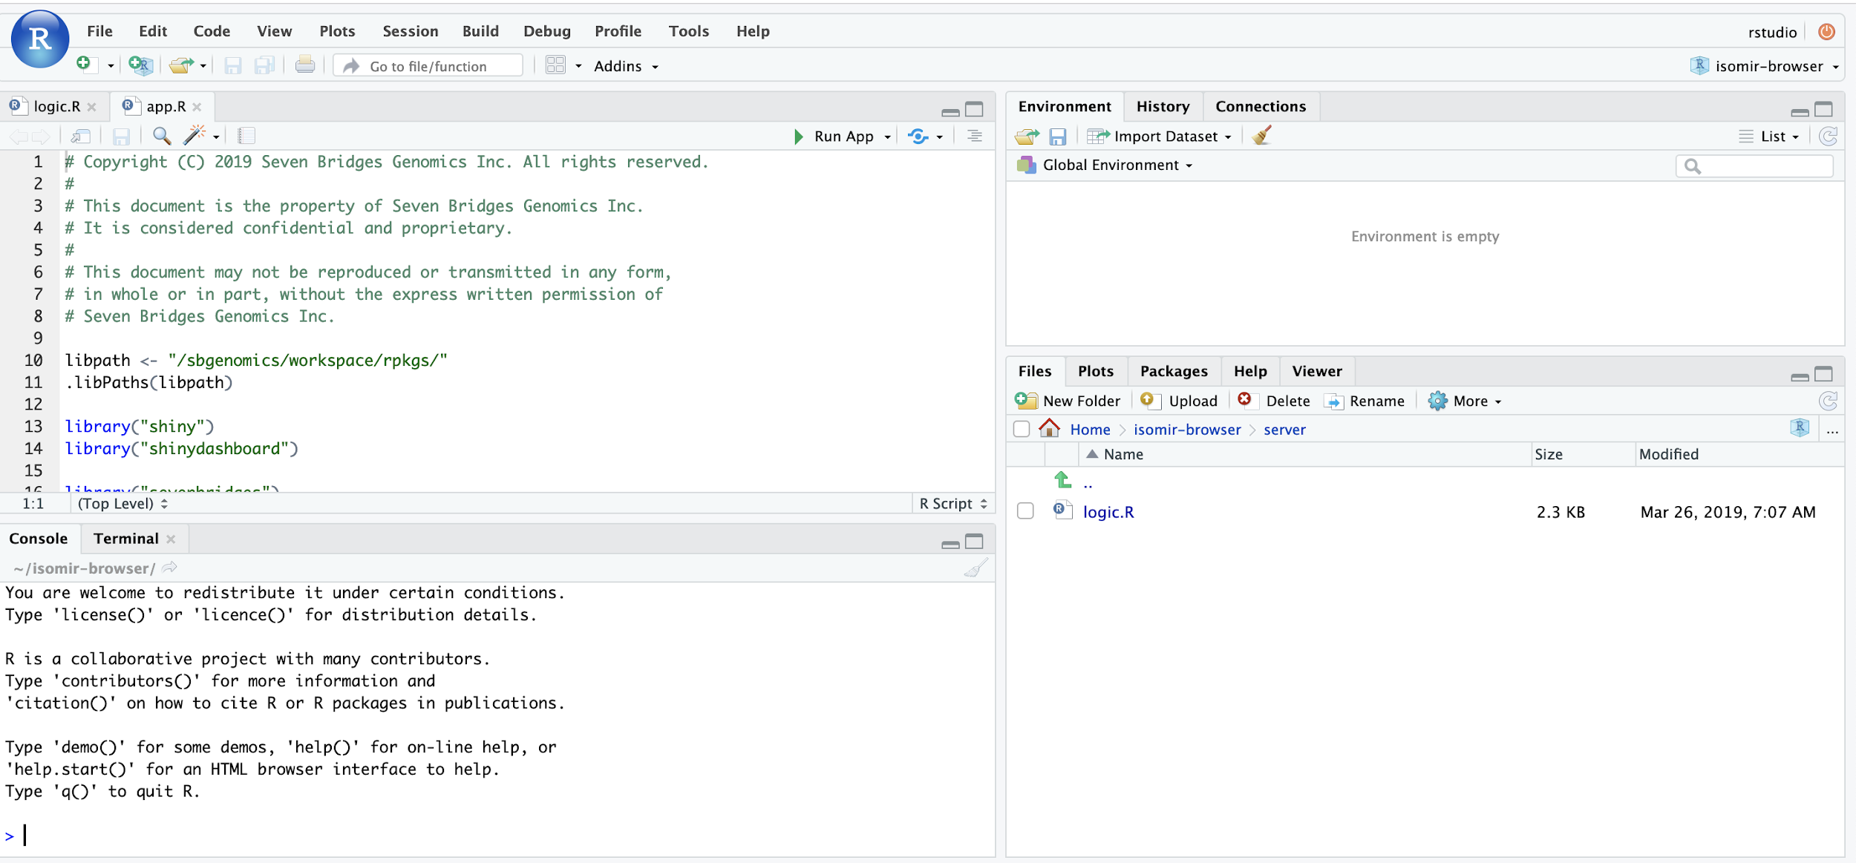
Quantify and visualize isomiR differences in RStudio
Notes:
Emphasize this is all still in the cloud

Slide 18
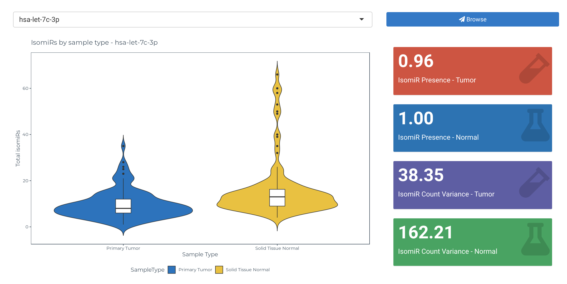
Quantify and visualize isomiR differences in RStudio
Notes:
Emphasize this is all still in the cloud

Slide 19
Merging Perspective

Slide 20
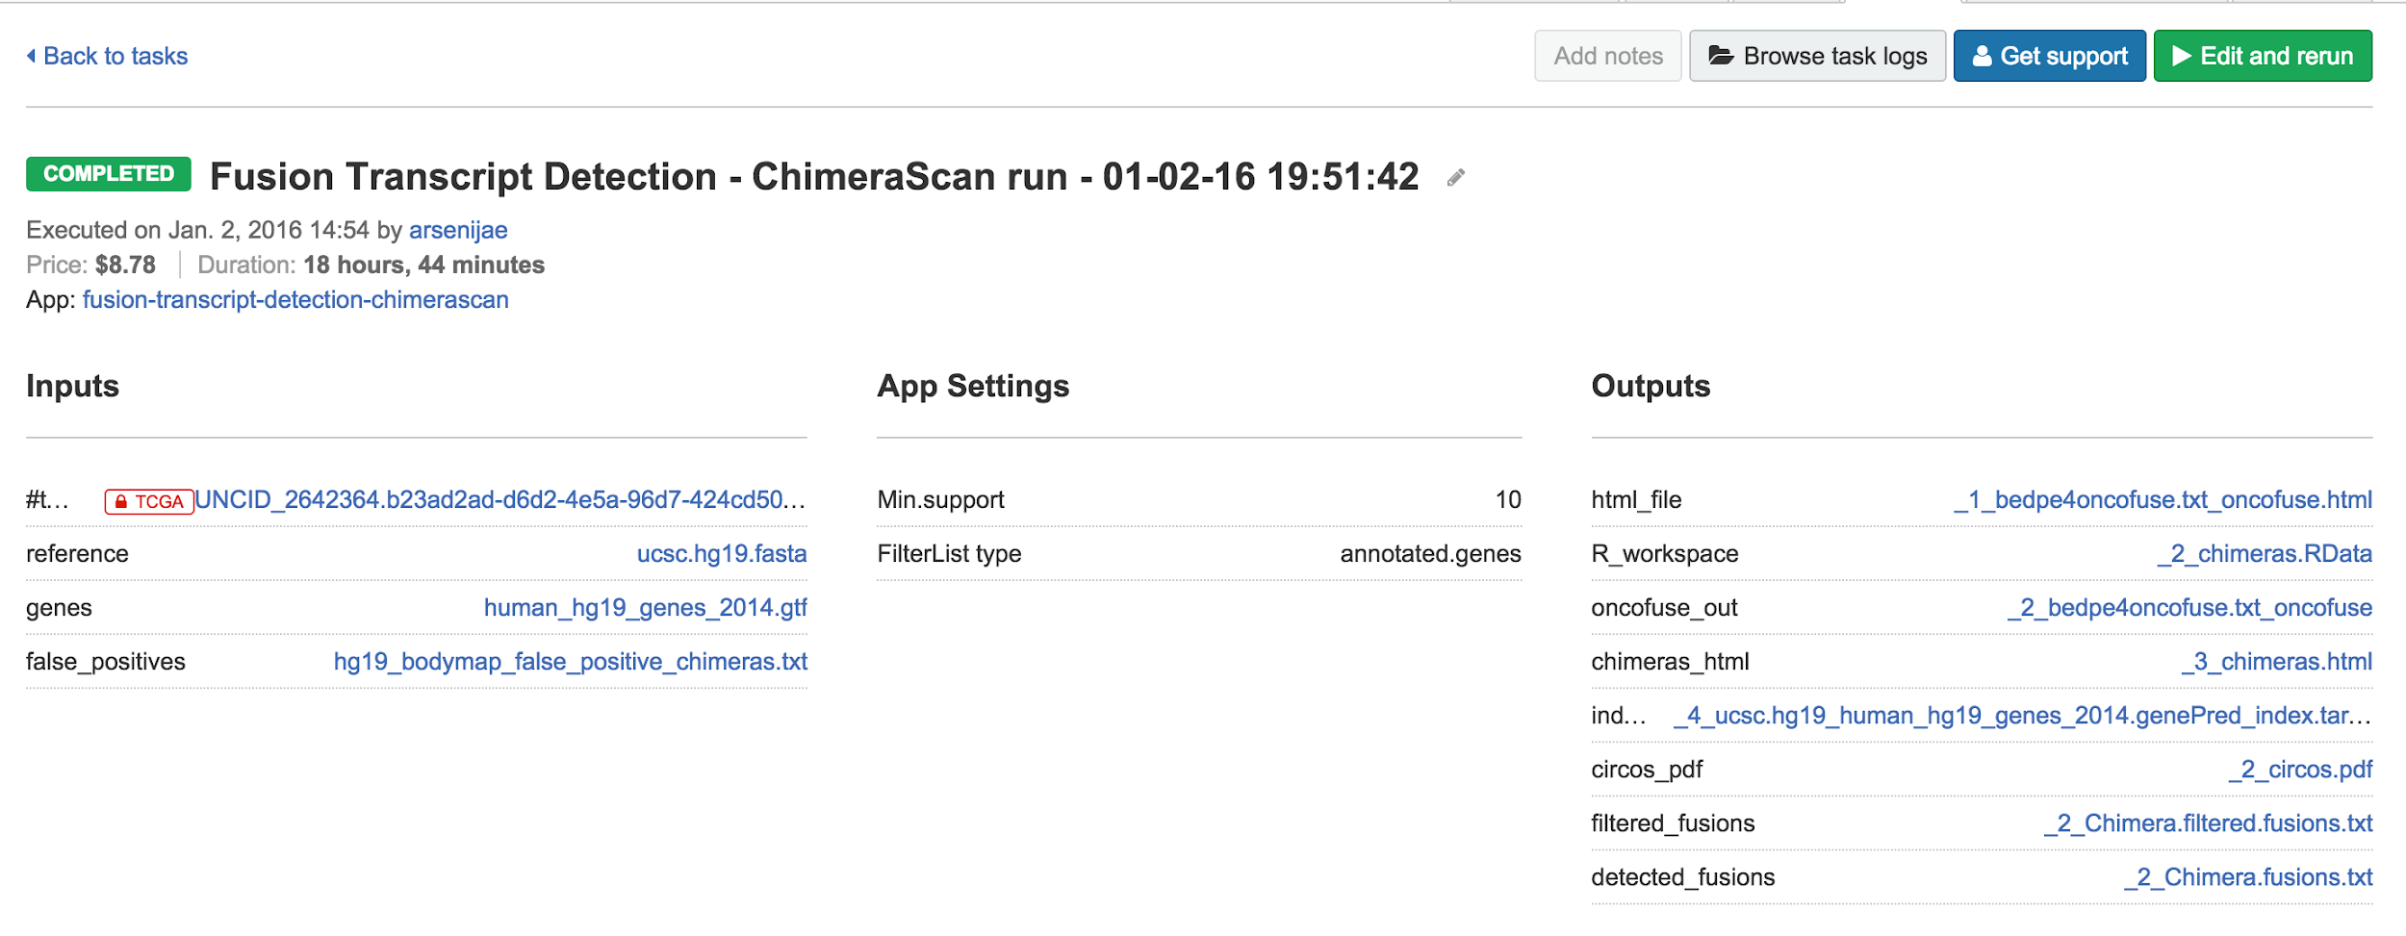
Owning our CWL Centric View of the World
Use of Docker-containerized bioinformatics pipelines to provide a consistent computational environment
Automatically generated and accessible logs for every task
App versions & parameters
Input & output files
All the specifications necessary to ensure your tools work reproducibly across platforms

Slide 21
BioCompute Object as as Communicator and a Integrator
Primary Platform Viewpoint and Focus
Communicate Workflow Efficiently
BioCompute Object Operational Usability
Efficient Generation of Complex Workflows
Emerging Public Programs Viewpoint and Focus
Integrate NCI and NHLBI Funded Efforts
Journal Submission Analysis Archiving
Reproducible and Portable Computation
Platform Specific Best Practice

Slide 22
BioCompute Object Implementations

Slide 24
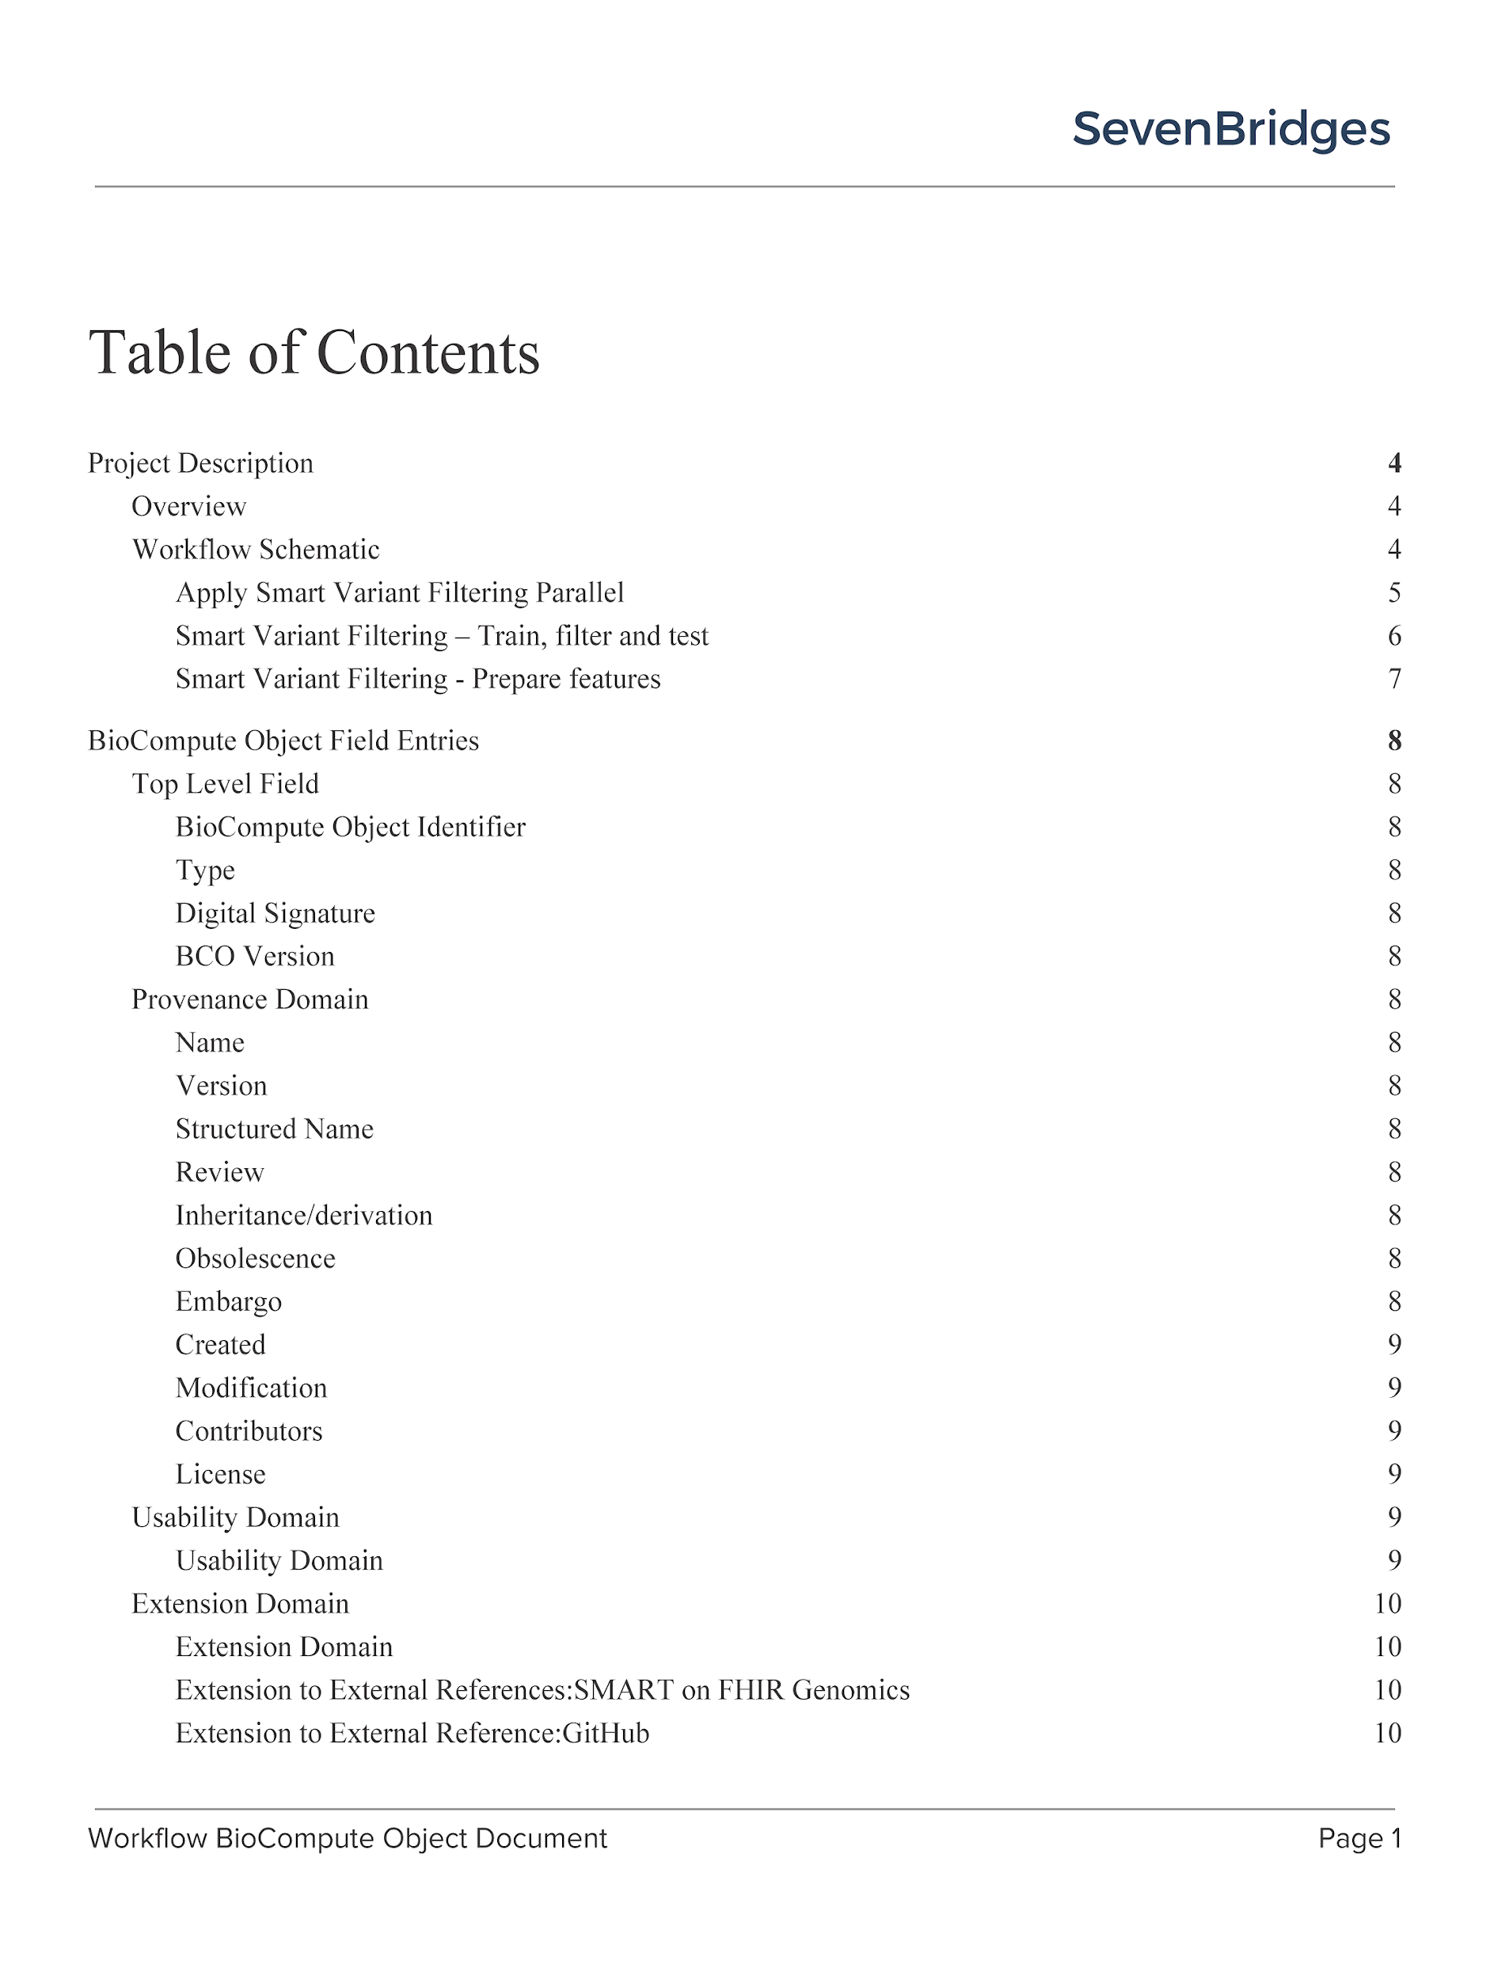
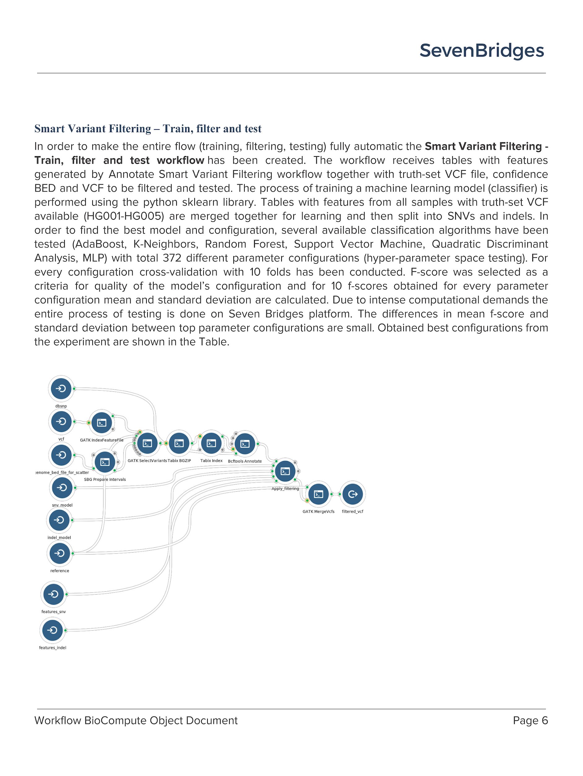
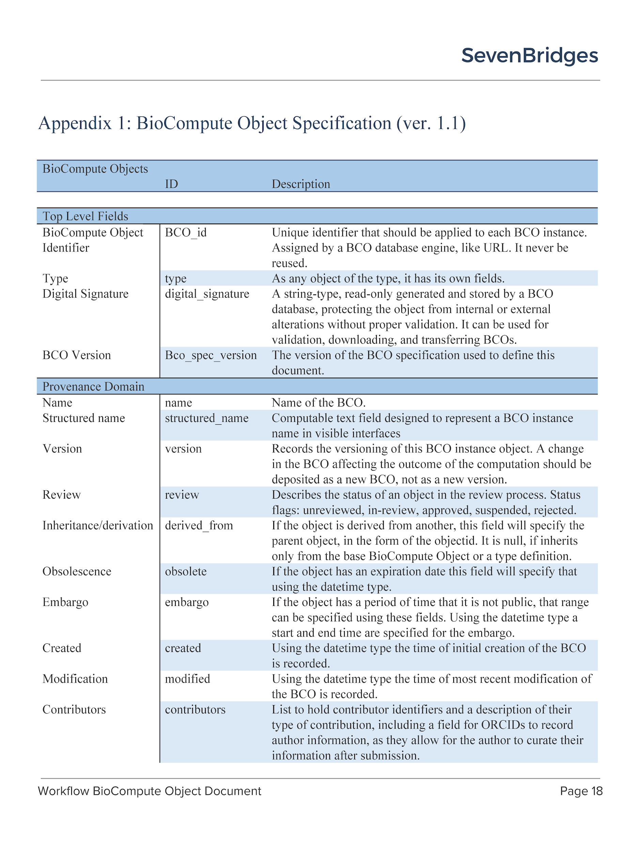
Implementation: BioCompute Templates Microsoft Word – Google Doc - Confluence
Table of Contents
Workflow Description
Include Spec. Version
Working documents/templates to support BioCompute content review and collaborations

Slide 25
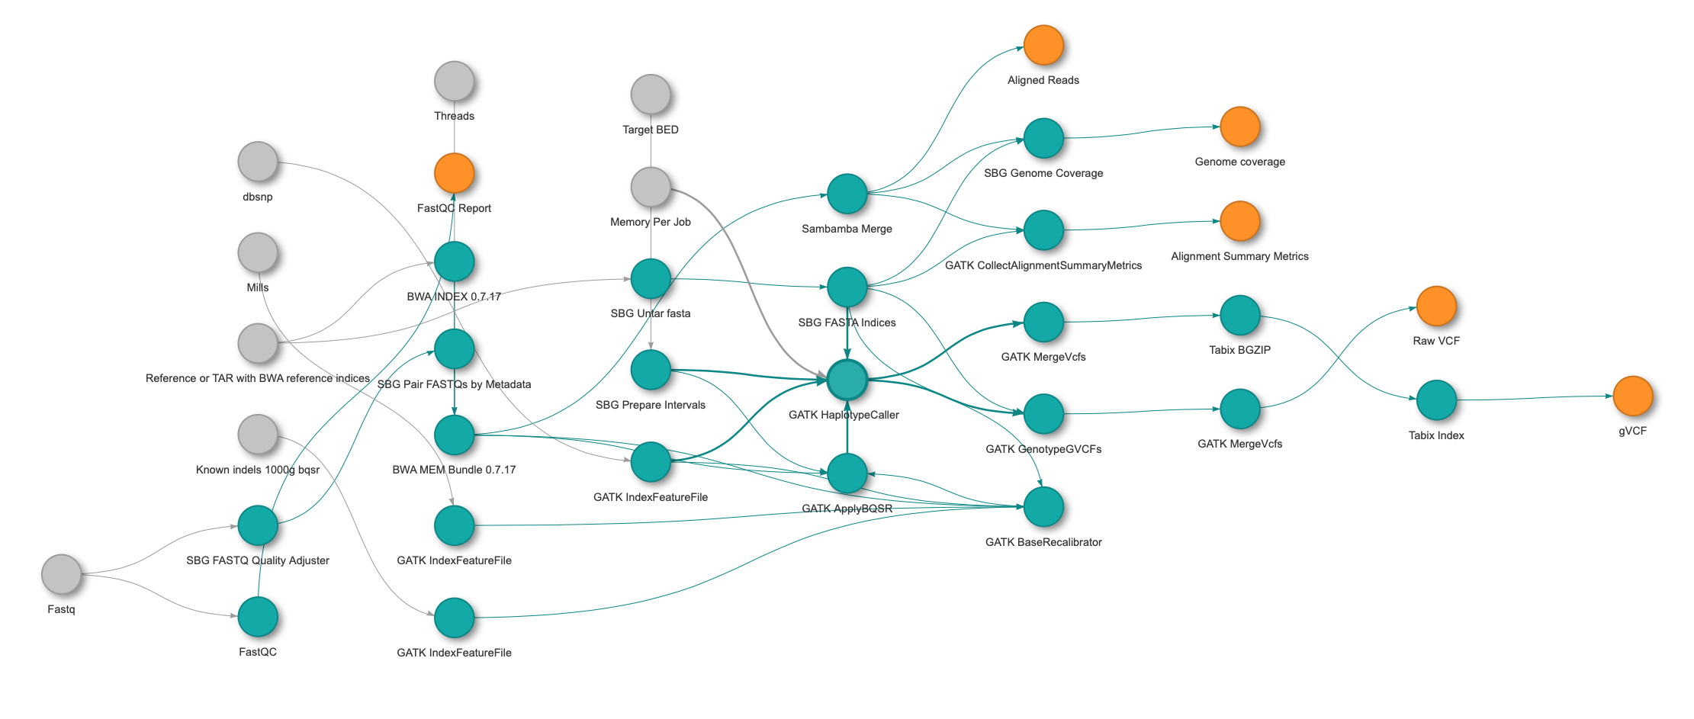
Implementation: R Toolkits for CWL Parsing and BCO Generation
Fig: TidyCWL Generated Whole Genome Workflow Wiring Direction
Goals
Prepopulate BioCompute Object Fields: Inputs, Outputs Parameters
Support Machine and Human Readable Output (JSON and PDF)

Slide 26
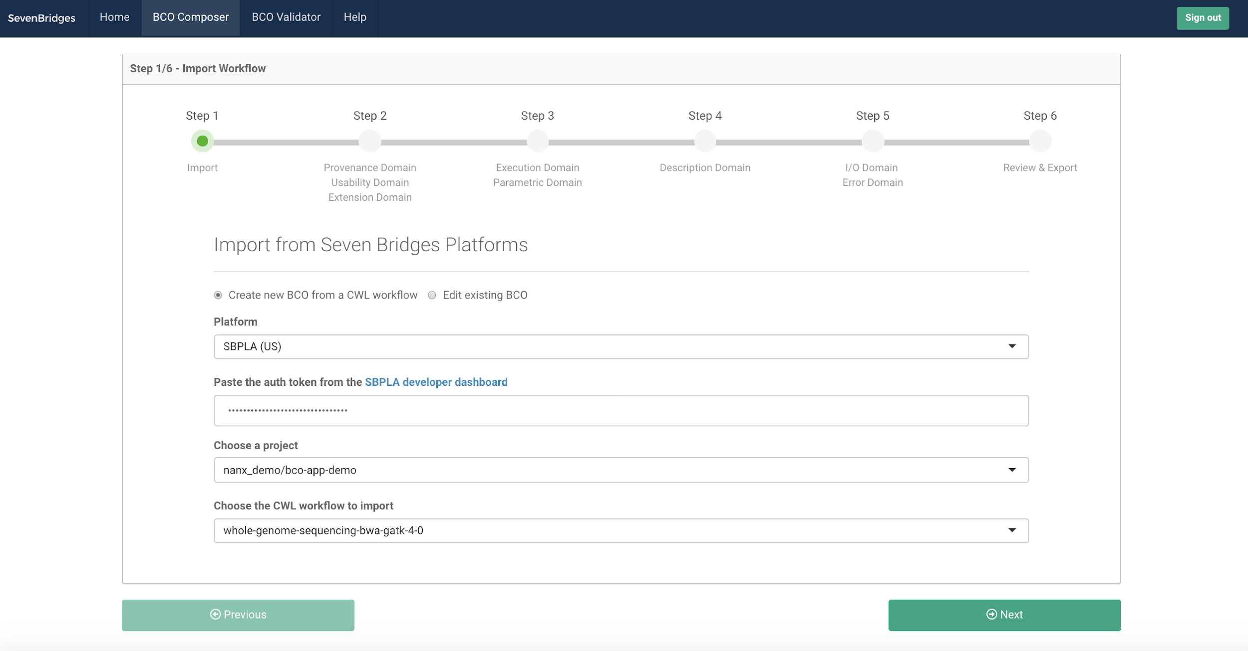

Slide 27
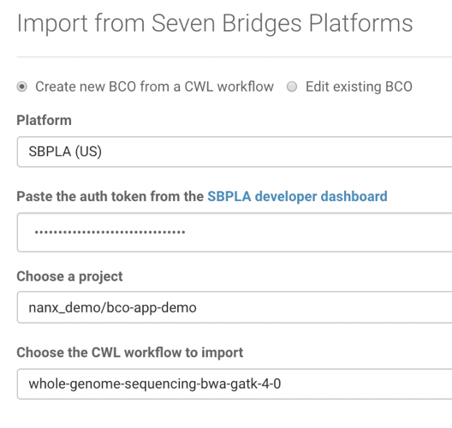

Slide 28
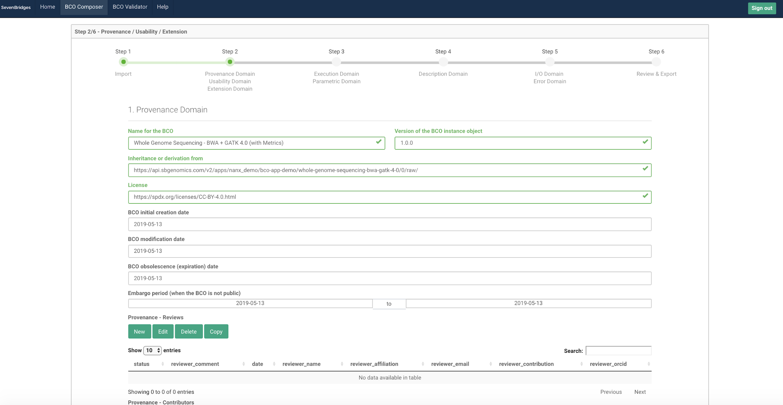

Slide 30
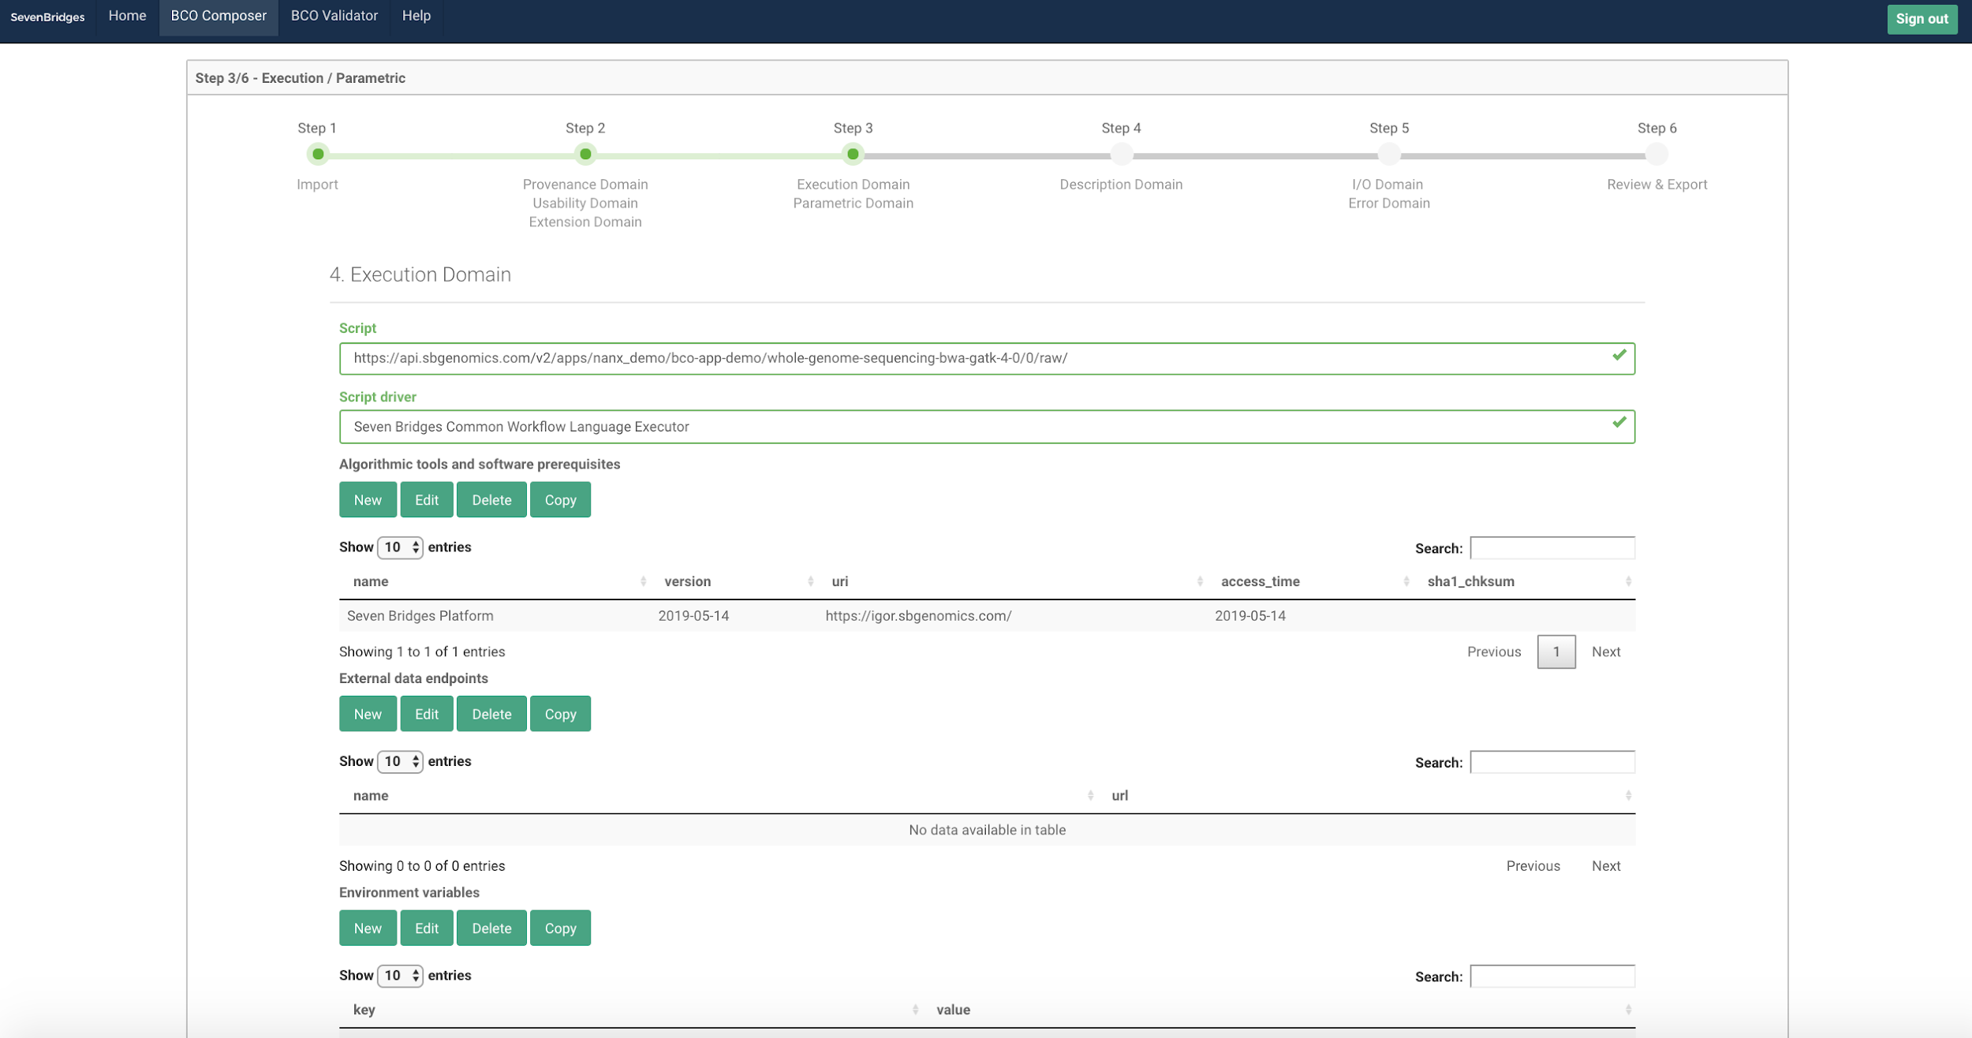

Slide 32
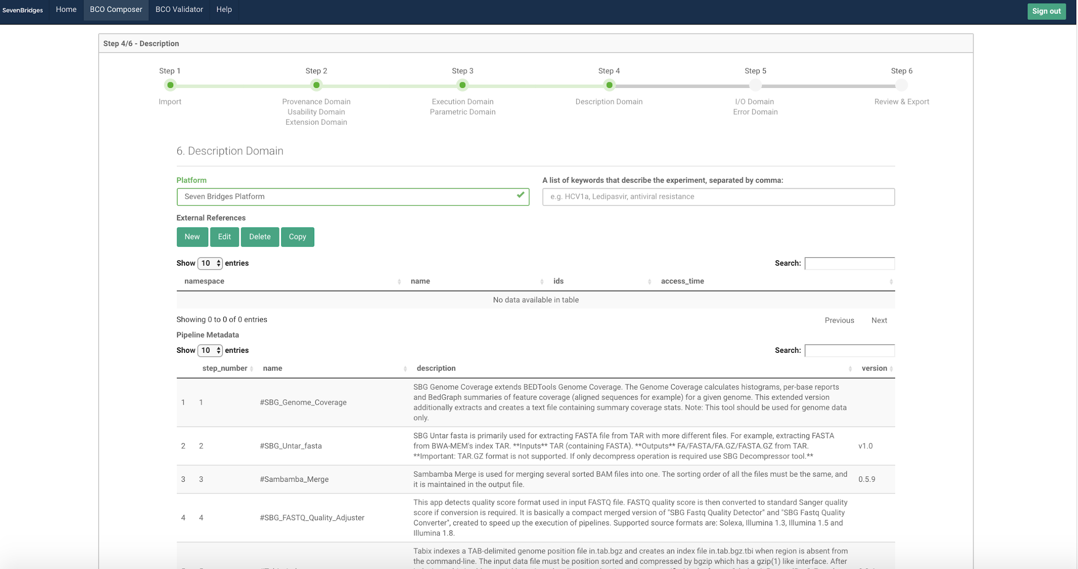

Slide 34
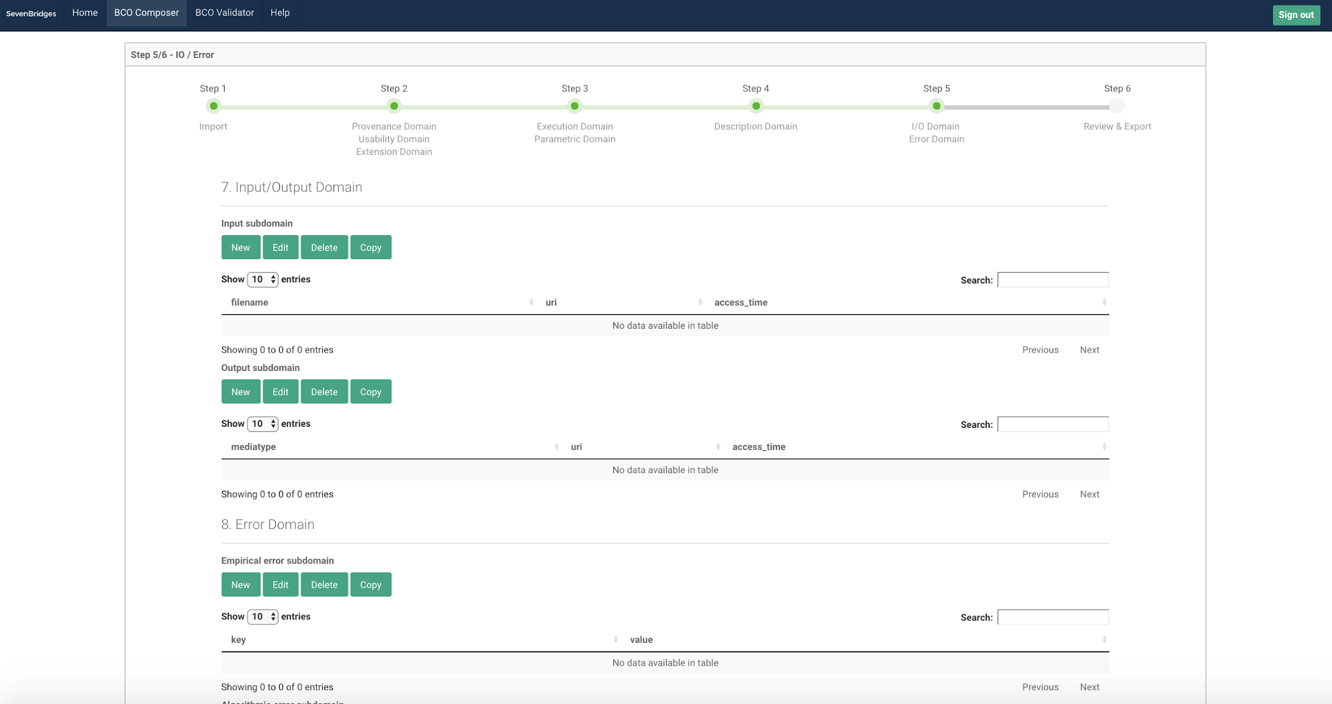

Slide 35
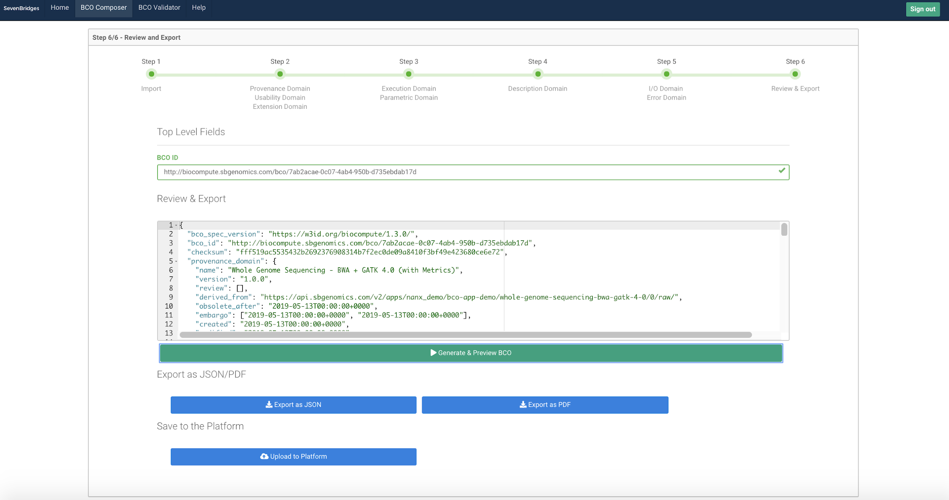

Slide 37
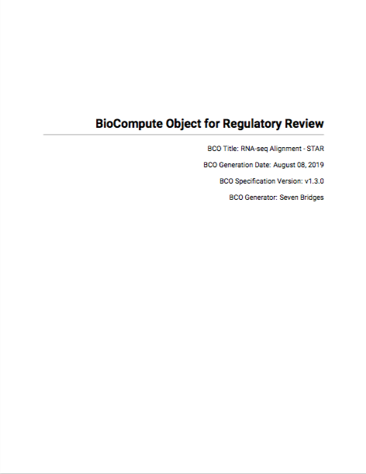
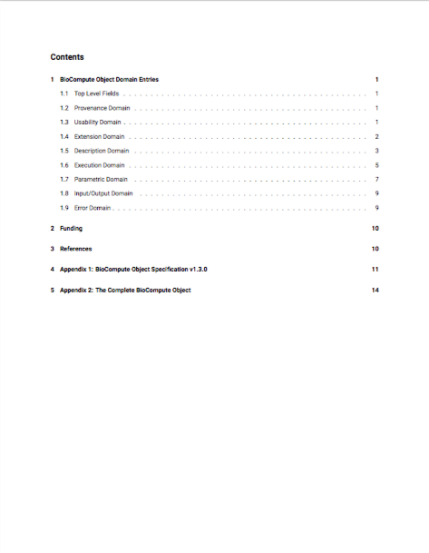
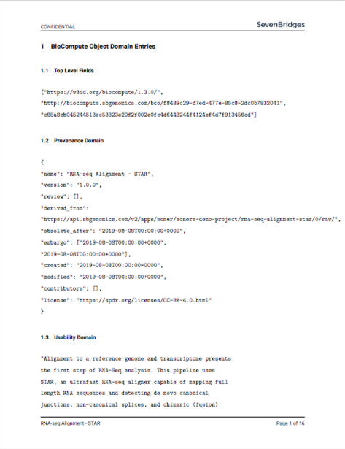
Generated PDF Output

Slide 39
Recent Advance and Use Cases

Slide 40
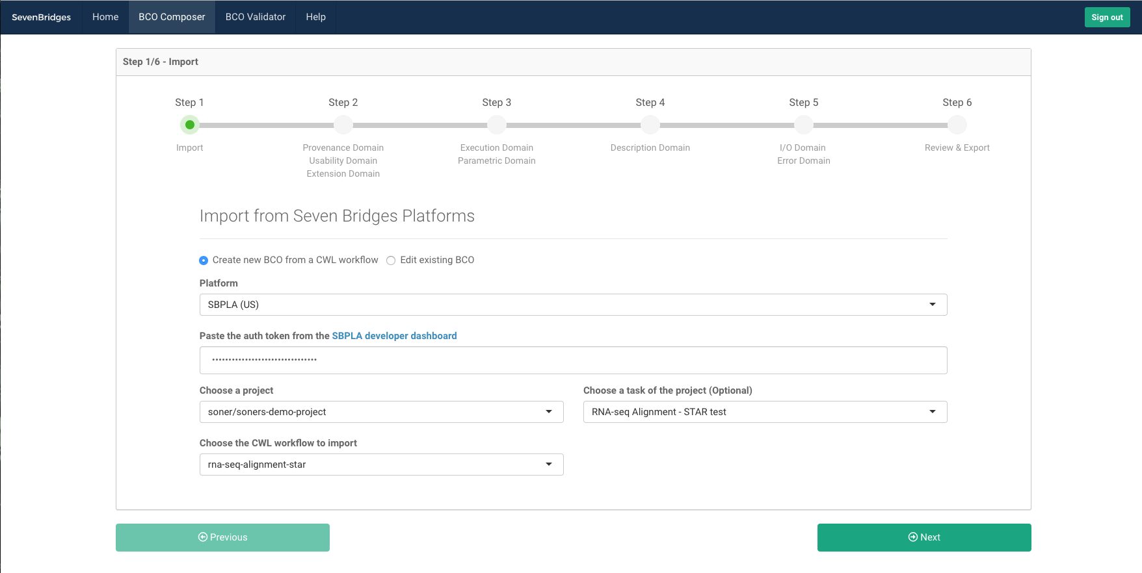
Generating a BioCompute Object for Task Information

Slide 41
Generating a BioCompute Object for Task Information

Slide 42
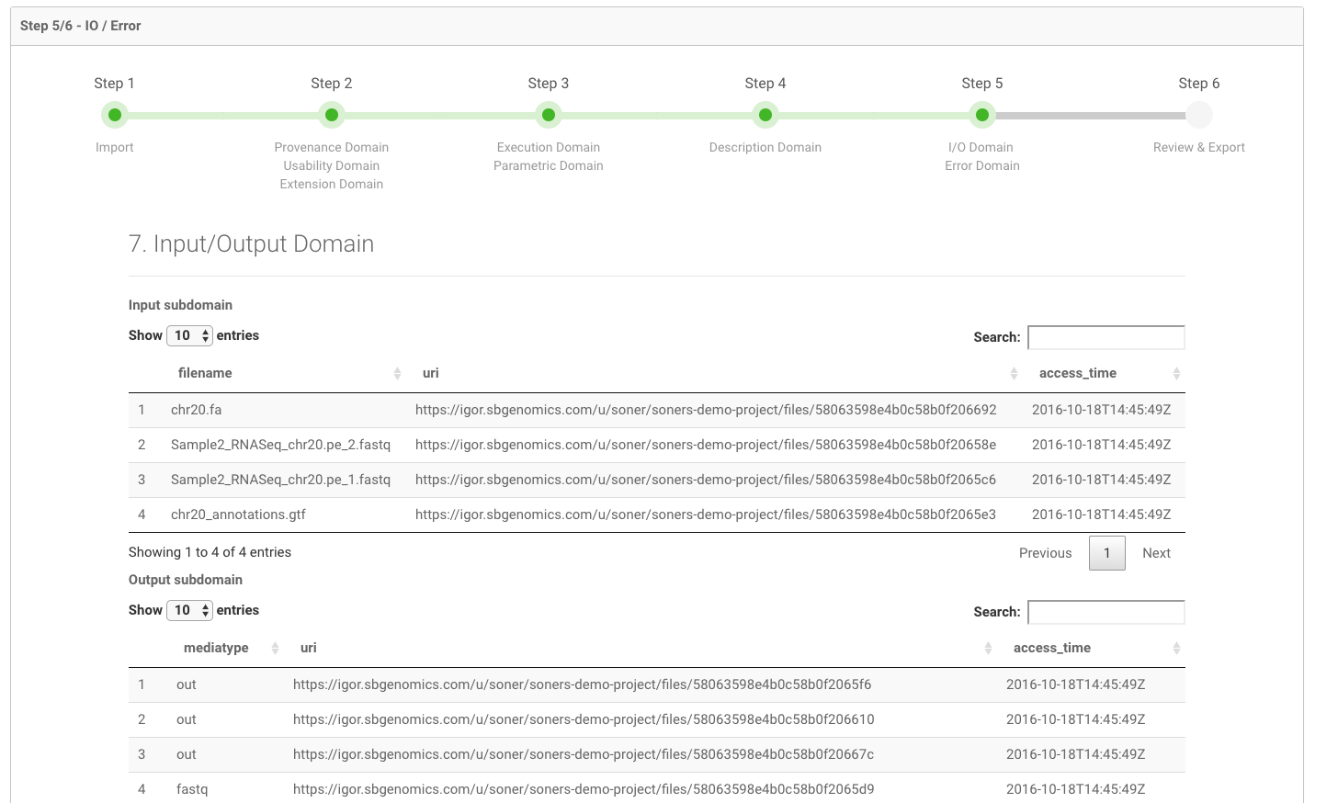
Archive a Task (Run) with a BioCompute Object

Slide 43
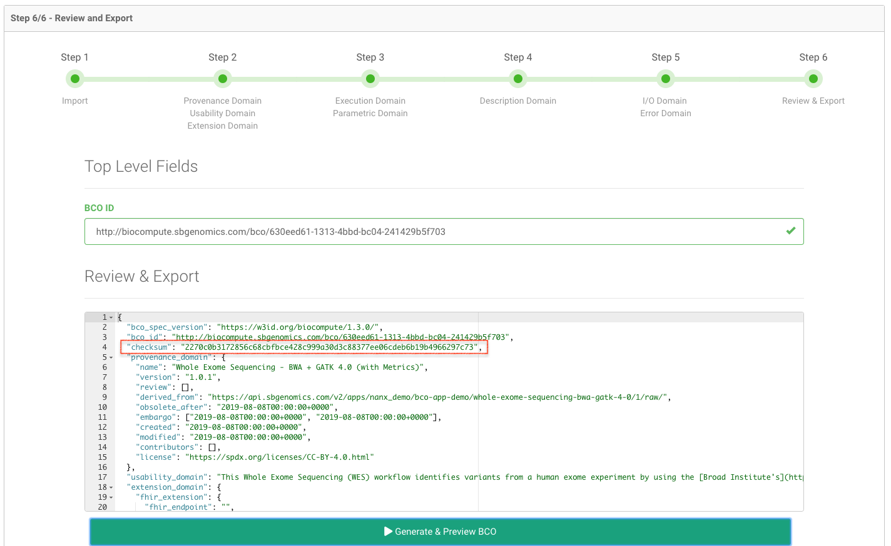
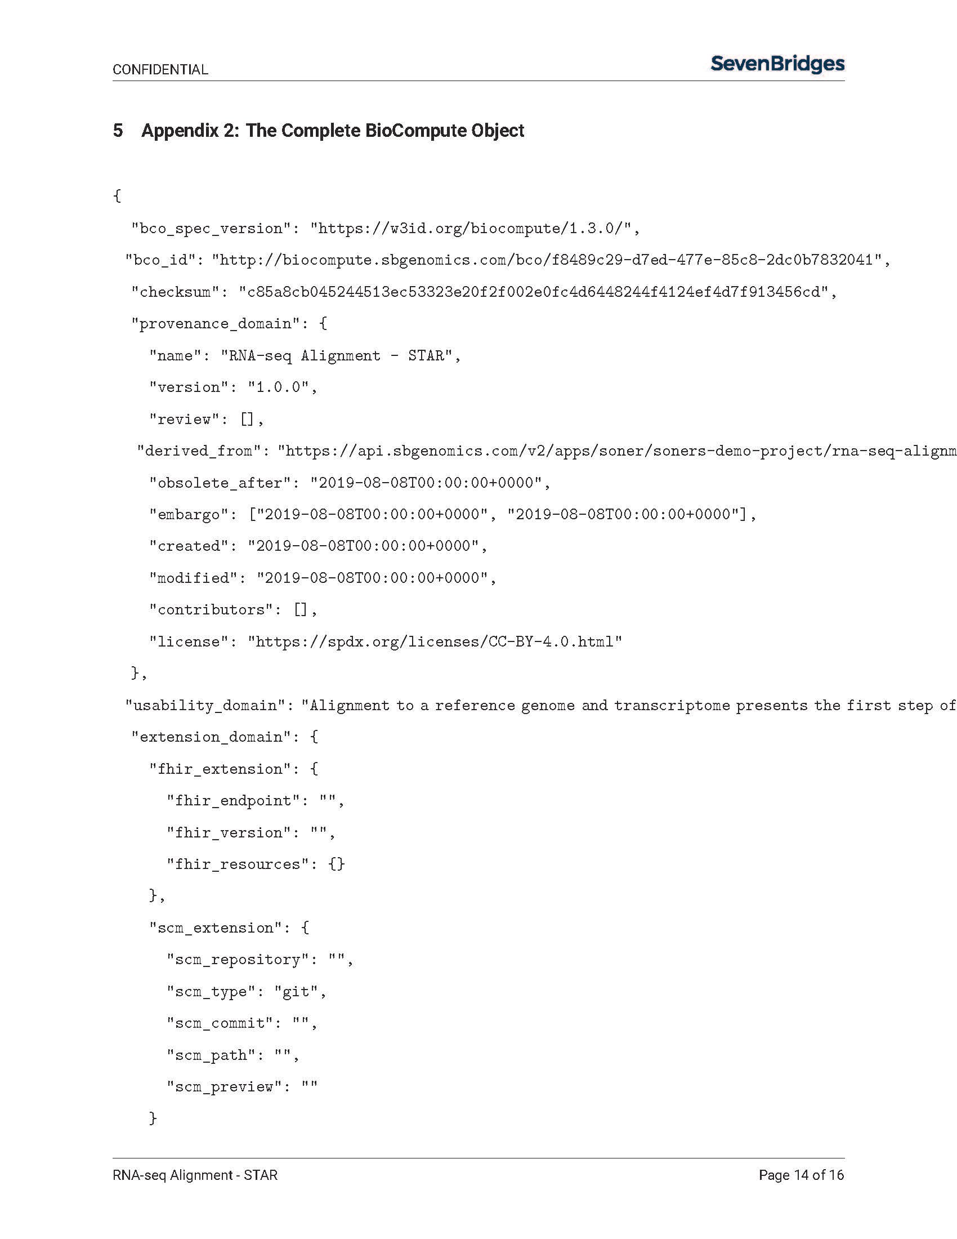
Check Sum Computed
BioCompute Object Generation Window
BioCompute Object – Generated PDF

Slide 44
Check Sum Computed
BioCompute Object Generation Window
BioCompute Object – Generated PDF

Slide 45
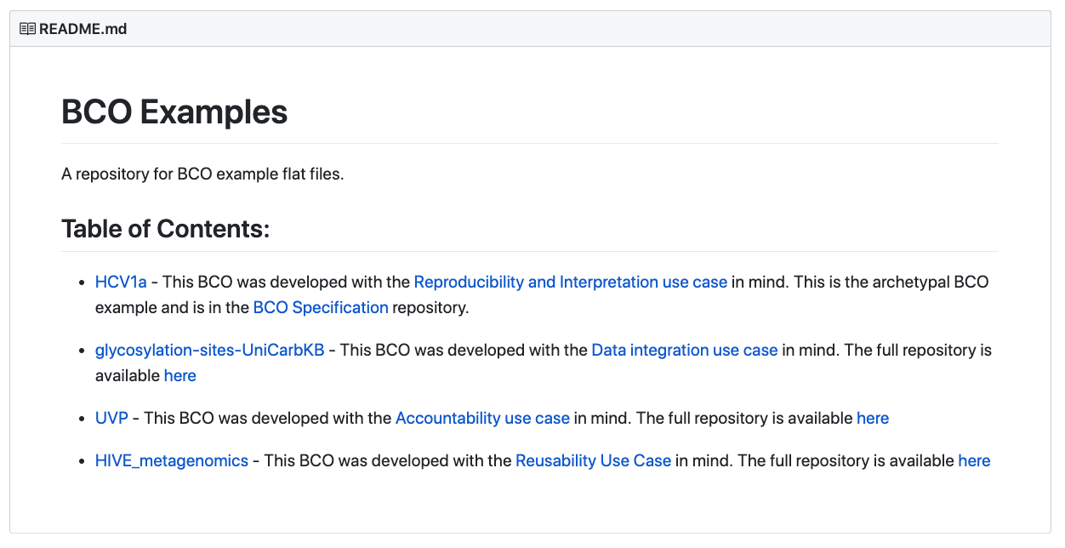
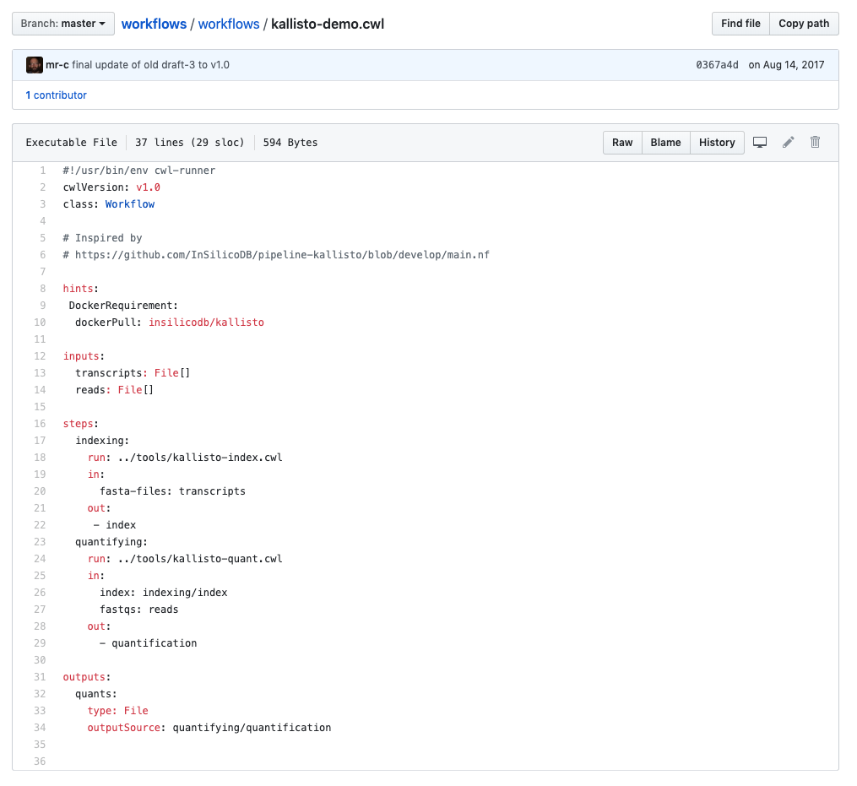
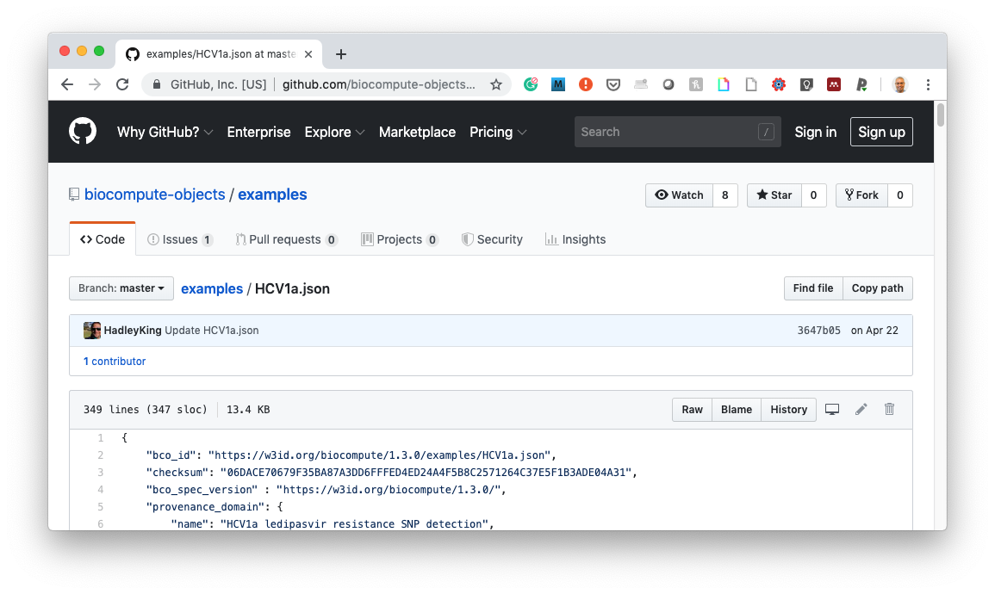
Publishing a BioCompute Object to a GIT Page Coming Soon!
BioCompute Object Examples Page on Git
Kallisto-demo CWL on Git
HCV1a BioCompute Object Examples on Git

Slide 46
Public Program Use Cases

Slide 47
BioCompute Object Motivation from our Public Programs
Current Use Cases
PDXNet
Standardize PDX workflow written in CWL executed with human data
Result comparison following exchange of workflow (execution on different hardware) did not agree
Tracked to different database version
Consortia Efforts
Archiving/Documenting Task Executions

Slide 48
BioCompute Object Motivation from our Public Programs
Current Use Cases
Emerging Use Cases
PDXNet
Standardize PDX workflow written in CWL executed with human data
Result comparison following exchange of workflow (execution on different hardware) did not agree
Tracked to different database version
Consortia Efforts
Archiving/Documenting Task Executions
Features Underdevelopment in Public Programs
Publishing
Research Objects
Digital Objects
Global Identifiers
Expanded Data Commons
Provenance
Git Friendly Workflow Development (CWL Editing)

Slide 49
Integrating BioCompute Objects into Current Development Efforts
Major Initiatives
Automation
Custom Front Ends
Scalability, Reproducibility, and Portability
Tools
BioCompute Object Prototype App
PDXNet Data Portal
CGC Reporting App
Rabix Benten
Libraries
TidyCWL
Seven Bridges CWL
BioCompute Object Library
R API Libraries
CWL Draft 2 to Ver. 1 converter

Slide 50
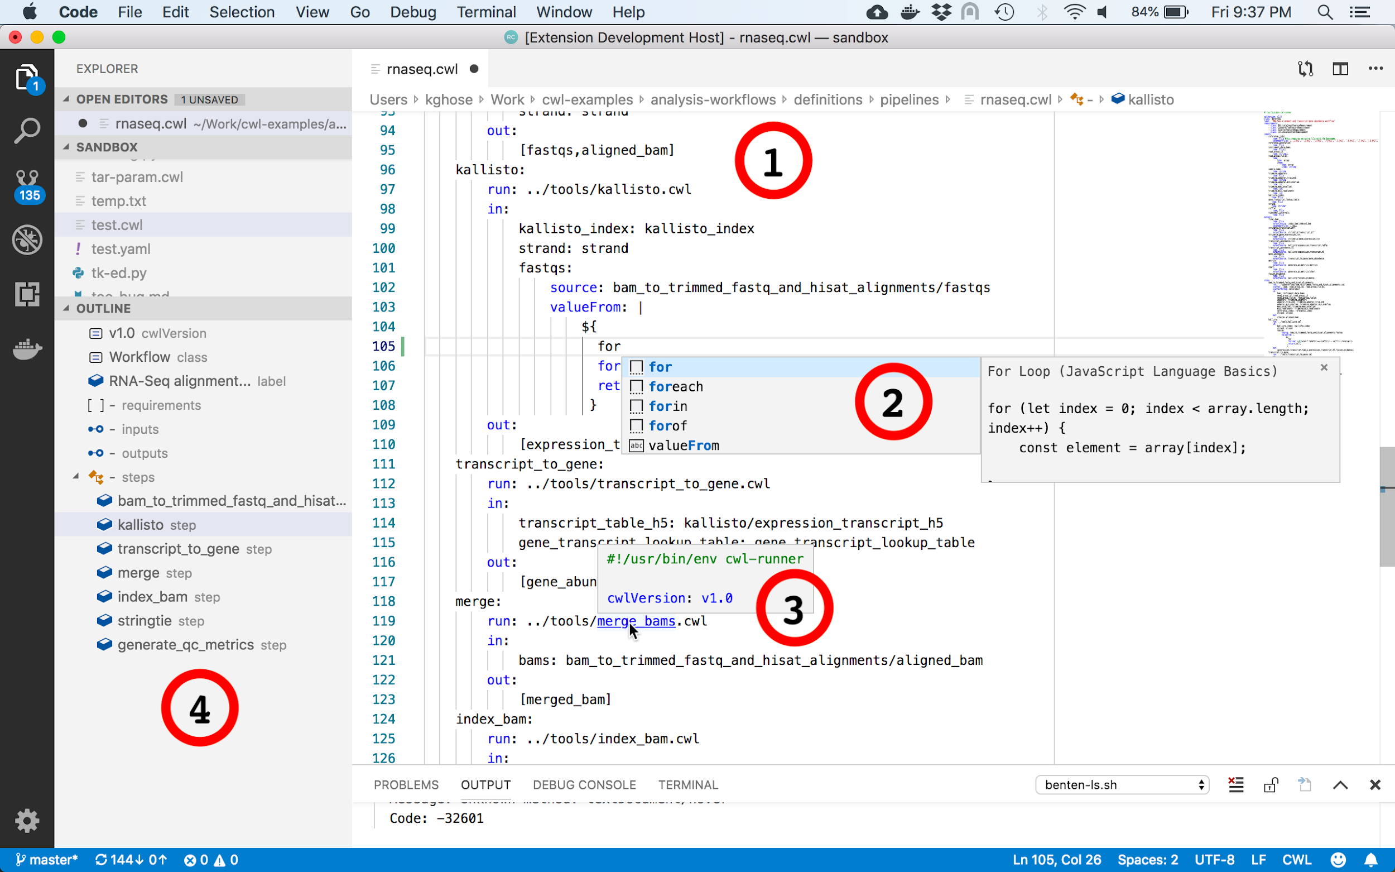
Integrating BioCompute Objects into Current Development Efforts
Benten: Git Friendly CWL Editor
Major Initiatives
Automation
Custom Front Ends
Scalability, Reproducibility, and Portability
Tools
BioCompute Object Prototype App
PDXNet Data Portal
CGC Reporting App
Rabix Benten
Libraries
TidyCWL
Seven Bridges CWL
BioCompute Object Library
R API Libraries
CWL Draft 2 to Ver. 1 converter

Slide 51
Integrating BioCompute Objects into Current Development Efforts
Benten: Git Friendly CWL Editor
Major Initiatives
Automation
Custom Front Ends
Scalability, Reproducibility, and Portability
Tools
BioCompute Object Prototype App
PDXNet Data Portal
CGC Reporting App
Rabix Benten
Libraries
TidyCWL
Seven Bridges CWL
BioCompute Object Library
R API Libraries
CWL Draft 2 to Ver. 1 converter
Proposal: Integrate BioCompute Object Publishing, Benten, and Toil

Slide 52
Outcomes and Directions

Slide 53
BCO Generation Prototype Project Outcomes, Goals, and Milestones
Primary Outcomes
Multiple Implementations Required to Support a Range of Team Members
Paper, Word Processing, Confluence and Shiny App
Building on CWL Infrastructure Can Reduce Time to Generate
Integrate project best practices (Project Descriptions vs. CWL workflow description)
Development Goals
BioCompute Object Git Publishing
Executable BioCompute Objects (CWL and Toil)
Planned Community Integration Milestones
Lecture and Workshop at George Washington University
Precision FDA Challenge

Slide 54
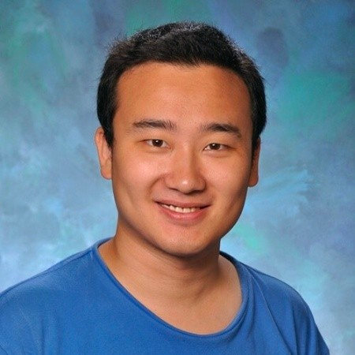
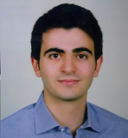
Acknowledgements
BioCompute Object Team
Nan Xiao
Senior Genomic Data Scientist
Soner Koc, MS
Genomic Data Scientist
George Washington University
Raja Mazumder, PhD
Jonathan Keeney, PhD
Amanda Bell
Charles King
Janisha Patel
Seven Bridges
Philip Brooks, PhD
Alison Leaf, PhD
Manisha Ray, PhD
Isheeta Sethi, PhD

