Slide 1
Informatics tools for identification, prioritization and clinical application of neoantigens (pVACtools; U01 CA248235)
Informatics Technology for Cancer Research (ITCR) 2022 Annual Meeting
Wednesday, 14 Sept 2022
Malachi Griffith, PhD
Associate Professor, Department of Medicine
Associate Professor, Department of Genetics
Washington University School of Medicine
mgriffit@wustl.edu
griffithlab.org
@malachigriffith #ITCR2022

Slide 2
The goal of one class of cancer immunotherapy is to leverage the immune system’s ability to attack non-self or “foreign” cells (recognized by their neoantigens)
Normal Cell
WT ‘self’ antigen
recognized as self
Cancer Cell
Neoantigen ‘non-self’ antigen
recognized as foreign
Notes:
A major focus of our work is on understanding how T cells can recognize tumor cells by their unique features. Our goal here is to really leverage the immune system’s remarkable ability to identify and destroy cells infected with non-self or “foreign” elements. Instead of the foreign element here being a pathogen that has invaded a cell, it is the tumor cell itself.
The reason this works is because tumors acquire somatic mutations and these genomic alterations create unique peptides that can be recognized as foreign.
Depicted here is an example of the simplest form of neoantigen. A single nucleotide change leading to a single amino acid substitution.
In normal cells, the wild type peptide may be presented by MHC but it will be recognized as self by the immune system
In the tumor cells, if the altered version of the peptide is presented it can lead to T cell recognition and ultimately cell death.
Two relatively new forms of cancer therapy that both rely on this principle are checkpoint inhibition therapies and personalized neoantigen vaccines.
In checkpoint blockade therapy you are inhibiting signaling molecules that the tumor upregulates to avoid immune recognition, effectively taking the breaks off of the immune system so that it can more aggressively recognize foreign antigens in the tumor.
In personalized neoantigen vaccines you are identifying a set of these peptides and delivering them to the patient to stimulate an immune response against the unique features of their tumor.
Neoantigens are antigens encoded by tumor-specific mutated genes.
Tumor-specific antigen presented by MHC Class I or II molecules on the cell surface
Created by somatic mutations in cancer leading to expression only on tumor cells
Tumor-specific epitopes (‘Neoepitopes’) are unique to each patient
These unique tumor epitopes result from somatic changes in the tumor genome (i.e. non-synonymous substitutions, insertions, deletions, splice site alterations, fusions, etc.)
Historically, experimental techniques have not been capable of rapidly and systematically identifying neoepitopes …

Slide 3
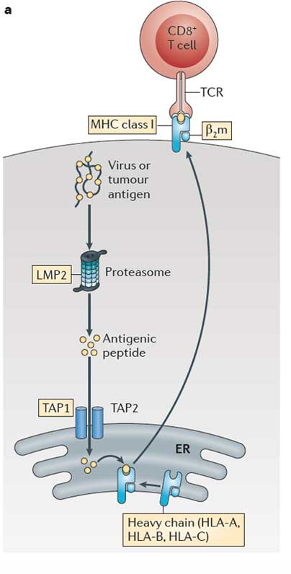
Invoking an adaptive immune response against the tumor involves a complex pathway
4. T cell receptor that uniquely matches the tumor peptide
1. Tumor produces a unique peptide corresponding to a somatic mutation
3. Neoantigen peptide presented by MHC
2. Processing and presentation of the tumor specific peptide
Kobayashi and van den Elsen, 2012
Notes:
So how do we leverage genomics information to design immunotherapies?
A major focus of this work revolves around identifying these neoantigens like the simple example I showed on the last slide
It all starts with a section of protein that is unique to the tumor
In the endogenous presentation pathway, this protein is cleaved into small peptides, transported into the endoplasmic reticulum where it may be loaded onto an MHC molecule, and finally this peptide MHC complex makes its way to the cell surface where it can be recognized by the TCR of a T cell.
The remainder of what I will discuss is focused on how we predict the neoantigens unique to each person’s tumor that can be presented and recognized in this fashion.

Slide 4
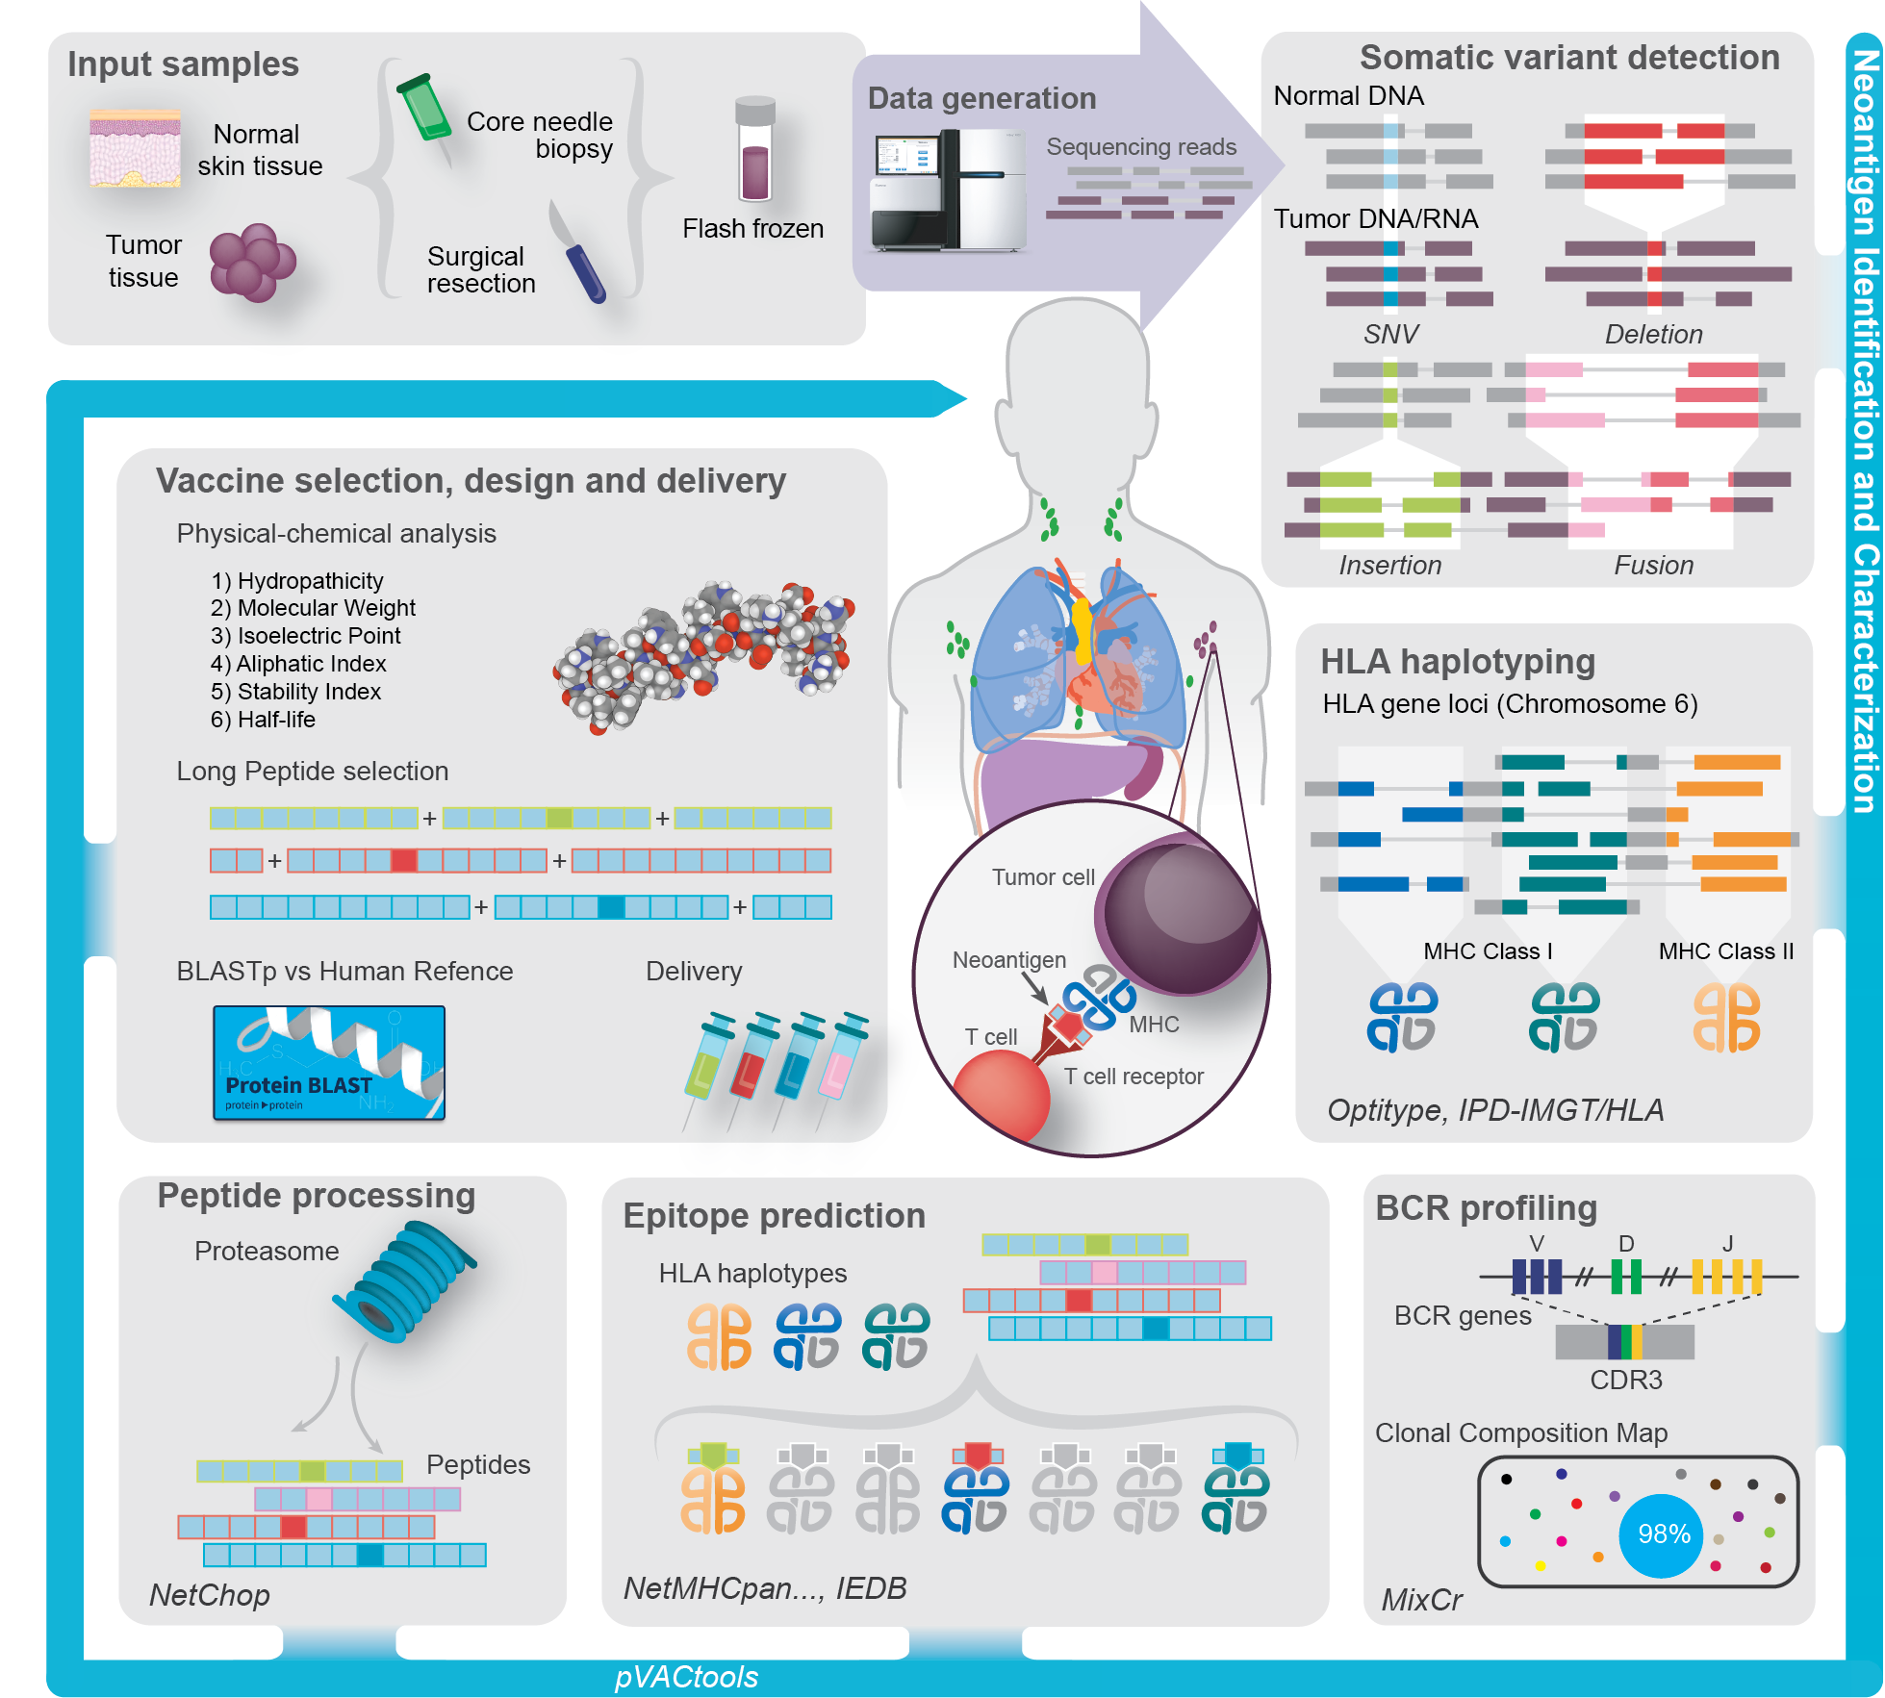
Personalized neoantigen therapies rely on a complex workflow
Richters and Xia et al. 2019
(Modified by Cody Ramirez)
Notes:
Identifying neoantigens and designing a personalized neoantigen vaccine is a complex workflow
At a high level, one starts with tumor samples from a patient.
Sequence data are mined to detect a variety of somatic variant types and determine the HLA alleles of the patient.
Additional predictors are applied to anticipate peptide processing, transport and stability.
The unique peptides of the patients tumor are modeled to predict their binding and presentation by the patients MHC alleles.
Finally a set of usual 5-30 of the best candidate neoantigens are selected and packaged into a vaccine (which may be formulated in a variety of ways) and delivered to the patient.
All of this is done as quickly as possible
One of the inspiring things about this approach is that it builds on everything we have been doing to advance tumor genome sequencing and analysis over the past 20 years. Literally several dozen bioinformatics tools developed in labs around the world are needed to go from raw data to a finalize vaccine design personalized for each patient’s tumor and MHC complement. We are standing on the top of a mountain here and the view is spectacular.

Slide 5
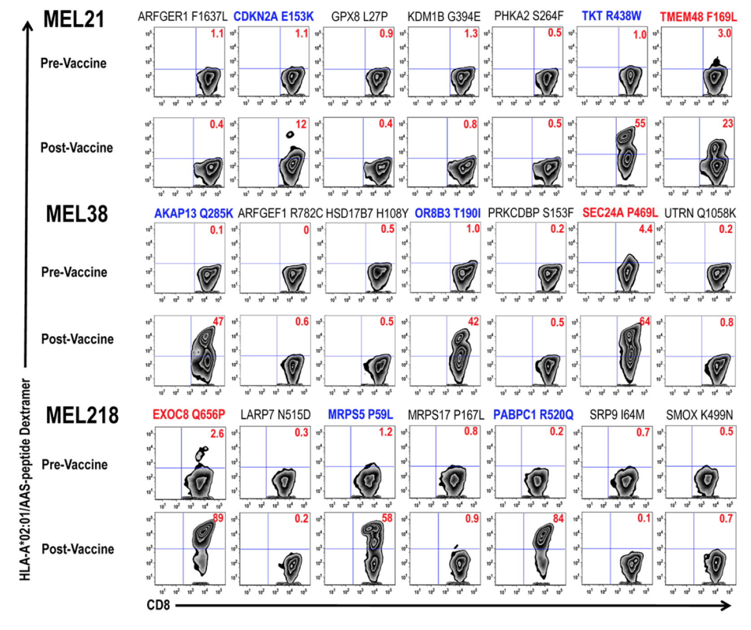
Early neoantigen vaccine results in humans show promise
Only 3 out of 7 vaccine candidates induced an immune response for each patient
~40% success rate at predicting neoantigens
Carreno et al. Science. 2015
Carreno et al. Science 348.6236 (2015)
Notes:
X axis in this plot is a sort for CD8 markers
Y axis is an MHC-Peptide Dextramer. This pulls T cells specifically reactive to each individual Peptide:MHC. A total of 21 distinct peptides are depicted here.

Slide 6
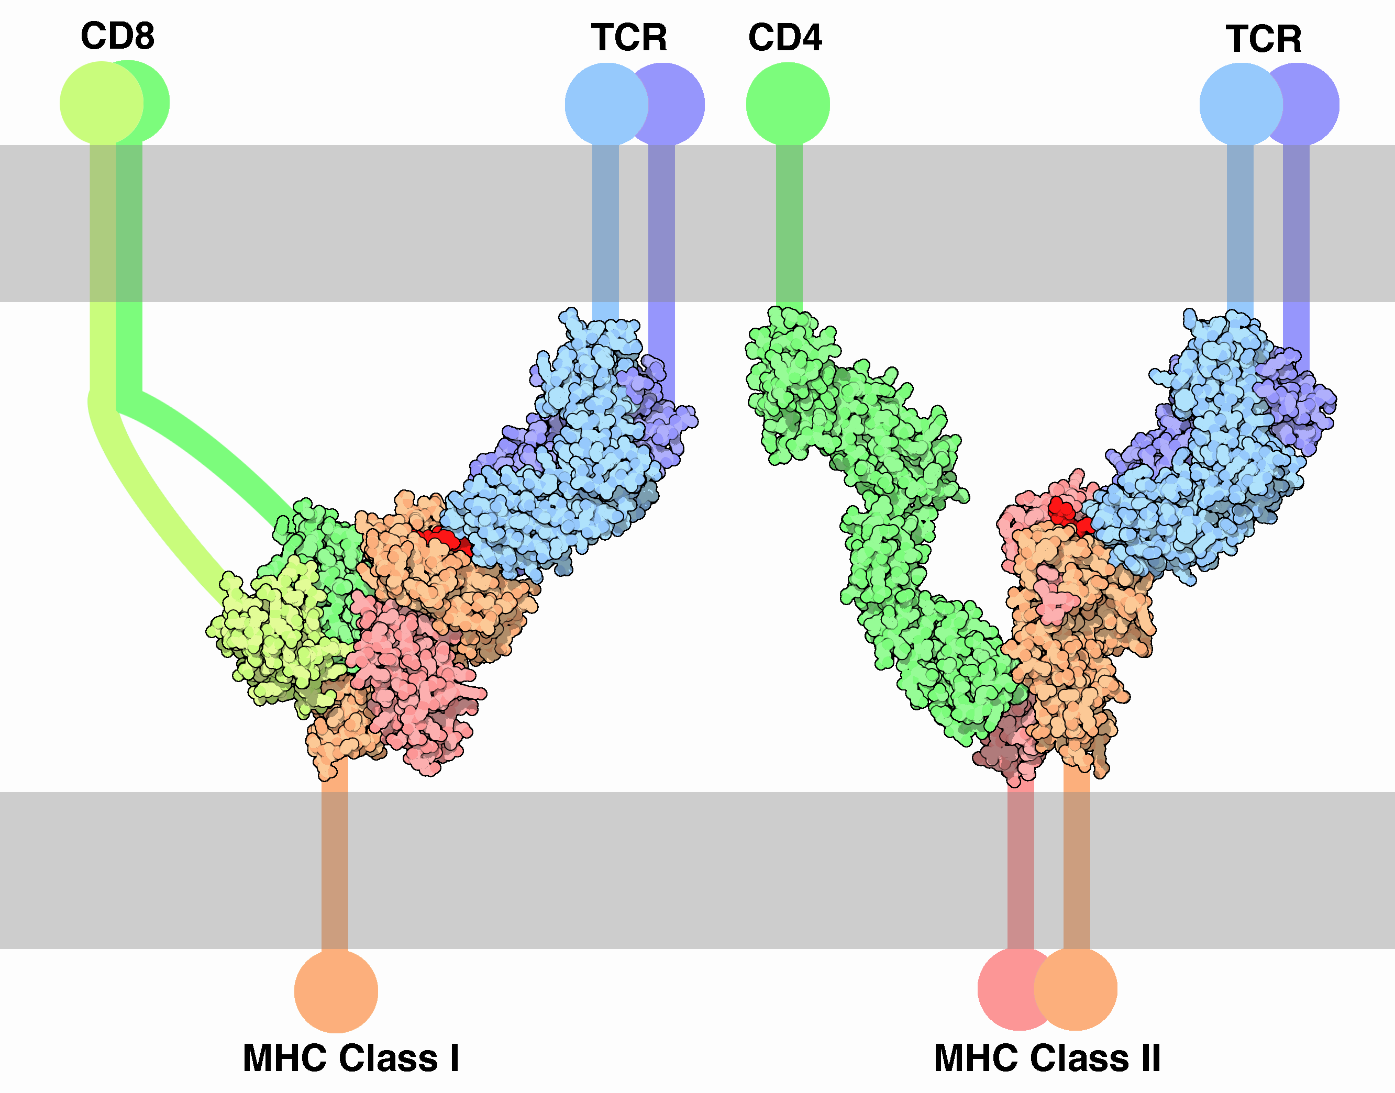
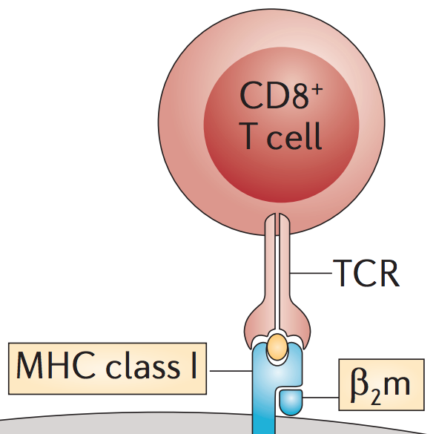
Neoantigen prediction is a major biology and informatics challenge
Almost infinite diversity of TCR sequences/structures
2.2 x 10¹⁴ possible 8-11mer peptides
(2.2 hundred trillion)
>5,000 known HLA alleles (not counting somatic alterations of MHC)
**Many** other supporting factors both upstream and downstream of this complex needed for a therapeutic response
http://pdb101.rcsb.org/motm/63
Notes:
We are inspired to study this problem by its vastness and complexity.
With more than 5000 known HLA alleles (one of the most genetically diverse loci in the human genome), and more than two hundred trillion possible short peptide sequences that can fit into them, and an almost infinite diversity of T cell receptor sequences that could recognize them, this area is an ideal playground for bioinformaticians.
- “An elaborate handshake is performed between a T-cell and an infected cell to make sure that the death sentence is warranted. The primary contact is between the T-cell receptor and the MHC-peptide complex (the peptide is in bright red here). Then, CD molecules bind to other portions of the MHC, strengthening the interaction. Two types of interaction are shown here. MHC class I, which is found on the surface of most of our cells, interacts with T-cell receptors and CD8 on cell-killing T-cells. MHC class II is found primarily on cells that specialize in finding dangerous proteins. It interacts with T-cell receptors and CD4 on other T-cells that stimulate the immune system. All of these proteins are connected to the cell membranes by flexible chains and hinges, so that they can move around and form this complex interaction.” http://pdb101.rcsb.org/motm/63

Slide 7
Identifying and characterizing neoantigens is critical for understanding the tumor immune environment, response to checkpoint inhibitors, and for designing personalized neaoantigen therapies that direct an immune attack (e.g. neoAg vaccines, engineered T cells, TCR-mimic antibodies, personalized adoptive T cell therapy, …)
Notes:
We focus much of our effort here because we believe that
1. identifying and characterizing these neoantigens is critical for understanding response to checkpoint inhibitor therapy and
2. is absolutely necessary for designing personalized cancer vaccines that direct an immune attack

Slide 8
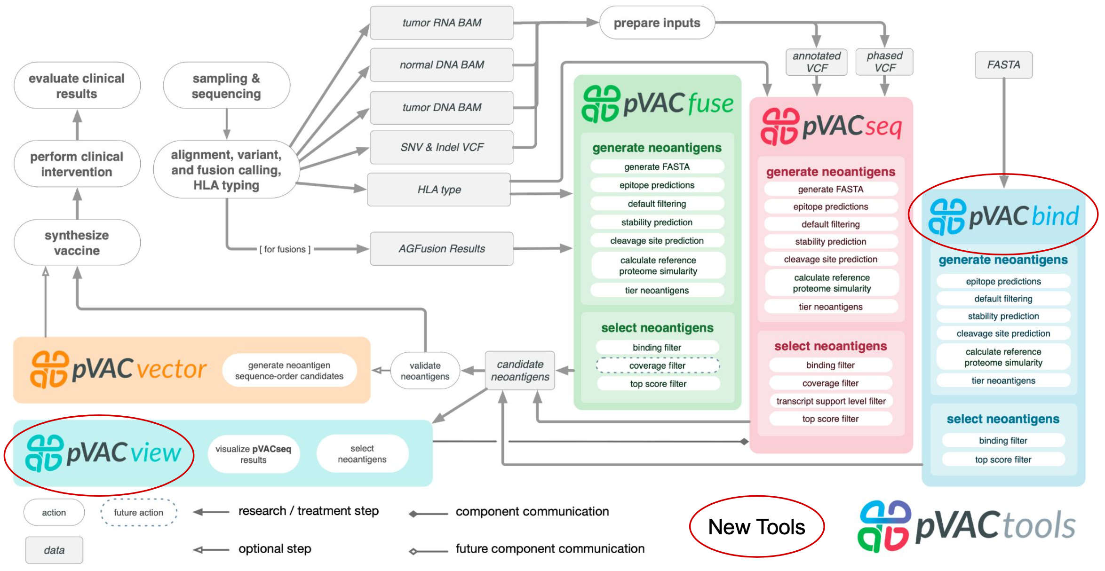
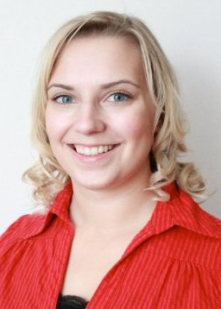
pVACtools (pvactools.org) was created to facilitate neoantigen identification/prioritization
Susanna Kiwala (poster #17)
Hundal and Kiwala et al. 2019
Notes:
We created pVACtools to facilitate this process. It is an analysis tool kit designed to support each step of personalized neoantigen vaccine design by an immunotherapy tumor board.
I don’t expect you to read all these details but, in broad terms it breaks the process down into components of data QC, HLA typing, various kinds of somatic variant detection, prioritization, visualization and packaging into a vaccine formulation.
If you want to learn more about this tool I would encourage you to visit pvactools.org or checkout out BioRXiv manuscript (recently accepted for publication in Cancer Immunology Research)
pVACseq - Neoantigen prediction for SNVs and Indels
pVACfuse - Neoantigen prediction for fusions
pVACvector - Optimizing design of spacers and shortlisted neoantigens to prevent high-affinity junctional epitopes (DNA Vector vaccines)
pVACviz - Browser-based UI for launching, managing, reviewing, and visualizing the results of pVACtools processes
pVACapi - HTTP REST interface to the pVACtools suite

Slide 9
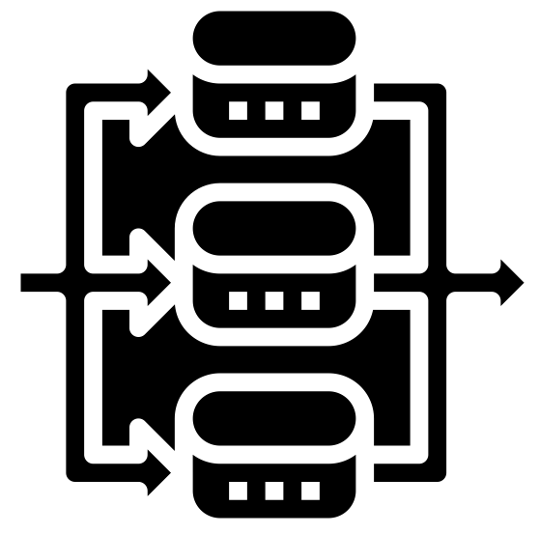
pVACtools modularity aims to broadly support neoantigen related analyses and clinical applications
Algorithms implemented
Prioritization, reporting, etc.
Neoantigen
analysis classes
Automated
orchestration
MHCflurry
binding_filter
run
MHCnuggetsI
coverage_filter
pvacseq
MHCnuggetsII
tsl_filter
NNalign
top_score_filter
pvacbind
run
NetMHC
download_example_data
NetMHCIIpan
install_vep_plugin
pvactools
pvacfuse
run
NetMHCcons
list_valid_alleles
NetMHCpan
allele_specific_cutoffs
pvacvector
run
PickPocket
generate_protein_fasta
download_cwls
SMM
generate_report
Workflow definitions
SMMPMBEC
reference_proteome
pvacview
run
SMMalign
cleavage
netChop
stability
Parallelization implemented
netMHC Stab
visualize

Slide 10
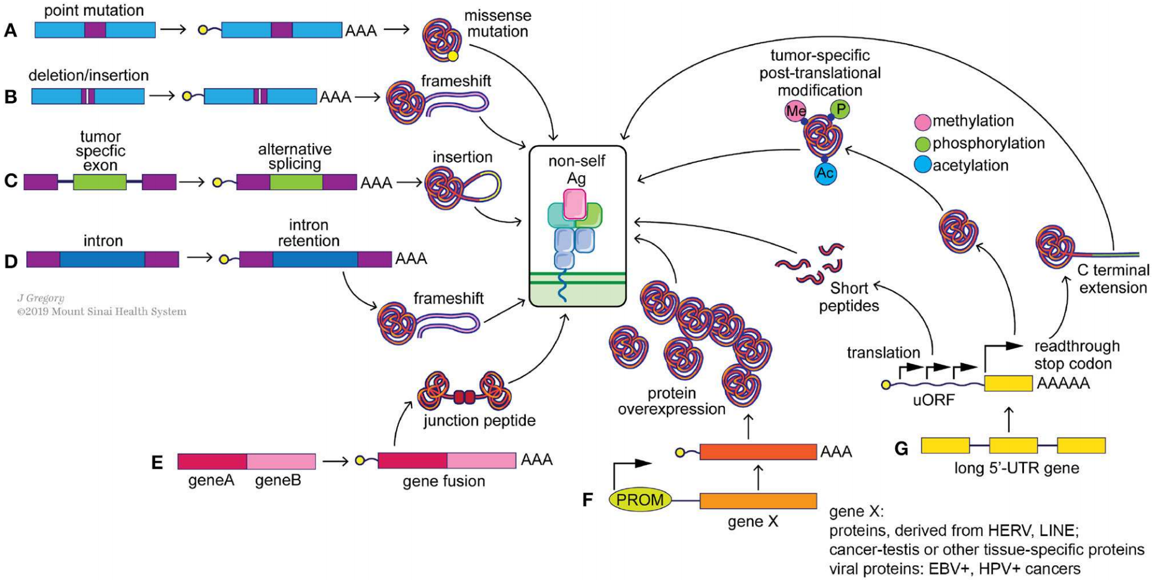
Mining neoantigens from different sources remains an active area of tool development
Roudko, Greenbaum and Bhardwaj, 2020
Notes:
One major area of focus in the field of neoantigen characterization is exploring the different possible sources of neoantigens and considering how different sources may influence the fundamental features of a good neoantigen on the past slide
Shown here are just some of the major neoantigen sources. Each generally requiring a highly customized workflow to accurately detect and annotate them.
First we have simple point mutations. An example of which I have shown.
Small deletions and insertions are of great interest because they can lead to frameshifts. Frameshifts may be undesirable in some ways. For example they might be subject to nonsense mediated decay and therefore have reduced expression. But if expressed they have several interesting advantages. For one they give rise to longer stretches of peptide sequence that are much more unique to the tumor genome than a peptide with a single amino acid substitution. Furthermore, in some cancer genes, many tumors can have frameshifts around the same positions in the protein. We see this in P53 for example. If these lead into the same altered reading frames, this raises the possibility of neoantigen peptides that are shared across individuals.
Aberrant tumor specific alternative splicing can similarly lead to rich sources of neoantigens when again a reading frame is shifted by the event, or a section of intron is retained that is not normally expressed.
Inter-chromosomal translocations can give rise to fusion proteins that also potentially harbor highly specific neoantigen peptides and in some cases are also strong drivers of tumor biology.
And it just goes on from there. Neoantigens can arise from pseudogenes that are reactivated, historical or contemporary viral integration events, read through translation events, an so on. And once expressed peptides can be post-translationally modified by methylation, phorphorylation, acetylation, etc. to give rise to even more diversity.
Figure caption:
Potential sources of “non-self” tumor neoantigens. Genomic alterations such as point mutations (A), indels (B) and gene fusions (E) can result in the generation of missense and frameshift neoantigens. Splicing aberrations such as the retention of cancer-specific exons (C) and introns (D) can also lead to frameshift neoantigens. Epigenetic changes can alter the expression levels of immunogenic genomically-encoded proteins (F) including viral proteins from integrated chronically-infected cells (EBV, HPV), cancer-testis antigens (e.g., MAGE-A4) and proteins derived from LINE and HERV elements. Post-transcriptional changes (G), including translation of upstream open reading frames (uORF), stop codon readthrough and protein modifications, such as methylation, phosphorylation and acetylation, can generate tumor specific neoantigens as well.

Slide 11
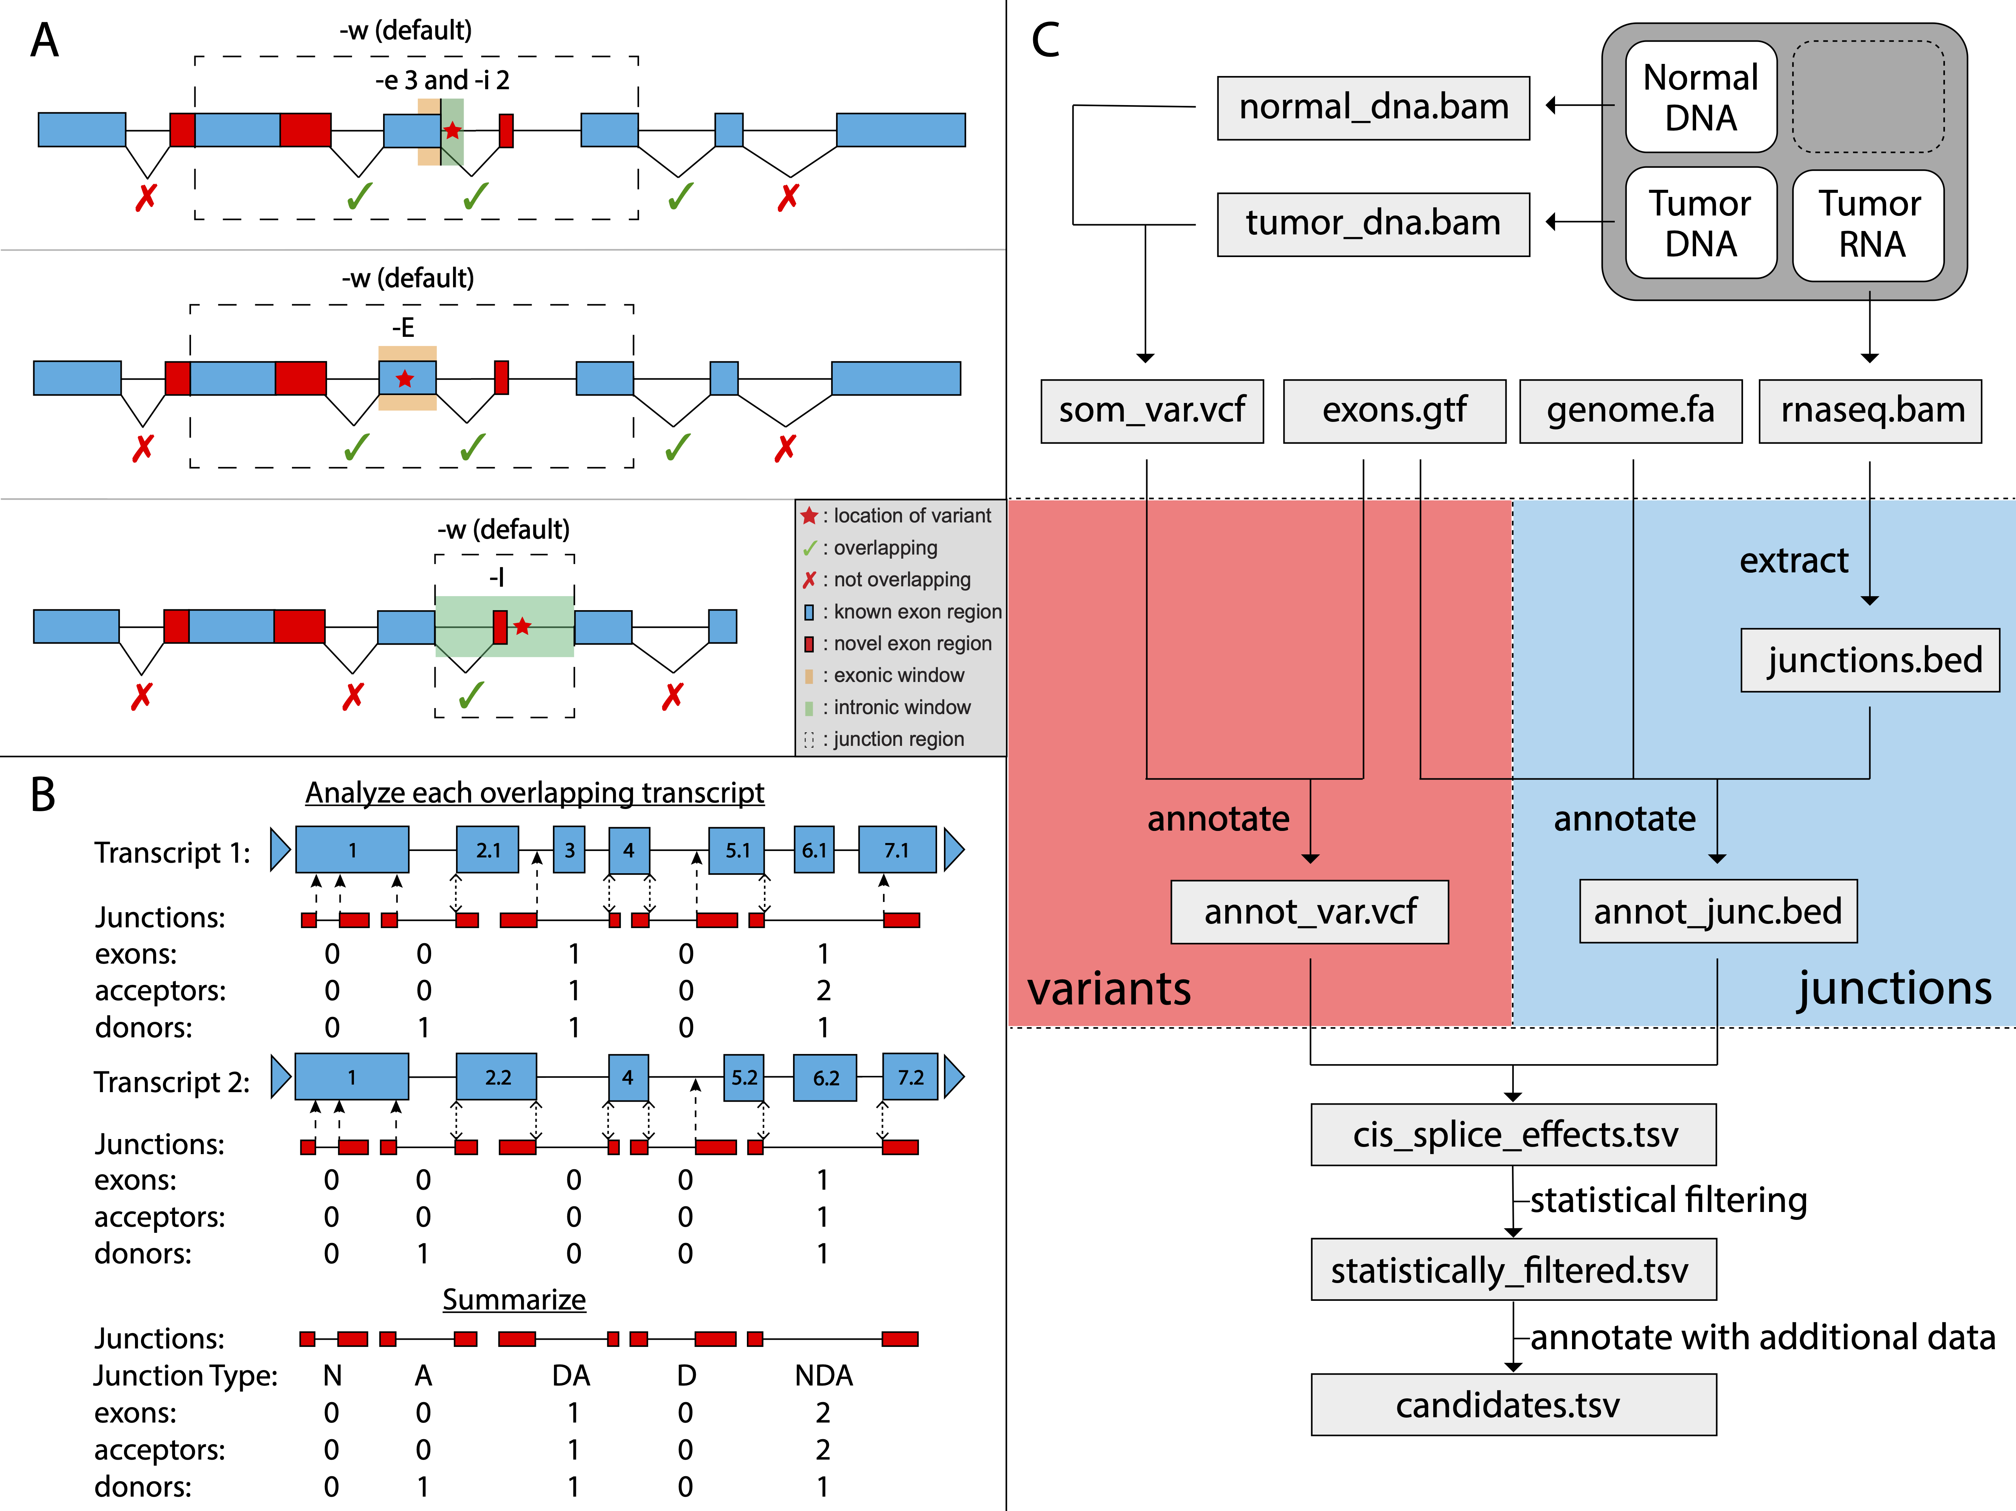
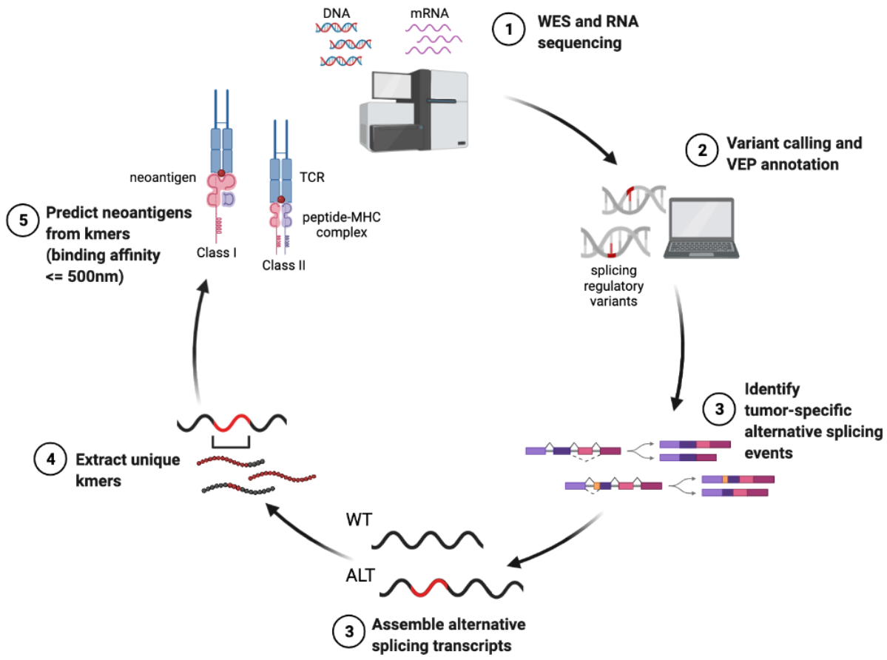
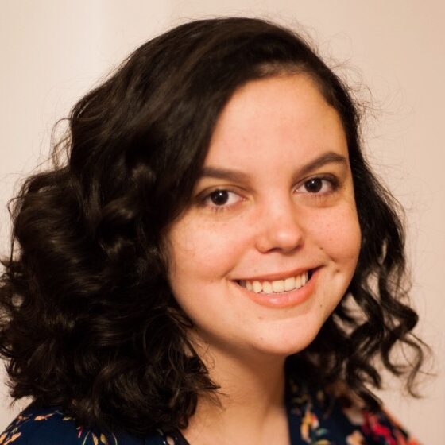
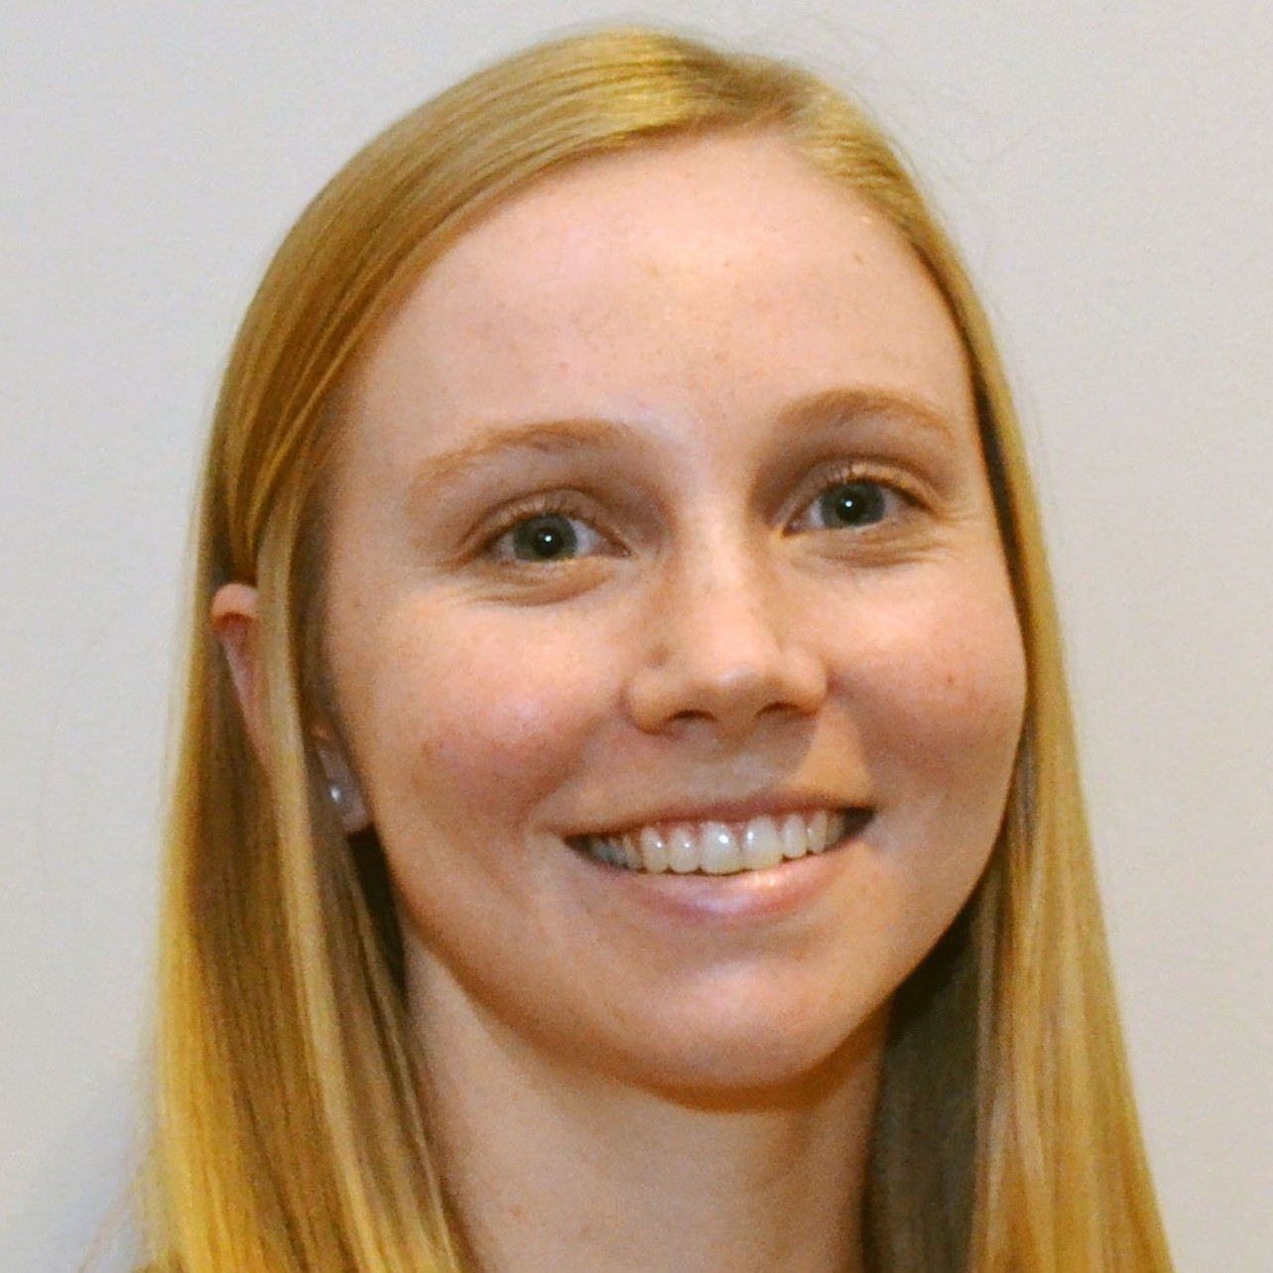
pVACsplice was created to identify neoantigens arising from tumor specific RNA splicing events
RegTools (www.regtools.org)
pVACsplice
Kelsy Cotto
Megan Richters
(poster #16)

Slide 12
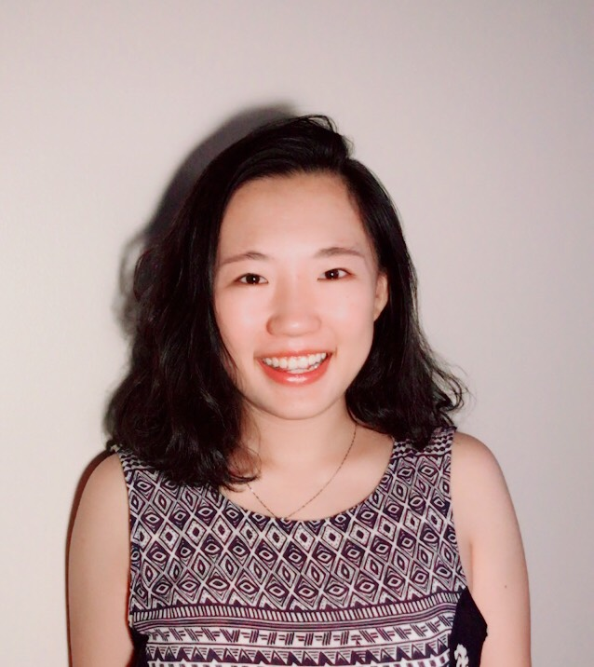
More nuanced interpretation of how each MHC allele presents the mutant and wild type version of tumor peptides can influence neoantigen selection
Different MHC alleles differ in how they hold on to (anchor) peptides
Is a peptide truly a *neo*antigen or could it be recognized as self and subject to tolerance (or worse lead to auto-immunity)?
Can we better define the anchor sites for each unique MHC/HLA?
Huiming Xia (poster #15) & Lightning Talk
Notes:
To give just one example of an area for improvement we have tackled.
Consider the very simple neoantigen in the top left. The mutant version consists of a single amino acid substitution.
When the mutant and wildtype are so subtly different, one must consider carefully how they might be presented and recognized by the immune system
Depicted here in cartoon form is an MHC – Peptide – TCR complex.
In these complexes, there are residues of the peptide that are critical to binding by the MHC molecule. These are called anchor residues and are shown interacting directly with part of the MHC grove.
The other, non-anchor, residues of the peptide are more critical to recognition by the TCR and are shown at the top, facing the TCR.
The reason we care about this in the context of neoantigen presentation is that if the mutant amino acid is in an MHC anchor residue, and both the mutant and wild type peptides are strong binders, then the residues shown to the immune system could actually be the same
This could lead to tolerance where the immune system does not recognize the peptide as foreign (meaning it would not be much use in directing a response against the tumor)
Or potentially worse, it could lead to auto-immunity where a response is stimulated that could impact healthy tissues.
Conversely, if the mutant amino acid is in a TCR contact residue, it might not matter if the wild type version of the sequence is also a strong binder, because the residues being presented to the immune system are unique.
In order to assess these possibilities we first need to define which sites in each MHC molecule are acting as anchors
We believe that existing peptide:MHC binding algorithms and neoantigen workflows do not sufficiently account for HLA specific difference in anchor configuration when considering the mutant vs. wildtype peptide comparison.

Slide 13
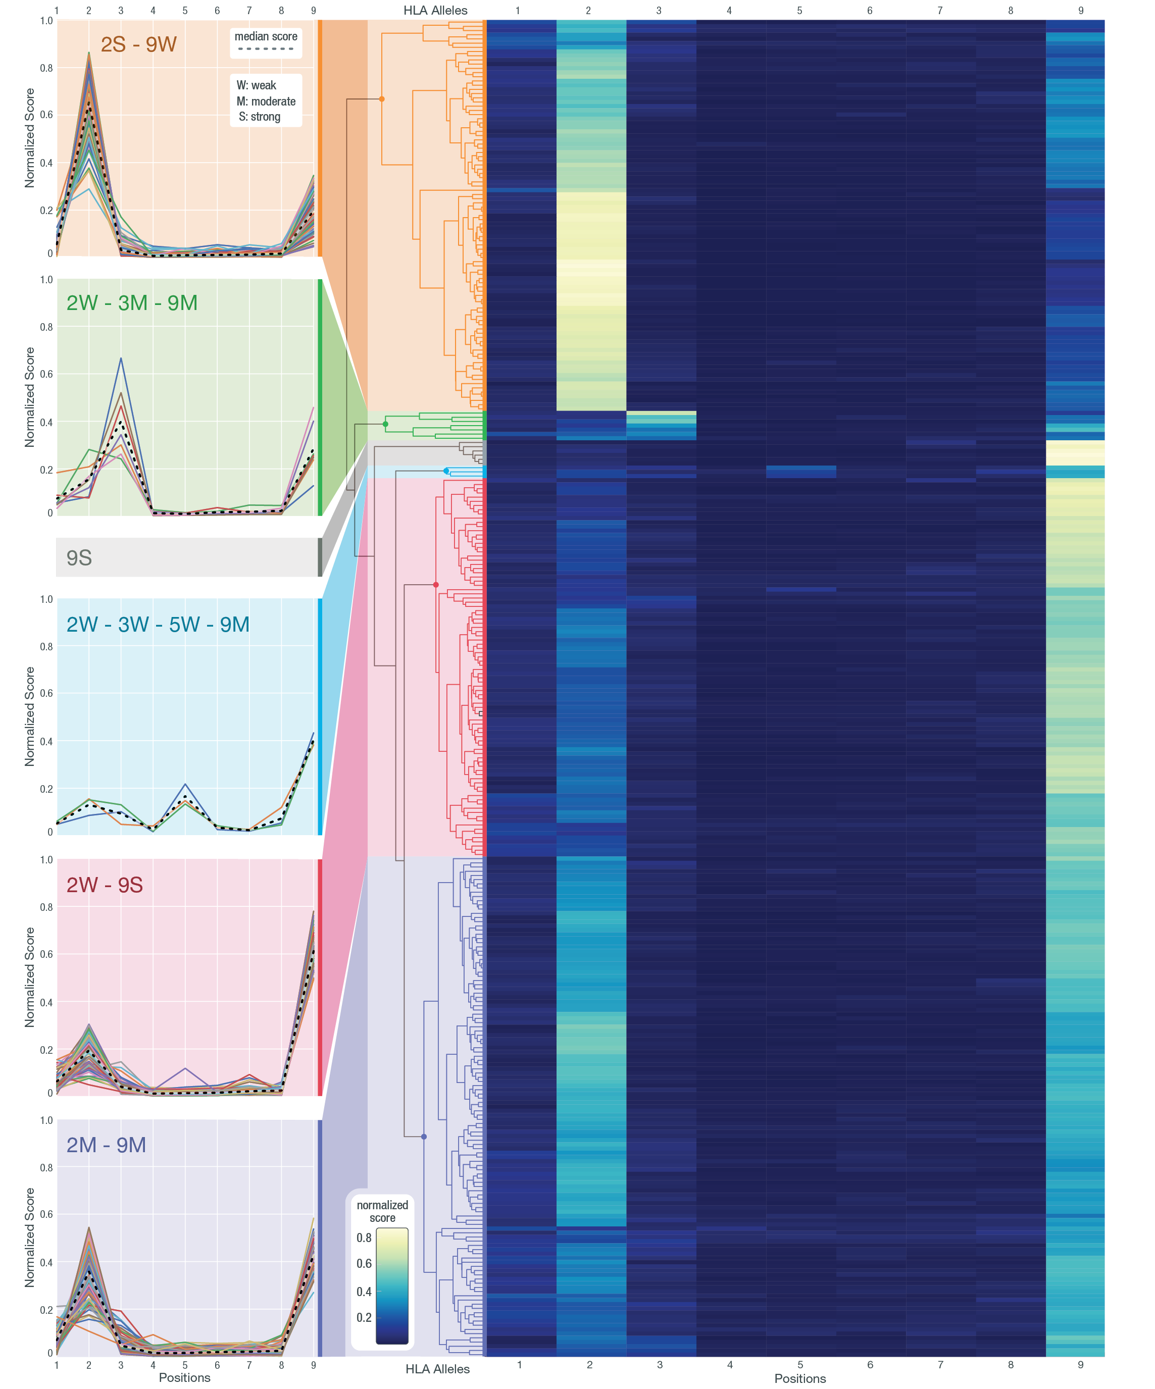
Across all 328 HLAs, distinct patterns of anchor site usage are apparent
328 HLA alleles:95 HLA-A, 175 HLA-B, 58 HLA-C

Slide 14
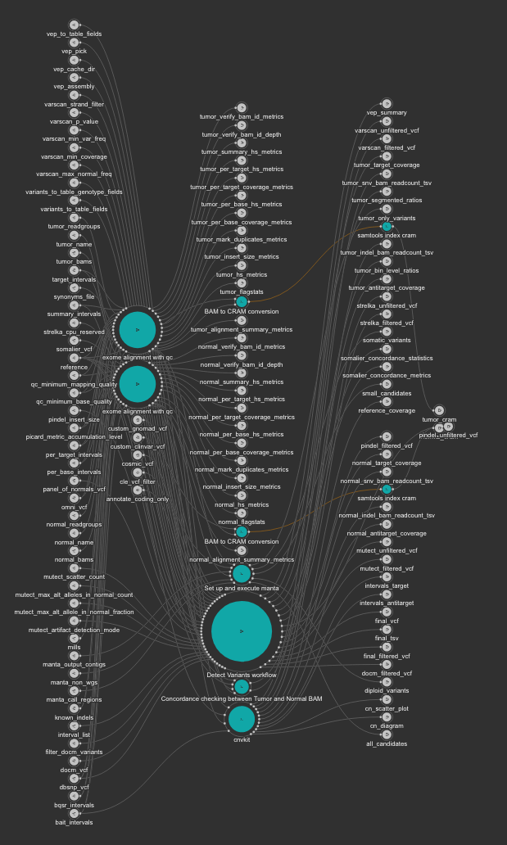
An end-to-end neoantigen workflow must integrate somatic mutation, HLA typing, peptide processing, peptide-MHC prediction, expression analysis …
To go from raw sequence data to neoantigen predictions
Raw data
References, annotation files, databases, web services
Tools
Number, combination, order and parameter settings
Reproducibility and interpretability are difficult to achieve and maintain
Immunogenomics pipeline implemented entirely using the CWL/WDL, docker, Cromwell
Personalized Neoantigen Identification Workflow
>50 tools
100s of parameter settings
100s of input/output files
100s of steps
1000s of compute tasks
Selected tools:
Multiqc, BWA-mem, STAR, Picard*, samtools*, bedtools*, vt, varscan, pindel, strelka, mutect, vep, kallisto, stringtie, pizzly, agfusion, vatools, bam-readcount, optitype, iedb, mhcnuggets, mhcflurry, …
https://github.com/genome/analysis-workflows (CWL + compute1)
https://github.com/griffithlab/analysis-wdls (WDL + google cloud)
Set-aside collaboration with Brian Haas (Trinity/CTAT)
Notes:
We implement our sequence analysis pipelines using the Common Workflow Language (an open standard for bioinformatics workflow definitions). The workflow manages dependencies between steps in the pipeline and parallelization of the computational work. The actual computational tasks leverage Docker containers for every tool and step. The entirety of these pipelines including all workflow and container specifications are published under open source licenses using the version control system git. These approaches help to facilitate reproducibility and quality control as improvements are implemented, and portability so that the compute can be done efficiently on local or cloud based compute clusters.

Slide 15
Complex output is now fed into an visual reporting interface to assist the interpretation and prioritization of neoantigen candidates
pvacview.org

Slide 16
In-patient results from trials leveraging pVACtools are starting to emerge from neoantigen vaccine trials at WASHU (10) and elsewhere
Personalized cancer vaccine trials using pVACtools:
Kidney Cancer (n = 15 patients)
NCT03598816 (James Hsieh)
Glioblastoma (n = 30 patients)
NCT03422094 (Gavin Dunn)
Breast Cancer (n = 54 patients)
NCT02348320 (William Gillanders)
NCT03199040 (William Gillanders)
Follicular Lymphoma (n = 10 patients)
NCT03121677 (Todd Fehniger)
Prostate Cancer (n = 20 patients)
NCT03532217 (Russell Pachynski)
Pancreatic Cancer (n = 15 patients)
NCT03122106 (William Gillanders / Daniel Laheru)
Melanoma (n = 12 patients)
NCT03092453 (Beatriz Carreno / Gerald Linnette)
Colorectal Cancer (n = 12 patients)
NCT03730948 (Beatriz Carreno / Kim Reiss-Binder)
+ NCI clinical trial contract (pancreas), Jeff Ward trial, JLF cases, …, neoantigen.clinwiki.org
Richters and Xia et al. 2019
(Modified by Cody Ramirez)
Notes:
With that in mind, we have involved ourselves in several clinical trials to test personalized neoantigen vaccines
I am aware of 29 of these trials world wide, of which our group is involved in designing the vaccines for 10.
At this early stage, these are mostly phase I, and small, primarily testing for safety
But nevertheless they allow us to explore and refine the approach in variety of tumors types and clinical scenarios with a truly wonderful group of clinical collaborators who make up our informal immunotherapy tumor board.
Results are yet to emerge for most of these. In fact, just yesterday, in order to be at this meeting I missed the first internal presentation of results from the most advanced of these trials. I hear second hand that the take home message is that the side effects appear minimal, evidence of T cell response is detected in most cases, and tumor responses and survival are promising (with the caveat that these are very early days and phase I trials are not robustly powered to assess outcome).

Slide 17
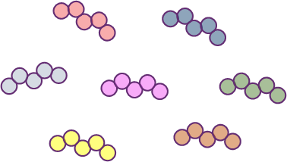
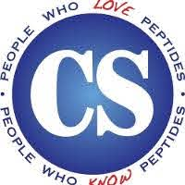
The Jaime Leandro Foundation for Therapeutic Cancer Vaccines has developed a workflow for Compassionate Access to Personalized Vaccines
Consent
Vaccine Prediction
Vaccine Review And Selection
Vaccine Manufacturing
Vaccine Assembly
Vaccine Administration
Immune monitoring
Contracting
Compassionate Protocol Agreement
(Treating institution with xCures)
Data Collection
Sequencing
Cost Recovery
Project Management _
Patient Navigation _
Regulatory Management _
Notes:
- We just received data for the 18th patient with an ambitious goal to treat 100 patients over the next 2 years.

Slide 18
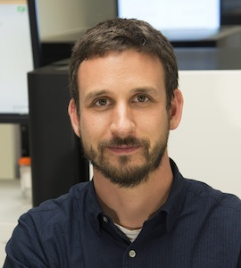
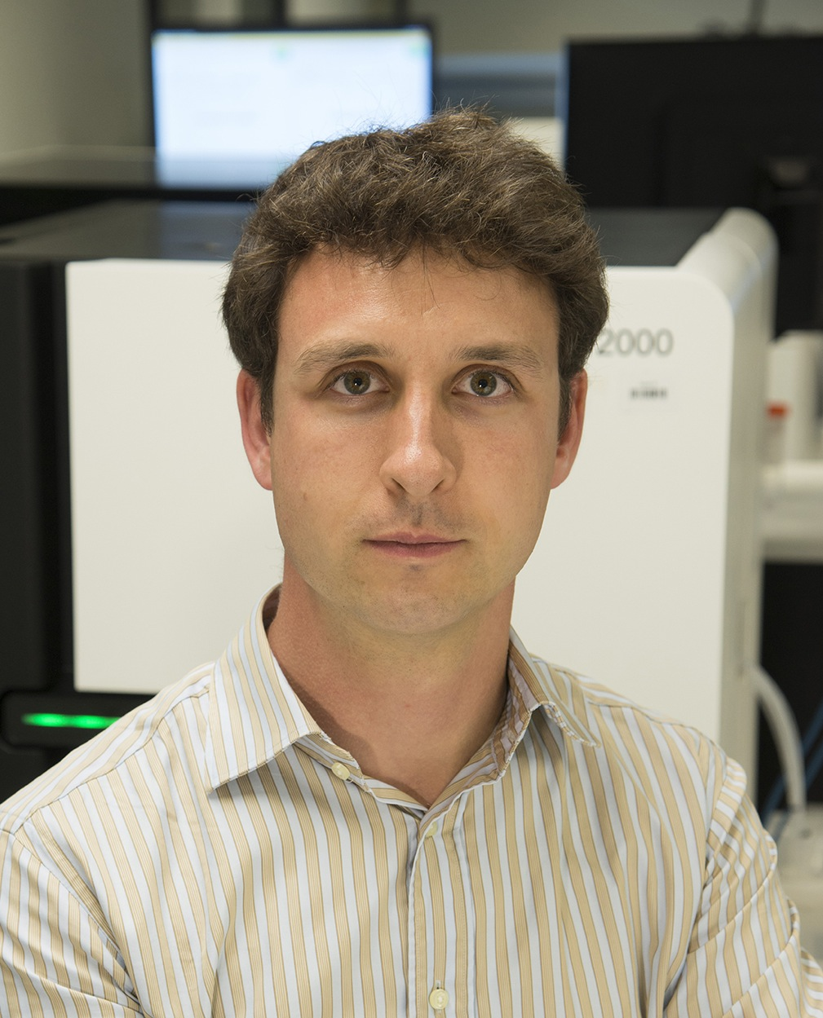
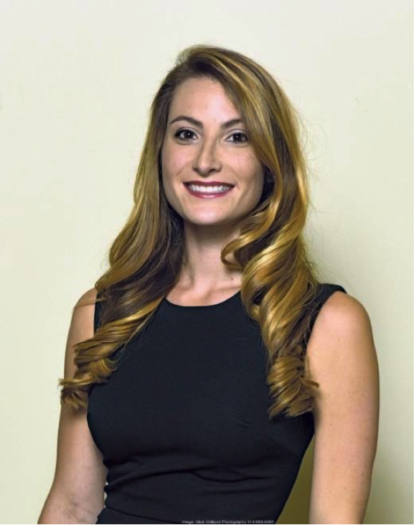
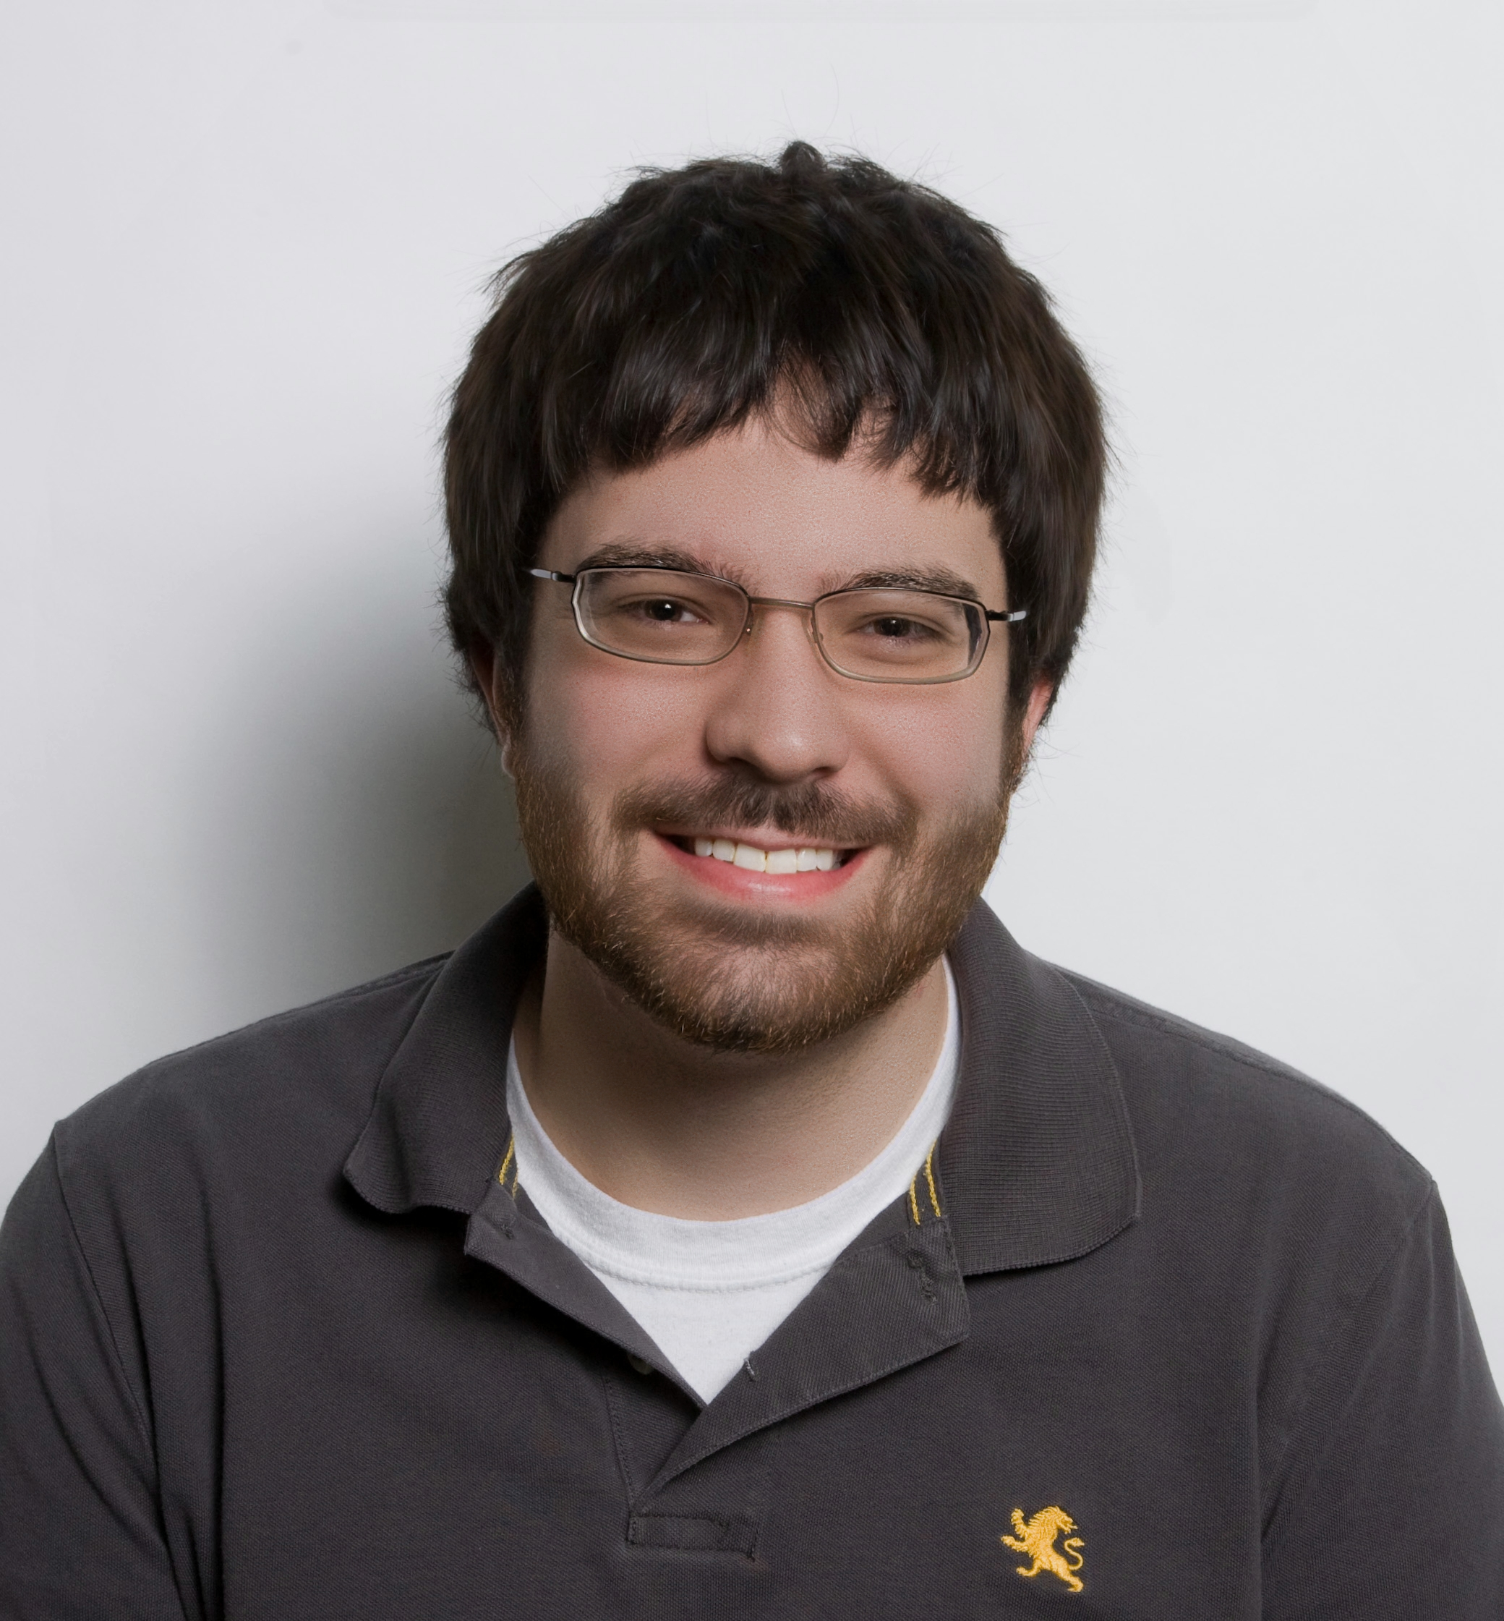
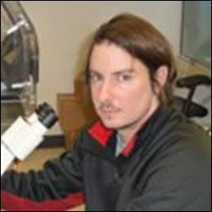
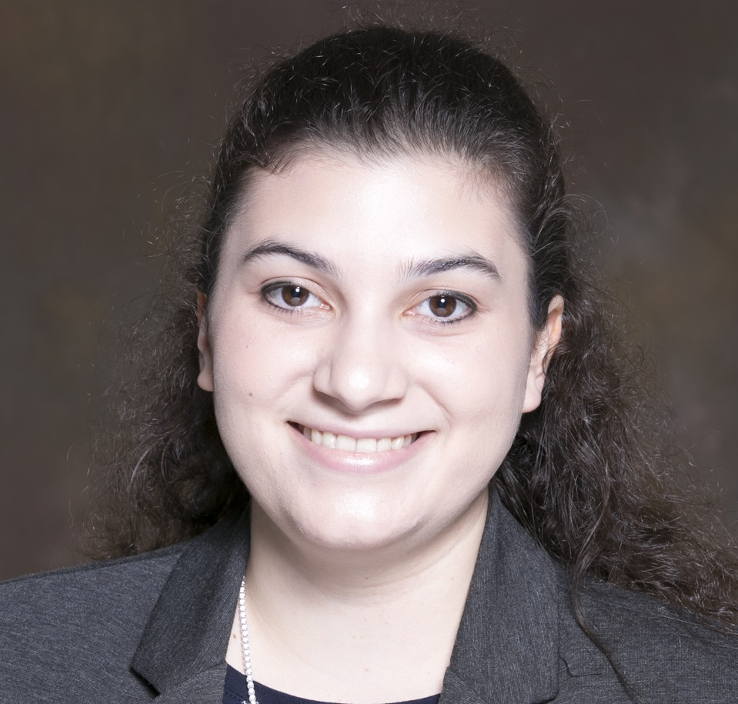
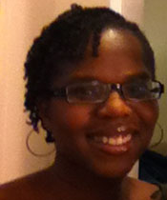
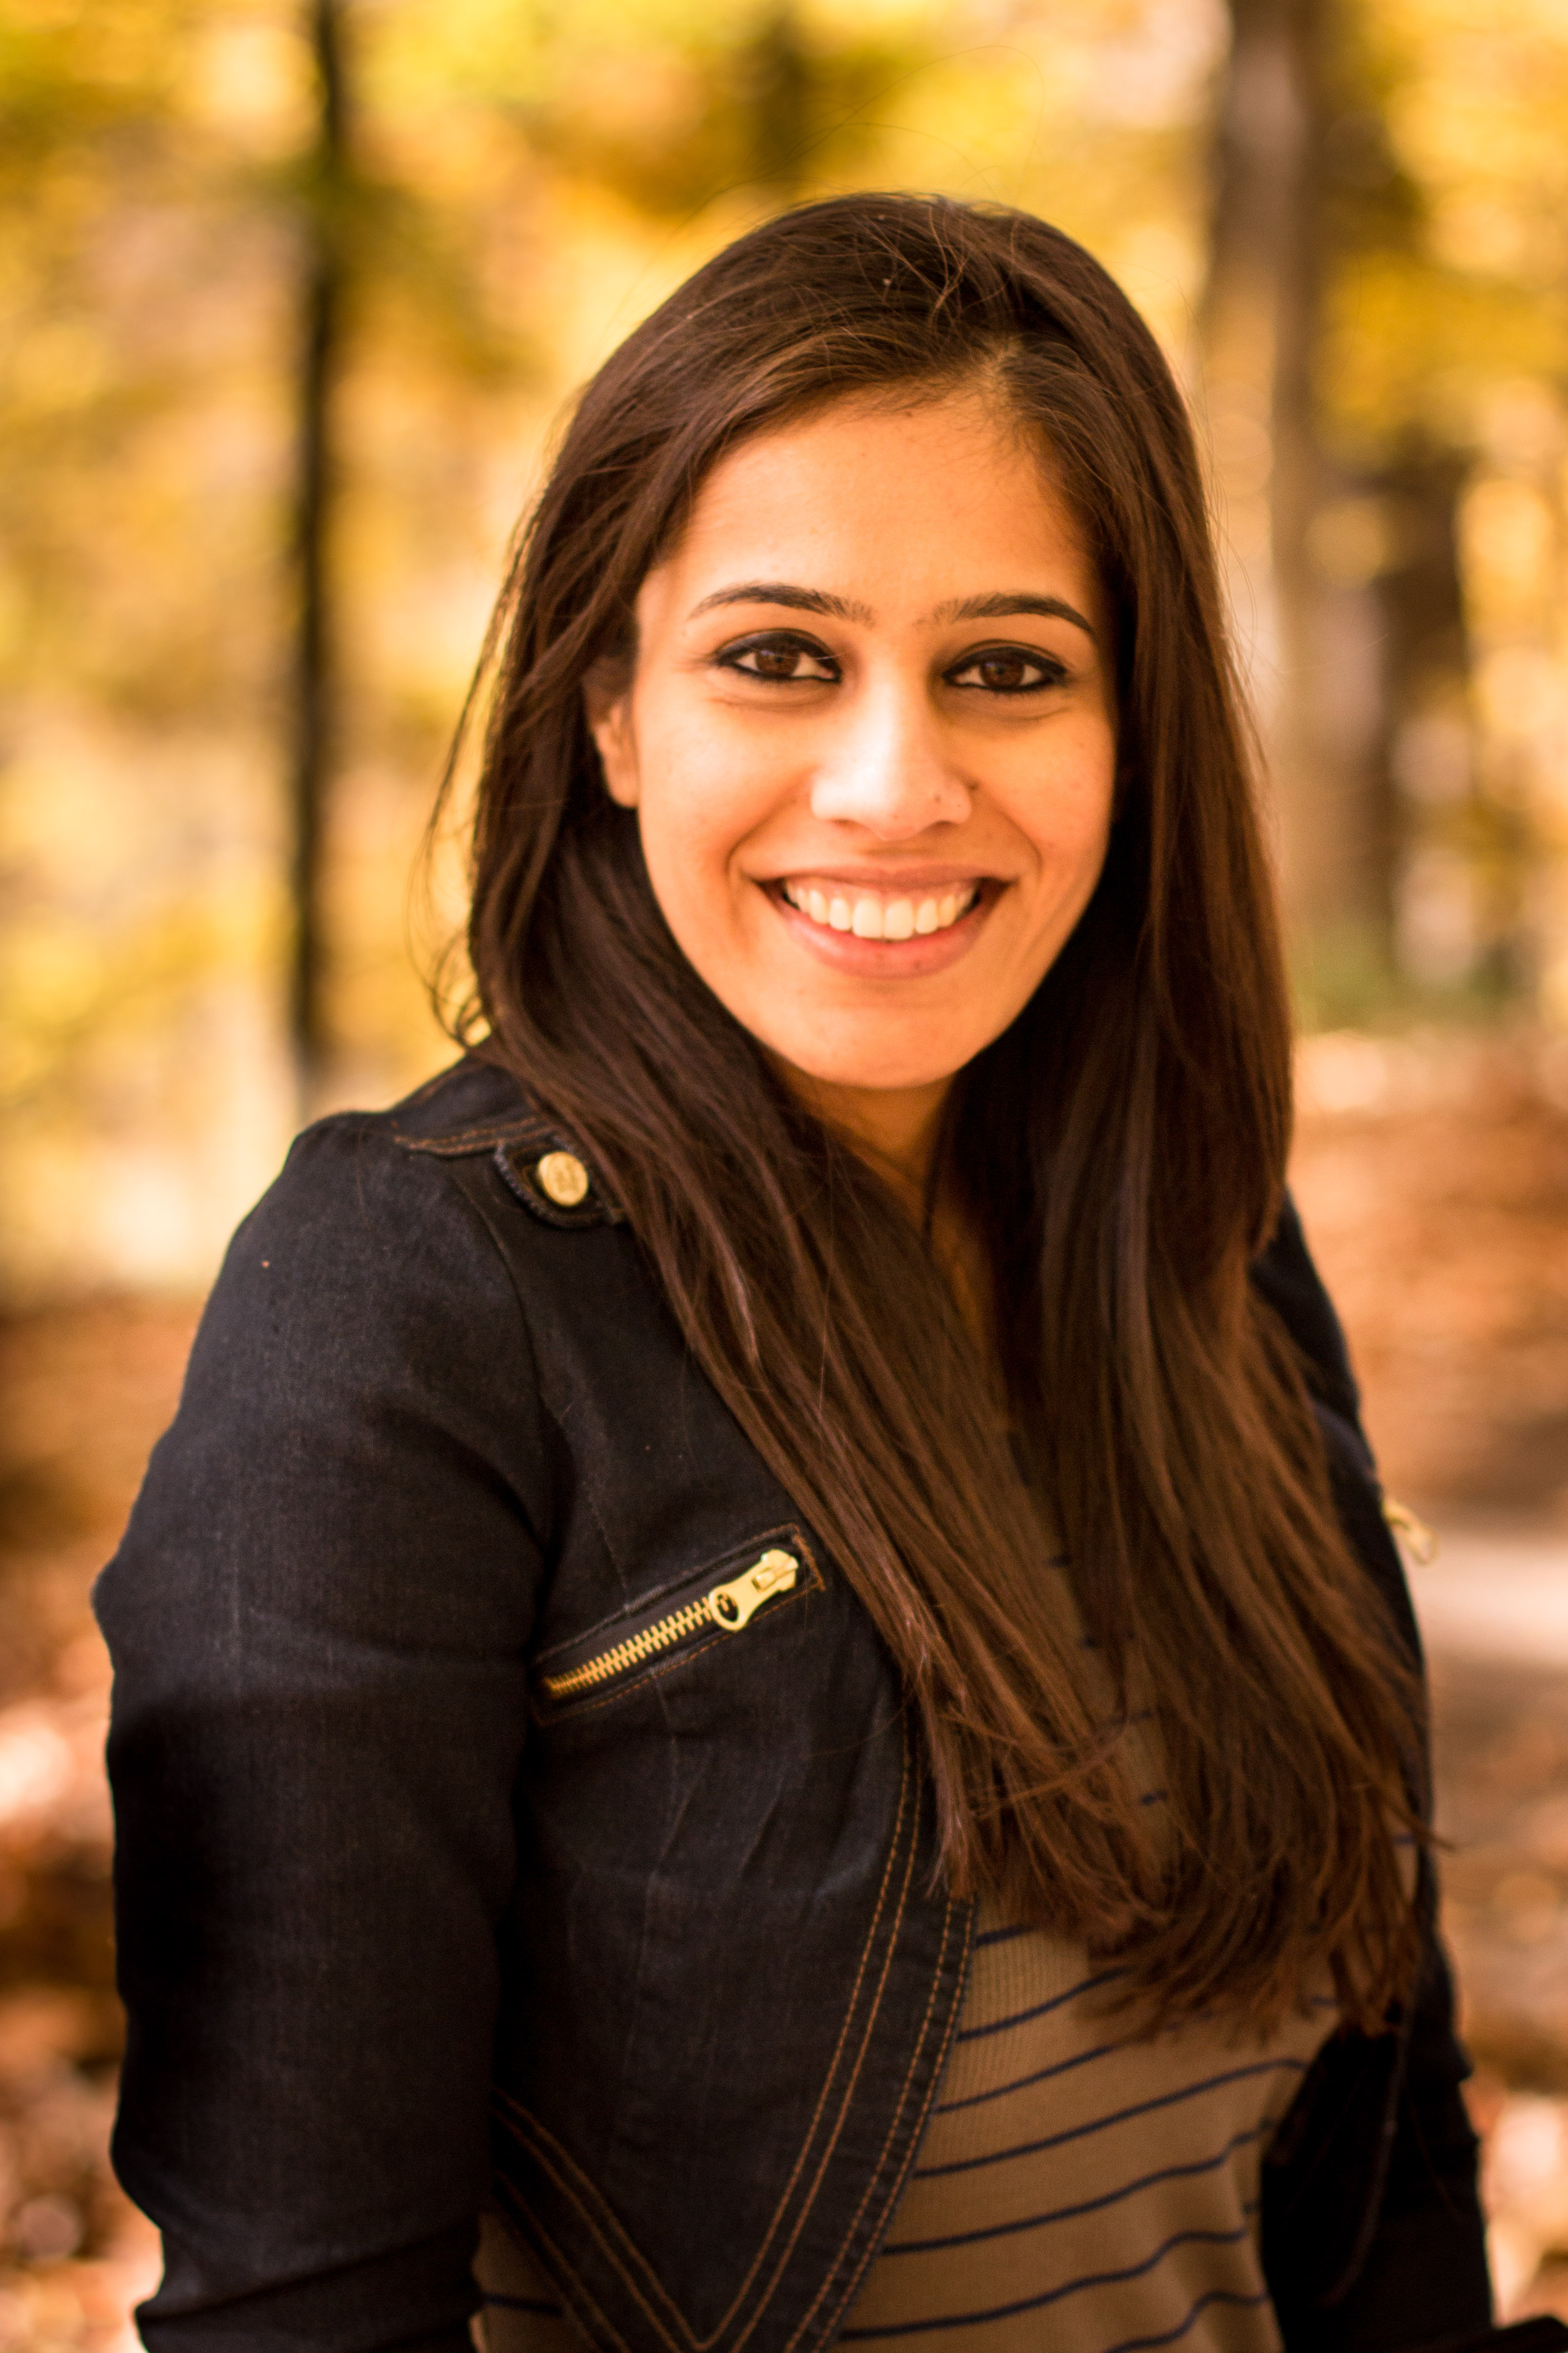
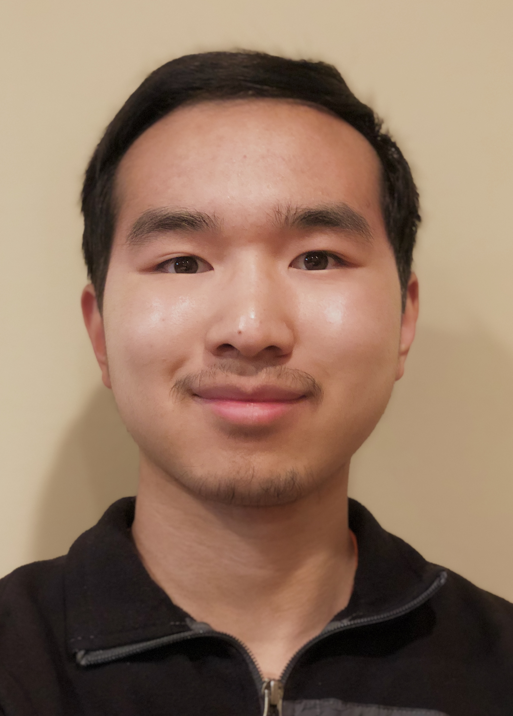
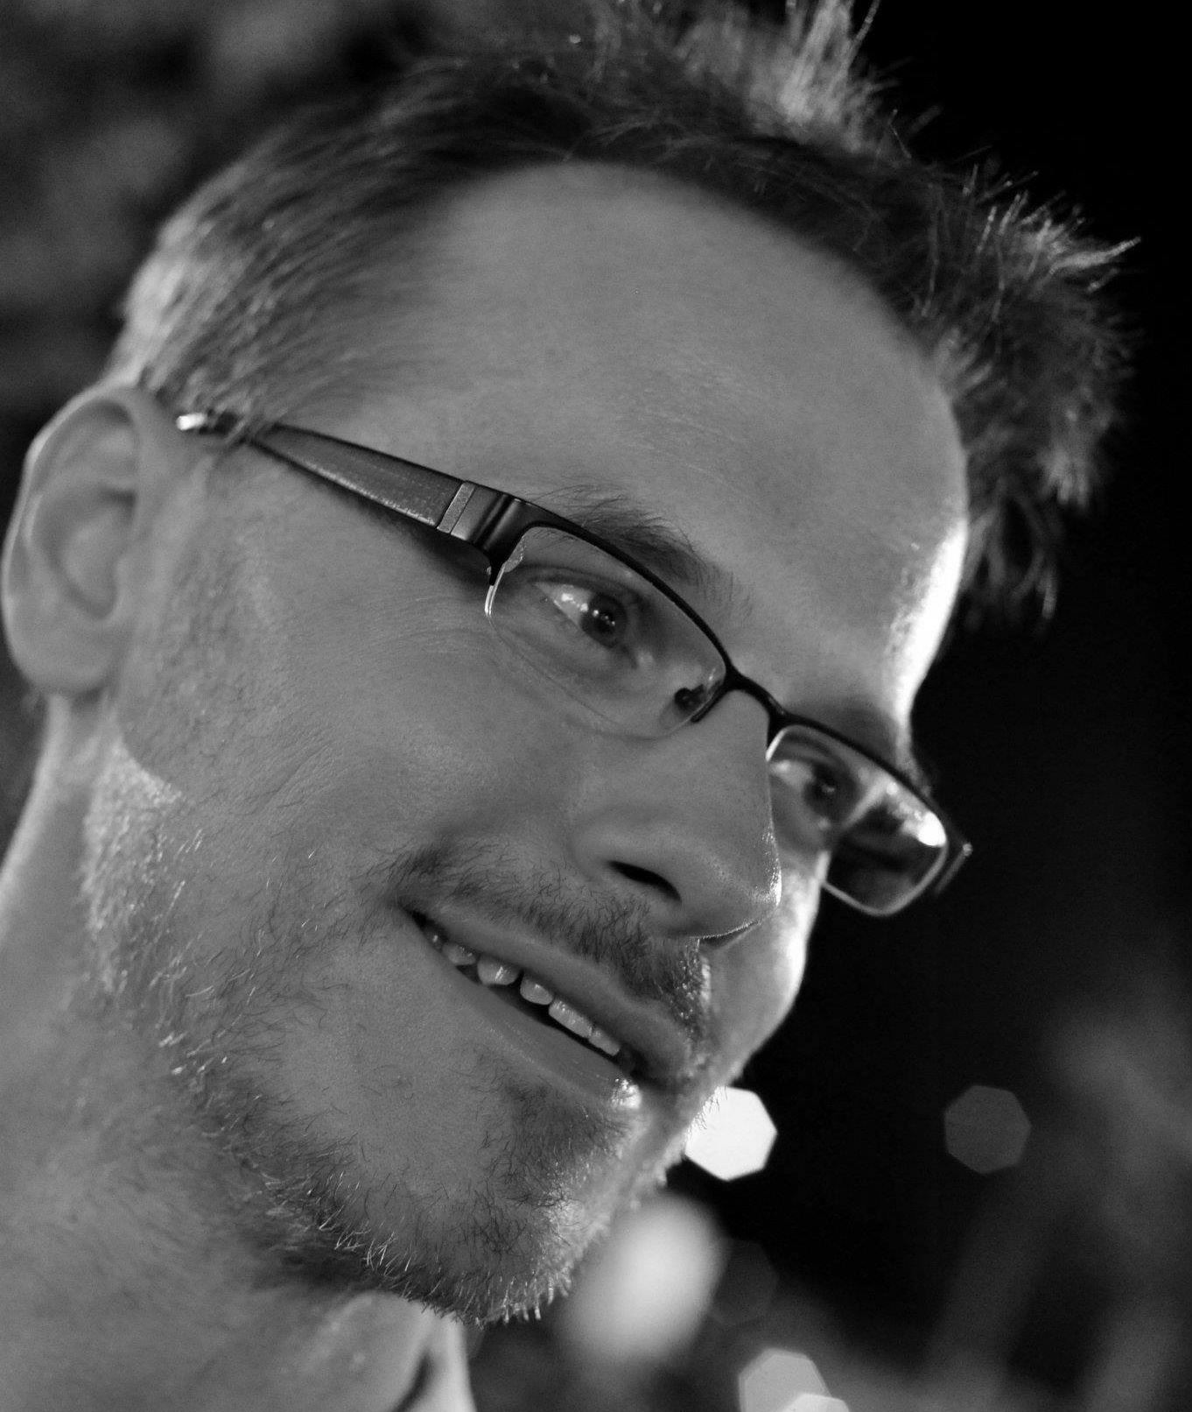
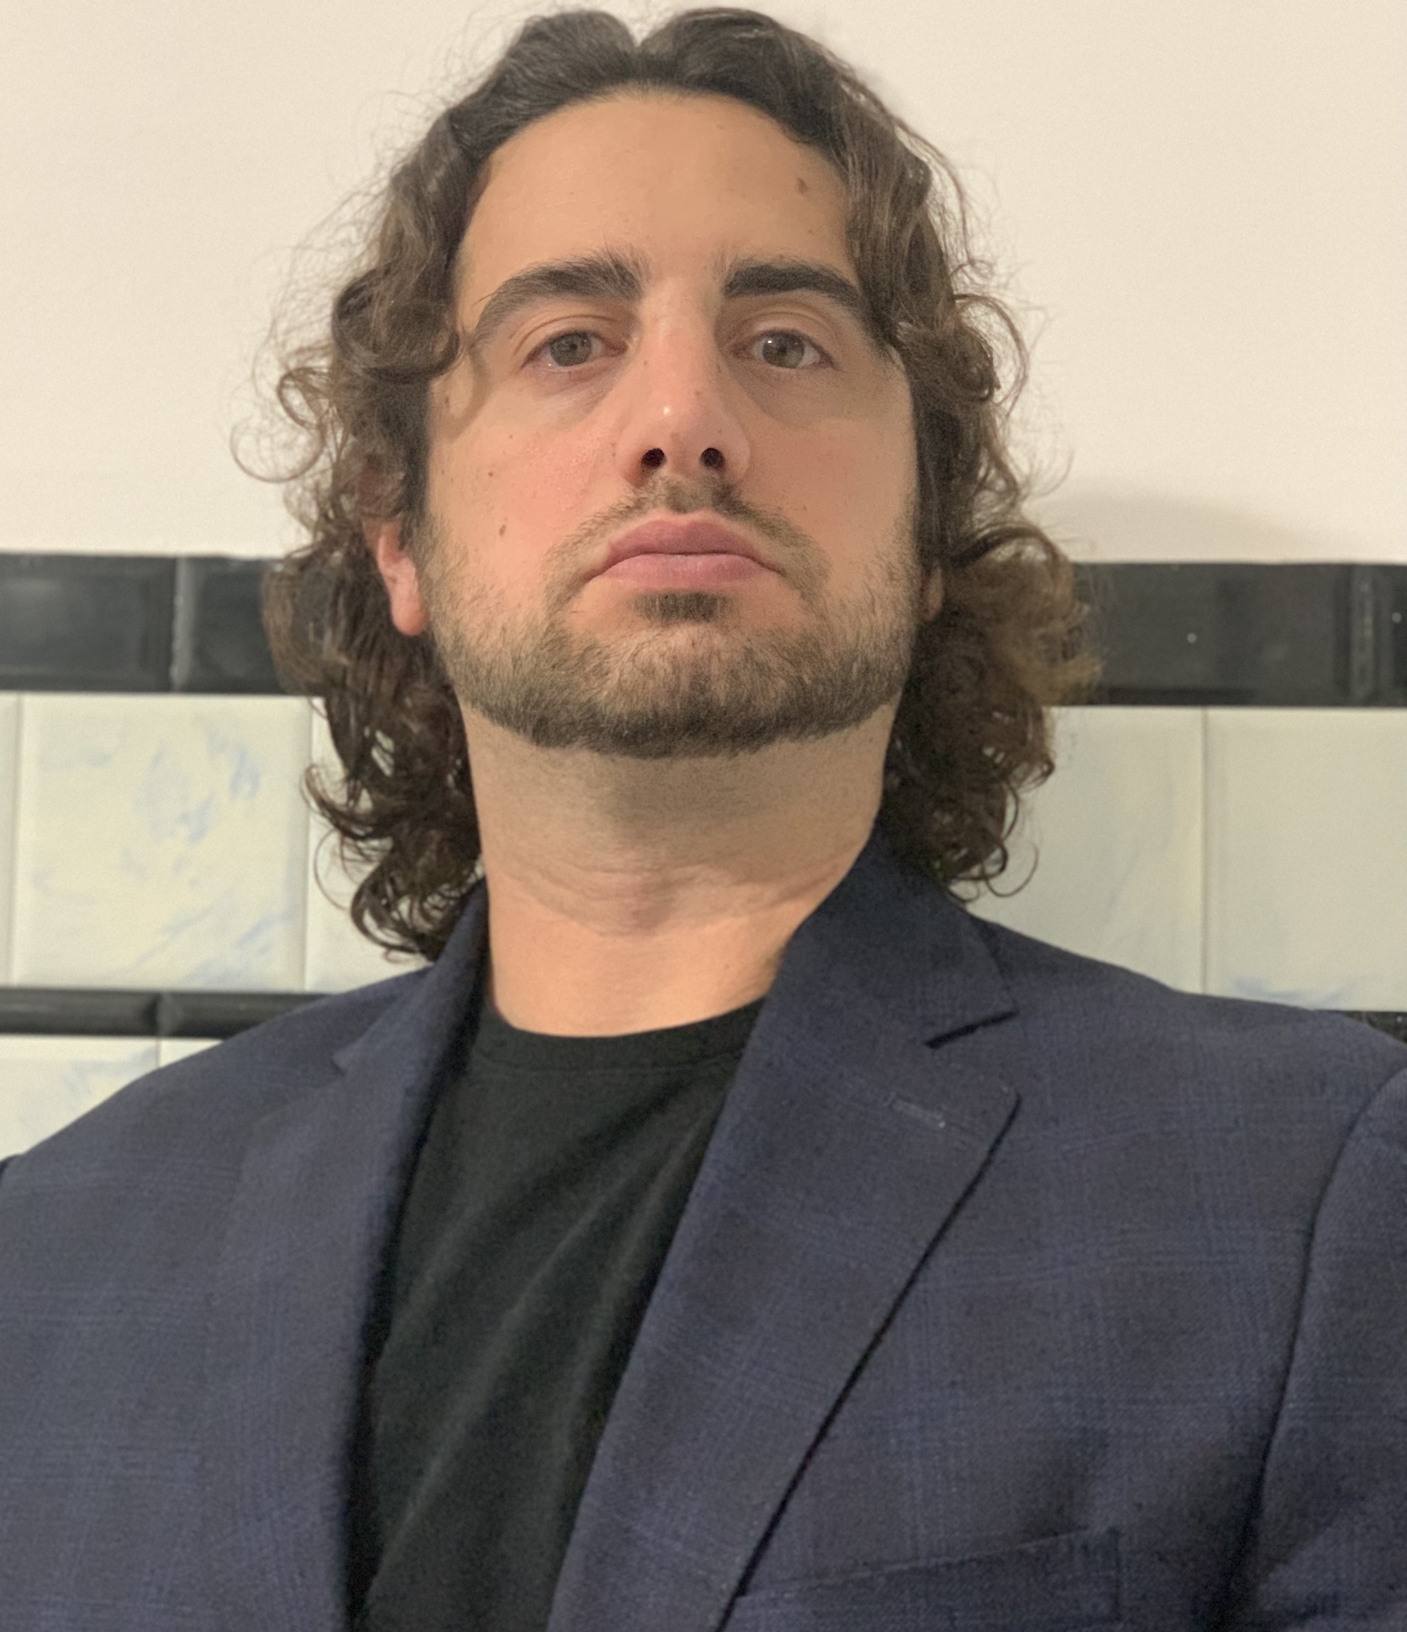
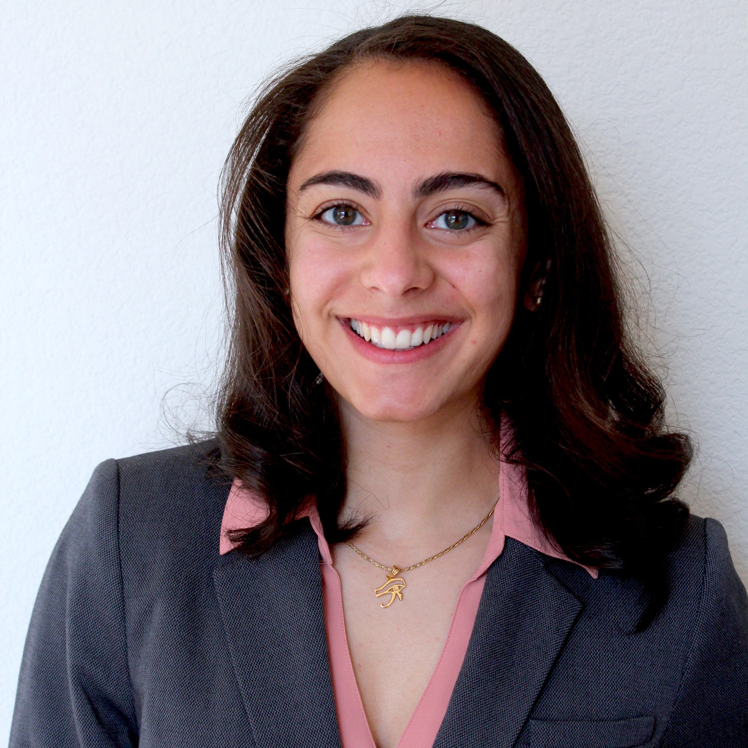
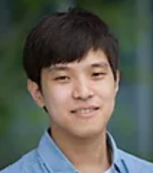
Acknowledgements – Griffith lab
Malachi
Griffith
Obi
Griffith
Erica Barnell
Katie
Campbell
Adam
Coffman
Kelsy Cotto
Arpad Danos
Bryan
Fisk
Sharon Freshour
Felicia Gomez
Jasreet
Hundal
Susanna Kiwala
Kilannin
Krysiak
Brian Li
John Maruska
Josh
McMichael
Dorian Morrissey
Megan Richters
Jason
Saliba
Lana Sheta
Zachary
Skidmore
Jason Walker
Huiming Xia
Jongsoo
Yoon
Undergraduates: Anamika Basu, Maya Natesan, Charles Shen, Jonathan Song and current PhD rotation students: Kartik Singhal, My Hoang, Nahyun Kong.
Notes:
With that I will end here by acknowledging all the members of our lab and the pVACtools team in particular.
For this work, I would like to particularly thank: Obi Griffith, Susanna Kiwala, Huiming Xia, Megan Richters, Josh McMichael, Jasreet Hundal, Cody Ramirez and Alex Wollam

Slide 19
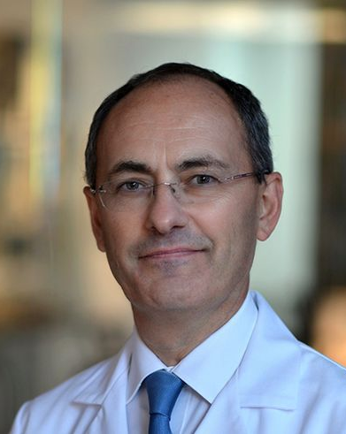
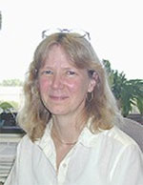
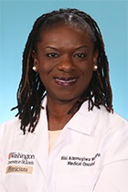
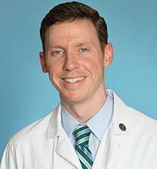
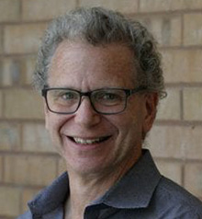
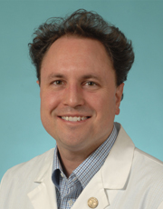
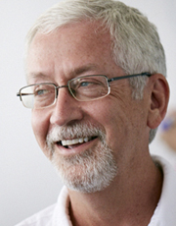
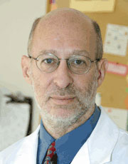
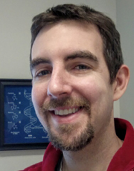
Acknowledgements – Collaborators
Solid Tumor
Govindan
Ellis (Baylor)
Schuler (Wisconsin)
Ademuyiwa
Dunn
Gillanders
Lin
Chapman
Fields
Uppaluri
(DFCI)
Rubin
Carreno
Hematologic
Bioinformatics
Fehniger
Ley
Wartman
Ratner
Miller
Walker
Notes:
- I would also like to acknowledge our wonderful collaborators, particularly for this work: Will Gillanders, Chris Miller, Gavin Dunn, Beatriz Carreno, Ravi Uppaluri, and Todd Fehinger who lead some of the clinical trials we are most actively engaged with.

Slide 20
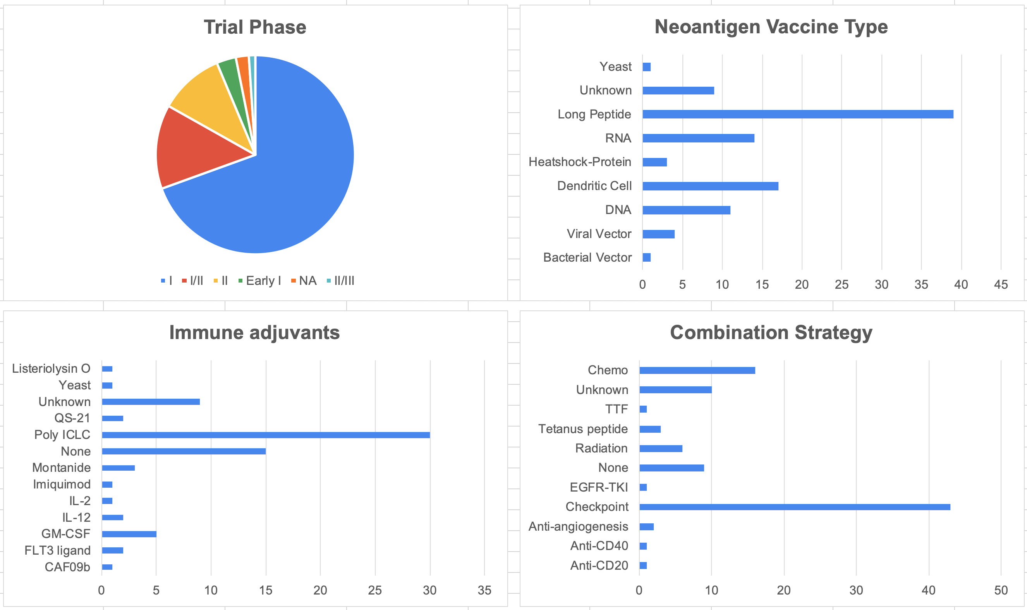
The clinical trial landscape suggests a diversity of outstanding questions (neoantigen.clinwiki.org summary)
This effort was supported by a gift from the Jaime Leandro Foundation for Therapeutic Cancer Vaccines
Notes:
These are just the few trials that we are directly involved in.
In parallel, we have begun an effort to systematically catalogue the characteristics of all active neoantigen vaccine trials worldwide.
This is being done in collaboration with the Jamie Leandro Foundation for Cancer Vaccines and ClinWiki
The results of this effort are publicly available at neoantigen.clinwiki.org. We are just getting going with this project but hope to have a completed first version by this summer.

Slide 21
Relevant publications
Hundal J, Carreno BM, Petti AA, Linette GP, Griffith OL, Mardis ER, Griffith M. pVAC-Seq: A genome-guided in silico approach to identifying tumor neoantigens. Genome Medicine. 2016 Jan 29;8(1):11. PMID: 26825632.
Hundal J, Kiwala S, Feng YY, Liu CJ, Govindan R, Chapman WC, Uppaluri R, Swamidass SJ, Griffith OL, Mardis ER, Griffith M. Accounting for proximal variants improves neoantigen prediction. Nature Genetics. 2019 Jan;51(1):175-179. PMID: 30510237.
Richters MM, Xia H, Campbell KM, Gillanders WE, Griffith OL, Griffith M. Best practices for bioinformatic characterization of neoantigens for clinical utility. Genome Medicine. 2019 Aug 28;11(1):56. PMID: 31462330.
Hundal J, Kiwala S, McMichael J, Miller CA, Xia H, Wollam AT, Liu CJ, Zhao S, Feng YY, Graubert AP, Wollam AZ, Neichin J, Neveau M, Walker J, Gillanders WE, Mardis ER, Griffith OL, Griffith M. pVACtools: A Computational Toolkit to Identify and Visualize Cancer Neoantigens. Cancer Immunology Research. 2020 Mar;8(3):409-420. PMID: 31907209.
De Mattos-Arruda L, Vazquez M, Finotello F, Lepore R, Porta E, Hundal J, Amengual-Rigo P, Ng CKY, Valencia A, Carrillo J, Chan TA, Guallar V, McGranahan N, Blanco J, Griffith M. Neoantigen prediction and computational perspectives towards clinical benefit: Recommendations from the ESMO Precision Medicine Working Group. Annals of Oncology. 2020 May 19. PMID: 32610166.

Slide 22
Funding
The primary academic affiliation of the Griffith Lab is the Department of Medicine at Washington University (secondary affiliation with Department of Genetics). The Griffith Lab is located at the McDonnell Genome Institute. The McDonnell Genome Institute is one of several large-scale sequencing centers in the United States funded by the National Institutes of Health (NIH) and National Human Genome Research Institute (NHGRI). In addition to support from Washington University, the Griffith Lab has received support from the external funding agencies, non-profit foundations, and other organizations shown here.

