Slide 1
Informatics Tools to Analyze and Model Whole Slide Imaging Data at the Single Cell Level
09/14/2022
Guanghua “Andy” Xiao
Professor
Mary Dees McDermott Hicks Chair in Medical Science
Quantitative Biomedical Research Center
Department of Population & Data Sciences
Department of Bioinformatics
UT Southwestern Medical Center at Dallas

Slide 2
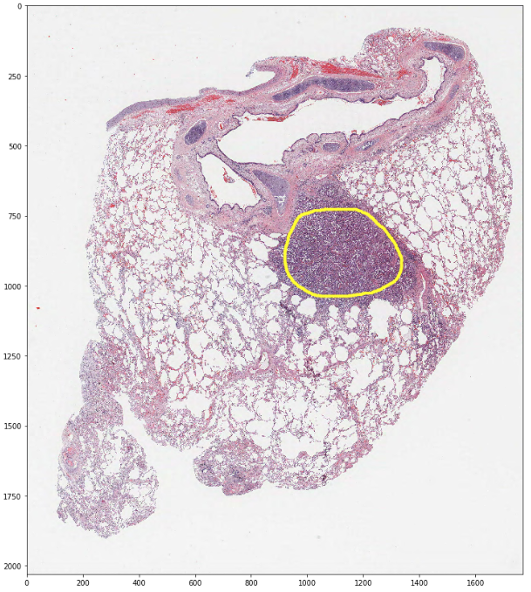
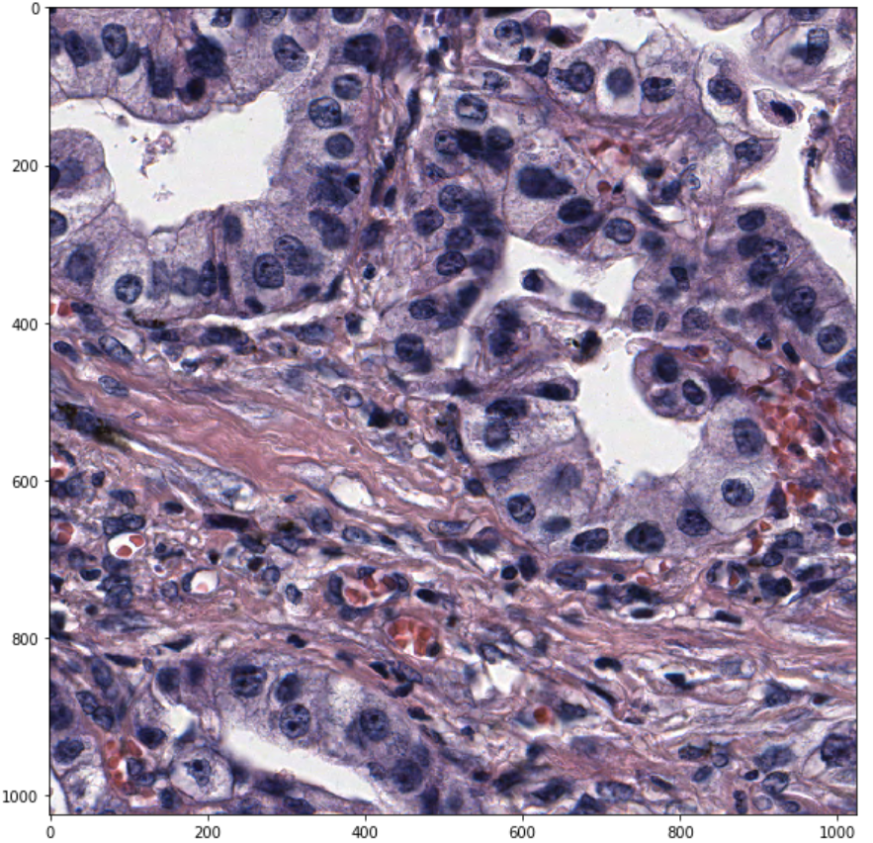
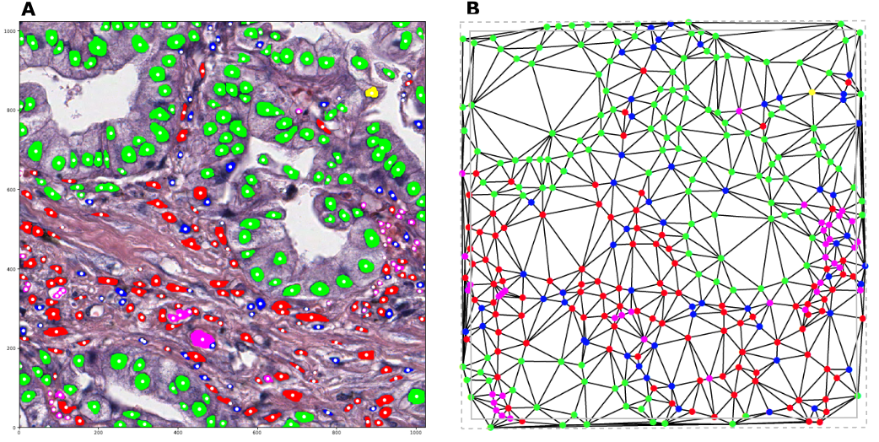
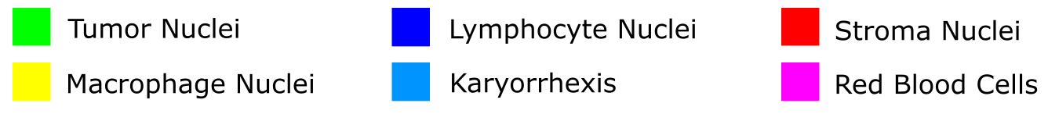
Algorithm Developments ---- Histology-based Digital (HD)-Staining
Algorithm Developments ---- Histology-based Digital (HD)-Staining
Pathology Slide
HD-staining results
Study tumor microenvironment
Image Patch
ROI
Hematoxylin and Eosin (H&E) stained tissue slide
Wang et al, Cancer Research, 2020
Wang et al, EBiomedicine, 2019
Li et al, Biostatistics 2018
Li et al, Annals of Applied Statistics, 2020

Slide 3
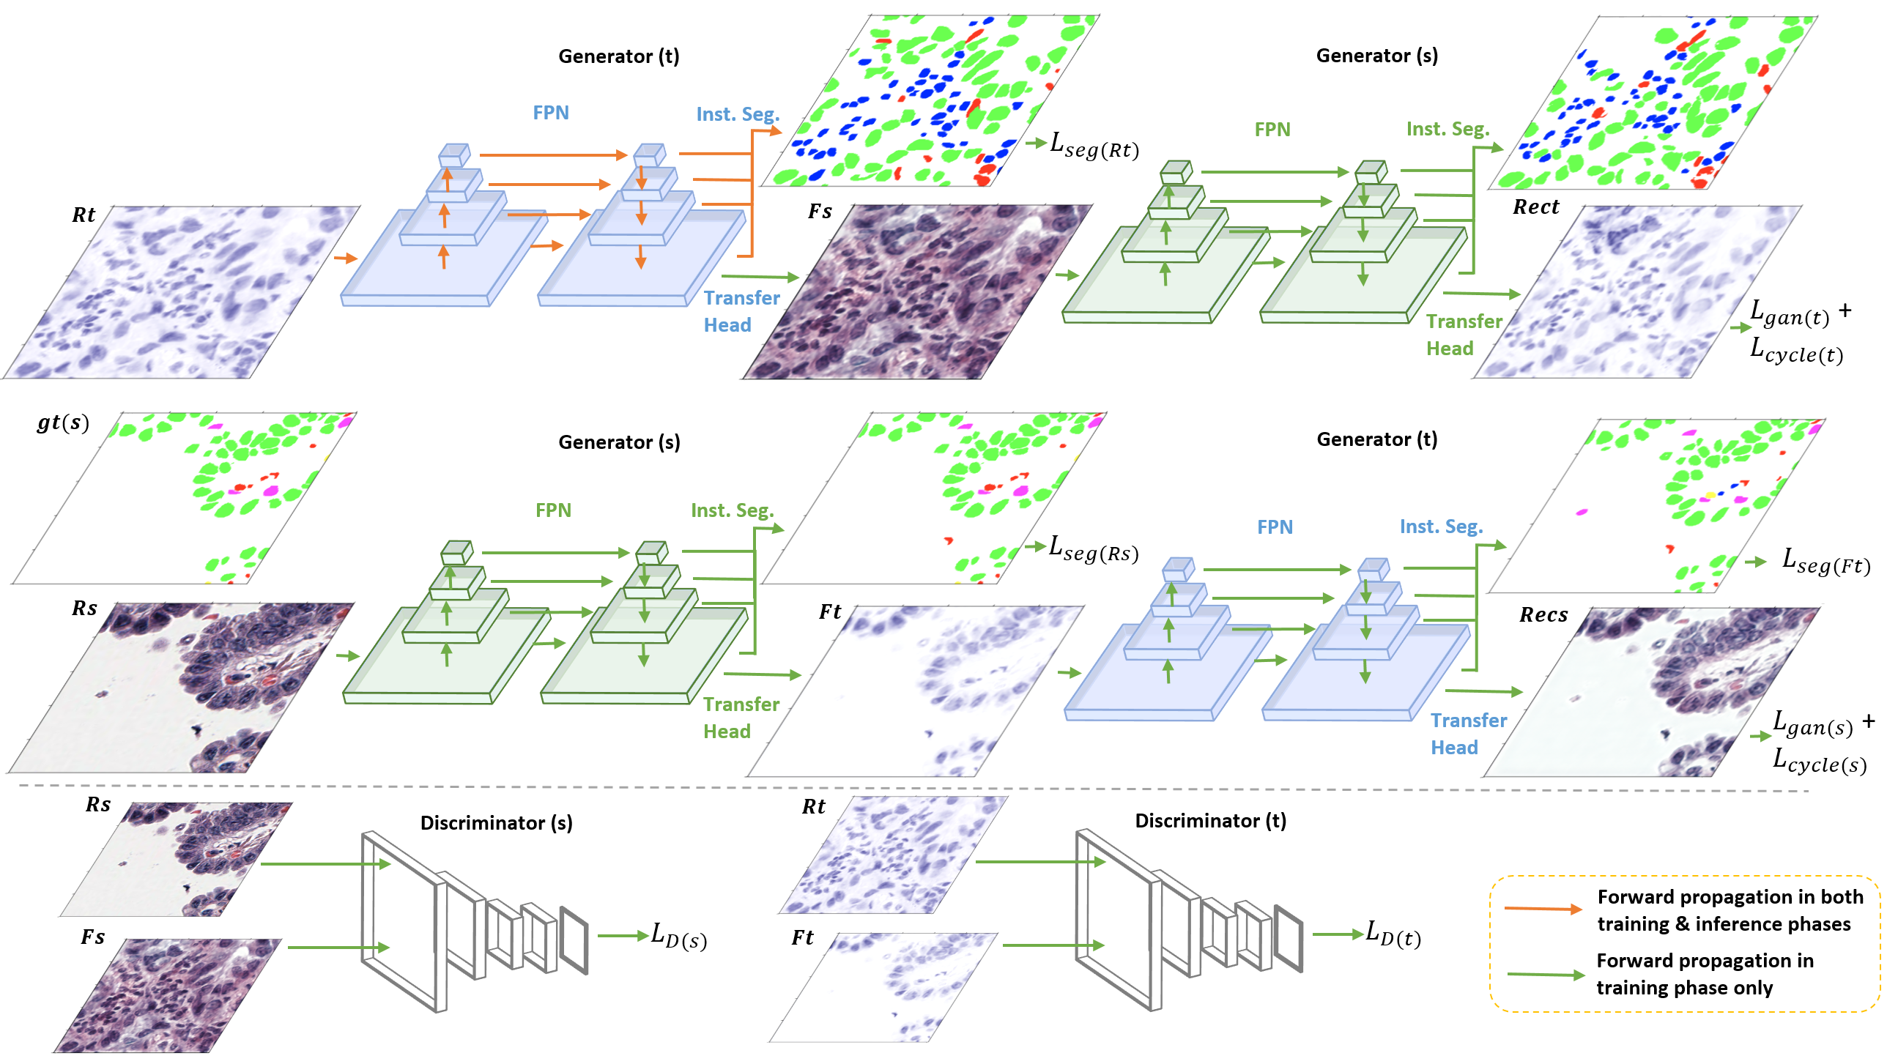
Algorithm Developments ---- Cell type classification using H-channel alone for Immunohistochemistry (IHC) stained images
Algorithm Developments ---- Histology-based Digital (HD)-Staining
Generative Adversarial Networks-based classification of Cells

Slide 4
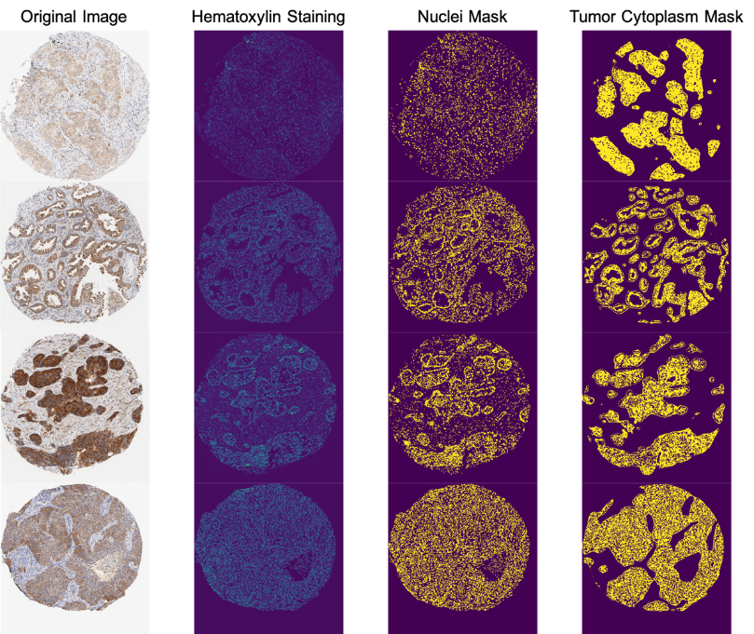
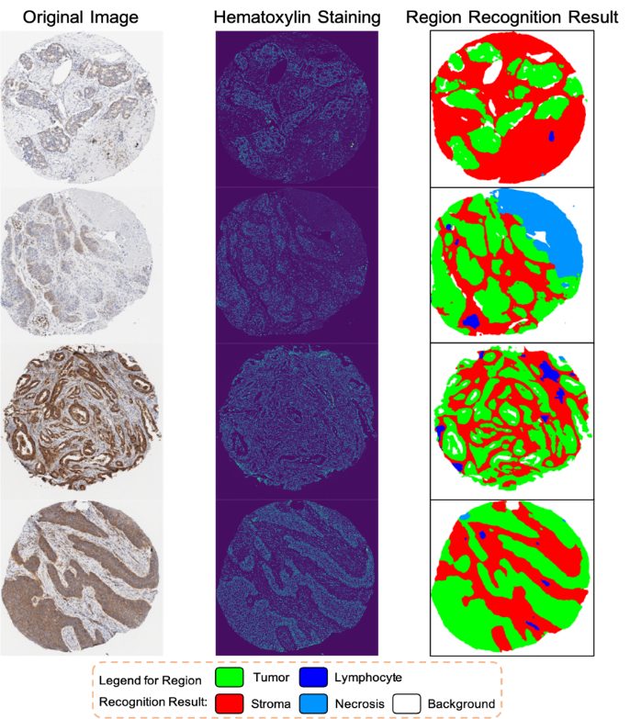
Application: Automatic IHC quantification
Algorithm Developments ---- Histology-based Digital (HD)-Staining
Nuclei Recognition
Region Recognition

Slide 5
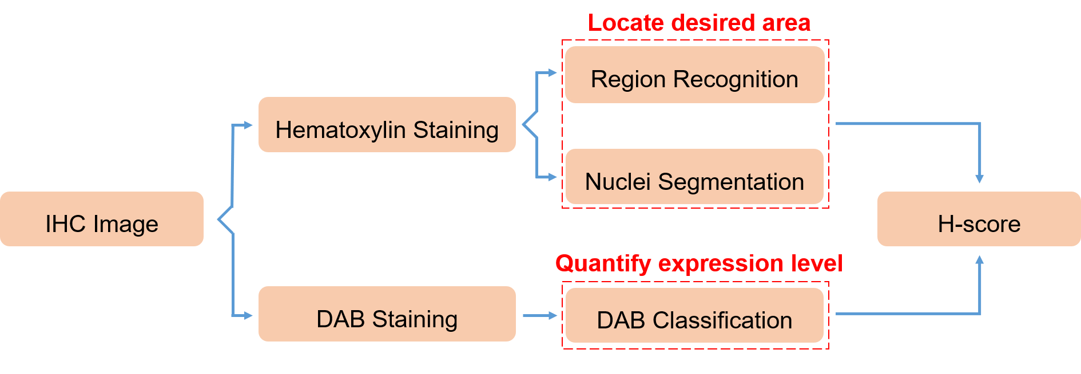
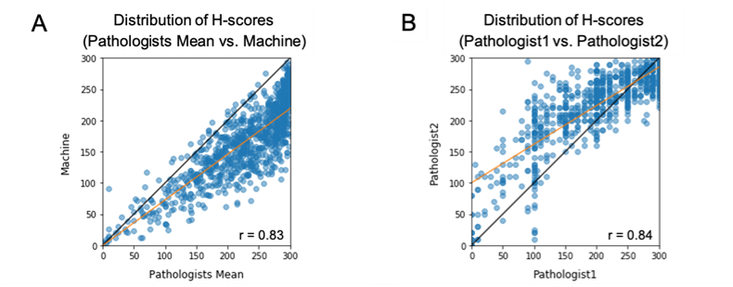
Application: Automatic IHC quantification
Algorithm Developments ---- Histology-based Digital (HD)-Staining

Slide 6
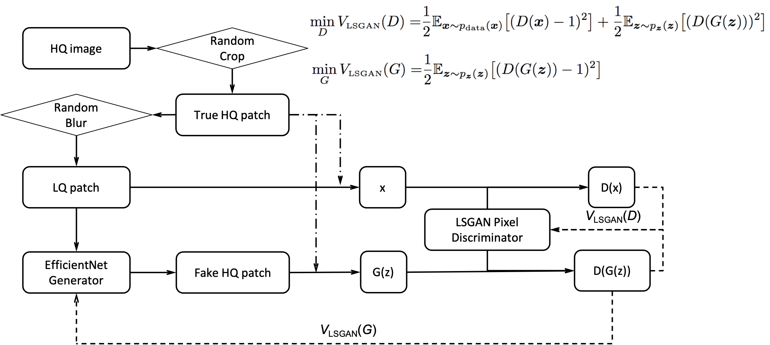
Enhance Pathology Image Quality with Restore-GAN
Algorithm Developments ---- Histology-based Digital (HD)-Staining

Slide 7
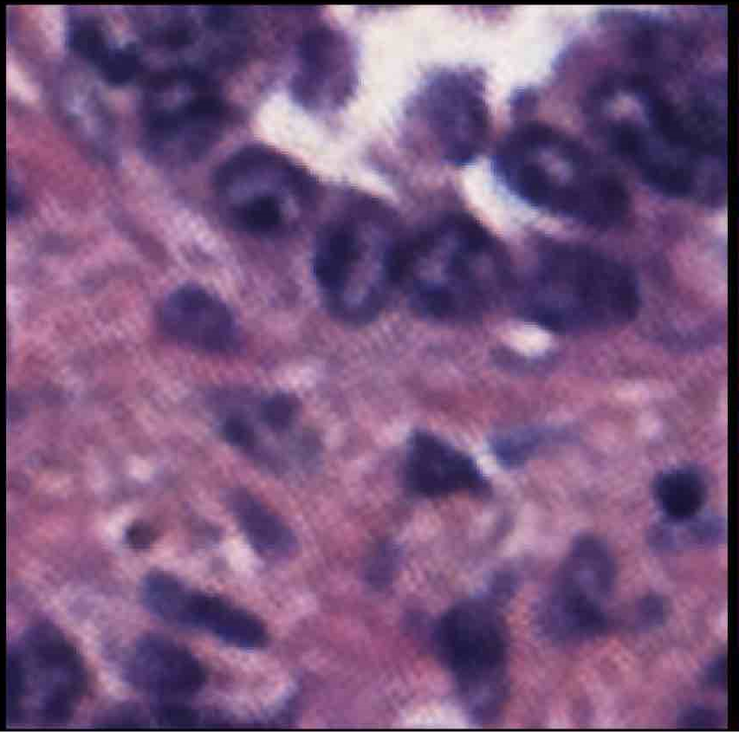
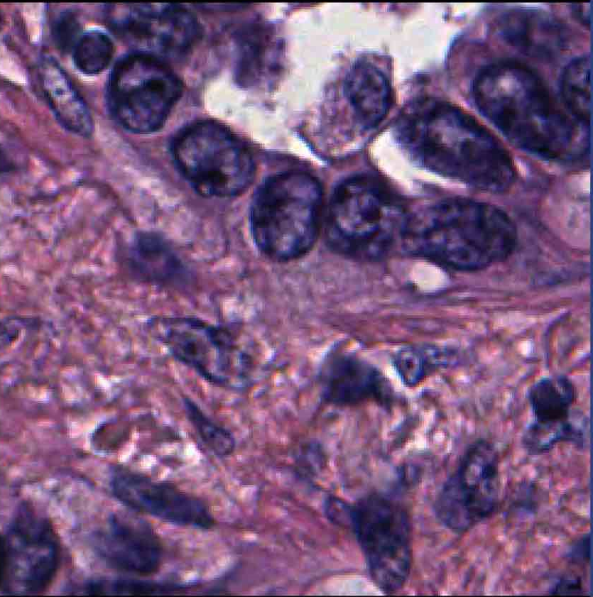
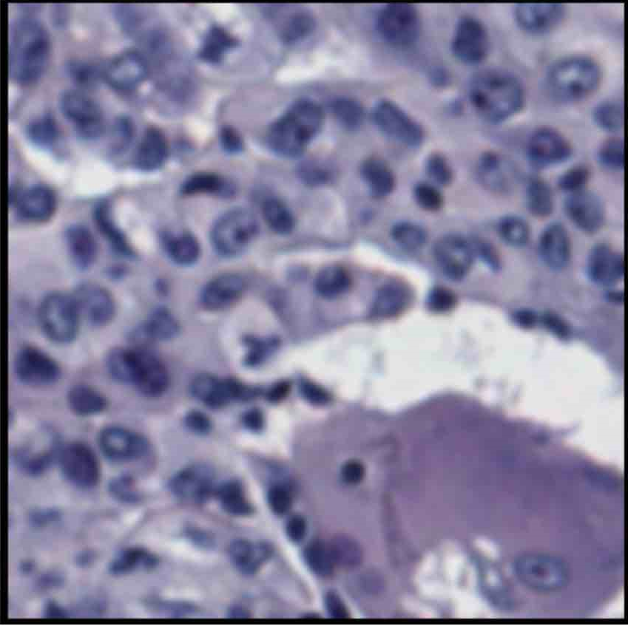
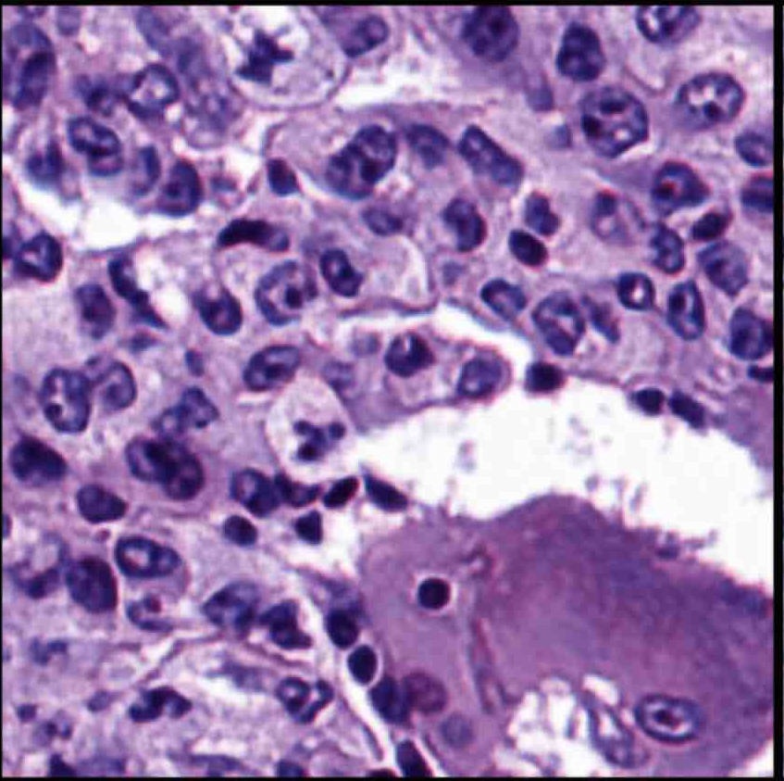
Enhance Pathology Image Quality with Restore-GAN
Algorithm Developments ---- Histology-based Digital (HD)-Staining
(A) A low resolution image patch from a 10X tissue image
(B) 40X high resolution image generated by restore-GAN
(D) improve image quality and color normalization using Restore-GAN
(C) low quality image patch

Slide 8
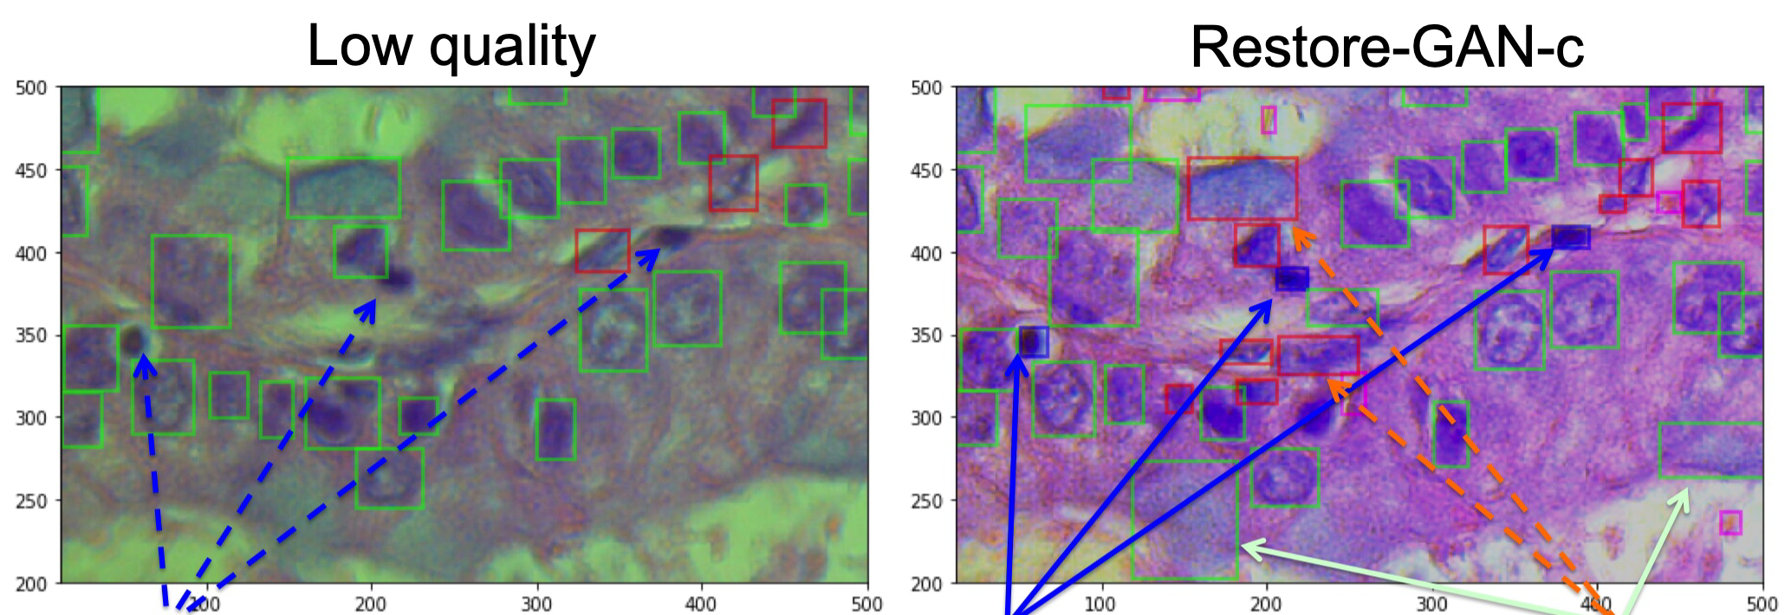
Enhance Pathology Image Quality with Restore-GAN
Algorithm Developments ---- Histology-based Digital (HD)-Staining
(A)
(B)
Lymphocytes
Lymphocytes
Stromal cells
Utilize Restore-GAN/Restore-GAN-c to enhance quality and normalize colorization. (A) A low quality image taken by a camera under a microscope. In order to clearly see the original image, we only show bounding box instead of mask of successfully detected nuclei. Green: tumor nuclei; Red: stromal nuclei; blue: lymphocyte nuclei; pink: blood cell. (B) image enhanced and color normalized using Restore-GAN-c. After enhancing resolution, missing lymphocytes (blue) and stromal cells are successfully recovered by HD-Staining algorithm.

Slide 9
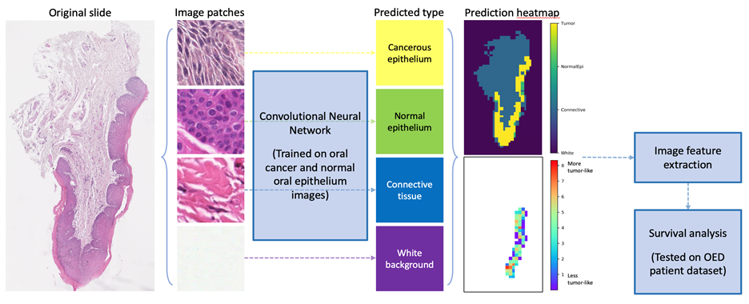
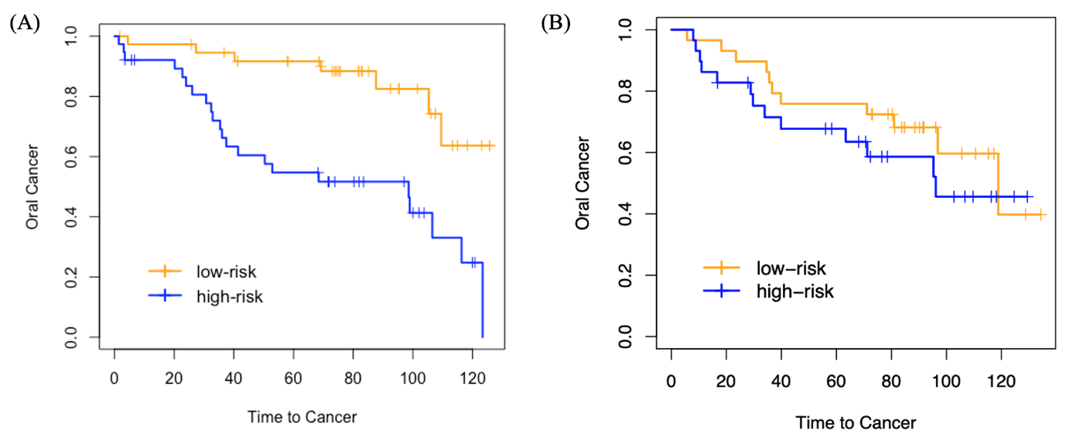
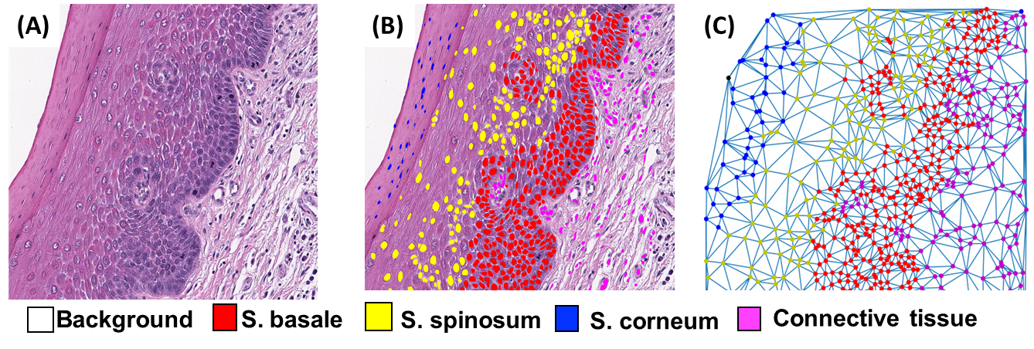
Potential Clinical Applications: Oral Cancer Risk Assessment
Algorithm Developments ---- Histology-based Digital (HD)-Staining
Time from oral dysplasia to cancer
HR = 3.33
95% CI = 1.37 – 8.09
p value = 0.007

Slide 10
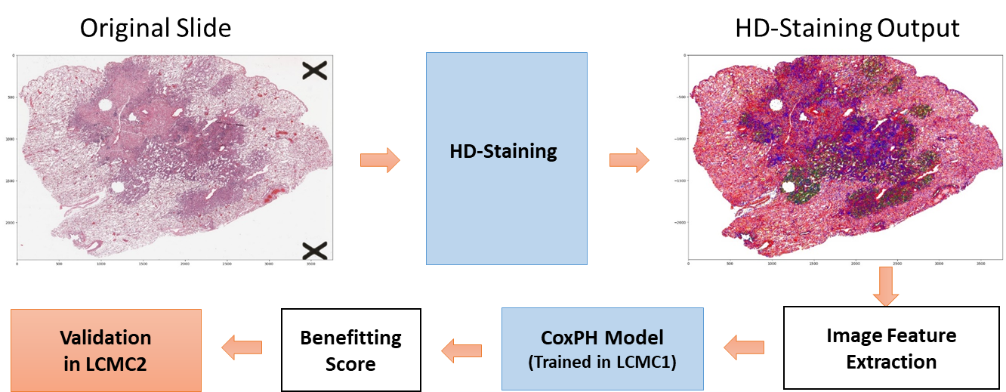
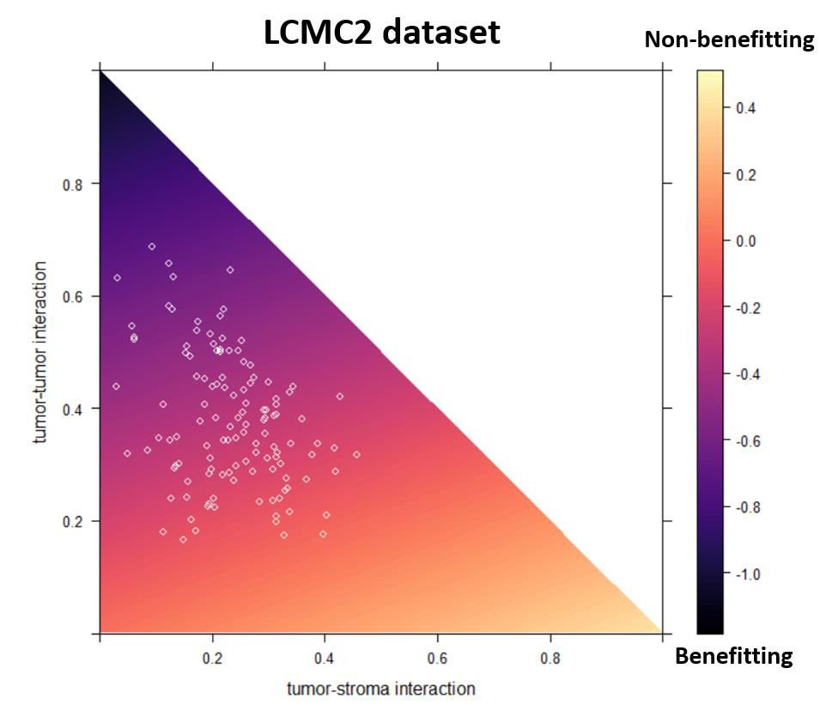
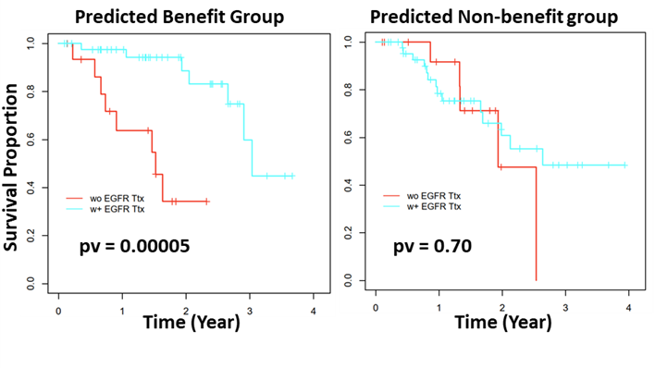
Potential Clinical Applications: Predict Patient Response to EGFR Targeted Therapy

Slide 11
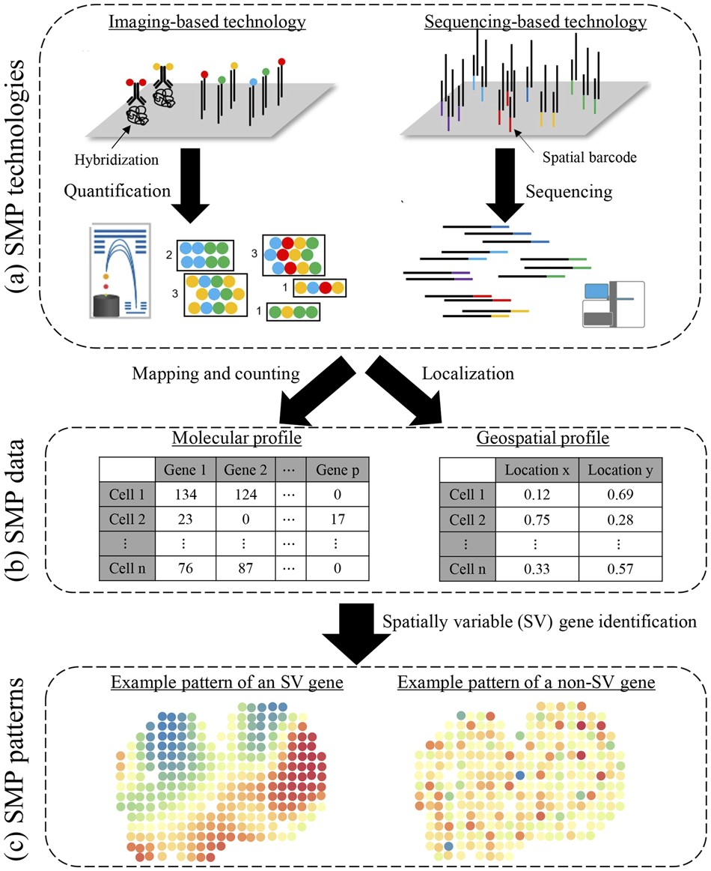
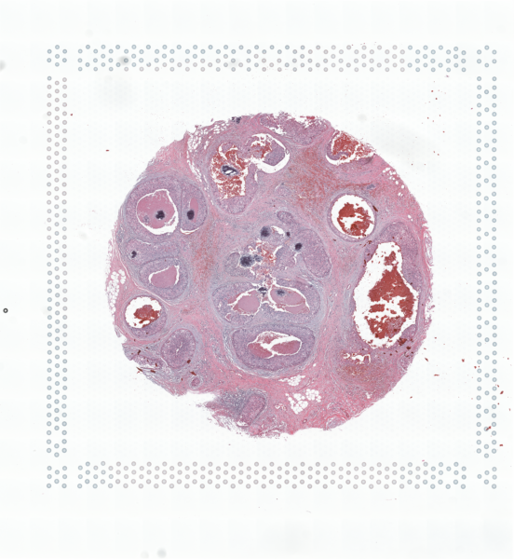
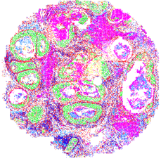
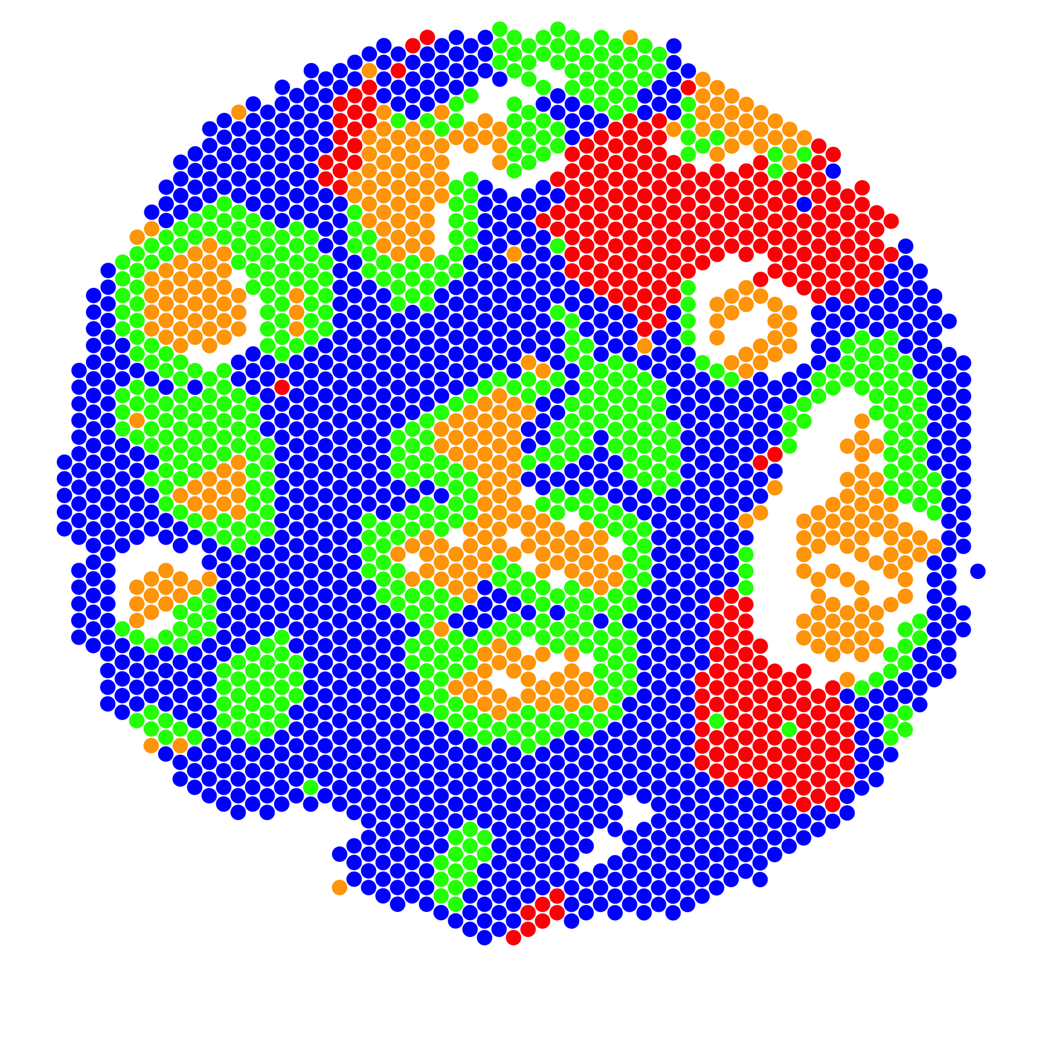
Spatial molecular profiling data analysis
Algorithm Developments ---- Histology-based Digital (HD)-Staining
Tumor tissue
Spatial Transcriptomics analysis
AI-based tissue image analysis

Slide 12
Informatics tools development for pathology imaging data
Algorithm Developments ---- Histology-based Digital (HD)-Staining

