Slide 1
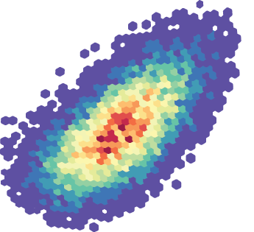
Inferring cell state tumor microenvironment maps by integrating single-cell and spatial transcriptomics
Itai Yanai
Institute for Computational Medicine
New York University School of Medicine

Slide 2
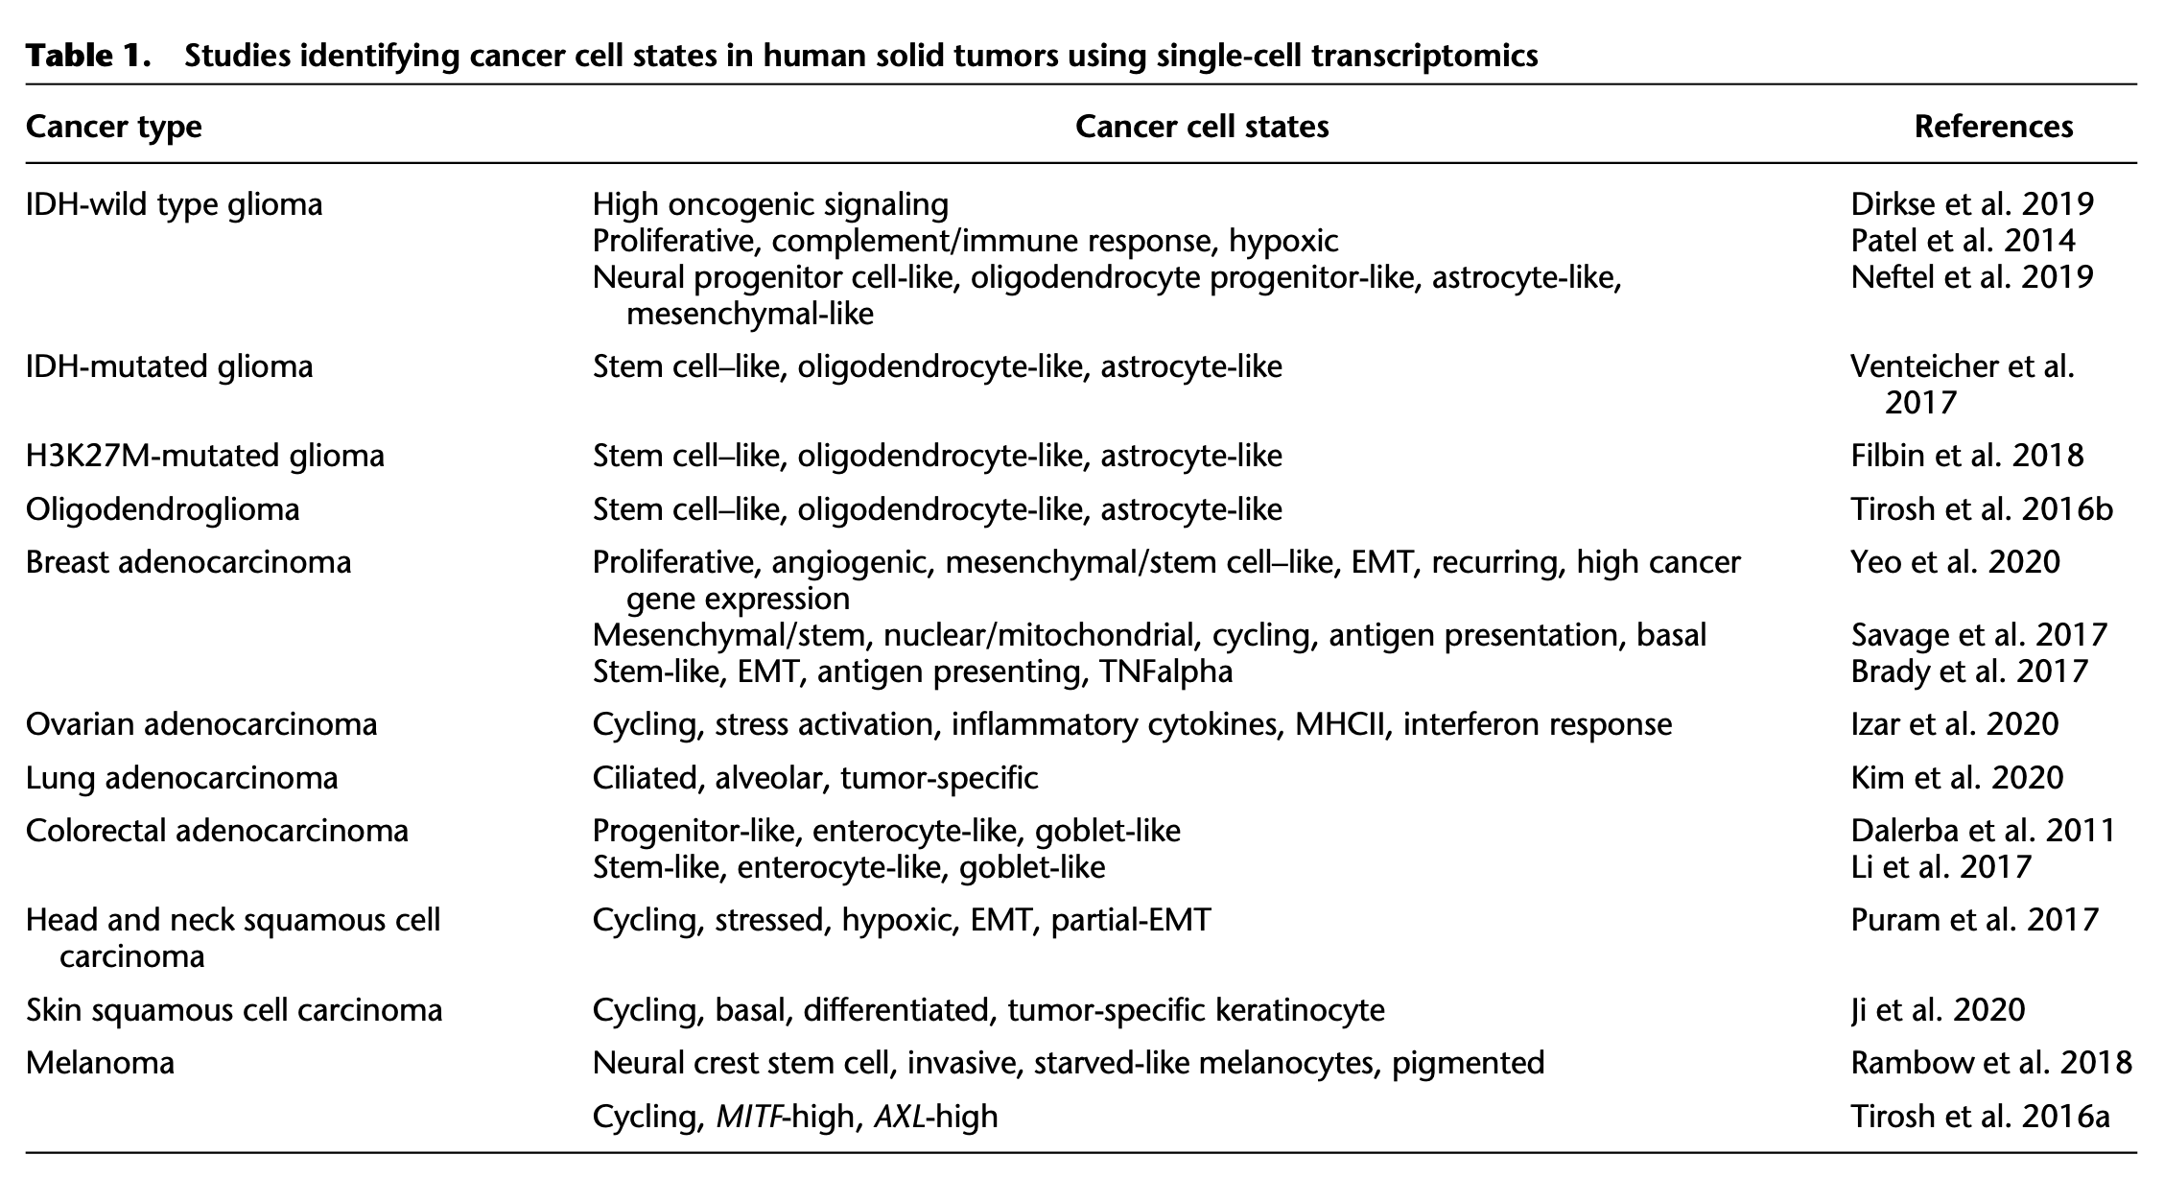
Many studies have identified cancer cell states using scRNA-Seq
Barkley et al. Genome Research 2021

Slide 3
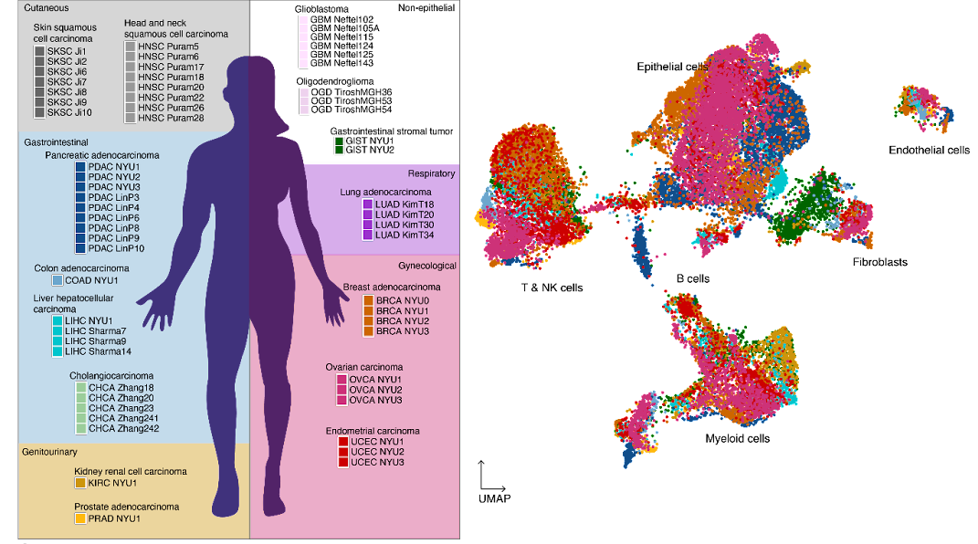
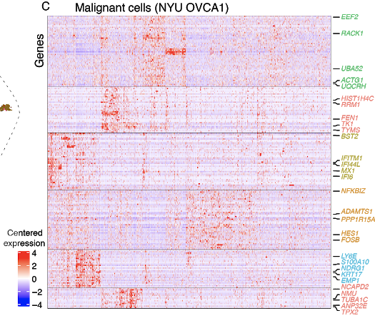
We studied 27 tumors of different cancer types
and used scRNA-Seq to detect gene modules
Tumor collection scRNA-Seq Module detection
Barkley et al., Nature Genetics 2022

Slide 4
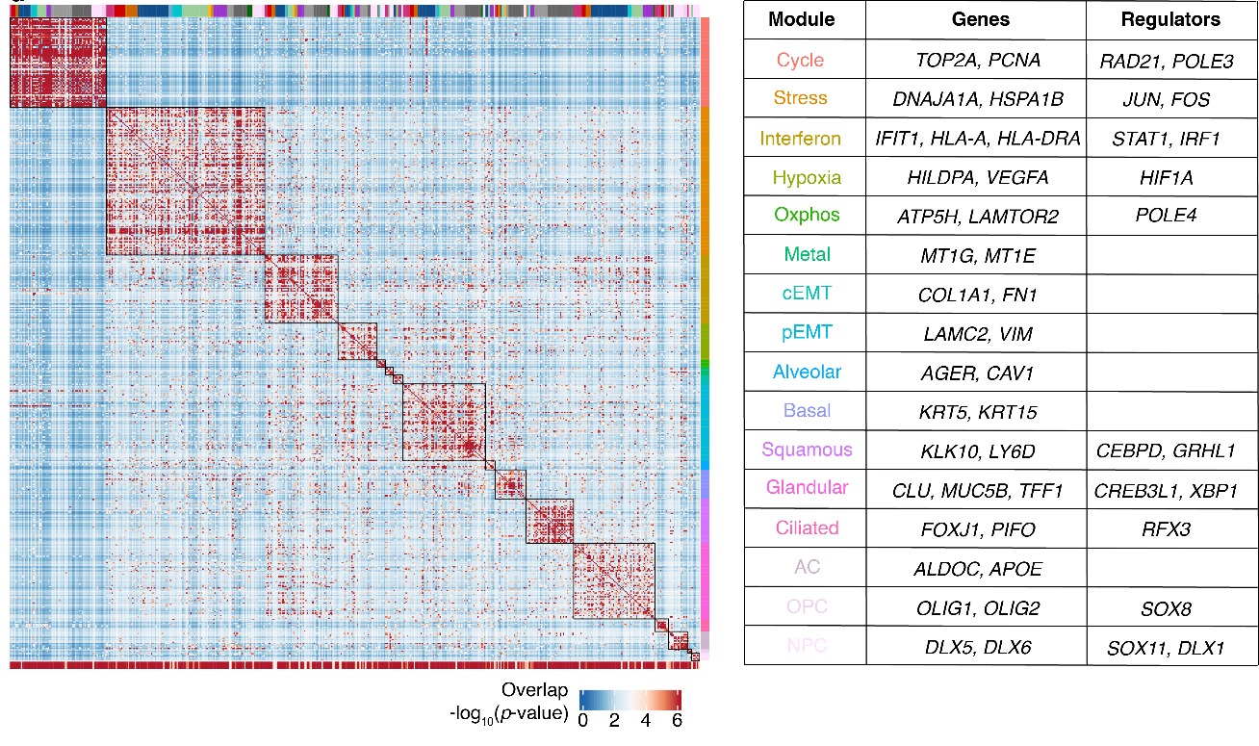
We identified a catalog of recurrent cancer gene modules
Barkley et al., Nature Genetics 2022

Slide 5
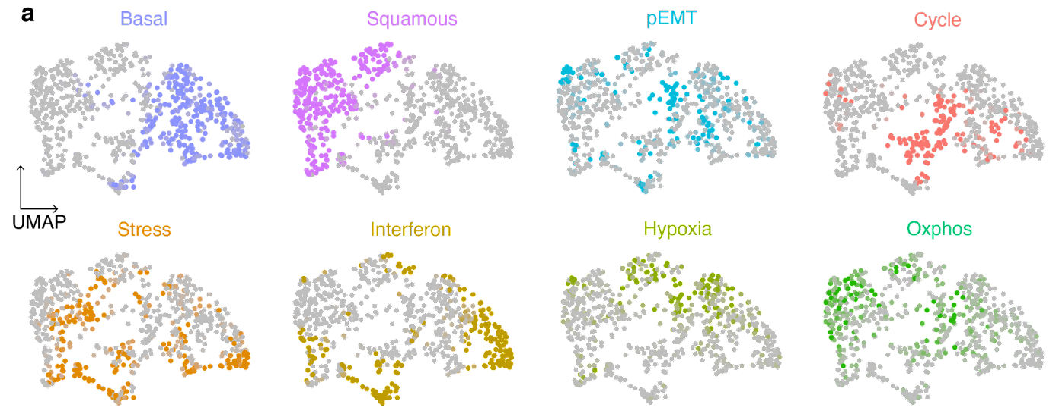
Cell states are mostly mutually exclusive
Barkley et al., Nature Genetics 2022

Slide 6
What are the roles of cancer cell states in tumorigenesis?
Barkley & Yanai. Trends in Cancer 2019

Slide 7
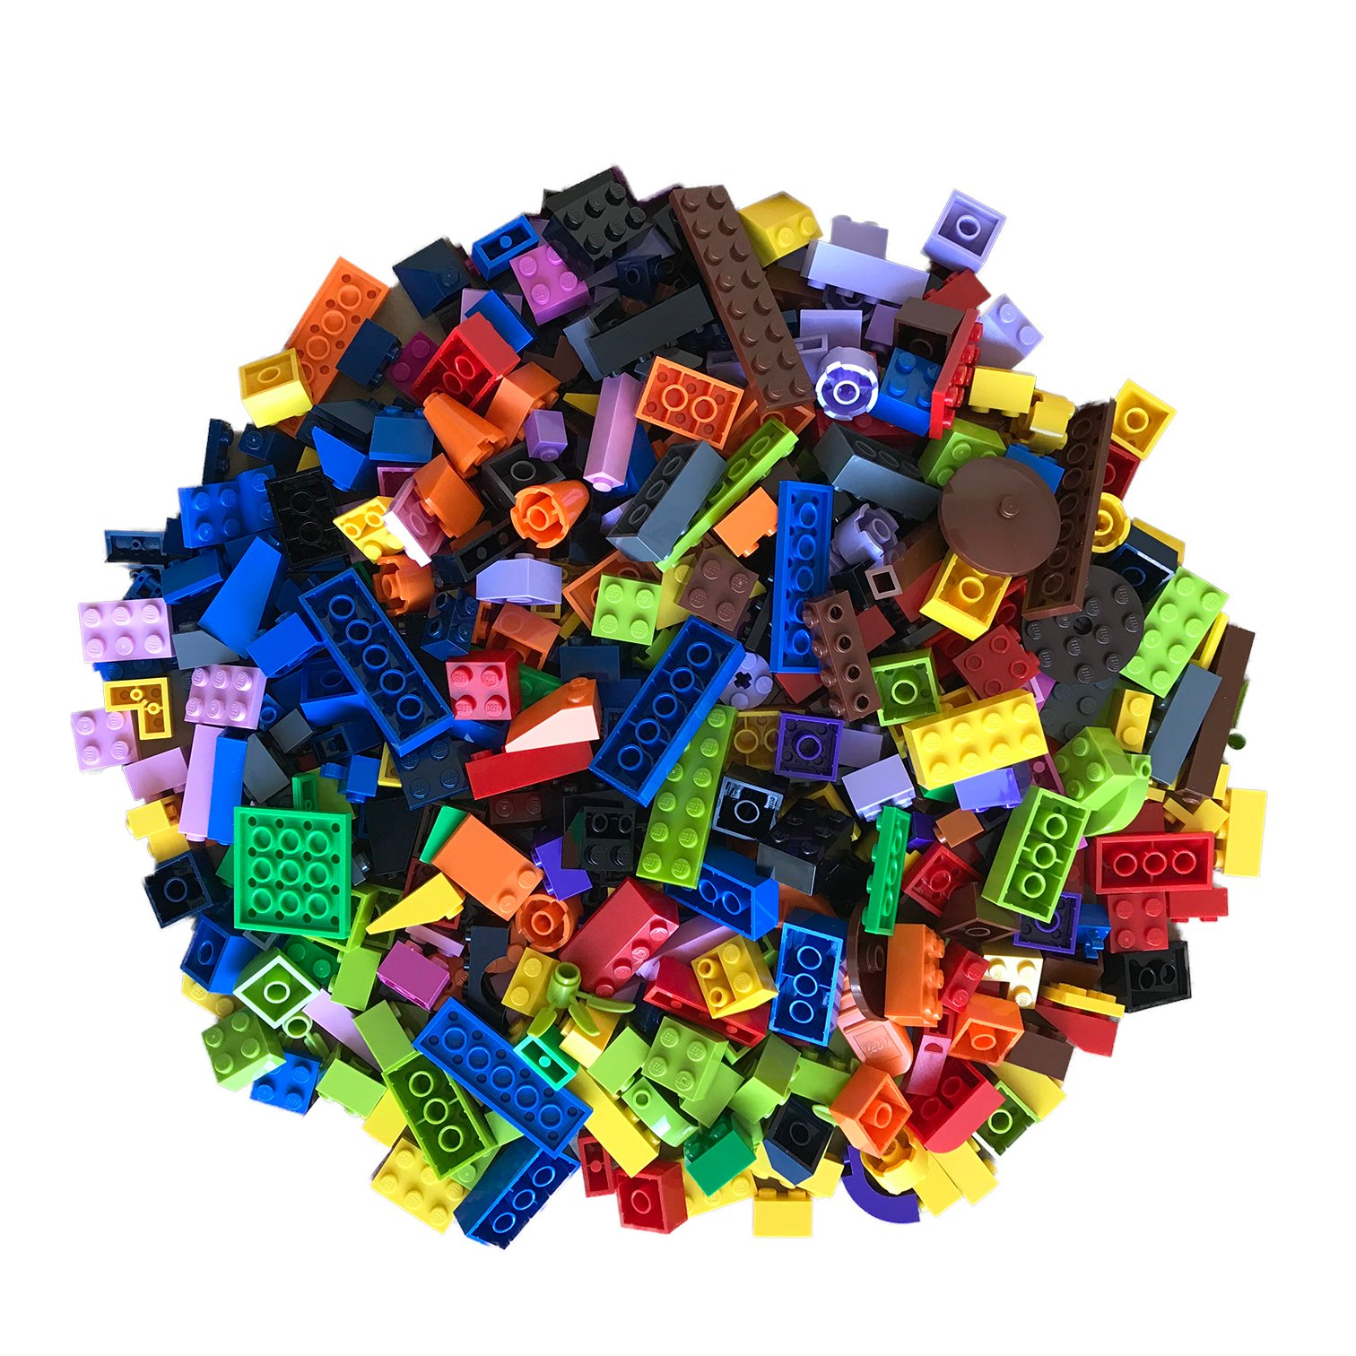
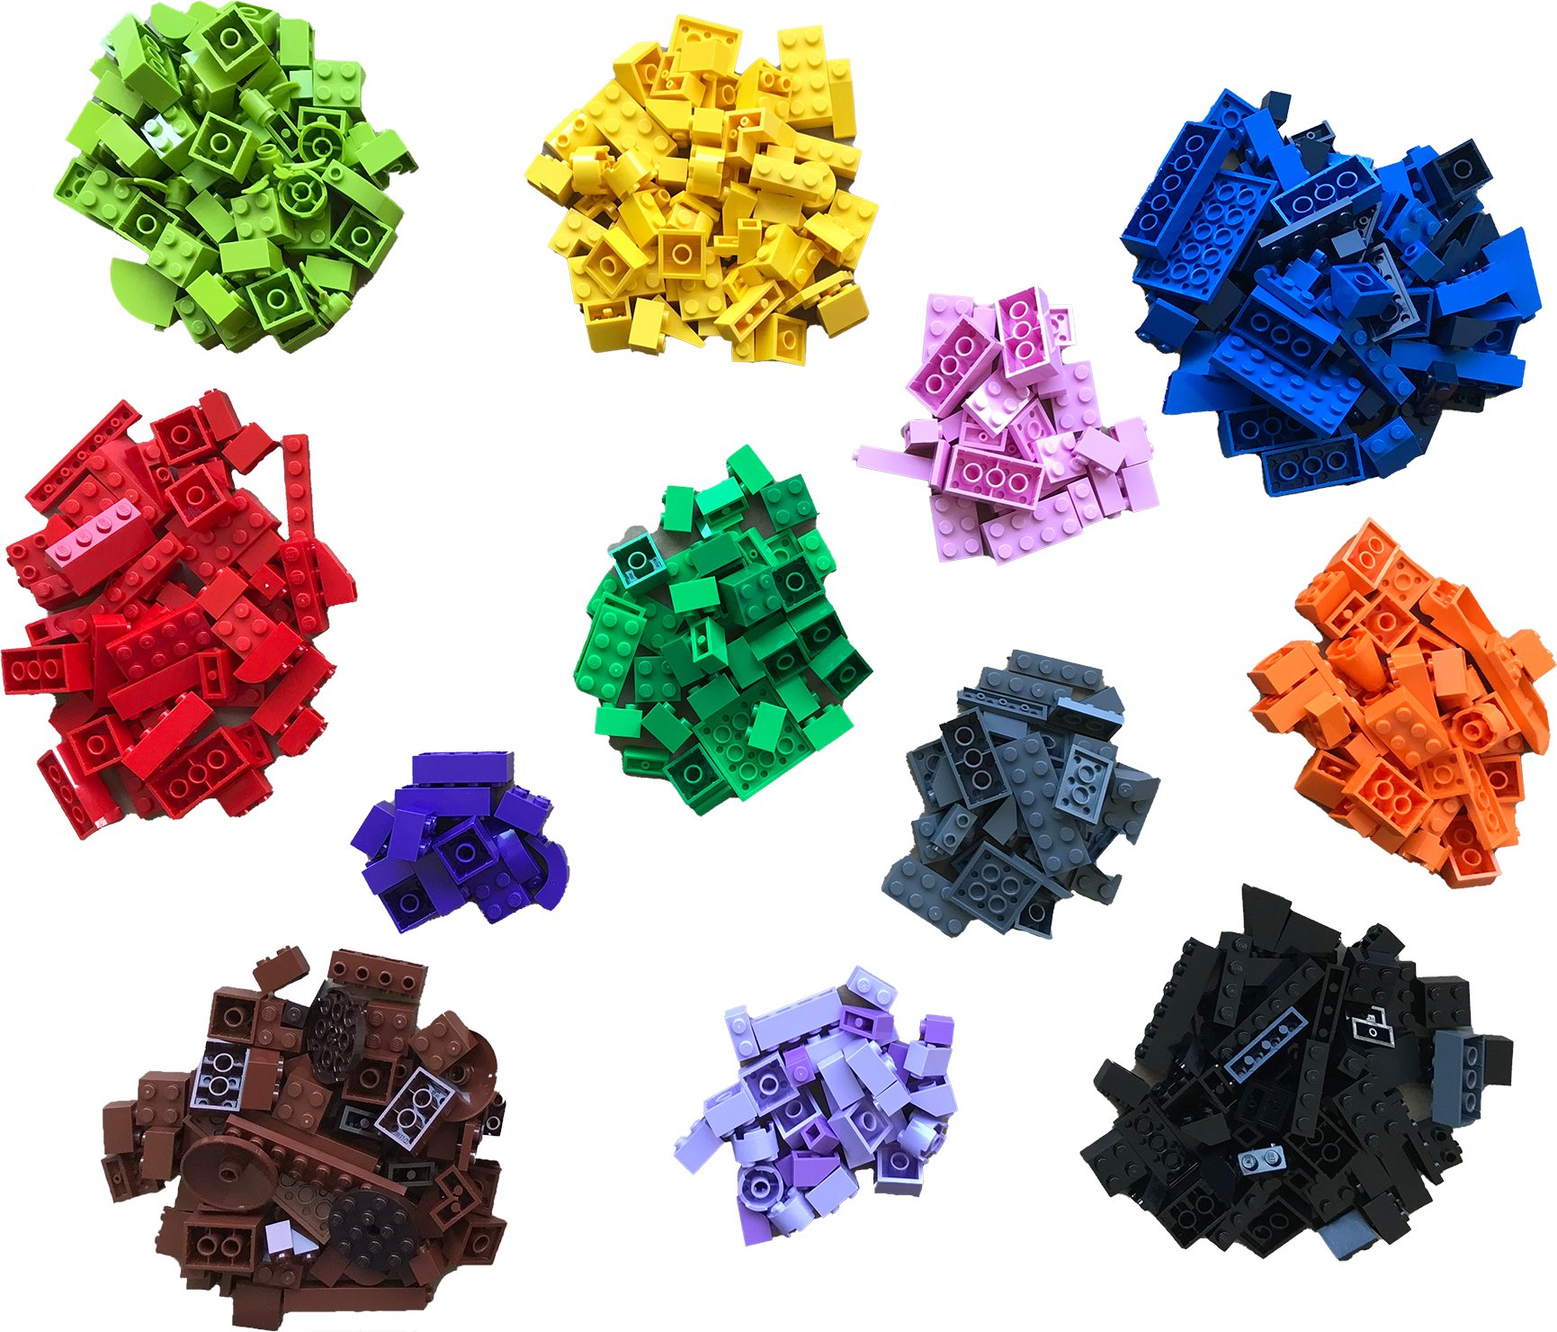

Can spatial transcriptomics offer clues into cancer cell states?
bulk single-cell RNA-Seq spatial transcriptomics
Bo Xia

Slide 8
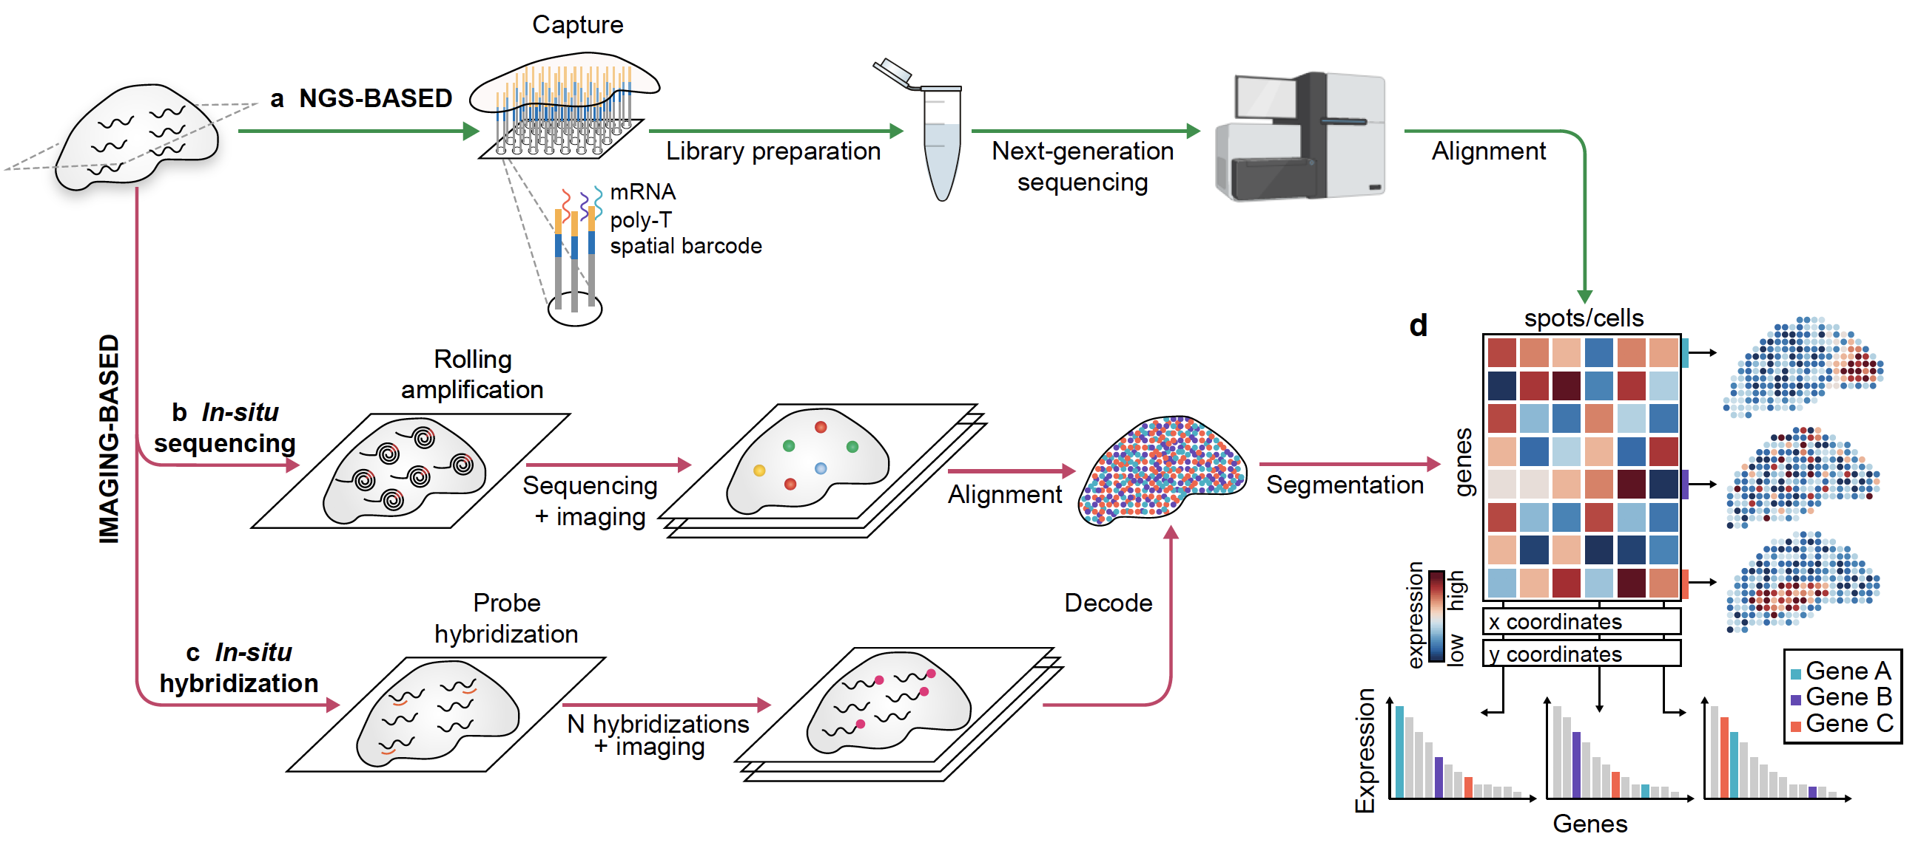
The technologies of spatial transcriptomics provide a gene expression matrix
Rao, Barkley, Franca, & Yanai Nature (2021)

Slide 9
How to integrate spatial transcriptomics and single-cell RNA-seq?
Single-cell resolution from scRNA-Seq
Gene expression with spatial resolution from ST
Gene 1
Gene 2
Gene 3
Gene 4
Gene 5
…
20,000 genes
Gene expression
Low
High
Spatial determinants of
transcriptional states in PDAC
Relationship between the stress cell states and inflammatory fibroblasts
Moncada, Barkley, …, Yanai Nature Biotechnology 2020

Slide 10
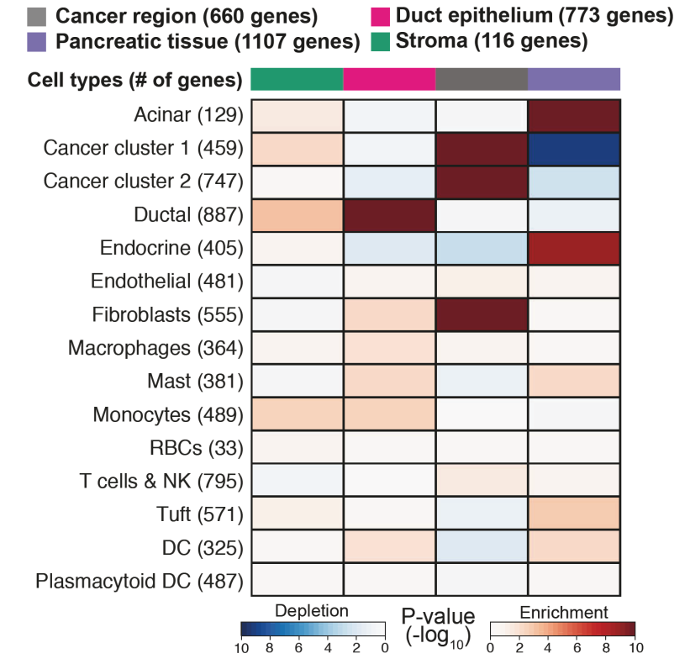
Multimodal Intersection Analysis (MIA) for the tissue-wide inference of cell type localization
Moncada, Barkley, …, Yanai Nature Biotechnology 2020

Slide 11
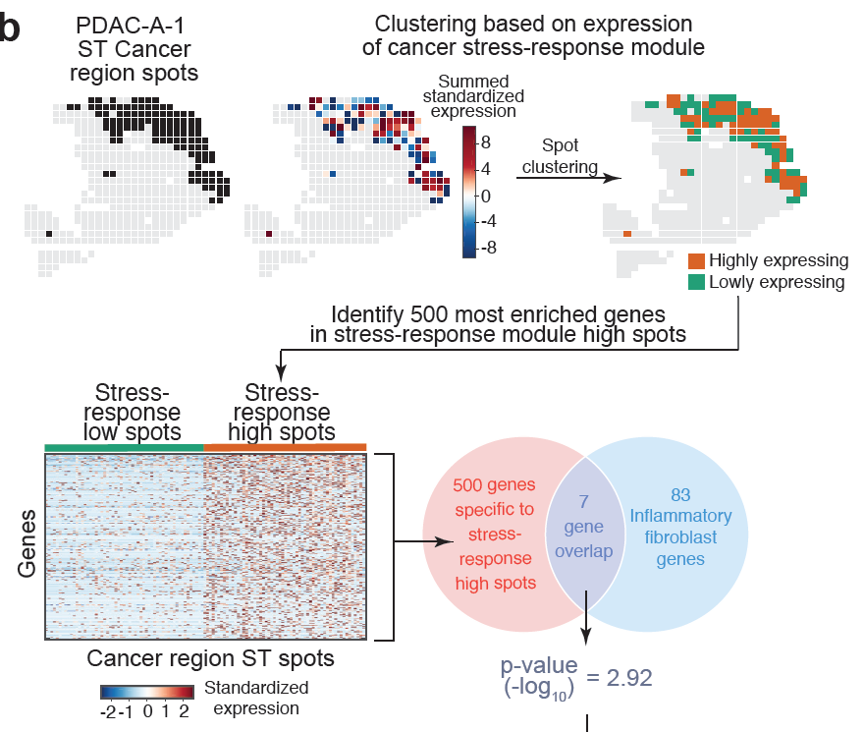
Querying for associations between cell states and cell types of the TME

Slide 12
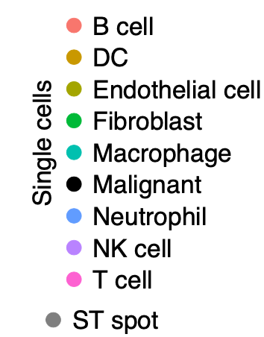
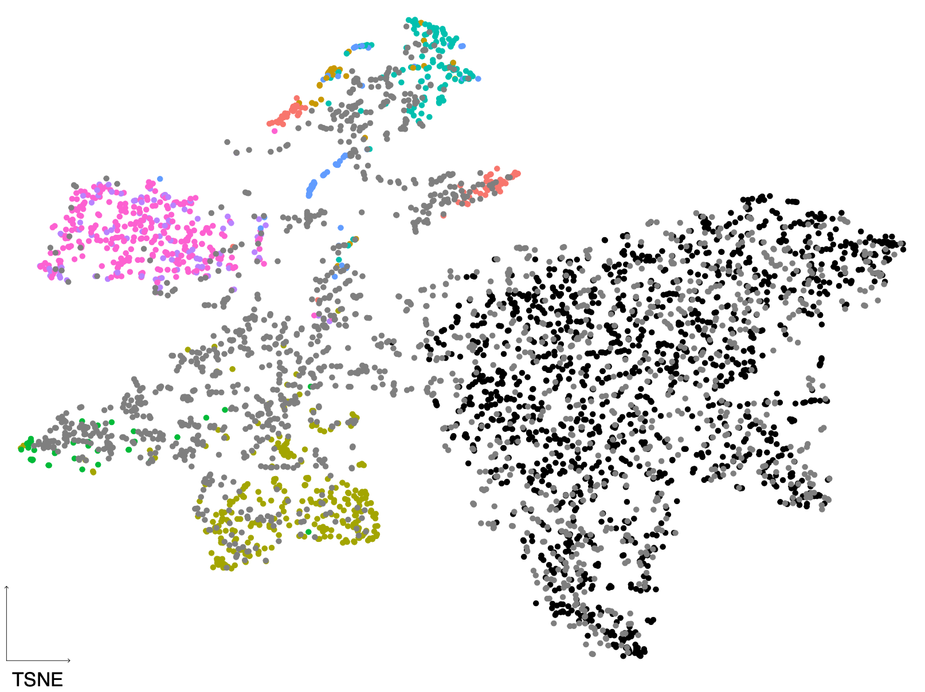
Direct comparison of single-cell and spatial transcriptomics data
in ovarian cancer
OVCA1
NYU1

Slide 13
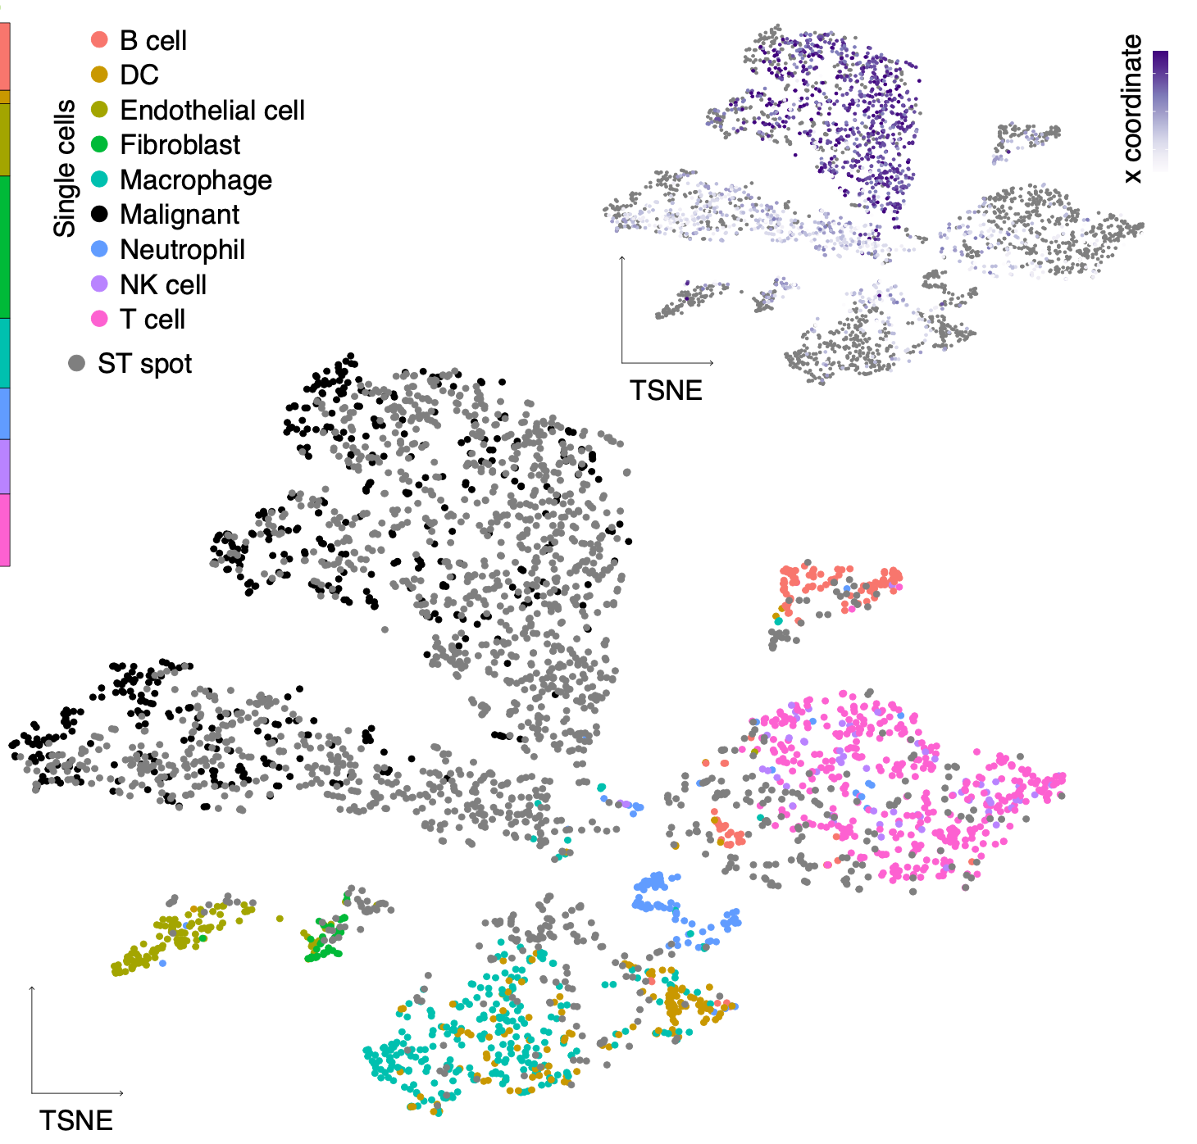
Integrating the spatial and single-cell transcriptomics data
liver hepatocellular carcinoma
LIHC
NYU1

Slide 14
Integrating the spatial and single-cell transcriptomics data
liver hepatocellular carcinoma
LIHC
NYU1

Slide 15
The Single-cell Neighborhood Map (SNAP) method for the discovery of cell neighborhood patterns.

Slide 16
Mapping tumor cell state relationships with the tumor microenvironment for biological insight.

Slide 17
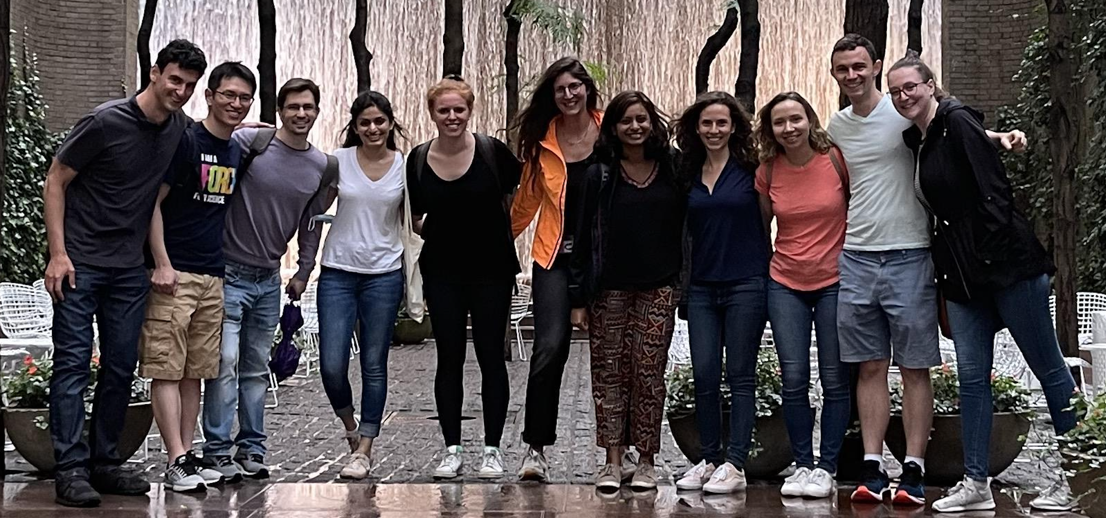
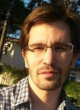

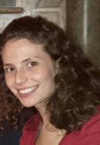

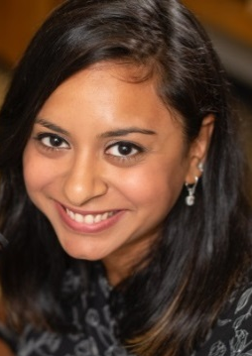

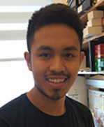


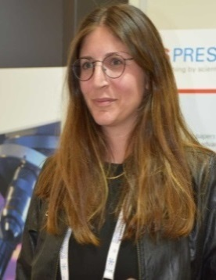

Acknowledging our wonderful lab
Dr. Gustavo Franca
Felicia Kuperwaser
Dalia Barkley
Alumni:
Dr. Tamar Hashimshony
Dr. Vlad Grishkevich
Dr. Gal Avital
Dr. Maayan Baron
Dr. Florian Wagner
Dr. Noa Sher
Dr. Reuben Moncada
Martin Feder
Sally Khair
Natalia Mostov
Naftalie Senderovich
Shay Ben-Elazar
Dr. Harel Zalts
Dr. Michal Levin
Dr. Leon Anavy
Dr. Alison Cole
David Silver
Avital Polsky
Bo Xia
Dr. Anjali Rao
Ayushi Patel
Dr. Reuben
Moncada
Dr. Maayan
Baron
Debbie
Liberman
Dr. Andrew
Pountain
Dr. Maayan
Pour
Peien Jiang

