Slide 1
Software and algorithms for elucidating the structure, function, and evolution of extrachromosomal DNA (ecDNA)
Vineet Bafna, Jill Mesirov
(UC San Diego)
Paul S. Mischel
(Stanford)

Slide 2
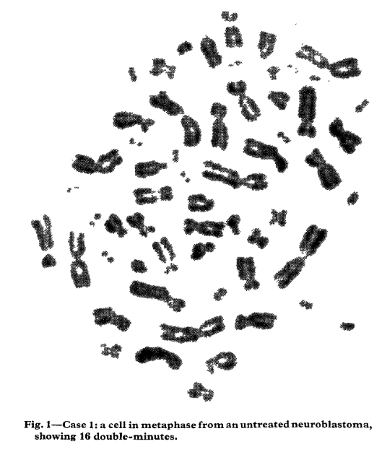
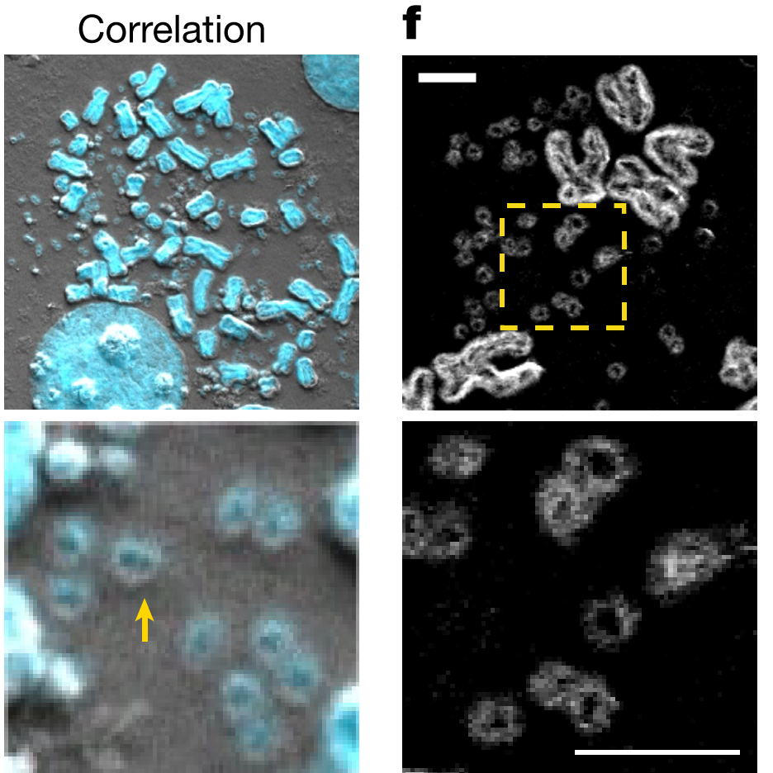
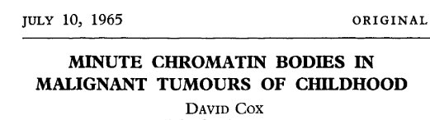
ecDNA: extrachromosomal, acentric, circular, large
Wu 2019, Nature

Slide 3
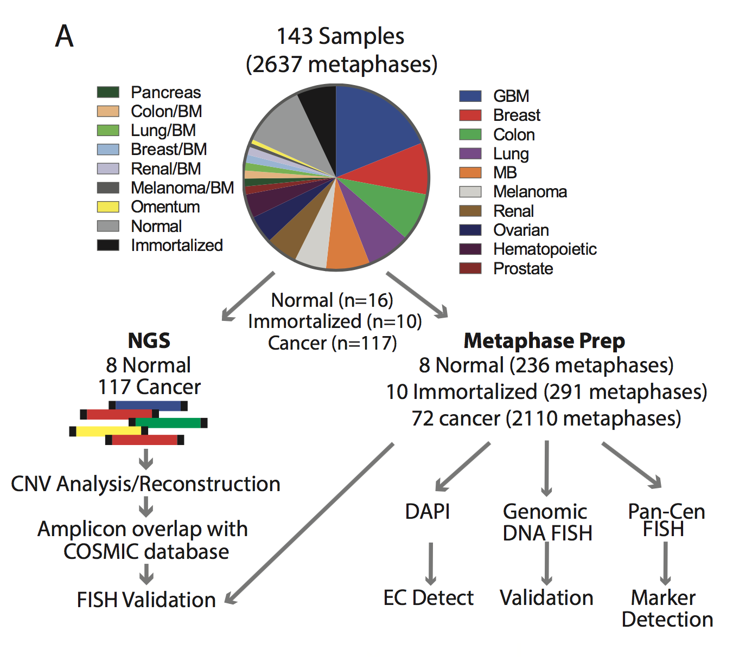
Turner, Nature 2017 (collaboration with Mischel lab)

Slide 4
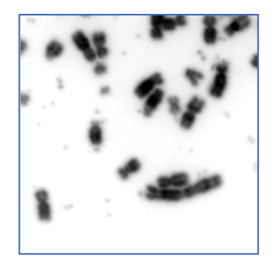
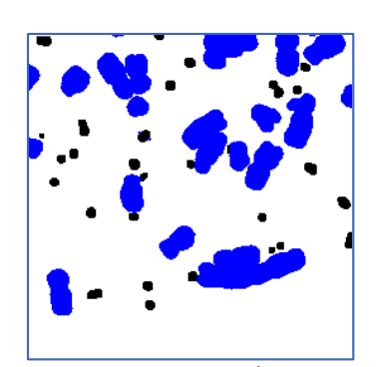
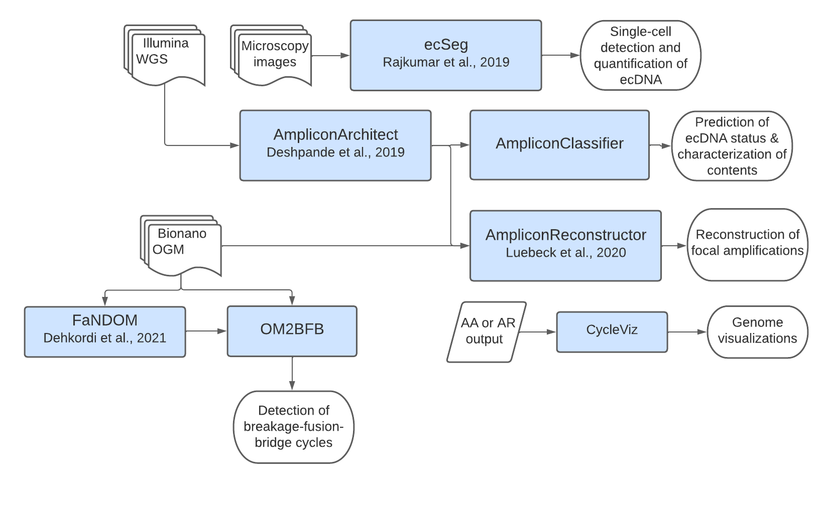
AmpliconSuite: ecSeg

Slide 5
ecDNA abound in tumors but not in normal!
Turner, Nature 2017

Slide 6
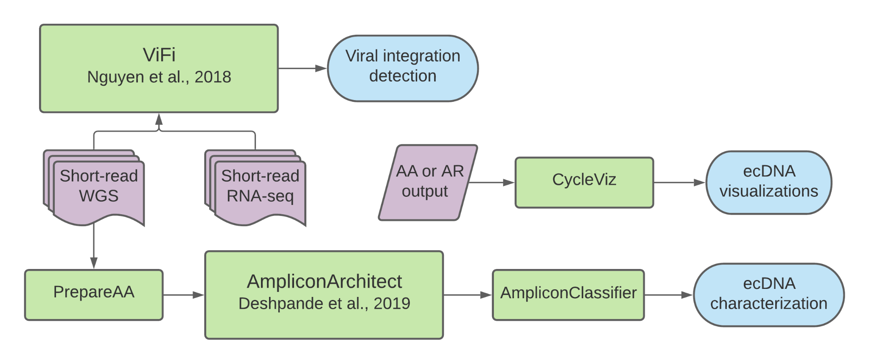
Can we detect ecDNA using genomic data?
and what is the the fine structure of ecDNA?
?

Slide 7
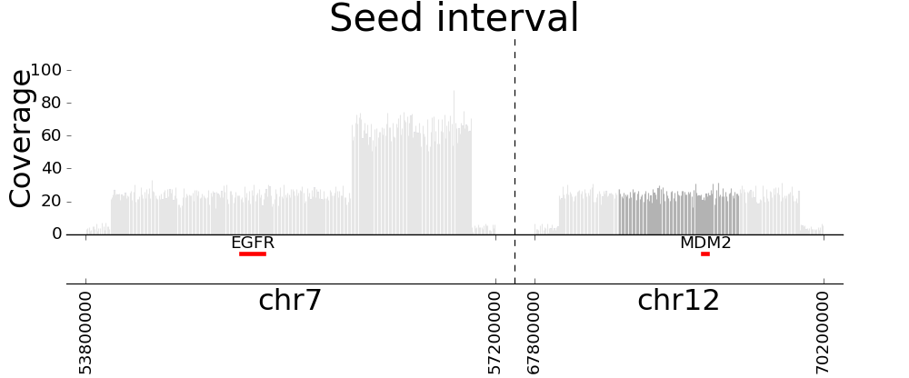

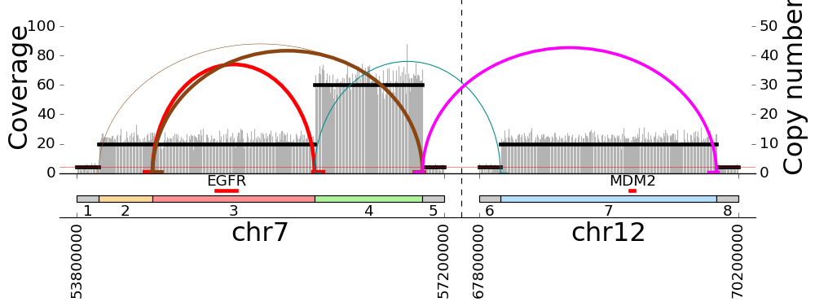
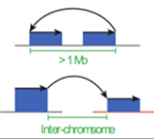

AmpliconSuite: AA+AC
Mapped sequence
Poster #33, Luebeck
Circular (ecDNA)
Complex non-cyclic
Amplicon graph
Linear

Slide 8
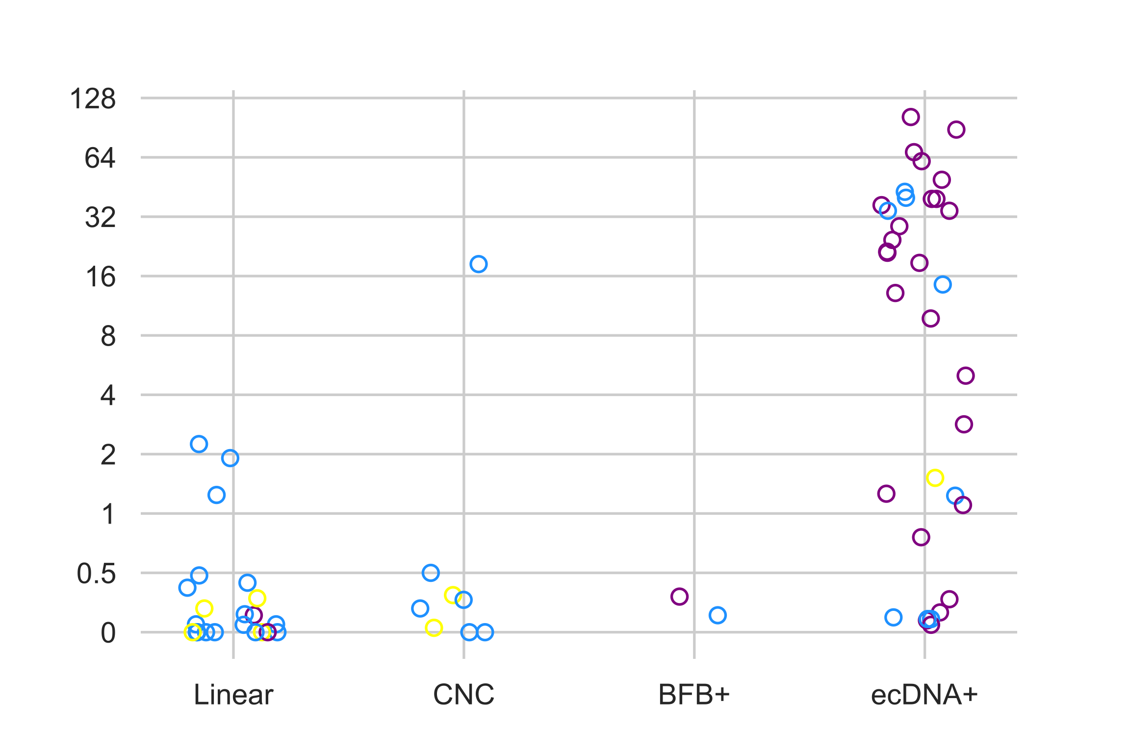
AC can be used to predict ecDNA
FN
TP
>82% precision & recall
#ecDNA/cell (cytogenetics)
Luebeck, poster #33
AA+AC calls on wgs
TN
FP

Slide 9
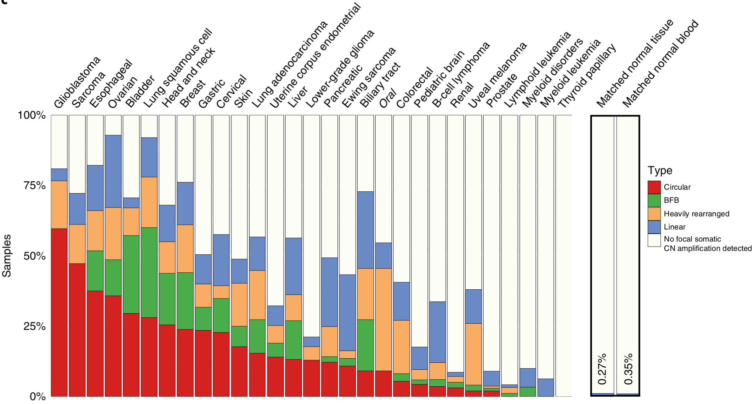
Distribution of ecDNA in pan-cancer samples (TCGA/ICGC)
Kim H, et al. EcDNA hubs drive cooperative intermolecular oncogene expression. Nature Genetics. 2020.

Slide 10
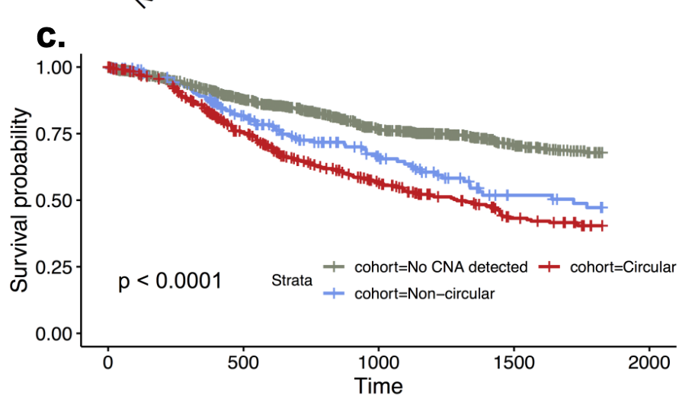
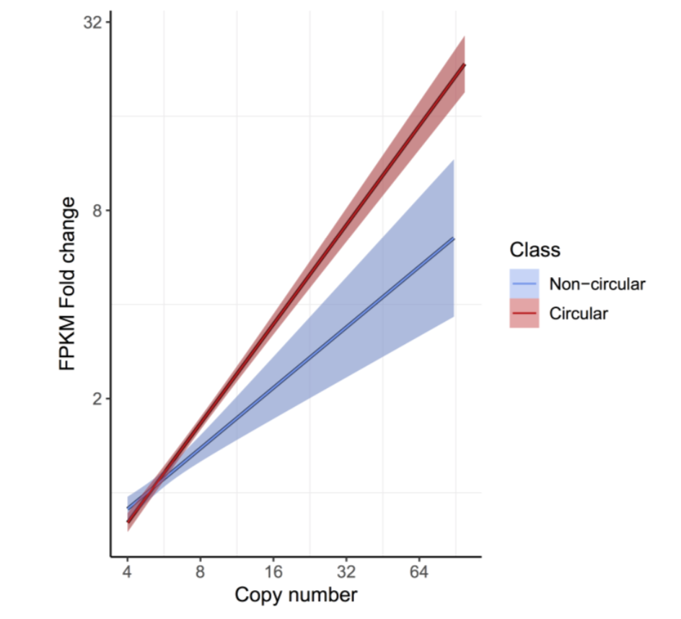
RNA-expression and outcomes for ecDNA
Kim, Nature Genetics 2020

Slide 11
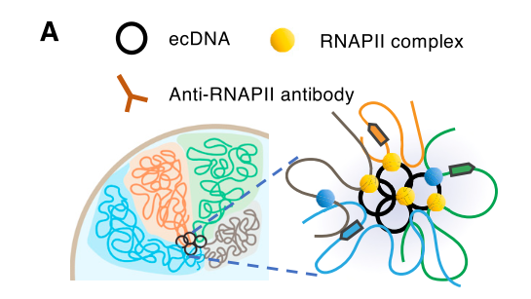
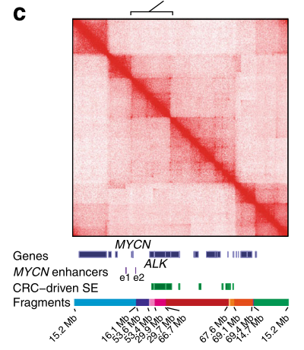
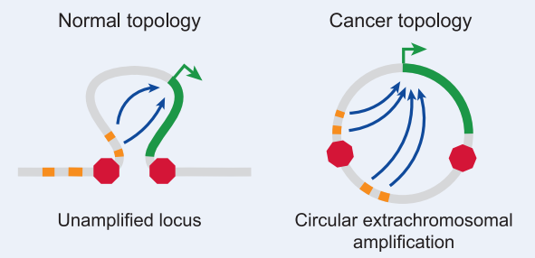
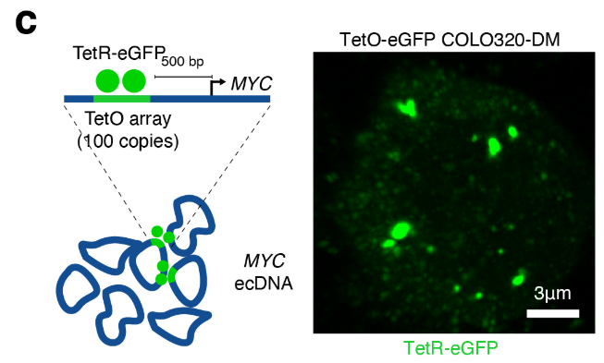
Results from other groups support the idea of ecDNA mediated regulatory rewiring
Zhu, Cancer Cell 2021
Glioblastoma, EGFR/Myc
Morton, Cell 2019
Glioblastoma, EGFR
Hung, Nature 2021
COLO320, Myc
Helmhauser, Nat Commun 2020
Neuroblastoma, MYCN

Slide 12
AmpliconSuite: Optical maps to disambiguate structures
Poster #33, Luebeck
Poster #54, Dehkordi

Slide 13
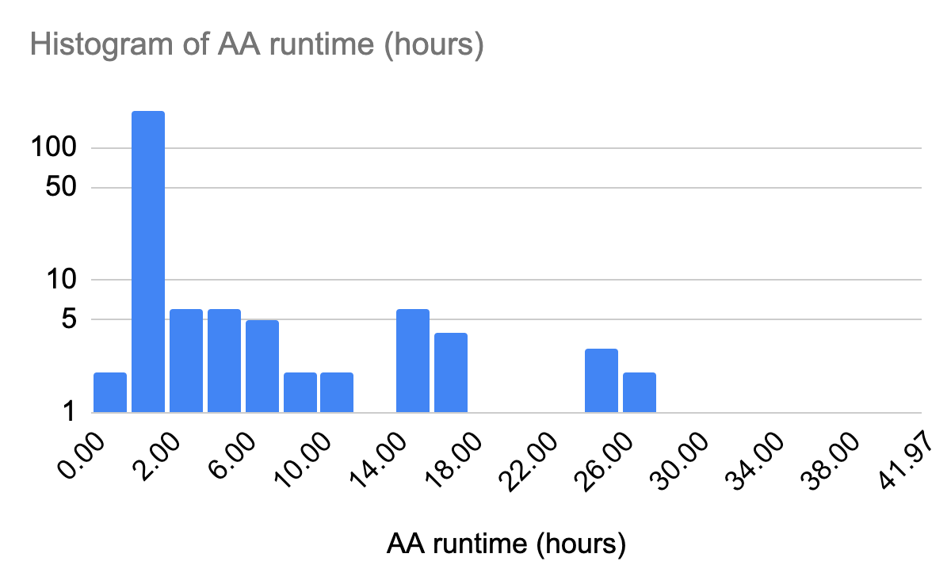
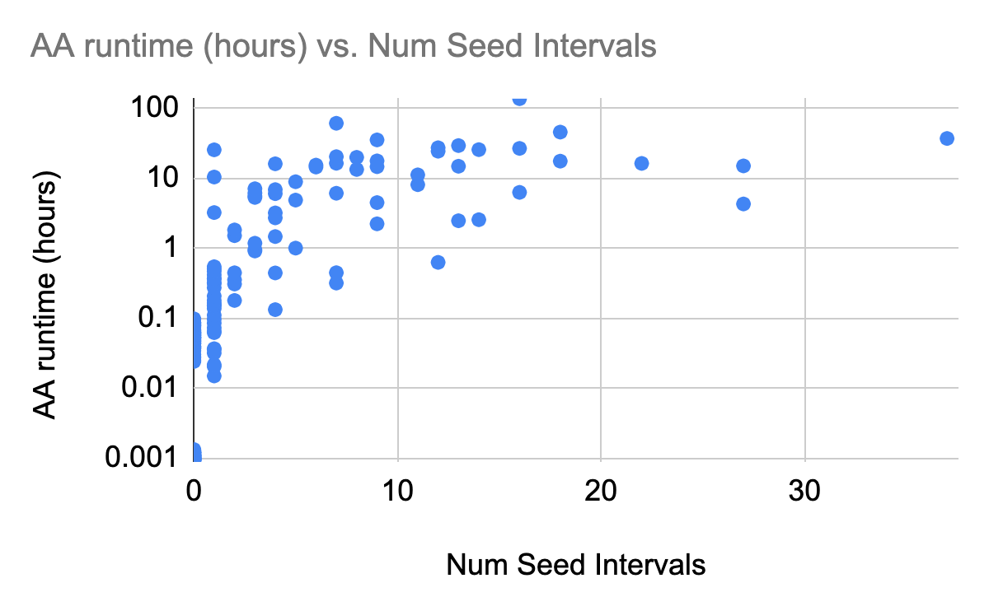
Challenges with AA analysis
Heavy compute requirements
Variable running time
Dependencies in the code
We have developed a GenePattern Module for a point and click interface to running AA.

Slide 14
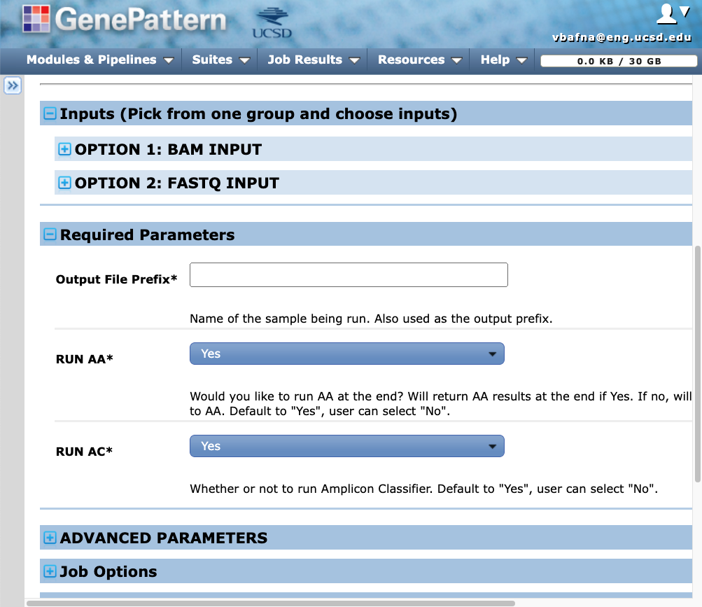
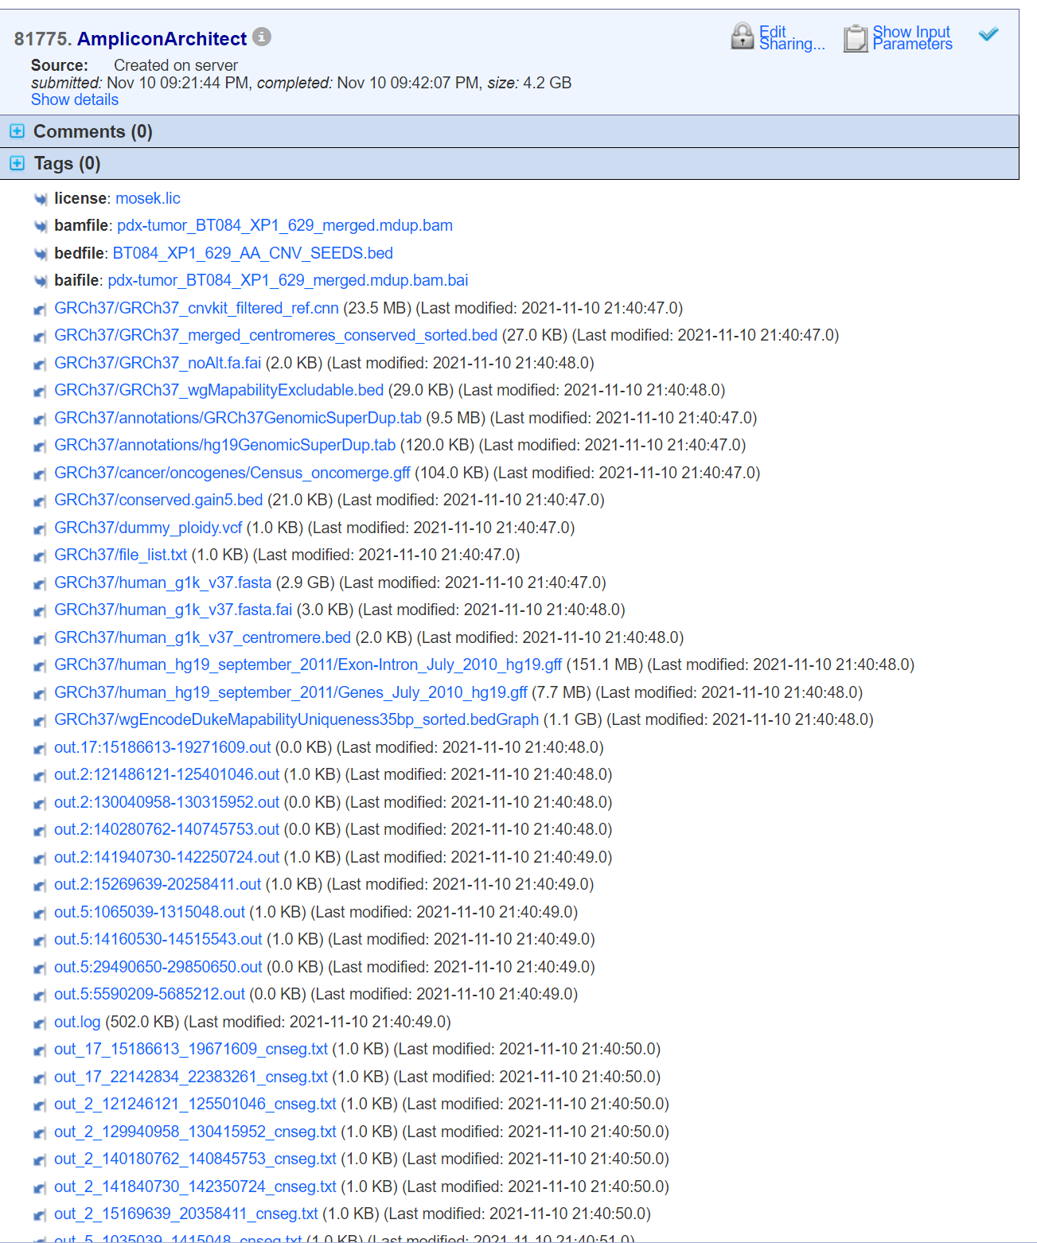
GP Interface for running AA (https://genepattern.ucsd.edu/)
Input
Output
Notes:
Send updated version to vineet, updated version of the presentation BY JAN 1

Slide 15
AmpliconRepository for browsing ecDNA (user or community driven projects)
Under construction

Slide 16
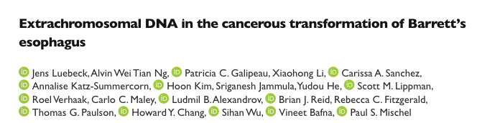
One last item: how early do ecDNA arise during progression to cancer?
Biorxiv,
Posted July 2022

Slide 17
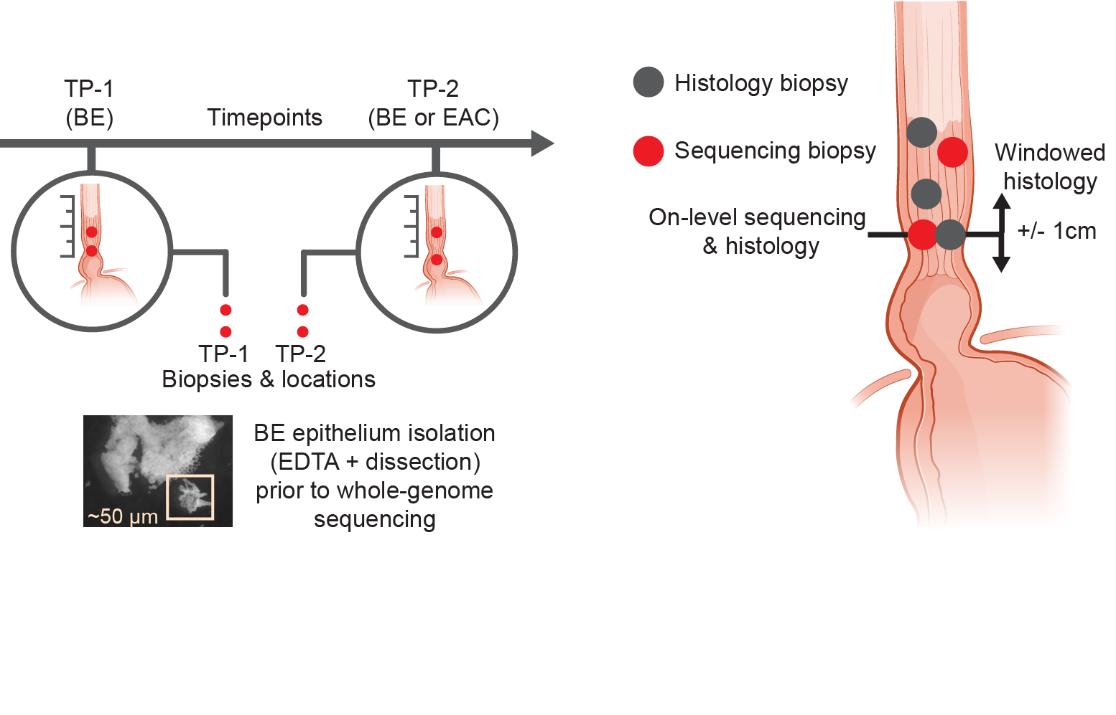
ecDNA in the cancerous transformation of Barrett’s esophagus
42
Non-dysplastic BE
25
High-grade dysplasia
Cambridge UK cohort, selected cross-sectional study (206 patients)
FHCC cohort, prospectively collected (80 patients X 2 timepoints )
51
Early-stage EAC
88
Late-stage EAC

Slide 18
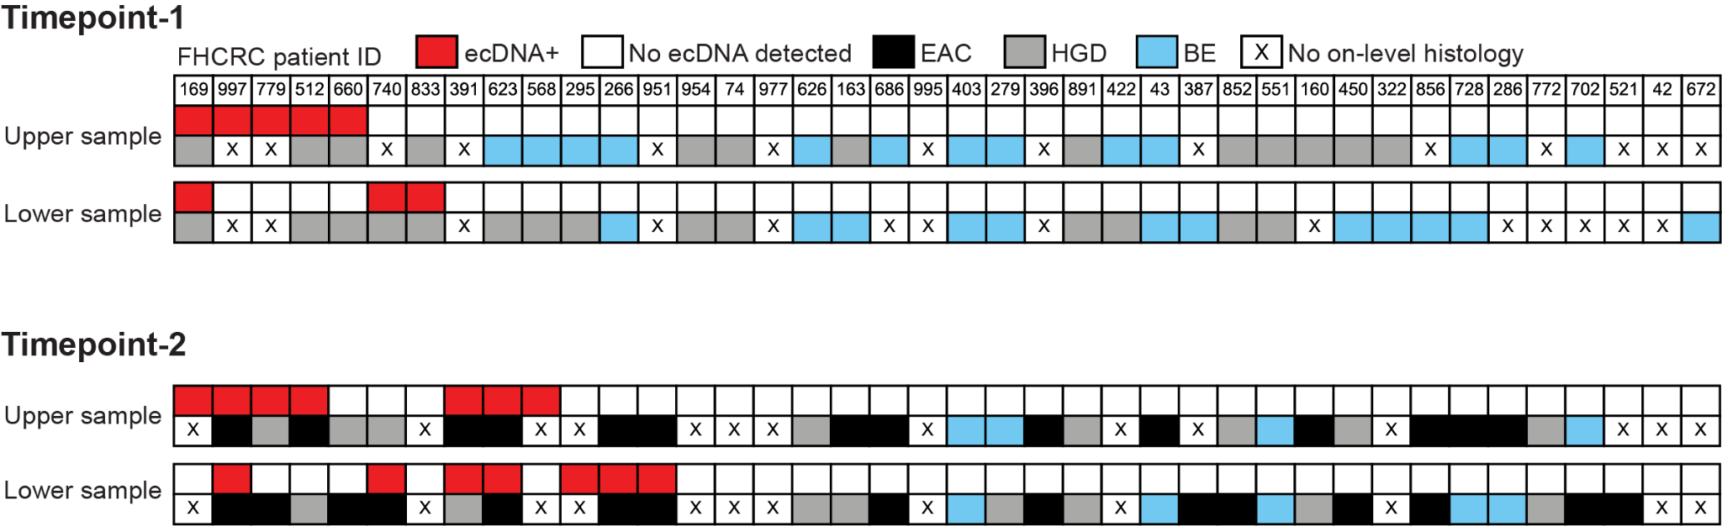
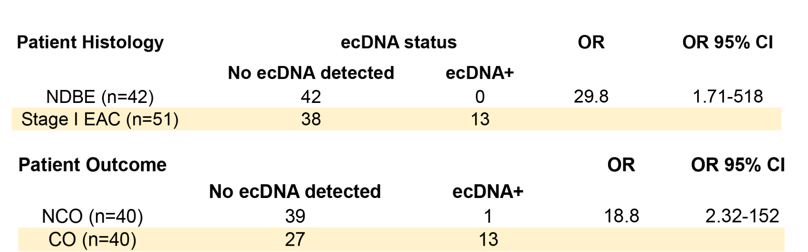
Patients with ecDNA(+) biopsies are much more likely to progress to cancer

Slide 19
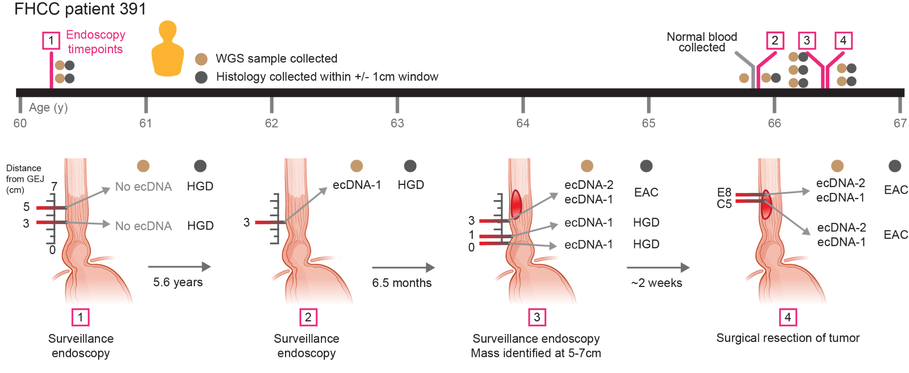
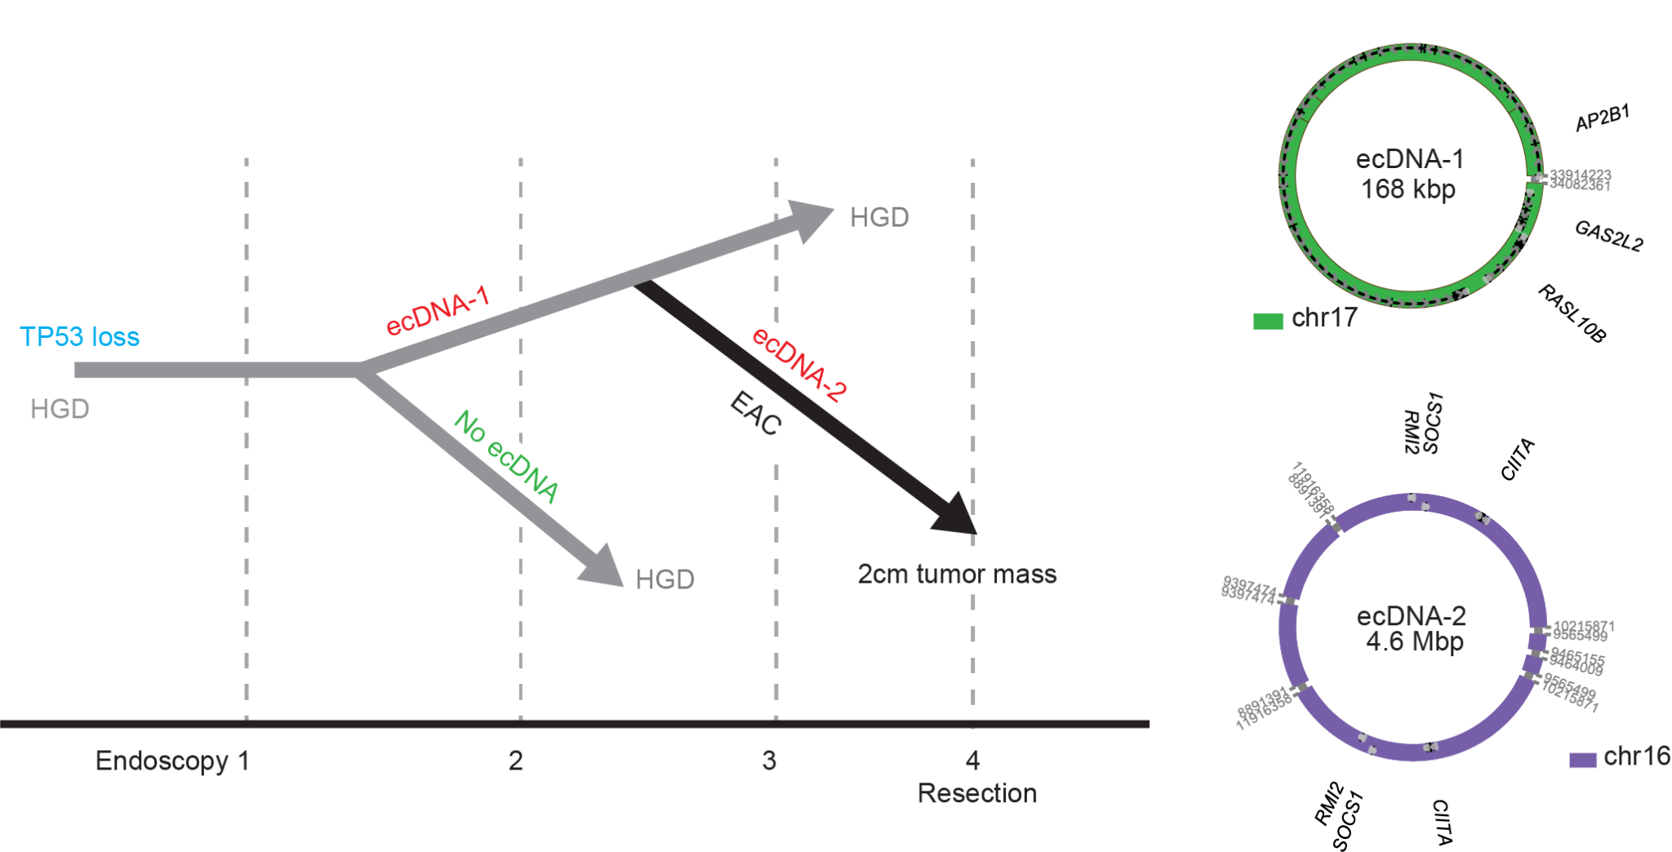
The same ecDNA found in pre-cancer are maintained in cancer.
ecDNA formation can be a truncal event in the malignant transformation.

Slide 20
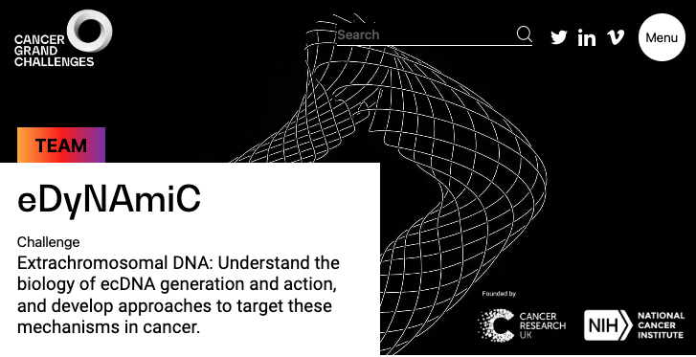
Acknowledgements
NCI (ITCR)
NIGMS,
Cancer Grand Challenges (NCI, CRUK)
Mesirov (co-I) lab
  Michael Reich, Ted Liefeld, Barbara Hill, Edwin Juarez,
Mischel (co-I lab)
Collaborators
  Chang, Wu, Alexandrov, Paulson, Fitzgerald
Bafna Lab
  Jens Luebeck
  Kaiyuan Zhu
  Siavash Raeisi
  Bhargavi Dameracharla

Slide 21
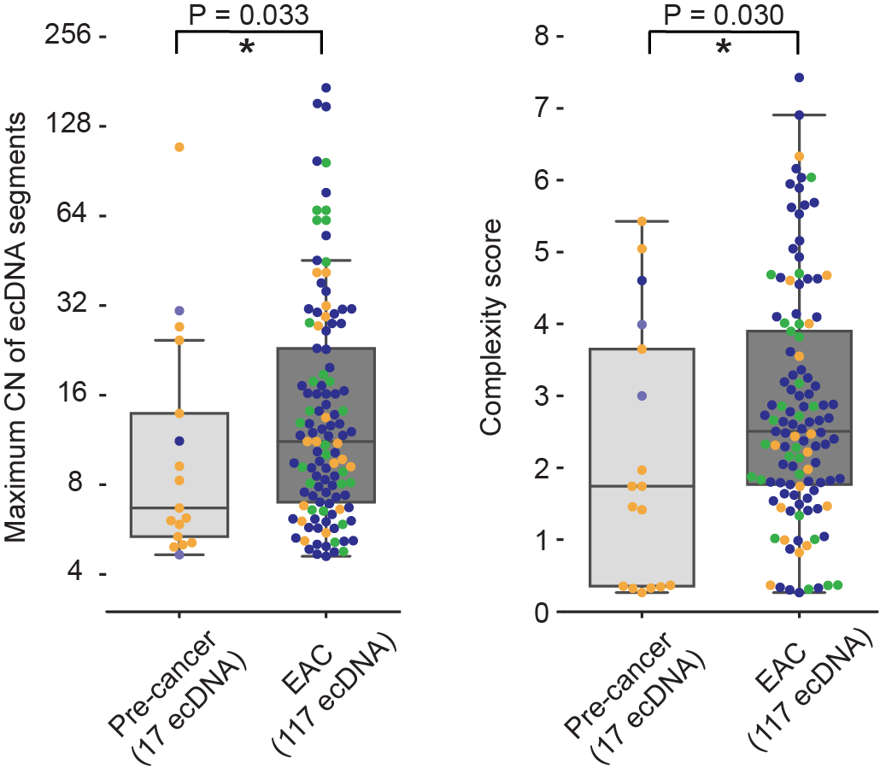
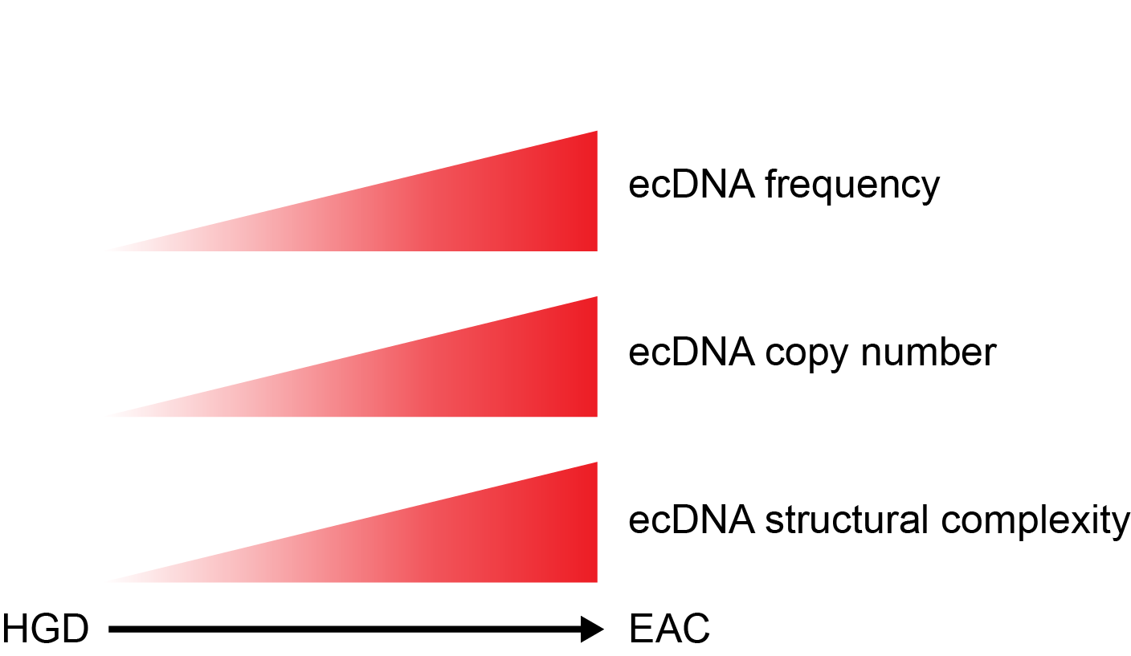

Slide 22
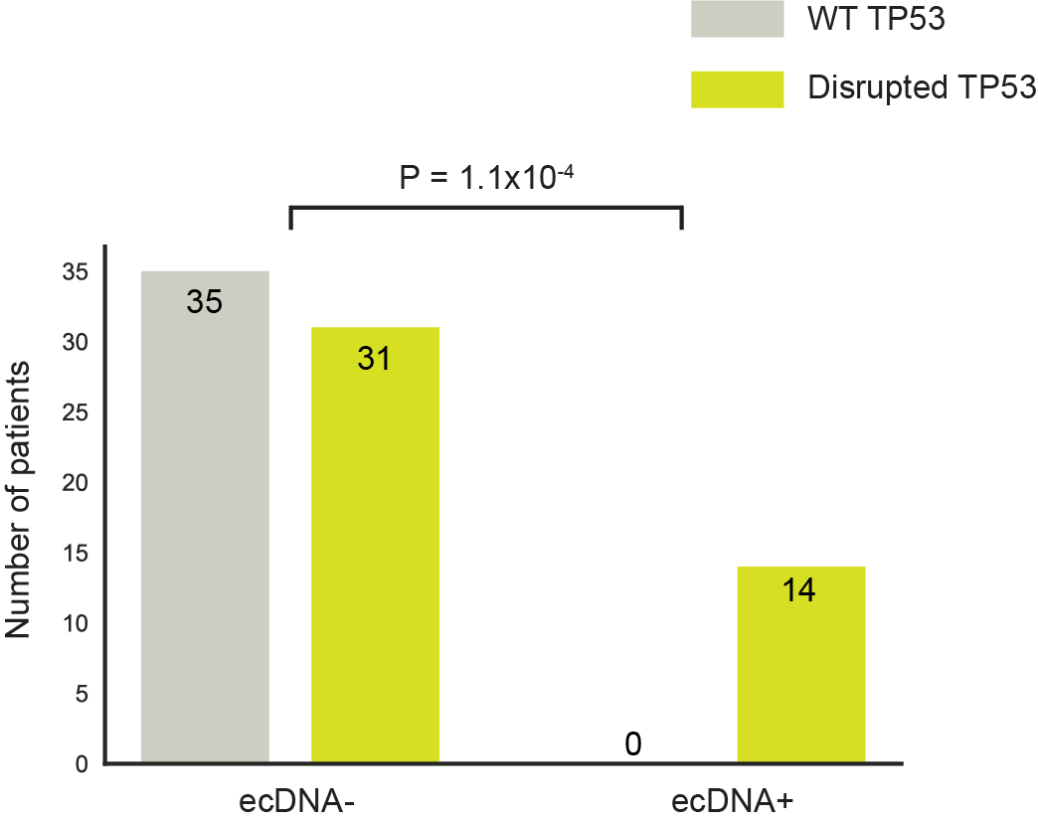
WT TP53
Disrupted TP53
ecDNA occurs in a subset of TP53 disrupted samples, suggesting prior TP53 disruption is critical for ecDNA formation in Barrett’s.
TP53 disruption
HGD
ecDNA formation
EAC

Slide 23
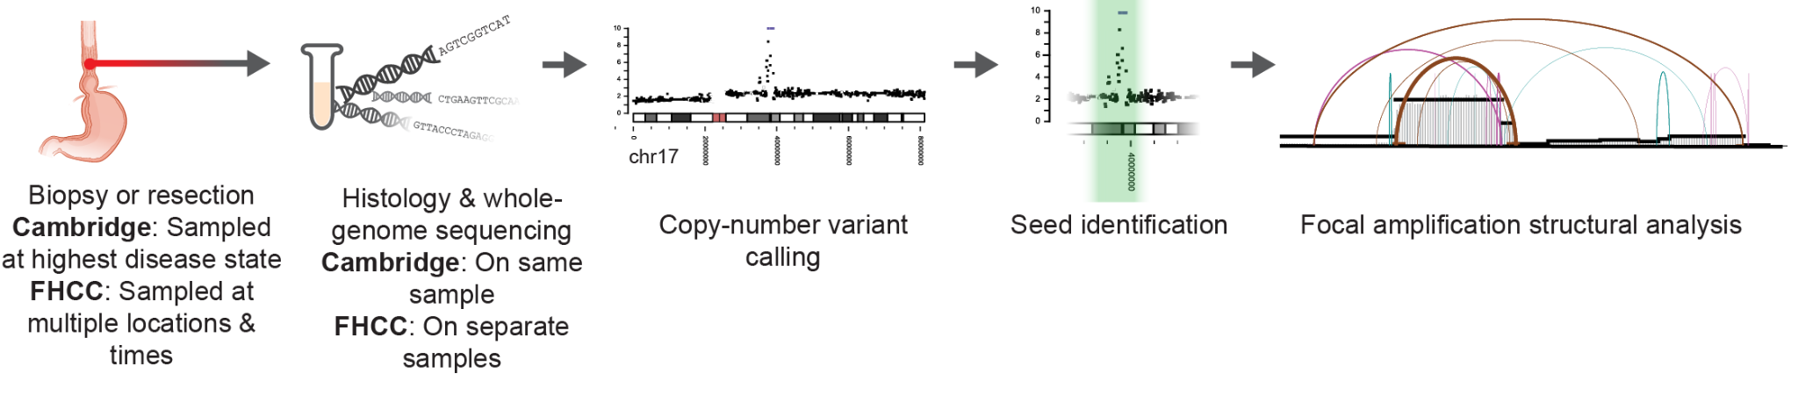
Extrachromosomal DNA in the cancerous transformation of Barrett’s esophagus.
Analysis of ecDNA in a longitudinal case-control cohort and an independent cross-sectional surveillance cohort of Barrett’s esophagus (BE) patients with BE or BE-adjacent esophageal adenocarcinoma.
Cambridge University, UK: 206 patients
Fred Hutchinson Cancer Center, USA: 80 patients

Slide 24
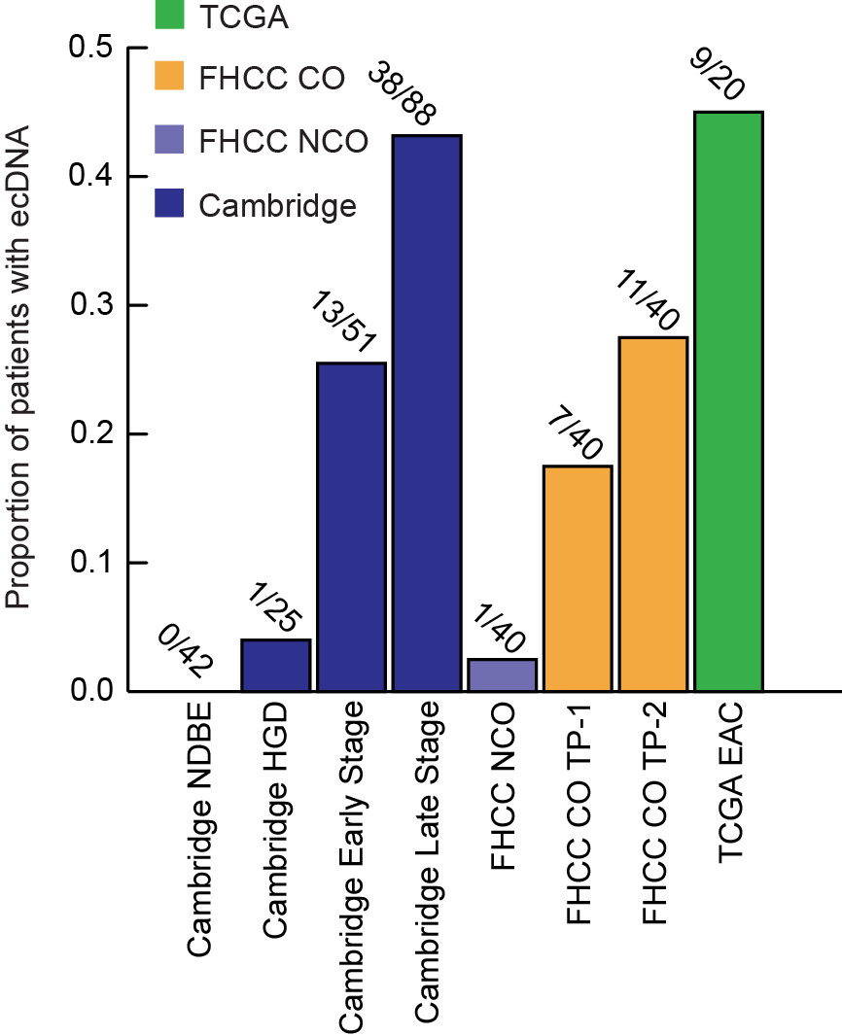
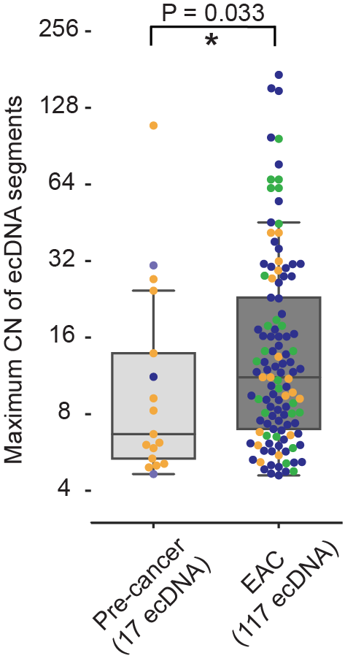
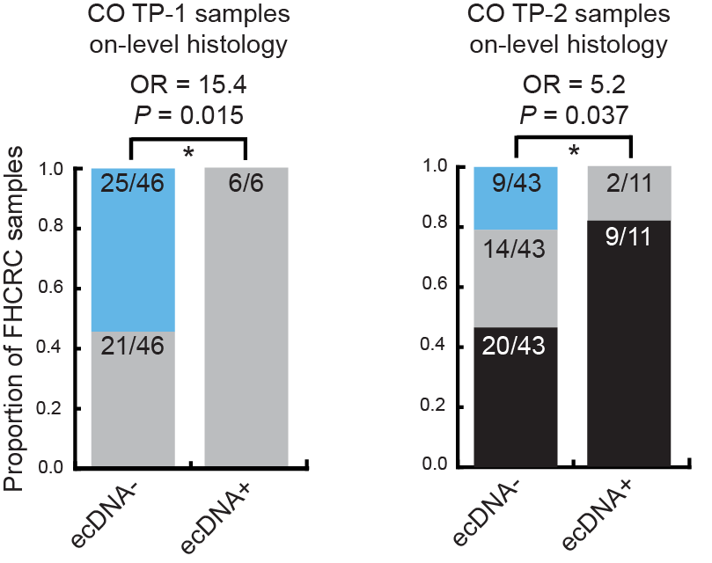
ecDNA…
is found in high-grade dysplasia from patients who later develop cancer.
associates with worsening histology.
becomes more frequent in late-stage cancers.
increases in copy-number between pre-cancer and cancer.

Slide 25


