Slide 1
Advanced development of Lancet, an emerging tool for complex variant calling in cancer genomics
Giuseppe Narzisi, PhD
Lead Bioinformatics Scientist
ITCR 2022
September 13th - 14th 2022
@gnarzisi
gnarzisi@nygenome.org

Slide 2
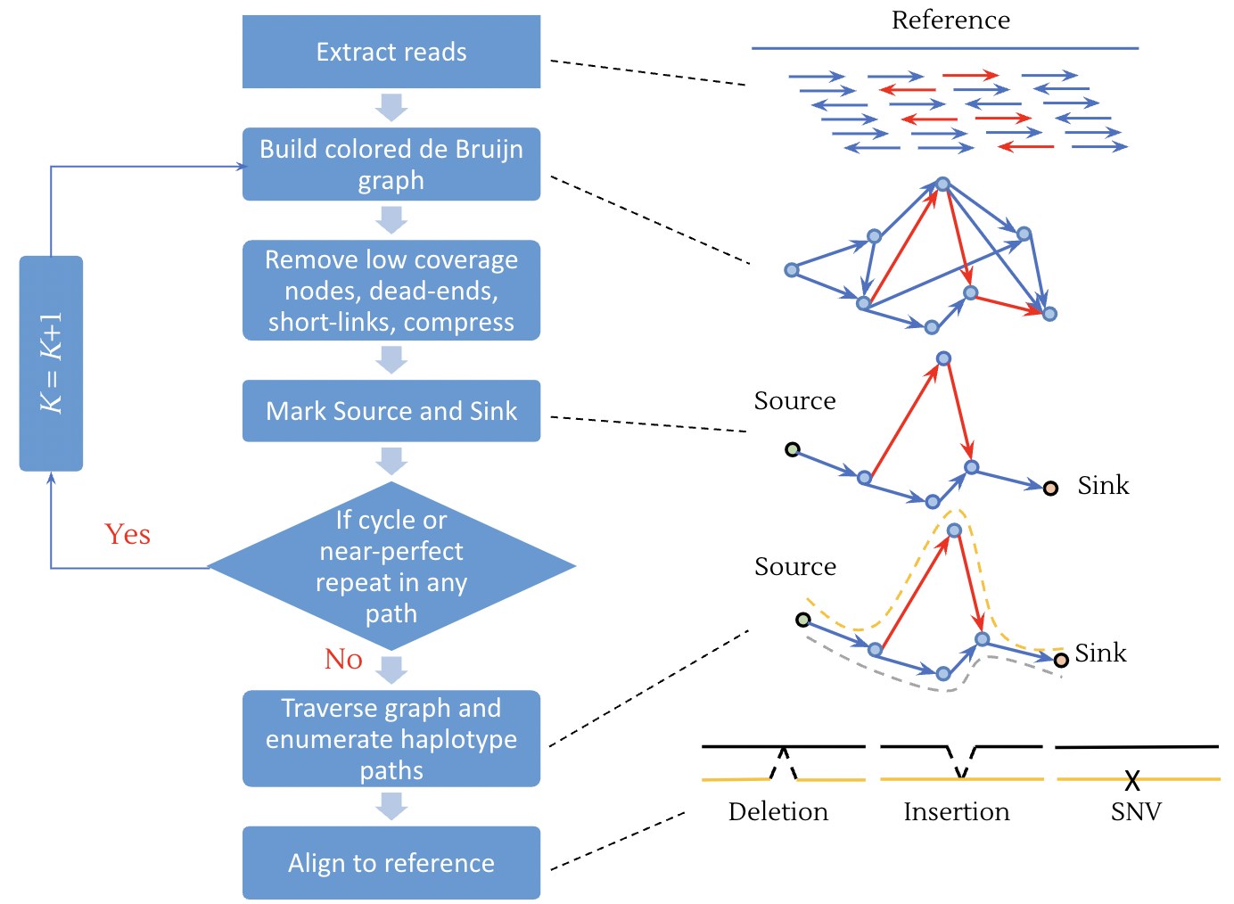
Lancet: somatic variant calling using colored de Bruijn graphs
Joint assembly of tumor and normal data
Reduced reference bias: in regions of genomes that substantially differ from the reference sequence.
Increased power to discover shared/private events across tumor and matched normal samples
More accurate variant allele fraction estimates, critical to understanding sub-clonal structures.
red = tumor, green = normal, blue = shared, grey = low coverage & sequencing errors

Slide 3
Lancet history
First released in late-2017.
Quickly become the method of choice for somatic variant calling via local assembly.
Funded by ITCR in 2018 under the NCI R21 award 1R21CA220411-01A1.
Cited in > 50 high-impact papers studying diverse cancer types: melanocytic naevi, polymorphous adenocarcinoma, pancreatic cancers, colorectal cancer, hyalinizing trabecular tumors of the thyroid, triple-negative breast cancer, etc.
Lancet is a critical component of the cancer pipeline at the New York Genome Center [Arora et al. (2019) Scientific reports, 9(1), 19123].
Funded by ITCR in 2021 under the NCI U01 award 1U01CA253405-01A1.

Slide 4
Lancet2 - refactored code for speed
https://github.com/nygenome/Lancet2
Rajeeva Musunuri
Bioinformatics
Data Scientist
Genome-wide computational performance on the Virtual Tumor.
Re-factor the source code using modern C++17 features for modularity and maintainability
Store the graph using a fast hash table (Abseil’s Swiss table) to improve graph traversal performance
Efficient pull-based reactive multi-threading strategy for local assembly of windows using a lock-free concurrent queue
Developer tool kit and APIs to facilitate new feature development and integration with other bioinformatics tools.
WGS | Total Runtime (core hrs) | Max Memory Utilized (GB) | Avg CPU Utilization (%)
Lancet v1.1.0 | 2902.7 | 38.69 | 94.1
Lancet2 alpha | 728.4 | 5.1 | 99.7
Mutect2 v4.2.6.1 | 954.4 | 12.7 | 11.6
Strelka2 v2.9.10 | 81.4 | 3.2 | 45.8
Notes:
Pull-based reactive multi-threading: Main thread has a list of windows that need to be processed. Worker threads request for new windows to be processed from the main thread one at a time via the lock-free concurrent queue. This way all the worker threads are effectively used throughout the runtime of the program regardless of variability in computation time of each window.
Lock-free concurrent queue: An industrial-strength lock-free queue for C++. Blazing fast performance.
https://github.com/cameron314/concurrentqueue
Swiss Tables: Designed to be used as a replacement for std::hash. It boast improvements to efficiency and provide C++11 codebases early access to APIs from C++17 and C++20.
https://abseil.io/blog/20180927-swisstables
https://abseil.io/about/design/swisstables
https://www.youtube.com/watch?v=ncHmEUmJZf4

Slide 5
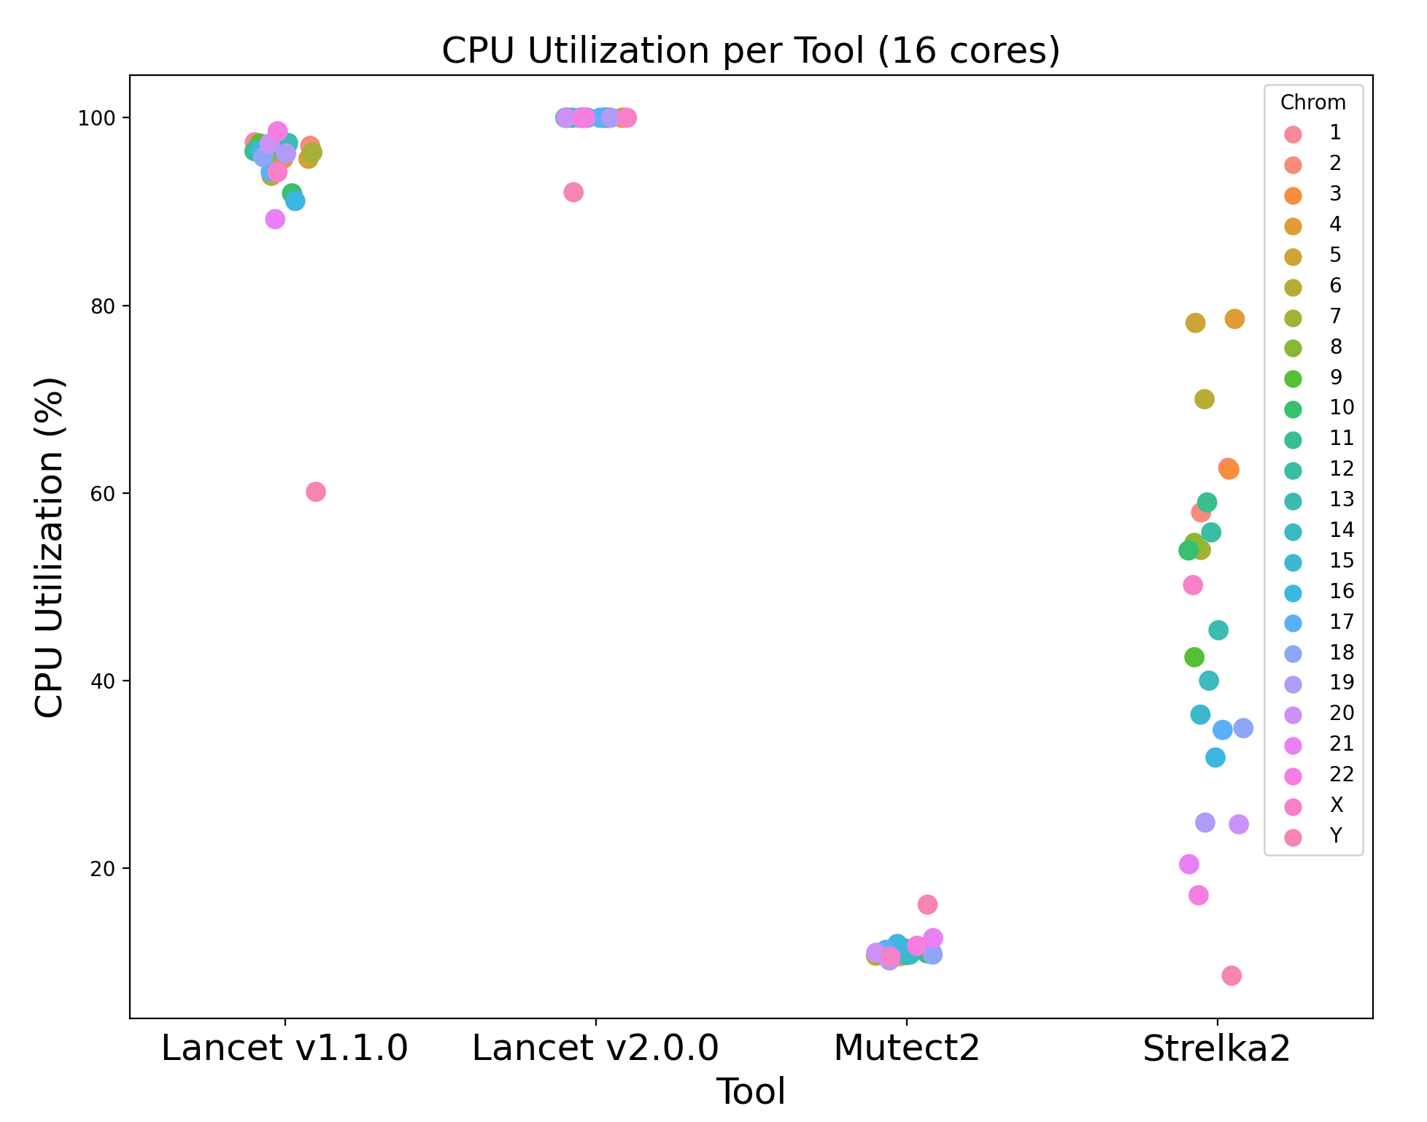
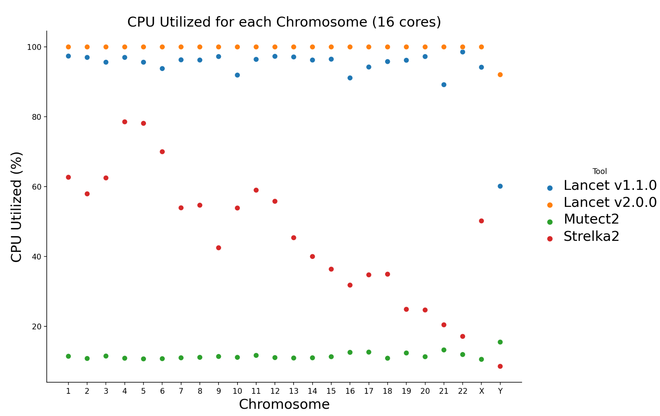
Computational performance
(CPU utilization)
Bryan Zhu
Bioinformatics
Programmer

Slide 6
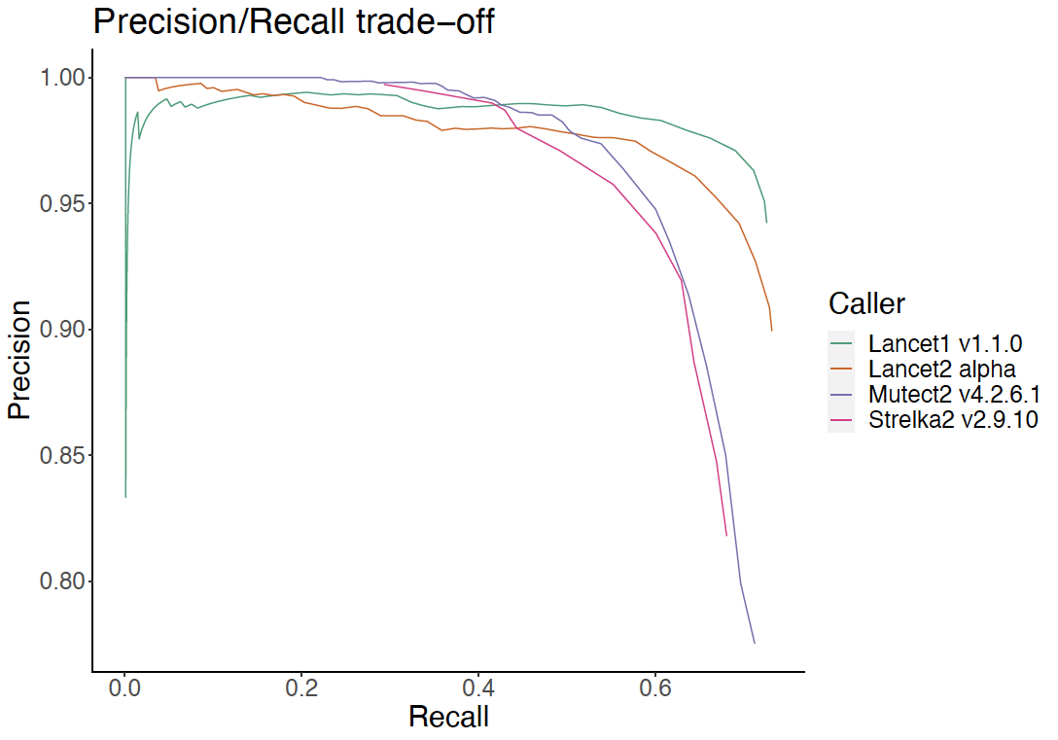
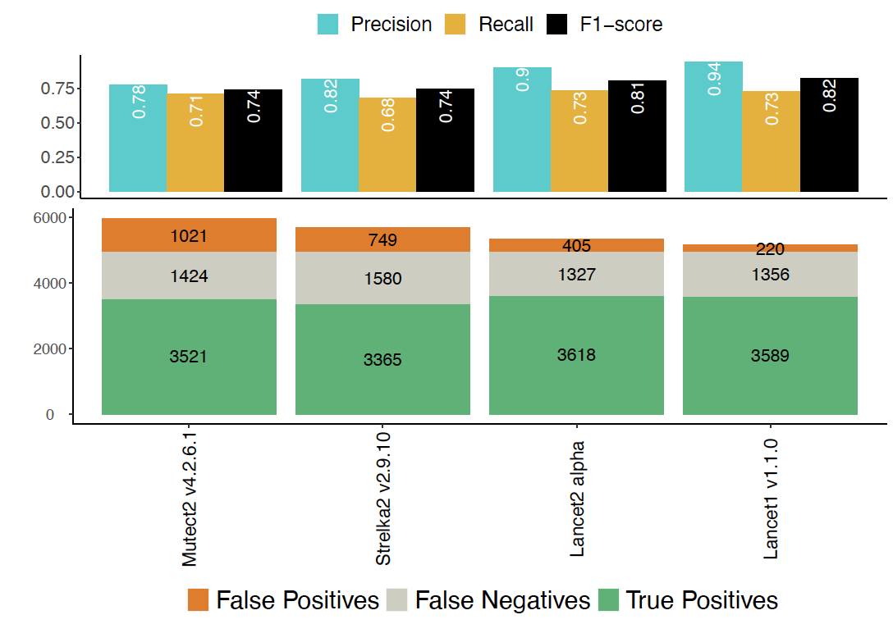
Somatic indel mutations performance comparison

Slide 7
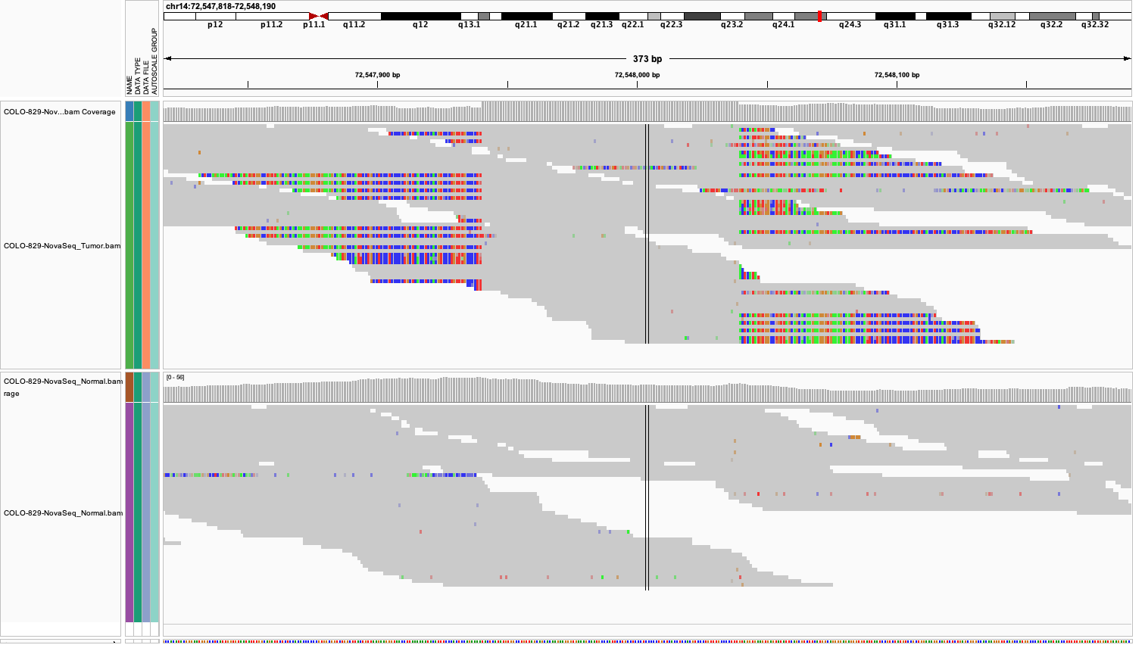
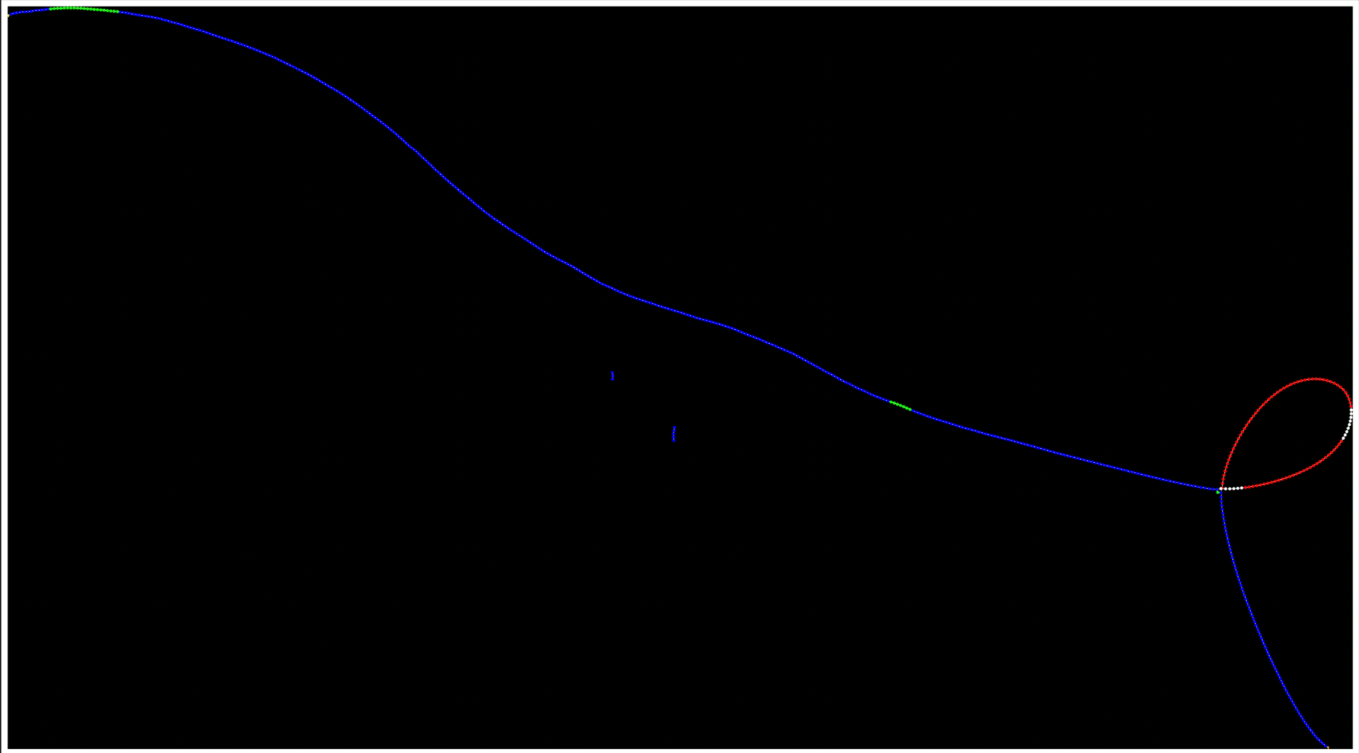
98 bp insertion in chr14 of COLO829 cancer cell-line
Tumor
Normal
Clear pattern of soft-clipped sequences in the tumor reads indicating the challenge to map the reads to the reference.
Lancet colored de Bruijn graph for the same 98bp insertion in COLO829 (red = tumor; green = normal; blue = shared; white = sequencing errors).

Slide 8
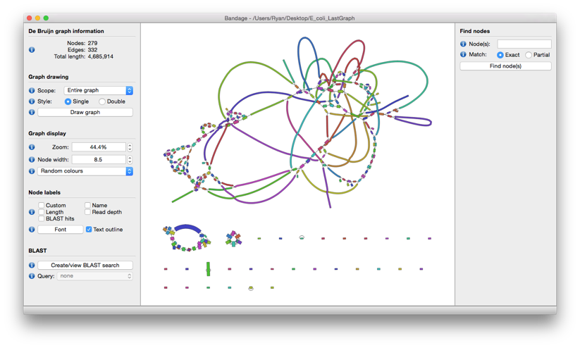
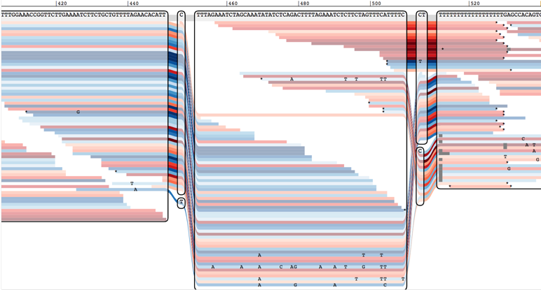
Visualizing (Cancer) Genome Graphs
Goal: explore the underlying graph data with high-resolution and fidelity.
Scale: dependent on the application (eg. whole-genome vs variant calling)
Bandage user interface. Multiple drop-down menus are available to, for example, move, label and color nodes.
SequenceTubeMap graph layout. Sequence graph illustration of a stretch of the BRCA1 gene with known variants from the 1000 Genomes project and supporting reads aligned.
Wick, R.R., et al., Bandage: interactive visualization of de novo genome assemblies. Bioinformatics, 2015. 31(20): p. 3350-2.
Beyer, W. et al. Sequence tube maps: making graph genomes intuitive to commuters. Bioinformatics 35, 5318–5320 (2019)

Slide 9
Set-aside project in collaboration with Benedict Paten (UCSC):
Aim: Integrating Lancet with vg and SequenceTubeMap to provide an enhanced approach to examining somatic variants with genome graphs.
Display somatic variants together with the supporting reads in an intuitive and elegant way.
Provide direct evidence for the presence of the variant in graph space.
Facilitate the inspection of important cancer variants by clinicians and researchers
SequenceTubeMap graph layout for the same 98bp insertion in COLO829. The sequence graph illustration shows both the inserted sequence and the reads supporting the inserted haplotype along with the reference.

Slide 10
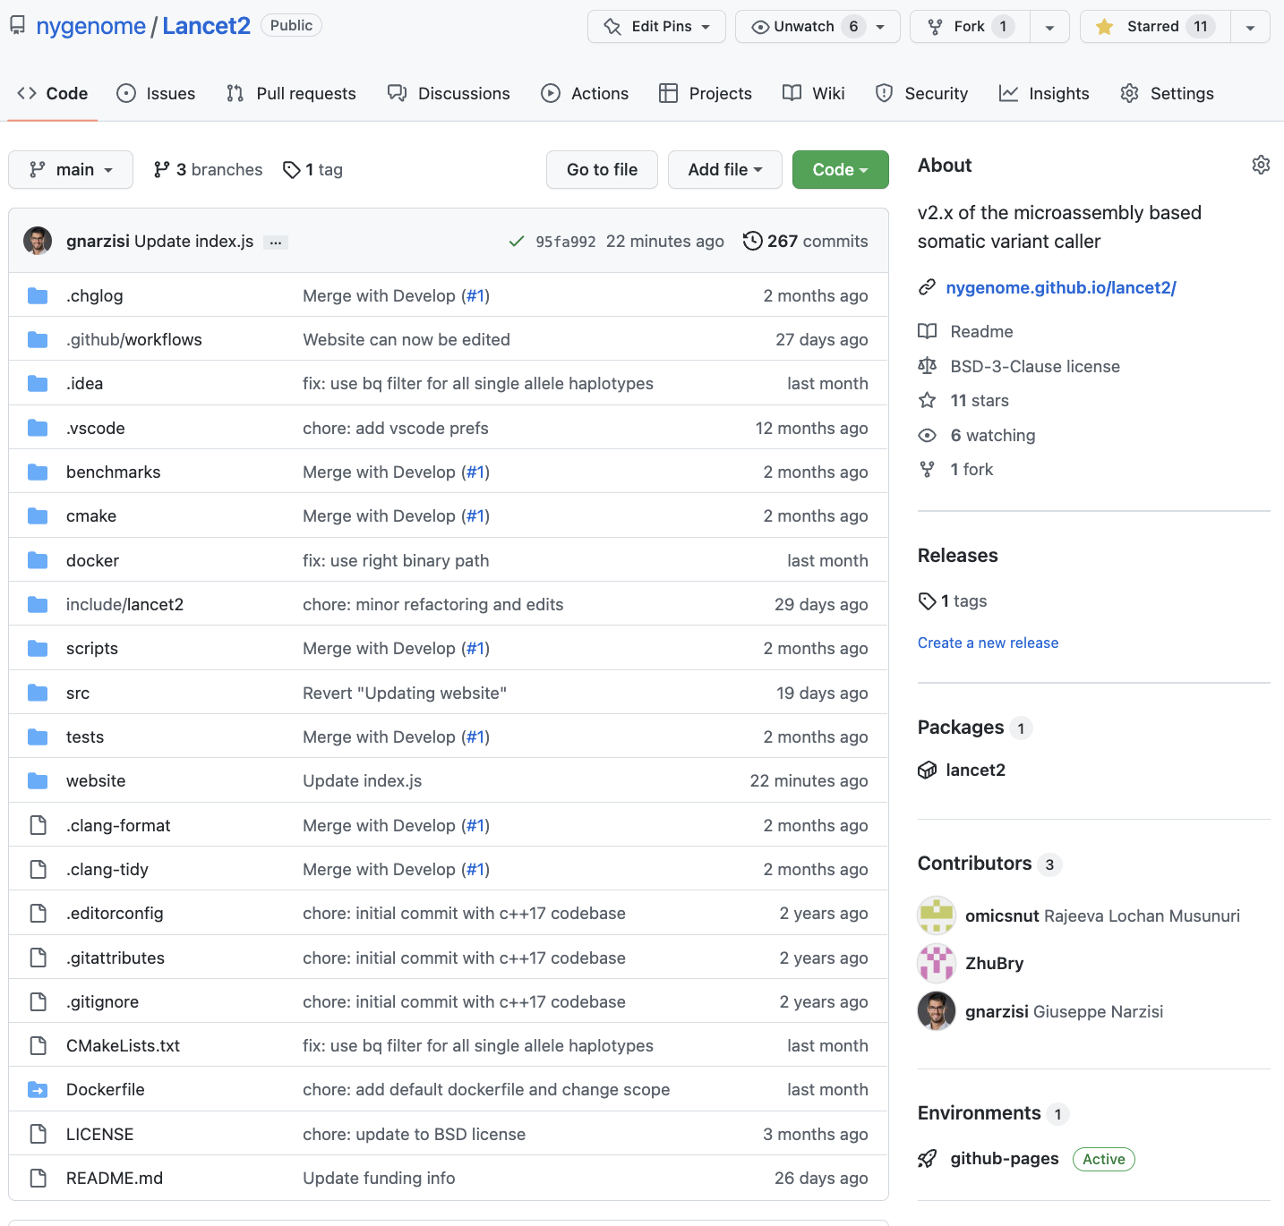
Github repository
Source code freely available (BSD-3-Clause) via NYGC github: https://github.com/nygenome/Lancet2
100% C/C++ code with native multi-threading parallelization.
Interactive user interface similar to other bioinformatics utilities (e.g., samtools, bamtools, bedtools, etc.).
Compilation:
git clone https://github.com/nygenome/Lancet2.git
cd Lancet2 && mkdir build && cd build
cmake .. && make
Pre-built docker images for Lancet2 are available on DockerHub: https://hub.docker.com/r/rmusunuri/lancet2

Slide 11
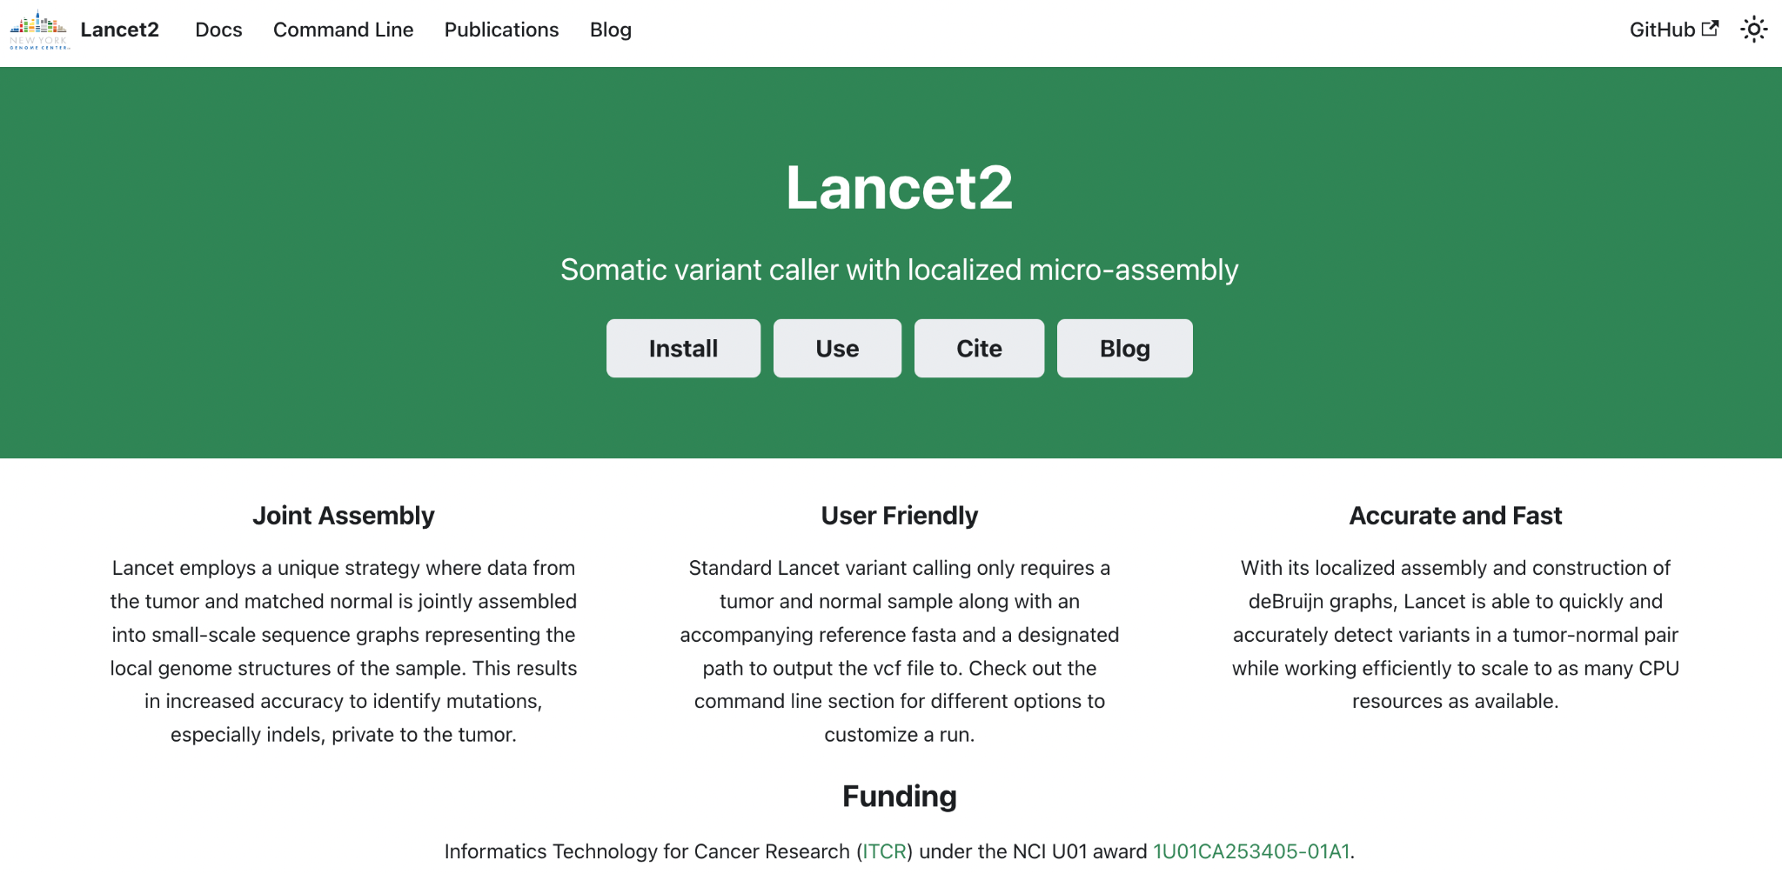
Documentation: https://nygenome.github.io/Lancet2/

Slide 12
Acknowledgements
Rajeeva Musunuri
Bryan Zhu
Jennifer Shelton
Minita Shah
André Corvelo
Nicolas Robine
Michael Zody
Kanika Arora, MSKCC
Ewa Bergmann, Illumina
Vladimir Vacic, 23andMe
Anne-Katrin Emde, Variant Bio
@gnarzisi
gnarzisi@nygenome.org

