Slide 1
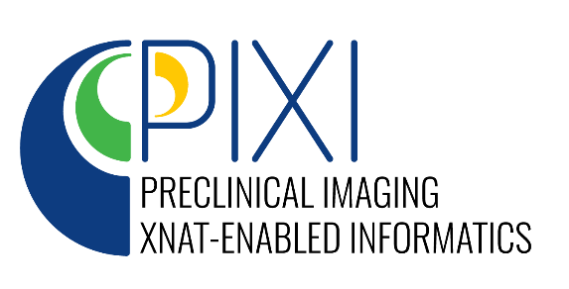
Development of an Open-Source Preclinical Imaging Informatics Platform for
Cancer Research
Andrew Lassiter
On behalf of Kooresh Shoghi, PhD, Daniel Marcus, PhD (MPIs)
Stephen M. Moore, William Horton, James D. Quirk, Jenny Gurney, Richard Laforest
NCI Informatics Technology for Cancer Research (ITCR) 2022
https://www.PIXI.org

Slide 2
The Scope & Unmet Need
NCI’s precision medicine initiative emphasizes the use of translational oncology models (PDX, GEMMs, etc.), reproducible, impactful, and open science.
Vast datasets (# of animals, # of time points,# modalities, drug therapies, probes, sequences, etc.) and dynamic/complex workflow.
Non-tractable data results in poor reproducibility and presents obstacles for data mining and open science collaboration.
Current databases are not compatible with the complexity and growing demands in preclinical cancer imaging which include big data needs and collection of metadata/annotation to support NCI’s precision medicine initiative.

Slide 3
Objective
Develop an open-source preclinical imaging informatics platform—Preclinical Imaging XNAT-enabled Informatics (PIXI)—to:
Manage the workflow of a preclinical imaging laboratory.
Develop a database to address the big data needs and collection of metadata/annotation to support NCI’s precision medicine initiative.
Develop and enable deployment of analytic and computational pipelines in preclinical imaging

Slide 4
Overview of Project

Slide 5
Small Animal DICOM & Metadata
Unlike clinical imaging where data/metadata collection standards are widely accepted by vendors and in practice of clinical research, standards are not widely accepted nor implemented in preclinical imaging.
The NCI co-clinical imaging research program (CIRP) has surveyed CIRP funded sites to identify metadata needs to support quantitative co-clinical imaging research.
Google surveys were created to cover separate topics.
A complete reference implementation will be a part of PIXI.
Element | Essential | Recommended | Not Needed
Common Animal Model | 20 | 2 | 1
Feeding and Environmental | 5 | 11 | 44
Study Protocol | 6 | 0 | 0
Imaging Common | 7 | 0 | 0
MR Imaging | 88 | 28 | 0
PET Imaging | 50 | 34 | 19
CT Imaging | 35 | 25 | 27

Slide 6
PIXI Database, PCI Workflow and Experiments
Imaging
PET
MR
CT
BLI
SPECT
US
Project
Pathology
H&E
IHC
ExVivo
MxIF
WT
Cell line
-OMICS
GeEx
RNA seq
WES
Subject
PDX
Intervention
Drugs
GEMM
Experiment
Descriptive
Animal Weight
Tumor Size
Metabolic
BioD
Housing
The XNAT Project/Subject/Experiment hierarchy was extended to support preclinical imaging workflows
Complete
Future Workflows

Slide 7
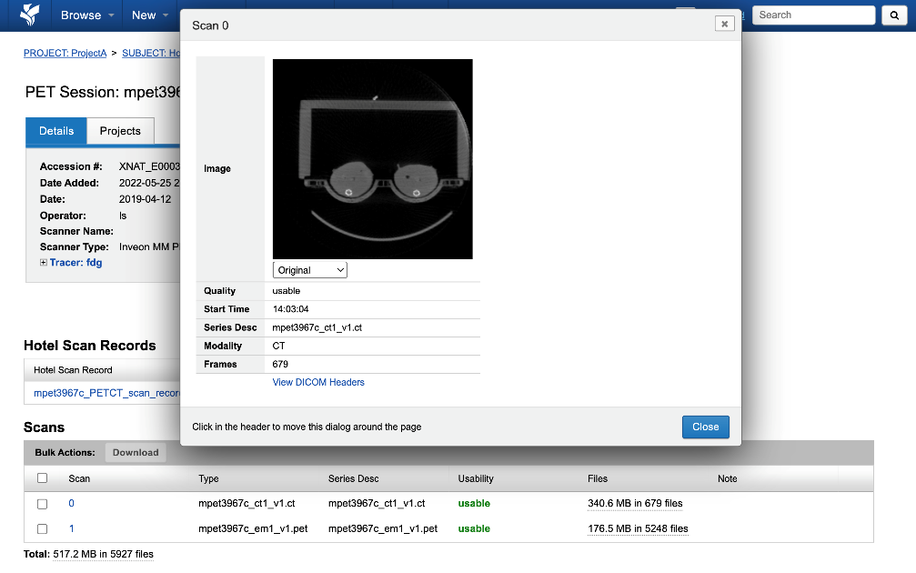
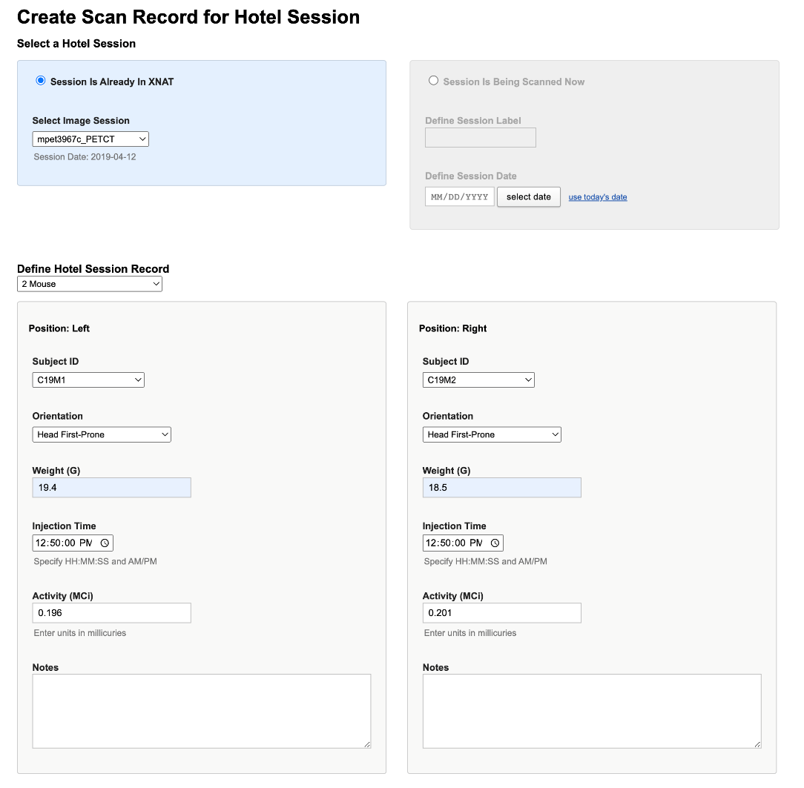
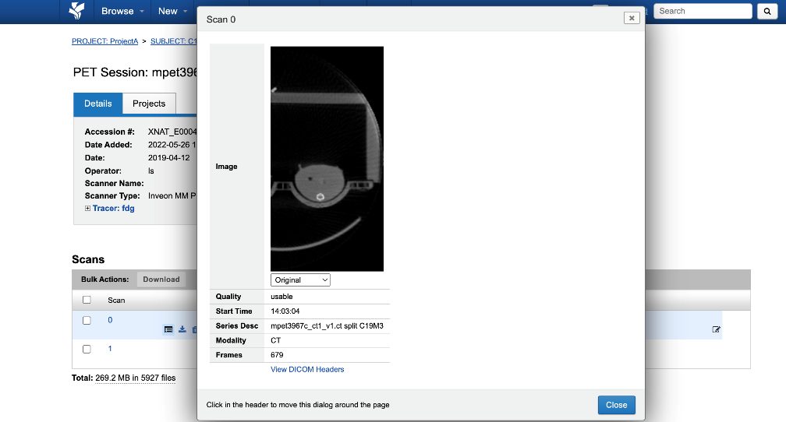
Interactive PET/CT Hotel Session Splitter
Hotel Image Session
Single Subject Image Session
DICOM splitting tool based on Kalen et al., Tomography 2021.

Slide 8
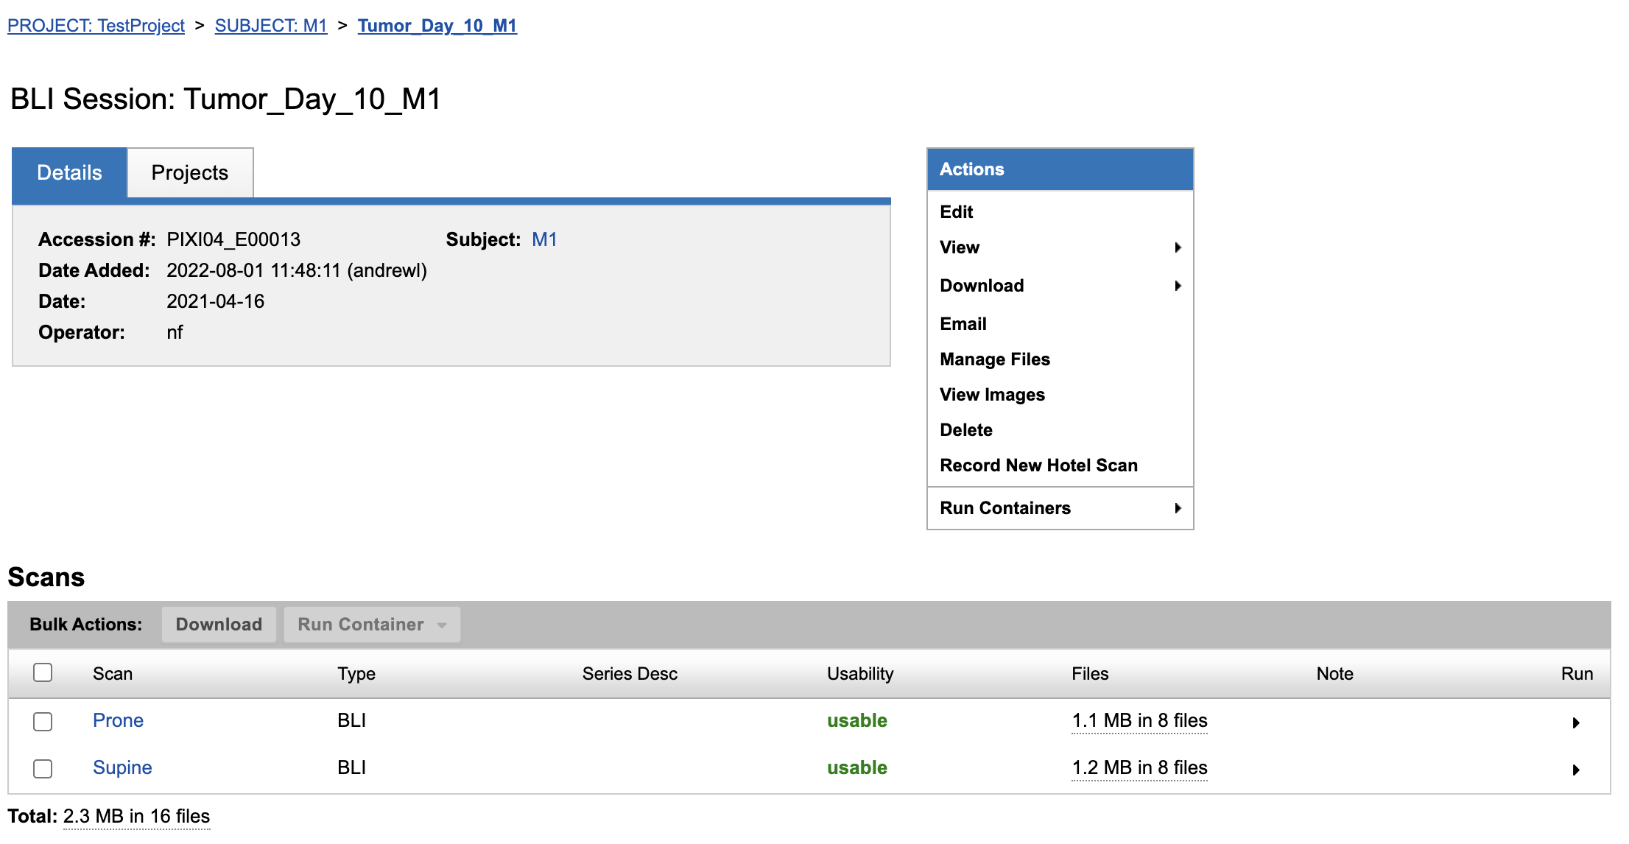
Bioluminescent Imaging
XNAT has strong support for DICOM imaging modalities. Improvements were made to core XNAT to support BLI images.
PerkinElmer IVIS 2D bioluminescent imaging format can now be imported into the PIXI database.
Li thresholding [1][2][3] is used to segment the mice into single subject image sessions.
Future work will focus on the automatic calculation of the bioluminescence signal for tracking tumor growth.
[1] Li C.H. and Lee C.K. (1993) “Minimum Cross Entropy Thresholding” Pattern Recognition, 26(4): 617-625 DOI:10.1016/0031-3203(93)90115-D
[2] Li C.H. and Tam P.K.S. (1998) “An Iterative Algorithm for Minimum Cross Entropy Thresholding” Pattern Recognition Letters, 18(8): 771-776 DOI:10.1016/S0167-8655(98)00057-9
[3] Li Thresholding¶. Li thresholding - skimage v0.19.2 docs. (n.d.). Retrieved July 1, 2022, from https://scikit-image.org/docs/stable/auto_examples/developers/plot_threshold_li.html

Slide 9
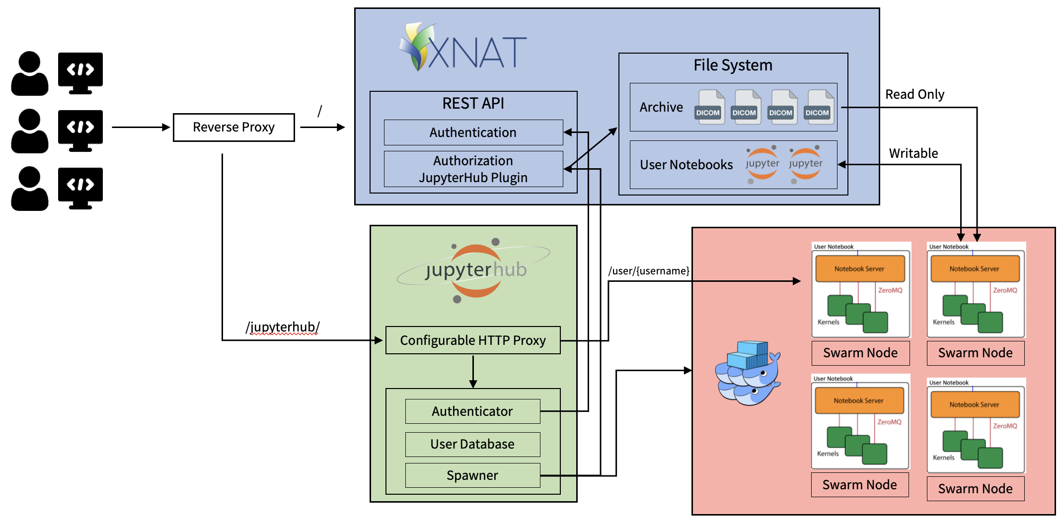
Jupyter Notebook Integration
Jupyter Notebooks are the preferred environment for drafting, revising, sharing, and documenting Python scripts.
Integration with PIXI allows users to launch Jupyter notebooks on entire projects, individual subjects, or single imaging sessions.
JupyterHub is used to launch single user Jupyter servers in Docker containers with imaging data mounted to the container. Users have direct, read only file access in a containerized environment and database access is available through the XNAT REST API.

Slide 10

Jupyter Notebook Demonstation

Slide 11
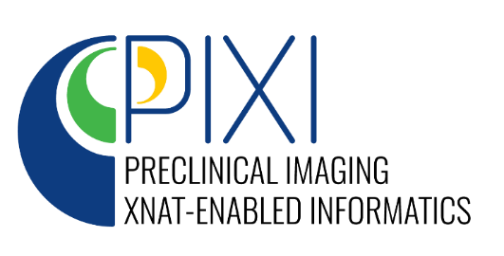
Summary
NCI CIRP
Baylor/UT@A/Stanford
UCSF
MD Anderson
University of Pennsylvania
Duke
U. Of Michigan
Washington University School of Medicine
Stanford
Consultants
Dr. David Clunie
Dr. Cristian Badea
Dr. Walter Akers
PIXI provides preclinical researches a cloud-based environment to both manage and analyze preclinical imaging datasets
  Metadata in support of preclinical imaging research
  Support for small animal subjects and hotel image sessions
  Integrated Jupyter notebooks for cloud-based analysis
First PIXI release expected in 2023
Register for updates and to become an early adopter at pixi.org
Funding
U24-CA209837
U24-CA253531

Slide 12
Backup Slides

Slide 13
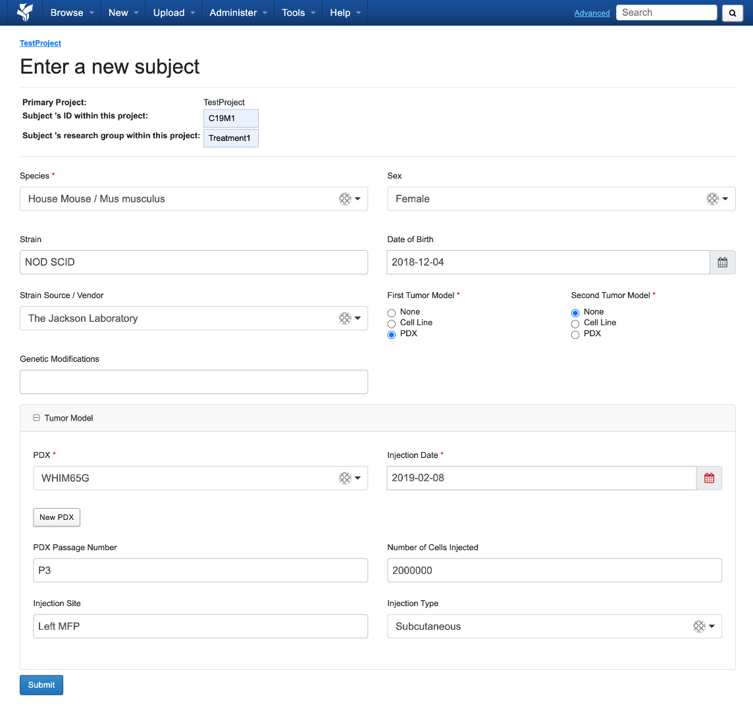
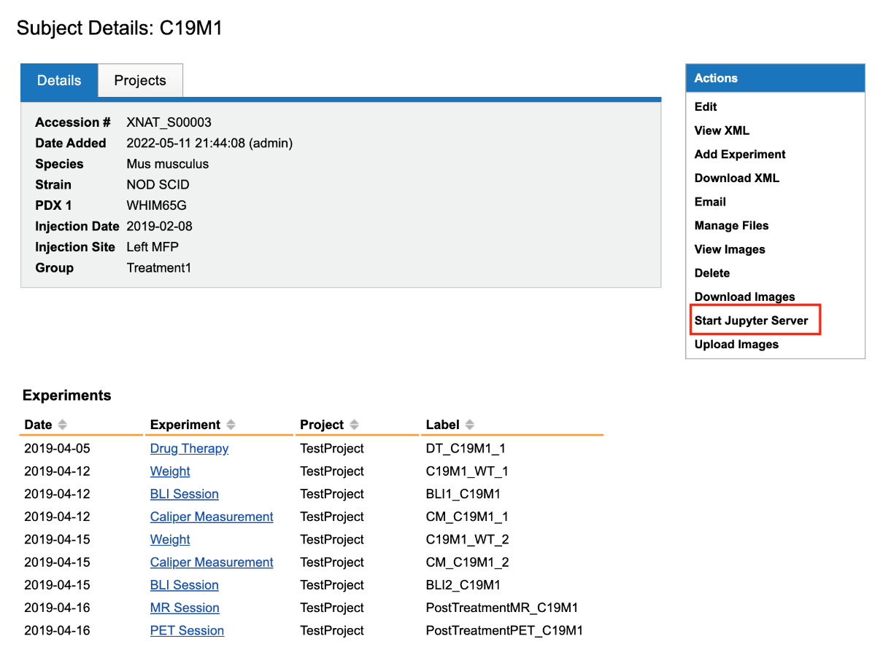
Animal Modeling
Subject
Species
Strain
Genetic Modifications
Strain Source / Vendor
Sex
DOB
PDX
PDX ID
PDX Source
Injection Date
Injection Site
Injection Type
# Cells Injected
Passage #
Cell Line
Cell Line ID
Source
Injection Date
Injection Site
Injection Type
# Cells Injected
Preliminary PDX metadata is based on PDX-MI (Meehan et al., Cancer Res 2017), but working within CIRP to finalize metadata.

Slide 14
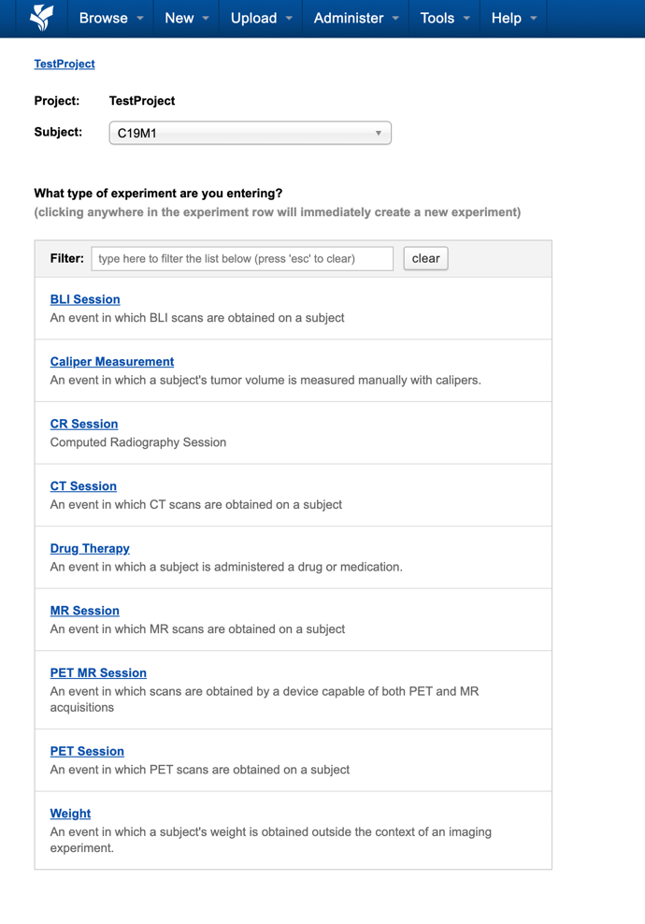
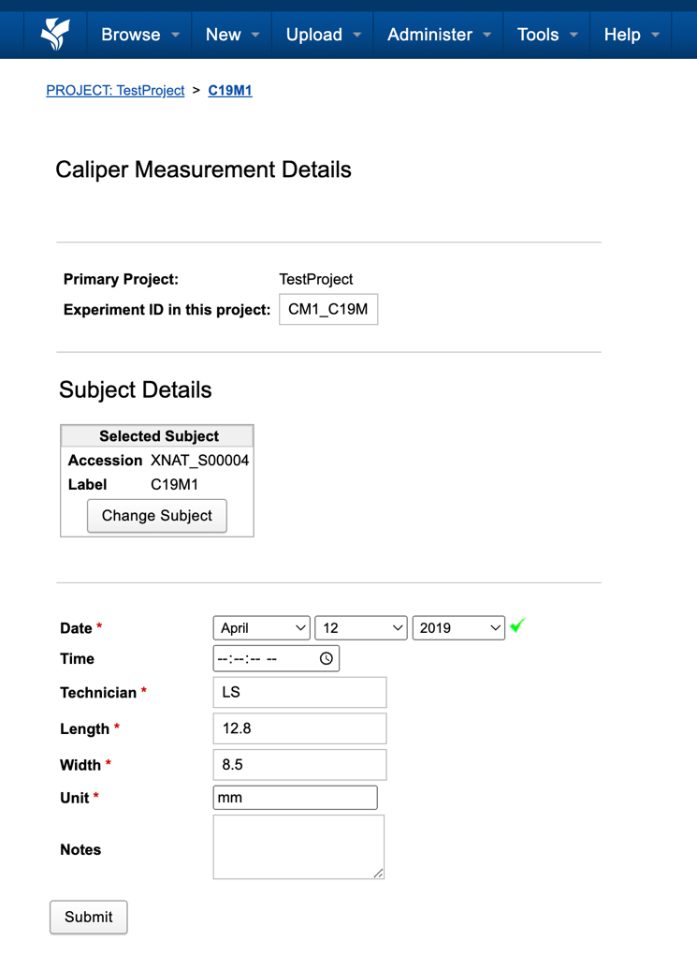
PIXI Experiment Workflows

Slide 15
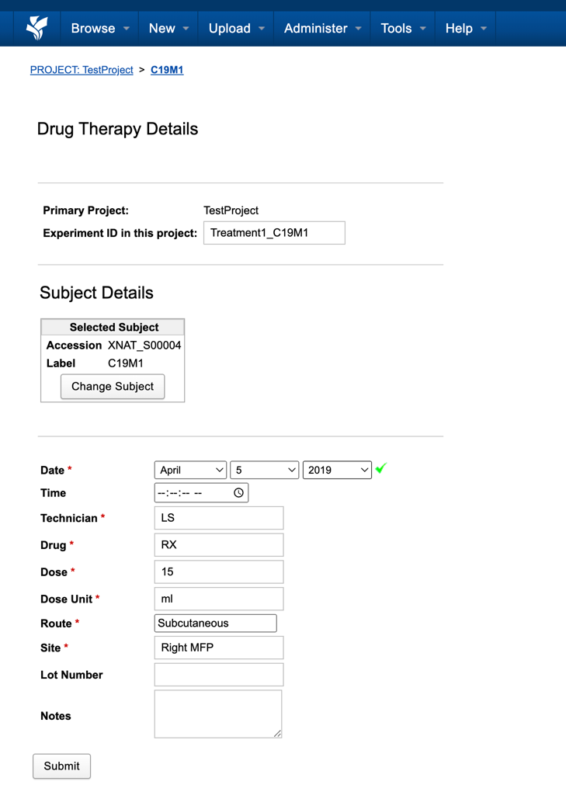
PIXI Experiment Workflows

Slide 16
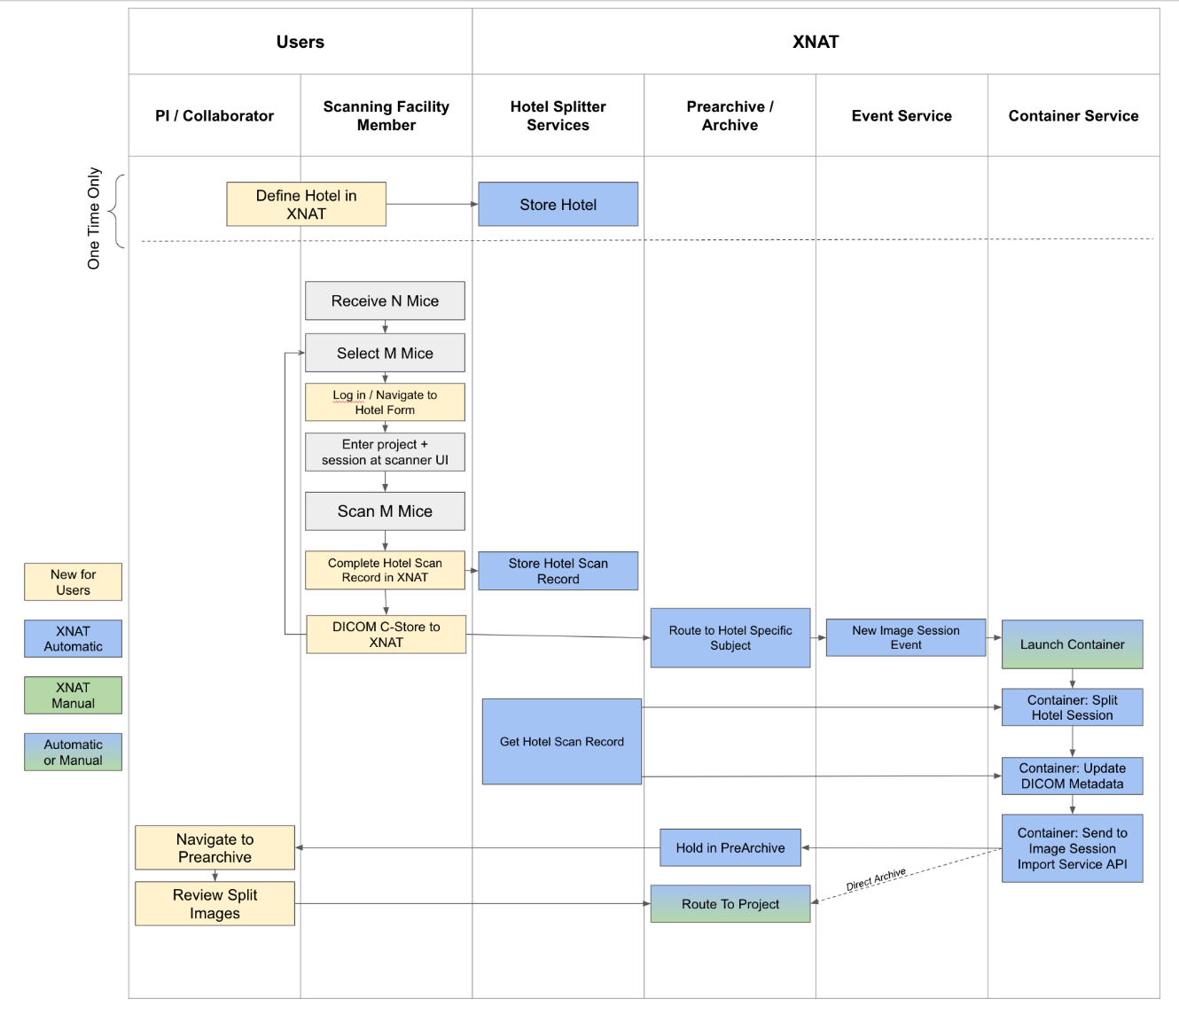
Hotel Image Session Splitter Workflow
Interactive hotel splitter works for in progress image sessions and for image sessions that are already in PIXI database
DICOM splitting tool based on Kalen et al., Tomography 2021.
DICOM metadata is updated for split image sessions
  UIDs
  Patient ID, Weight, Orientation, Comments
  Radiopharmaceutical doses and injections (for PET)

