Slide 1
muMS2: an open-source R package for analyzing metabolomics data (1U01CA264071)
Pat Schloss, PhD
Marcy Balunas, PhD
Department of Microbiology & Immunology
University of Michigan Medical School

Slide 2
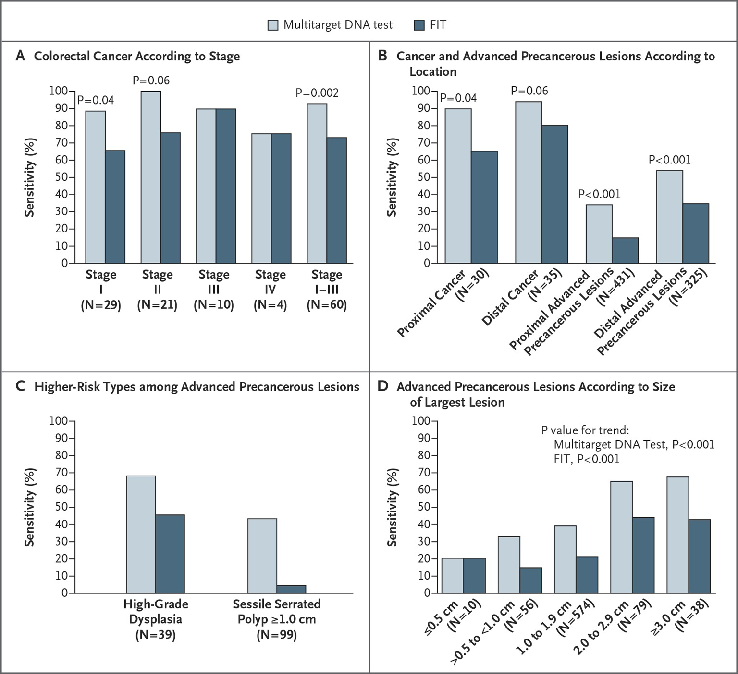
Colorectal cancer diagnostics
~30% of patients follow screening guidelines
Desire for non-invasive diagnostics
Cologuard struggles with detecting adenomas and advanced adenomas
Imperiale et al 2014 NEJM doi: 10.1056/NEJMoa1311194

Slide 3
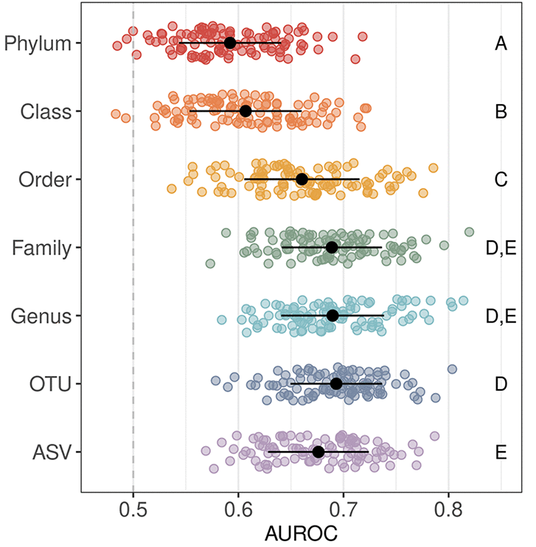
The microbiome is a source of biomarkers for cancers
Strong evidence that viruses and bacteria can cause cancers
16S rRNA gene sequencing combined with machine learning models indicated that there is an association between the fecal microbiome and presence of screen relevant neoplasias (SRNs)
Armour et al. 2022 mBio doi: 10.1128/mbio.03161-21

Slide 4
Moving away from taxonomic data
Considerable interpersonal variation in the human microbiome
  Typical person has 100-1000 bacterial species
  10¹² bacteria per g of fecal material
  Each person has a unique combination of a finite number of taxa
  Convergent and divergent evolution and horizontal gene transfer are prevalent
Hypothesis: Chemistry provides the interface between human and our microbiome

Slide 5
Challenges
16S rRNA gene sequences
(circa 2005)
Thousands of possible MS features
  But only 5% have a known structure
  Primarily compounds from central metabolism
Existing tools
  Largely based on classification of unknowns to knowns
  Proprietary
  Web-based
Limited access to published datasets
Tremendous diversity
  >90% as yet uncultured
  Strong bias towards pathogens
Existing tools
  Largely based on classification of unknowns to knowns
  Custom, closed research source code
  Web-based
Limited access to published datasets

Slide 6

What was our solution for 16S rRNA gene sequencing?
Database independent approaches
  Cluster sequences based on how similar they are to each other rather than to a database
  Phylogenetic
Develop culture of openness
  Databases
  Sequence collections
  Software – DOTUR, SONS, mothur, QIIME, dada2
Schloss et al. 2009. AEM doi: 10.1128/AEM.01541-09
Schloss 2020. AEM doi: 10.1128/AEM.02343-19

Slide 7
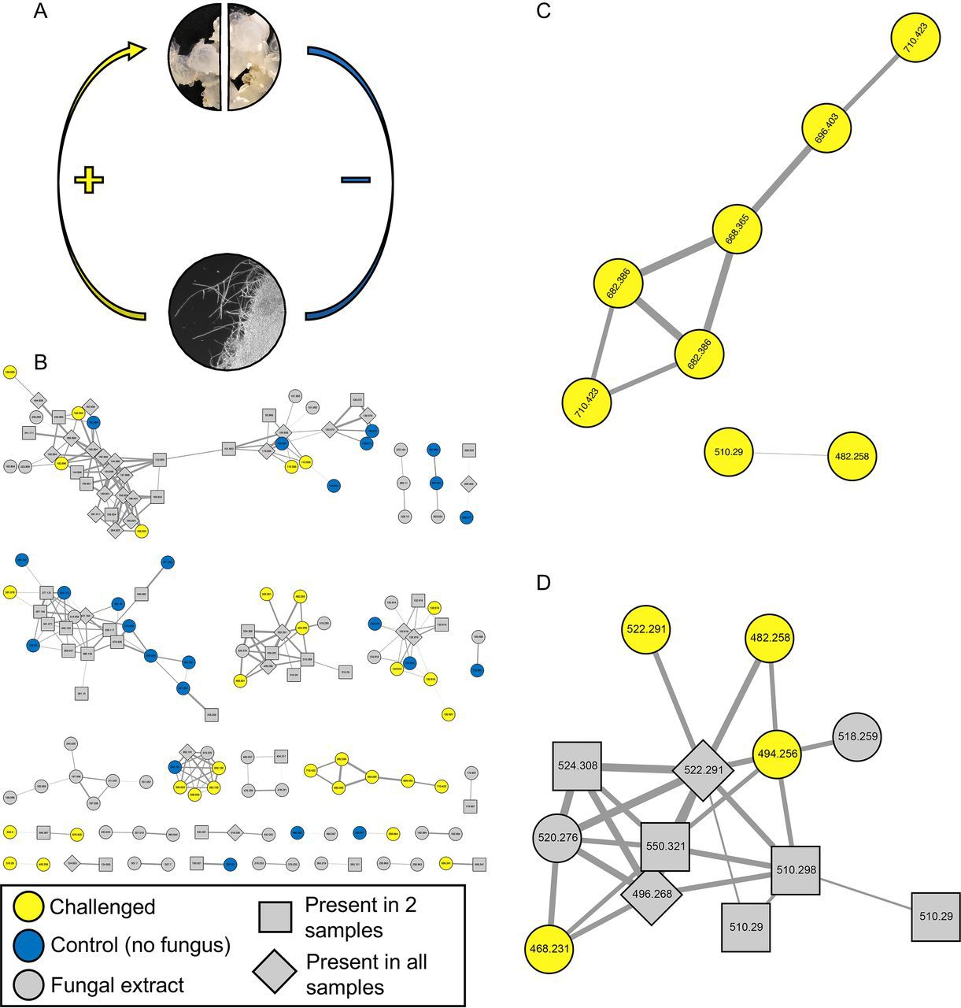
GNPS is a good first step towards these goals
Web-based
Open questions
  Distances and thresholds
  Clustering methods
  Quantification
Community analysis is not the primary goal
Kerwin et al. 2019 mBio doi: 10.1128/mBio.02376-19

Slide 8
Aim 1. Develop the muMS2 R package
Foundation
  Open-source R package
  Extensible for additional development
  Transparency
  Democratizes development
Usage
  Can be run locally
  User can have greater control over parameters and algorithm selection
  Operating system independent
  End goal of output is community analysis rather than discovery

Slide 9
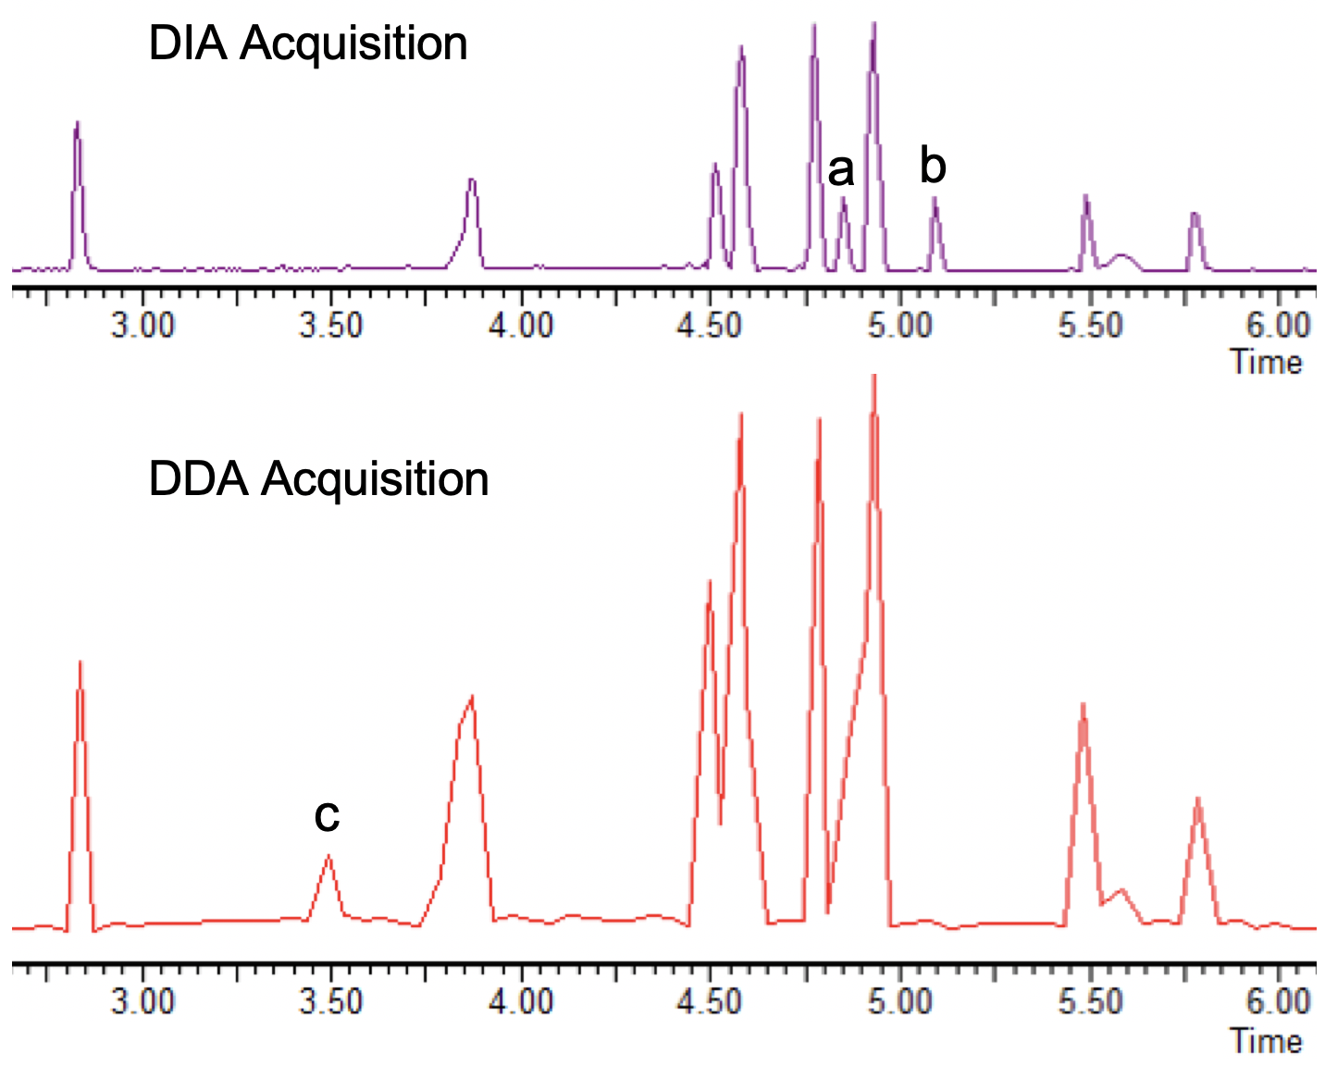
Aim 2. Construct a predictive abundance algorithm for quantification of MS features
Quantification is fraught with many challenges
Will validate using synthetic metabolomic data
Will implement existing methods as well as a mixture model

Slide 10
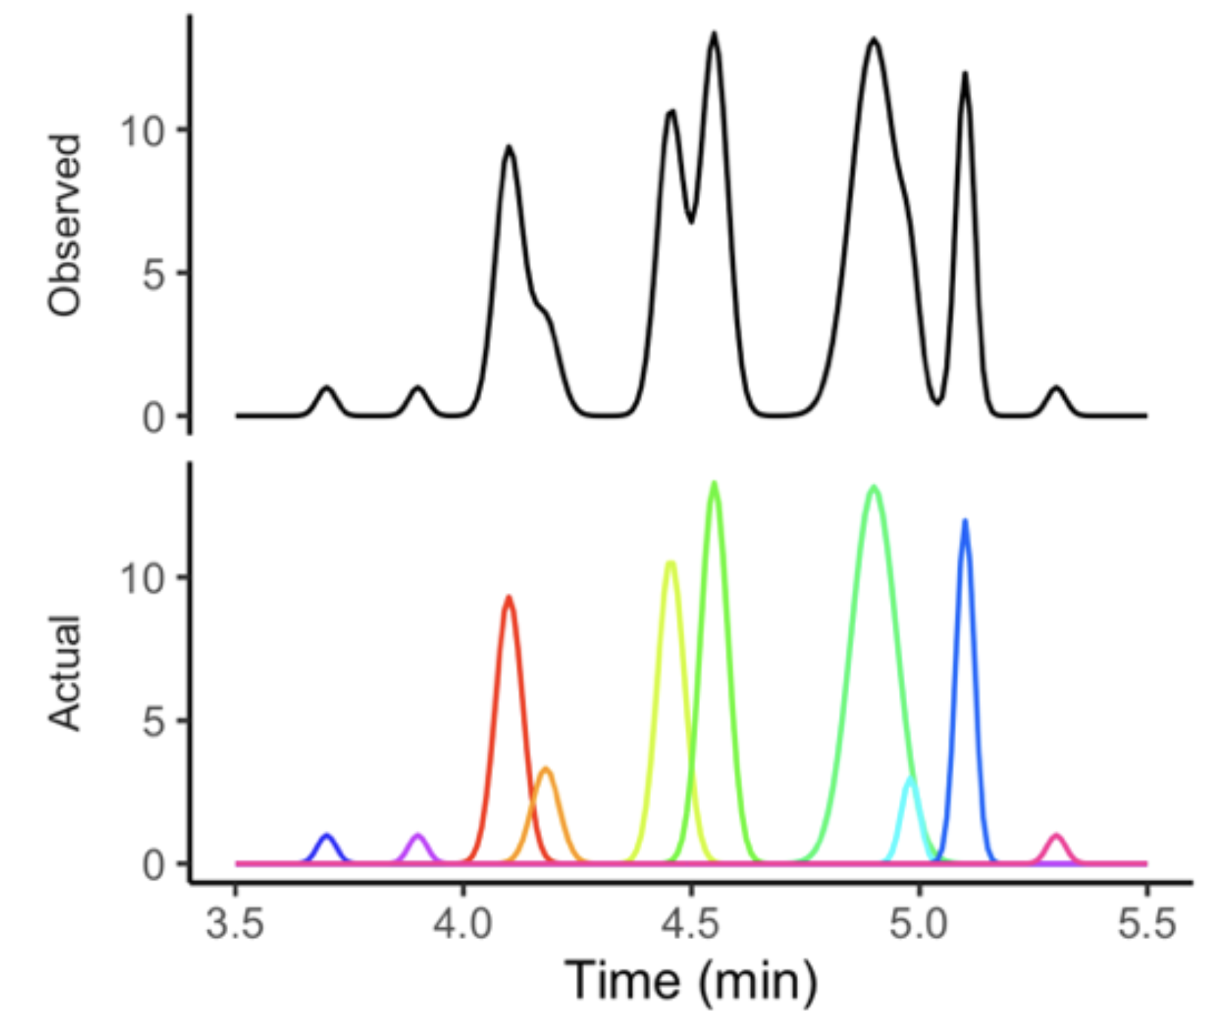
Aim 2. Construct a predictive abundance algorithm for quantification of MS features
Quantification is fraught with many challenges
Will validate using synthetic metabolomic data
Will implement existing methods as well as a mixture model

Slide 11
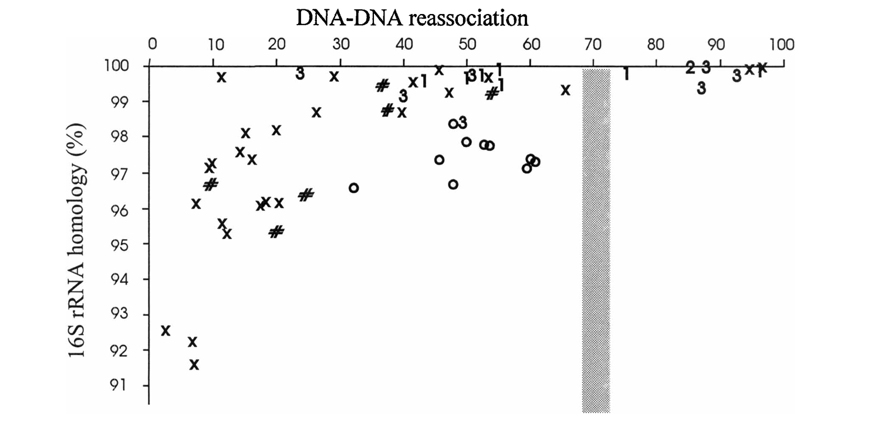
Aim 3. Construct operational metabolomics units (OMUs) framework
Using in silico MS data from diverse classes of molecules we will evaluate various distance metrics to find meaningful thresholds for different levels of resolution
Will calculate distances using fragmentation patterns, molecular weight, and/or retention time

Slide 12
Aim 3. Construct operational metabolomics units (OMUs) framework

Slide 13
Aim 3. Construct operational metabolomics units (OMUs) framework

Slide 14
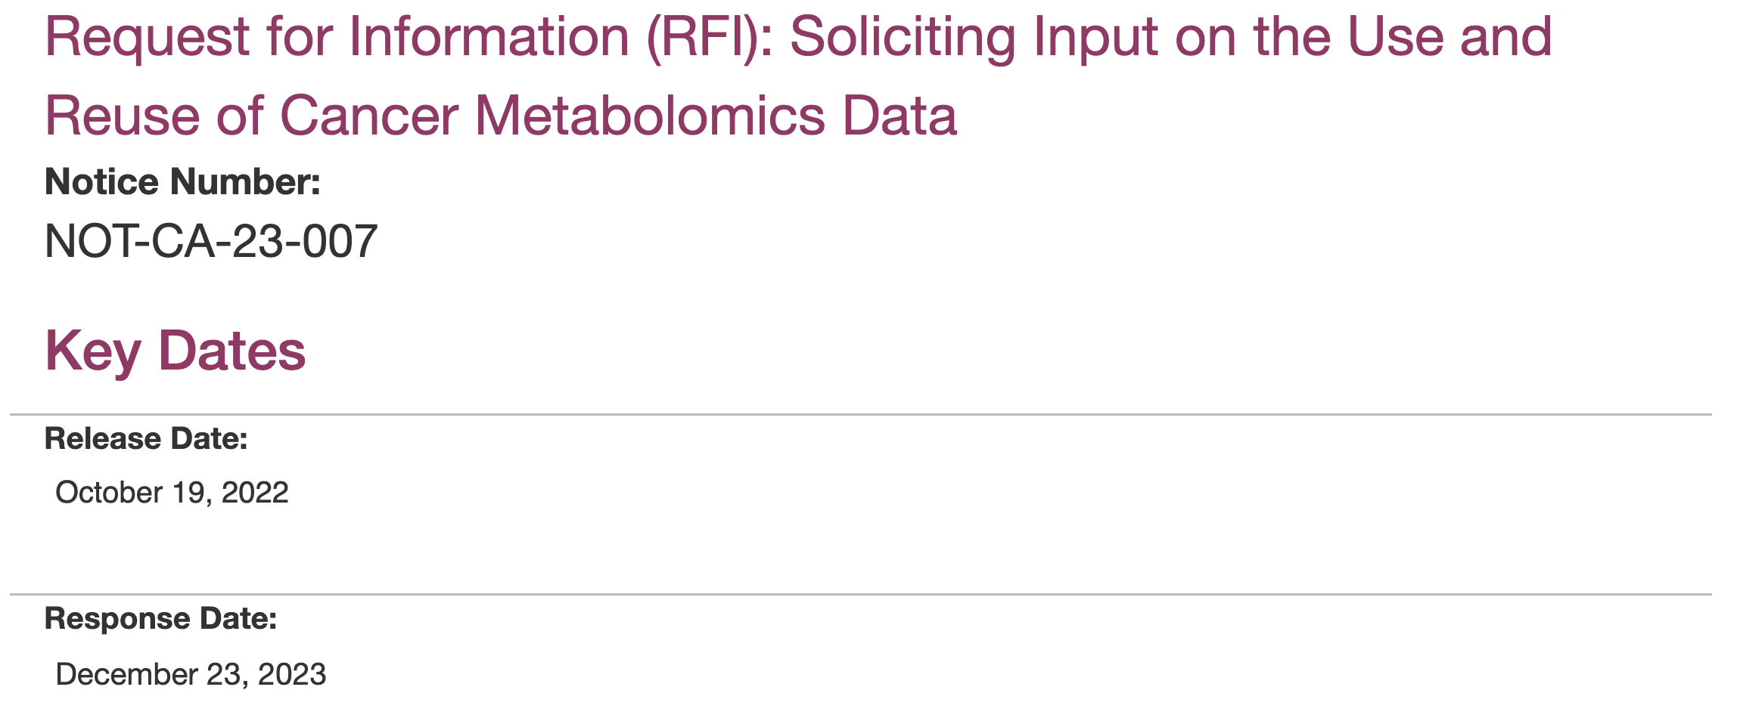

Slide 15
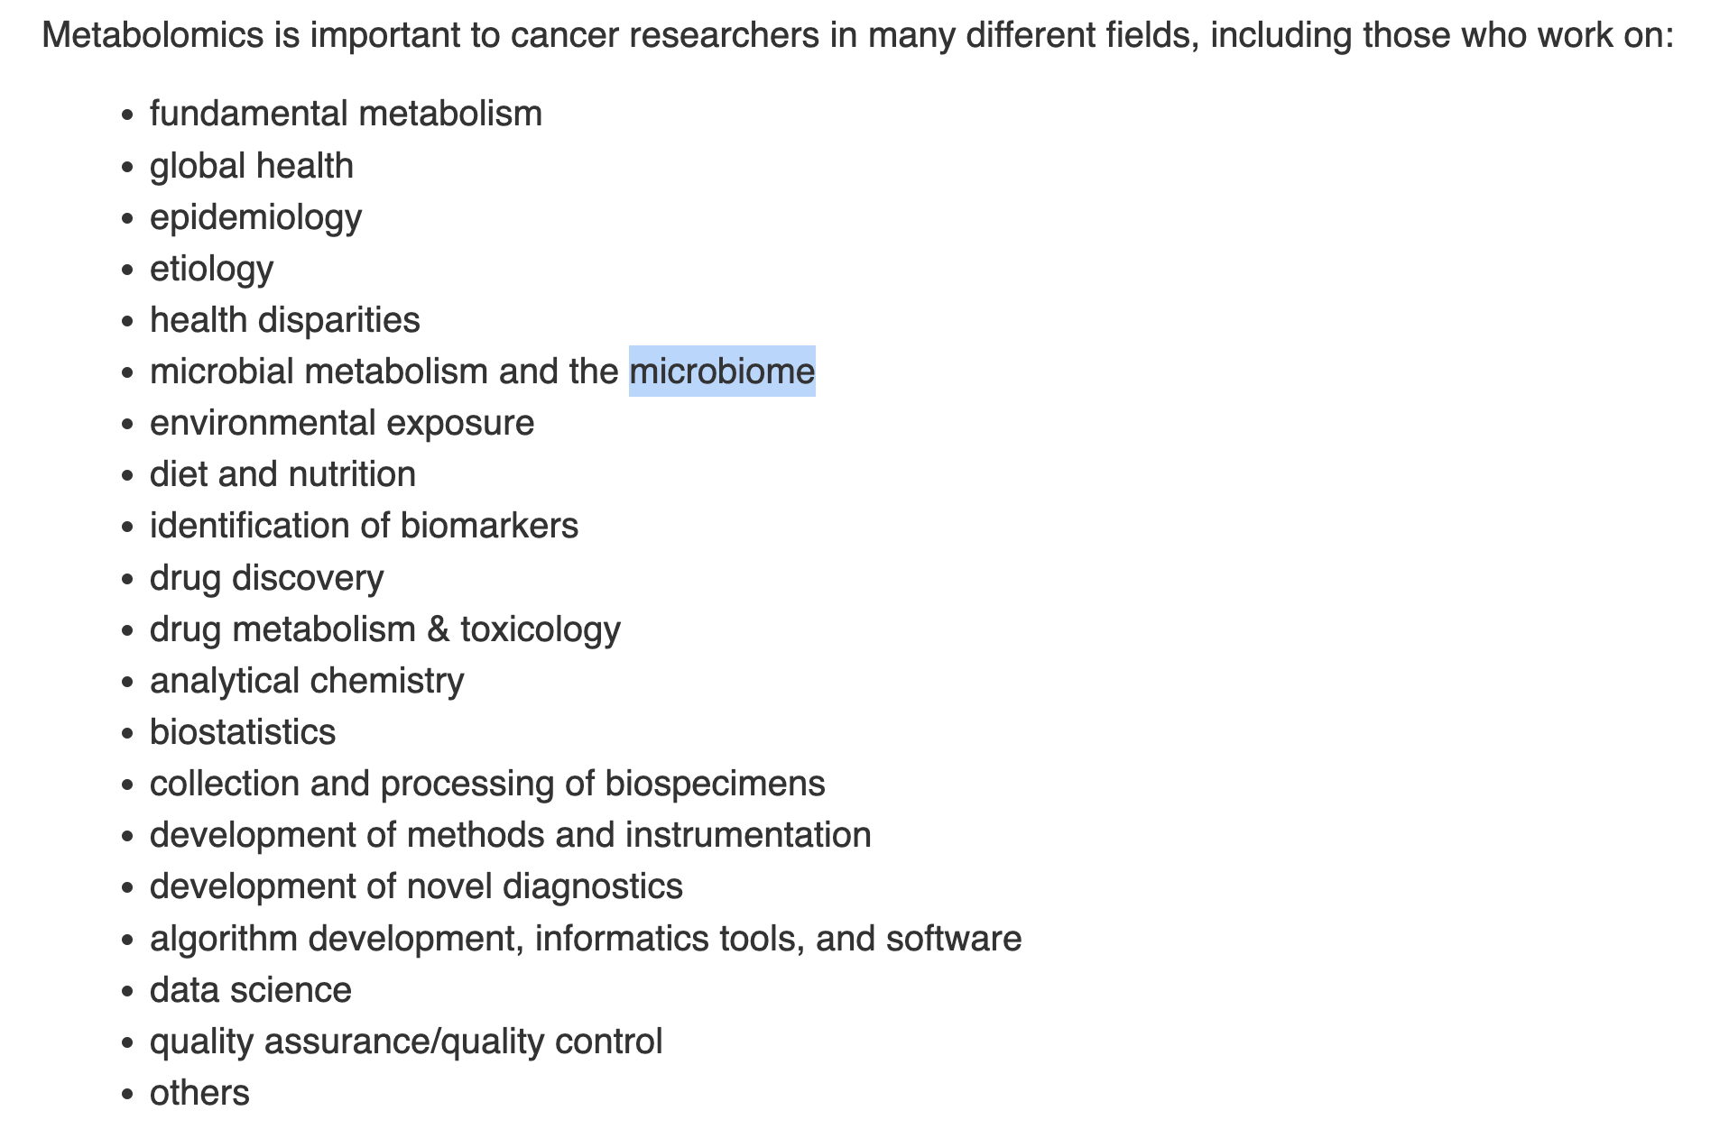

Slide 16
