Slide 1
OKRA: Oncology Knowledgebase Rapid Alerts using the My Cancer Genome precision cancer medicine knowledge resource
Vanderbilt University Medical Center
December 1, 2022
MPIs Christine Micheel, Travis Osterman
Project Team
Kate Mittendorf, Michele LeNoue-Newton, Dan Fabbri, Joseph Coco, Cheng Ye, Scott Sobecki, Mike Nicholas, Health IT, VUMC IT
Notes:
I am going to talk to you today about our new R21 award, entitled OKRA, Oncology Knowledgebase Rapid Alerts. This project uses the My Cancer Genome knowledgebase.
My co-MPI is Dr. Travis Osterman, and I am joined on the call today by scientist Kate Mittendorf. Our collaborators are also listed here.

Slide 2
Translational Science Spectrum
Notes:
I’m going to start off by highlighting this figure from the National Center for Advancing Translational Sciences. I think we can argue that nearly all cancer research is in some capacity “translational”, as you can see everything from basic research to public health research shown in this figure representing the “translational science spectrum”. From reviewing other ITCR funded projects and attending this year’s annual meeting, it seems that most of our projects live in the basic research and preclinical research categories. Our project is much more on the side of clinical implementation. Even so, it still falls into the category of informatics technologies for cancer research.

Slide 3
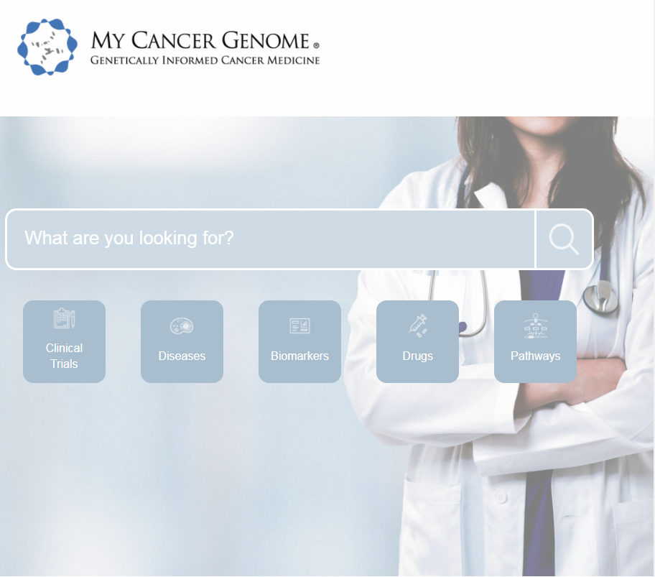
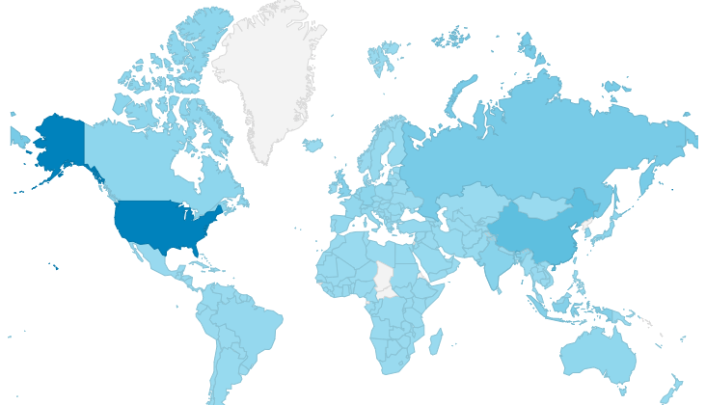
Gene-directed cancer treatment options for patients and physicians
Includes gene-directed clinical trial search and variant prevalence information from AACR Project GENIE database, which houses sequencing data from 100K+ patients.
3.5 M page views
~9,000 visits/week
213 countries and territories
4000+ clinical trials
500+ diseases
400+ genes
2300+ biomarkers
1000+ drugs
Notes:
I want to spend just a moment introducing you to My Cancer Genome, since not everyone on the call will be familiar with it. My Cancer Genome was the first knowledgebase of its kind, it went live in 2011, with the goal of providing gene-directed cancer treatment options for patients and their physicians. My Cancer Genome also includes information about cancer clinical trials, cancer-directed therapies, and includes prevalence data from AACR Project GENIE.
Total of 3.5 M pageviews since it went live at the beginning of 2011. It is an internationally used resource, with only about 30% of visits from the US, with China and Russia being the next most prevalent users of the resource.

Slide 4
MCG Information Architecture
Ontologies, Hierarchies, and Nomenclature Systems
External Data Sources
Assertions
Curated Assertions
Clinical Trial Documents with Cancer-Related Keywords
ClinicalTrials.gov
HGVS
Trial Eligibility Groups
Cancer.gov
ISCN
Biomarker Ontology
Trial Treatment Contexts
UMIN Clinical Trials Registry
RefSeq
Therapeutic Assertions
Calculated Assertions
Universal Transcript Archive Repository
WHO Classification
Functional Assertions
Disease Ontology
Biomarker and Disease Prevalence
OncoTree
Uniprot
Clinical Trial Landscape
dbNSFP
SNOMED-CT
Drug Ontology
Treatment Trends
NCI Thesaurus
Publicly Available Genomic Alteration Data
Biomarker-Disease Frequency
AACR Project GENIE
More information can be found at https://www.mycancergenome.org/content/page/my-cancer-genome-data-sources/
Notes:
Because our project will rely on the MCG knowledgebase, I want to spend a minute or two outlining its content and architecture. Essentially, knowledge is imported from outside sources into the curation tool and is manually curated as necessary to generate what we call curated assertions – which are things like clinical trial eligibility groups and therapeutic assertions – and calculated assertions – such as biomarker and disease prevalence. To generate this system, we imported publicly available nomenclatures, hierarchies, and ontologies, outlined on the left of this slide, to develop internal biomarker, disease, and drug ontologies that we manually supplement as necessary. We also import cancer clinical trial documents from external document sources (like ClinicalTrials.gov) and manually annotate them using the biomarker, disease, and drug ontologies to generate a database of curated clinical trial eligibility groups and treatment contexts. We also use the biomarker, disease, and drug ontologies to generate therapeutic assertions that describe the predicted response to a drug in the context of a specific disease setting and biomarker status. These assertions are developed based on drug approvals, treatment guidelines, and literature review prior to release to the My Cancer Genome website.
Ontologies or datasets with rounded edges are manually supplemented or curated by MCG curators.
Ontologies, nomenclatures, or datasets with square, rectangular edges are not manually supplemented or curated.
Colored/grey fields and arrows show the information flow from ontologies and datasets that directly contribute to curated and calculated assertions. Those that are not colored are imported into an ontology or dataset prior to assertion generation. Black, skinny (non-block) arrows show information flow from curated assertions to calculated assertions (i.e., how curated assertions are used to generate calculated assertions).
Term Definitions
Functional Assertions: Variant location and effect information in Overview section of Biomarker pages
Biomarker and Disease Prevalence: GENIE charts in Overview section of Biomarker and Disease pages
Clinical Trial Landscape: # of Trials vs. Biomarker or Disease charts in Biomarker and Disease pages
Treatment trends: drug landscape charts in clinical trials section
Biomarker-disease frequency: Significance section of biomarker and disease pages

Slide 5
Publicly Available
Resources
Clinically Integrated
Solutions
My Cancer
Genome
Vanderbilt EHR Info Button
>7,240 patients
Website
>3.5M page views
213 countries
Laboratory Reporting Tool
>9,000 specimens
18 institutions
Mobile App
>39,000 sessions
Molecular Consult Tool
Notes:
The My Cancer Genome knowledgebase hasn’t only fueled the MCG website, it also is or has been used in other publicly available and clinically integrated solutions. This R21 focuses on integrating MCG content into the EHR alongside molecular testing results. Long ago, when Vanderbilt used a home-grown medical record, and we included info buttons to results of our targeted gene panels. With changing sequencing panels and moving to a new medical record, these links were lost.
Since the number of molecular variants such as mutations that have clinical implications has been growing rapidly, as have the number of molecularly targeted therapies, this information is almost essential to help clinicians keep their practices up to date. But, each institution wants to be able to control what content they view, whether it be from a specific source like MCG, from an internally curated database, or from another source other than or separate from the NGS test vendor.

Slide 6
OKRA Specific Aims
Aim 1. Develop an open-source algorithm and API for computing and storing biomarker-driven CDS from the MCG knowledgebase.
Aim 2. Develop methods for integration of biomarker-driven CDS into the EHR as human-readable statements.
Notes:
Vanderbilt is not the only institution with this problem, and so we plan to create an open-source algorithm and API for computing biomarker-driven clinical decision support leveraging the My Cancer Genome Knowledgebase. Then, we will develop methods for integration of biomarker-drived CDS into the HER as human-readable statements, using NSCLC testing results in the Vanderbilt medical record as a demonstration. In future work, we plan to study the effectiveness of the CDS as well as implementation of this solution at other institutions.

Slide 7
Notes:
This figure shows the proposed architecture for our tools.
Aim 1 focuses on creating the API that will listen for or receive pushes of HL7 formatted molecular test results, match results to assertions in the MCG knowledgebase, and send human-readable CDS back to the EHR or to a storage location like the cache shown here.
Aim 2 will focus on using NSCLC as a proof-of-concept, to integrate OKRA CDS into the EHR as knowledge alerts to oncologists that display alongside the molecular results report.

Slide 8
Aim 1
Develop an open-source algorithm and API for computing and storing biomarker-driven CDS from the MCG knowledgebase.
Notes:
Let’s look at Aim 1 in a little more detail. First, the API will listen for or receive pushes of HL7-formatted results from a reference lab or in-house test. Next, matching the variants returned in the molecular testing results to the variants in MCG is a non-trivial task. In the next couple slides I will outline our first steps in this direction.
Full text of Aim 1:
Develop an open-source algorithm and API for computing and storing biomarker-driven CDS from the MCG knowledgebase.
We will develop an algorithm that will compute targeted therapy options and natural language CDS for a patient’s cancer type and molecular profile from the content stored in the MCG knowledgebase. We will build a web service API that receives molecular testing data, calls the MCG knowledgebase, runs the CDS algorithm, and outputs natural-language CDS in an HL7-compliant format that can be cached for rapid retrieval and that is compatible with any HL7-compliant EHR.

Slide 9
Assertion Example
Notes:
This slide shows how an assertion, as housed in the knowledgebase, is translated into human-readable text for use in interpretive reports or in CDS in the EHR. On the left, you can see an abbreviated version of the MCG information architecture I showed you a few slides ago. Imported and manually curated information is used to assemble therapeutic assertions, shown in the middle. Each therapeutic assertion has a drug, disease, one or more biomarkers, a treatment setting, a use statement, and a source and source summary. An example is shown in part B. So, in this case, the resulting human-readable statement is that An FDA approval supports the use of sotorasib in metastatic NSCLC harboring a KRAS G12C mutation. The source summary shows a string of useful text from the FDA label.

Slide 10
Tempus Example: genomic data for a missense mutation
OBX|8|CWE|62374-4^Human reference sequence assembly version [ID]^L|1|LA140295^GRCh37^LN||||||||||
OBX|9|CWE|83005-9^Variant Category^L|2a|LA26801-3^Simple^LN||||||||||
OBX|10|CWE|48018-6^Gene studied^L|2a|8975^PIK3CA^HGNC||||||||||
OBX|11|ST|PATHOLOGYNOTES^Interpretation^L|2a|PIK3CA encodes the catalytic subunit, p110 alpha protein, of the phosphatidylinositol 3-kinase (PI3K) enzyme. The p110 subunit is responsible for the enzyme's phosphorylation activity, and is involved in the PI3K-AKT-mTOR and the Ras-Raf-MEK-ERK pathways that mediate cellular growth and survival. Activating mutations, copy number gains, and overexpression of PIK3CA are associated with cancer progression.||||||||||
OBX|12|CWE|51958-7^Transcript ref sequence ID^L|2a|NM_006218^NM_006218^RefSeqT||||||||||
OBX|13|CWE|48005-3^Amino acid change p.HGVS^L|2a|p.E542K^p.E542K^HGVS.p||||||||||
OBX|14|CWE|41103-3^Transcript DNA Change (cHGVS)^L|2a|c.1624G>A^c.1624G>A^HGVS.c||||||||||
OBX|15|ST|47998-0^DNA seq var display name^L|2a|p.E542K - c.1624G>A Missense variant (exon 9) GOF|||||||||| OBX|16|ST|91272006^Chromosome^L|2a|3||||||||||
OBX|17|ST|69547-8^Genomic ref allele^L|2a|G||||||||||
OBX|18|NR|81254-5^Genomic allele start-end^L|2a|178936082||||||||||
OBX|19|ST|69551-0^Genomic alt allele^L|2a|A||||||||||
OBX|20|CWE|48002-0^Genomic source class^L|2a|LA6684-0^Somatic^LN||||||||||
OBX|21|CWE|81304-8^Variant analysis method [Type]^L|2a|LA26398-0^Sequencing^LN||||||||||
OBX|22|CWE|53037-8^Genetic sequence variation clinical significance [Imp]^L|2a|LA67038^Pathogenic^LN||||||||||
OBX|23|NM|81258-6^Allelic freq NFr^L|2a|0.154||||||||||
OBX|24|CWE|69548-6^Genetic variant assessment^L|2a|LA9633-4^Present^LN||||||||||
Notes:
So what do HL7-formatted NGS results look like? Vanderbilt uses Tempus for NGS tumor sequencing, and so here I am showing an example excerpt of a message from Tempus indicating a missense mutation. The API will need to be able to find the relevant information in this message.

Slide 11
Tempus Example: genomic data for a missense mutation
OBX|8|CWE|62374-4^Human reference sequence assembly version [ID]^L|1|LA140295^GRCh37^LN||||||||||
OBX|9|CWE|83005-9^Variant Category^L|2a|LA26801-3^Simple^LN||||||||||
OBX|10|CWE|48018-6^Gene studied^L|2a|8975^PIK3CA^HGNC||||||||||
OBX|11|ST|PATHOLOGYNOTES^Interpretation^L|2a|PIK3CA encodes the catalytic subunit, p110 alpha protein, of the phosphatidylinositol 3-kinase (PI3K) enzyme. The p110 subunit is responsible for the enzyme's phosphorylation activity, and is involved in the PI3K-AKT-mTOR and the Ras-Raf-MEK-ERK pathways that mediate cellular growth and survival. Activating mutations, copy number gains, and overexpression of PIK3CA are associated with cancer progression.||||||||||
OBX|12|CWE|51958-7^Transcript ref sequence ID^L|2a|NM_006218^NM_006218^RefSeqT||||||||||
OBX|13|CWE|48005-3^Amino acid change p.HGVS^L|2a|p.E542K^p.E542K^HGVS.p||||||||||
OBX|14|CWE|41103-3^Transcript DNA Change (cHGVS)^L|2a|c.1624G>A^c.1624G>A^HGVS.c||||||||||
OBX|15|ST|47998-0^DNA seq var display name^L|2a|p.E542K - c.1624G>A Missense variant (exon 9) GOF|||||||||| [free text field, vendor dependent]
OBX|16|ST|91272006^Chromosome^L|2a|3||||||||||
OBX|17|ST|69547-8^Genomic ref allele^L|2a|G||||||||||
OBX|18|NR|81254-5^Genomic allele start-end^L|2a|178936082||||||||||
OBX|19|ST|69551-0^Genomic alt allele^L|2a|A||||||||||
OBX|20|CWE|48002-0^Genomic source class^L|2a|LA6684-0^Somatic^LN||||||||||
OBX|21|CWE|81304-8^Variant analysis method [Type]^L|2a|LA26398-0^Sequencing^LN||||||||||
OBX|22|CWE|53037-8^Genetic sequence variation clinical significance [Imp]^L|2a|LA67038^Pathogenic^LN||||||||||
OBX|23|NM|81258-6^Allelic freq NFr^L|2a|0.154||||||||||
OBX|24|CWE|69548-6^Genetic variant assessment^L|2a|LA9633-4^Present^LN||||||||||
Notes:
Here we have highlighted some of the information the API will need to be able to locate, such as the human reference sequence assembly version, the gene studied, the reference sequence, and the c dot and p dot information. There is also content that is Tempus-specific, such as “variant category” and “pathology notes”, and those will be ignored by the API.

Slide 12
Detailed Framework: Matching Logic
Framework
Instance
Diagnosis
{Any, All, None}
Diagnosis
All: Non-Small Lung Cancer; None: Squamous Cell Carcinoma
Biomarker
{Any, All, None}
Biomarker
Any: EGFR L858R, EGFR exon 19 deletion; None: EGFR T790M
Therapeutic Context
{Any, All, None}
Therapeutic Context
Any: metastatic
Therapy
Erlotinib
Note: this is an abbreviated example
Notes:
So how do we get from test results to therapeutic assertions in MCG? In an ideal case, we would know the diagnosis, biomarkers, and therapeutic context for each test result and patient. This project will focus on NSCLC as the diagnosis and all associated NGS biomarker test results for which there is an MCG therapeutic assertion. Looking at biomarker matching, you can see that MCG assertions use concepts like EGFR exon 19 deletion, or EGFR activating mutations, not just more straightforward concepts like EGFR T790M.

Slide 13
Mutation Concepts
Copy Number Alterations (CNV)
Loss
Amplification
SNV
Mutation
Frameshift
Nonsense
Missense
Deletion
Insertion
CTX
Fusion
Notes:
Our API will need to be able to move as needed within interrelated variant concepts. This figure shows how variant concepts relate in MCG, and you can see that we cover both genomic and protein-based alterations. The schematic shows genomic alteration concepts and the parts of a gene or protein that the concept can be mapped to.

Slide 14
NSCLC Mutation Concepts
Copy Number Alterations (CNV)
Loss
Amplification
SNV
Mutation
Frameshift
Nonsense
Missense
Deletion
Insertion
CTX
Fusion
Notes:
This slide focuses in on the variant types that we will address related to NSCLC in this R21.
For example, the API will be able to recognize any deletion in exon 19 of EGFR as being a member of the group EGFR Exon 19 Deletion as included in the MCG knowledgebase.

Slide 15
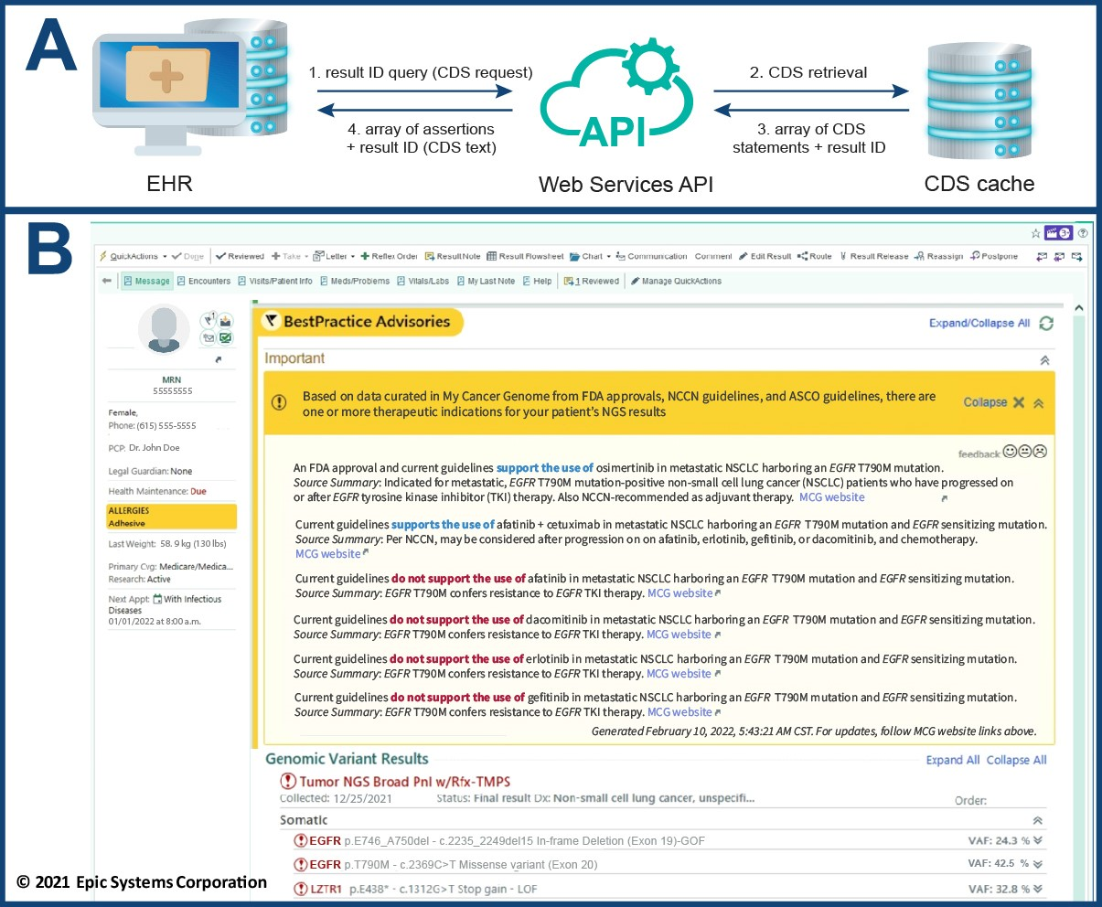
Aim 2
Develop methods for integration of biomarker-driven CDS into the EHR as human-readable statements.
Notes:
Let’s spend a few minutes on Aim 2 before we close. Aim 2 focuses on getting the CDS into the EHR. We will do a proof-of-concept demonstration using NSCLC and the VUMC EHR, which is an instance of Epic as of November 2017.
Part A of this figure shows the data flow for Aim 2. This is one example data flow, though there may be others as we work through what interoperability will look like for this aim.
Part B of this figure shows a mock-up of what the CDS might look like in our instance of Epic.
Full text of Aim 2:
Develop methods for integration of biomarker-driven CDS into the EHR as human-readable statements. In this aim, we will build API functions to (a) receive communications from the EHR when an oncologist views tumor test results, (b) retrieve cached CDS, and (c) send reusable CDS blocks to the EHR. Using NSCLC as a proof-of-concept, we will integrate OKRA CDS into the EHR as knowledge alerts to oncologists that display alongside the molecular results report.

Slide 16
Aim 2– Related Learnings to Date
The output of the API is the CDS + result ID, not necessarily cached CDS + result ID
While diagnosis is always sent with a test order, it is not always returned in the HL7 results messages
Working through institution-specific policies and processes around security and support for research vs. operational vs. transitioning tools will be part of Aim 2 as well as any future work with external institutions
Notes:
IT brought up sticky question of whether the cache was considered part of the legal medical record. To avoid confusion, we decided to write CDS from the API directly into a storage location within the EHR, removing that issue. Institution will know what the physician has viewed, and when, and no external server will need to store potentially identifiable information.
Diagnosis is a necessary component of the matching algorithm. A diagnosis is sent with the test order, but it is not returned in the HL7 message. There is no single place to retrieve this information from the EHR, and creating an algorithm to estimate it is its own project. So, working on best approaches to this problem for this R21. This may be a solved problem at other institutions and in other EHR systems.
Our Health IT knows how to handle homegrown research projects as well as how to handle externally sourced operationally focused tools. Less able to handle research projects that are intended to become operational after development.

Slide 17
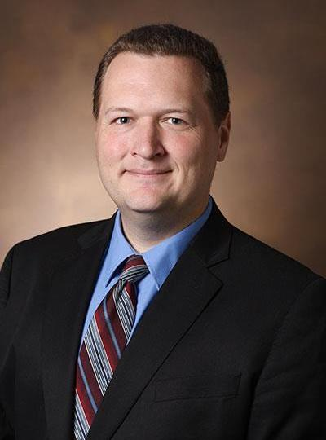
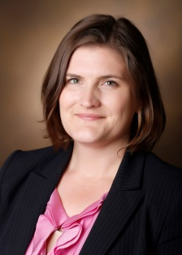
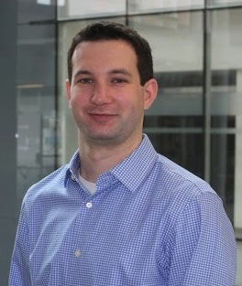
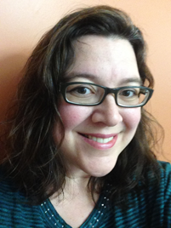
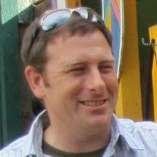
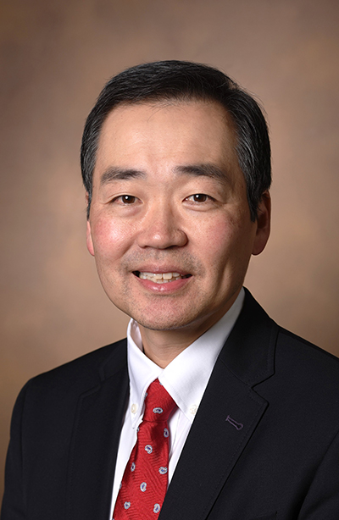
Acknowledgements
The My Cancer Genome team thanks our funders past and present, including the Susan G. Komen Foundation, the Edward P. Evans Foundation, the Joyce Family Foundation, the Robert J. Kleberg, Jr. and Helen C. Kleberg Foundation, the T. J. Martell Foundation, Pfizer, GenomOncology, Bristol-Myers Squibb, and the National Cancer Institute. We also thank VUMC IT and Health IT.
Notes:
Here is our acknowledgement slide. The official R21 project team is shown on top, and the current greater MCG and Precision Oncology team is shown on the bottom.

