Slide 1
ITCR Monthly Teleconference
October 7, 2022
Please add your name and institution to the GoogleDoc

Slide 2
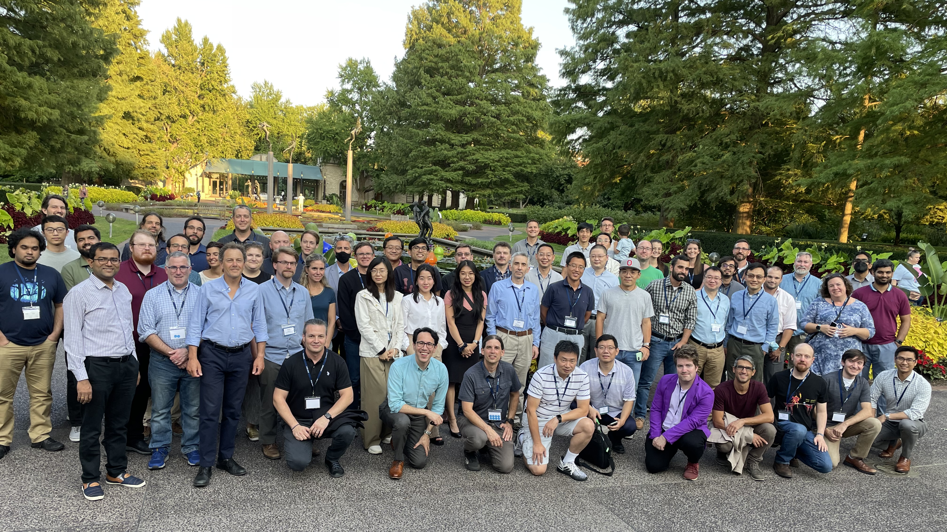
ITCR Annual Meeting 2022

Slide 3
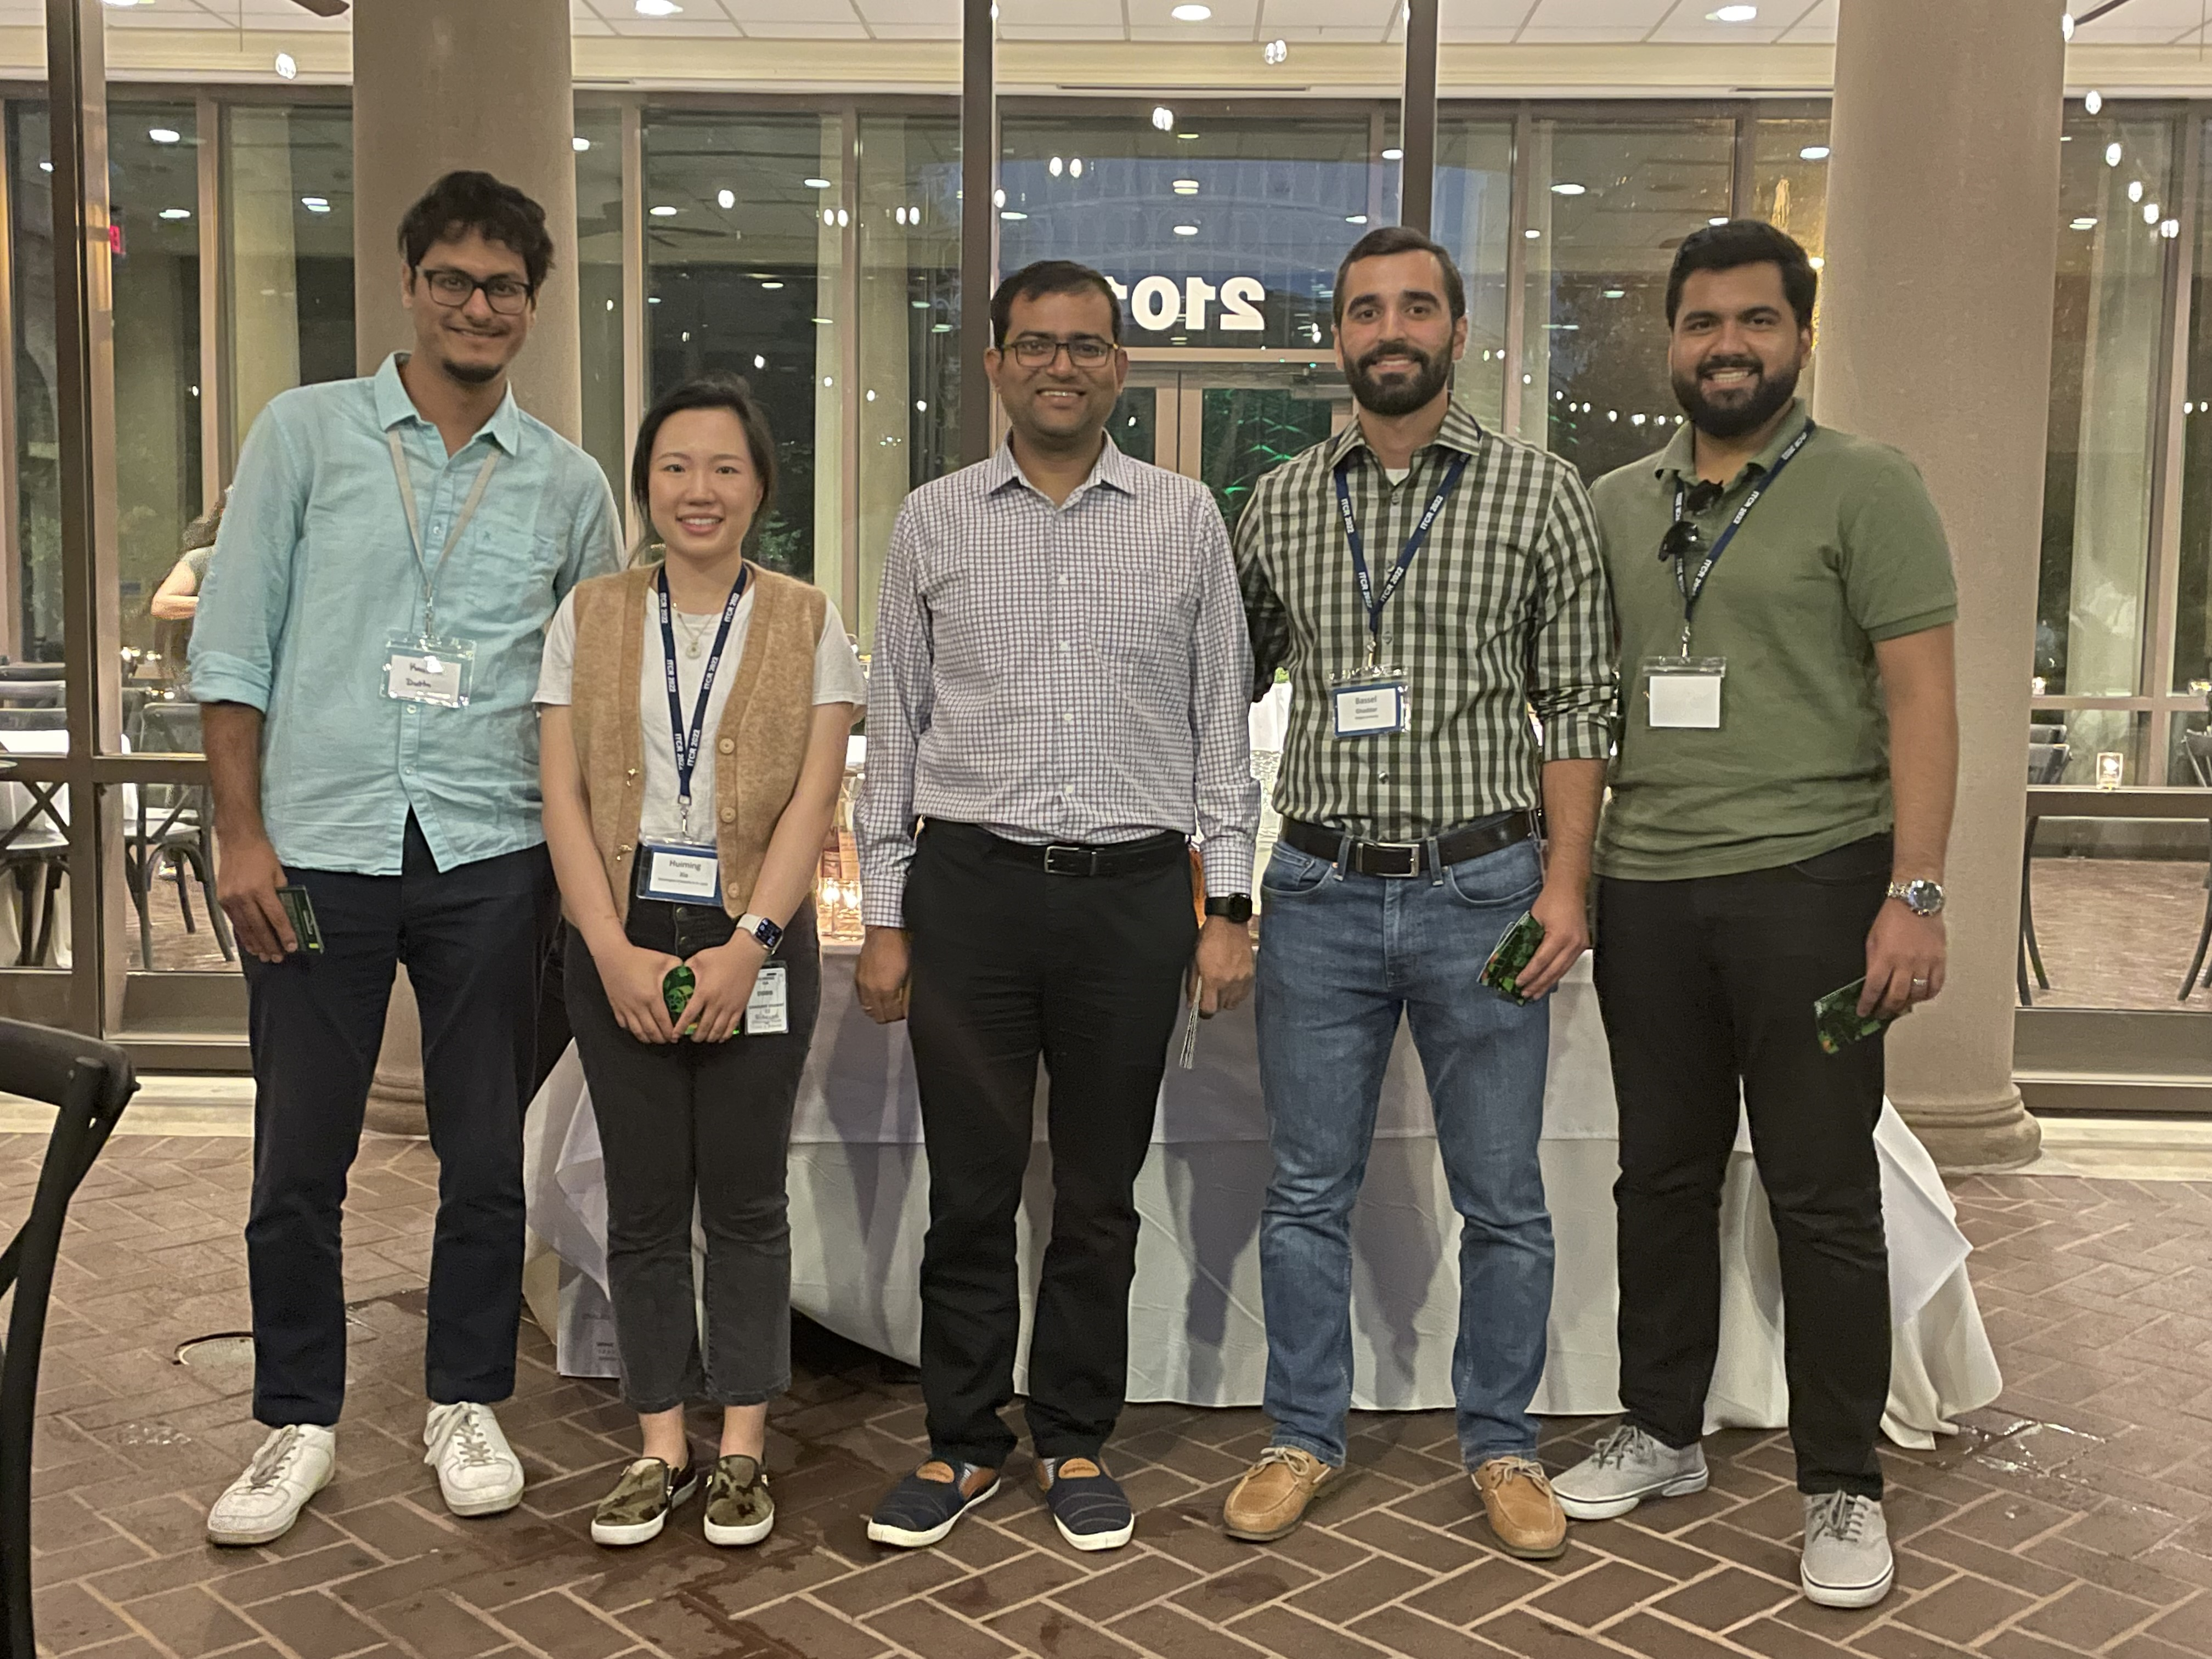
Congratulations to the poster contest winners!
First Place
Ujjwal Baid, University of Pennsylvania
Kaushik Dutta, Washington University
Second Place
Bassel Ghaddar, Rutgers University
Susanna Kiwala, Washington University
Third Place
Intekhab Hossain, Harvard University
Huiming Xia, Washington University

Slide 4
2022 NCI IMAT PI Meeting
23rd Annual Innovative Molecular Analysis Technologies Principal Investigators Meeting
Nov 30 – Dec 2, 2022
Lawrence, KS
Sessions on immuno-oncology tools, advanced imaging, synthetic biology, biospecimen procurement/preparation, spatial –omics, single cell analysis, and more!
Interested in attending? Please contact Tony Dickherber, anthony.dickherber@nih.gov

Slide 5
Upcoming receipt date for set-side proposals (U01/U24 awardees)
Next receipt date:
December 16, 2022
Future receipt date:
March 27, 2023
Steering Committee
Satish Viswanath
Jing Zhu
Ben Raphael
Juli Klemm
Li Lang
Bjoern Peters
Andy Xiao
Executive Secretary: Kelly Crotty
Special thanks to Abha Arora for stepping in while Kelly is on maternity leave!

Slide 6
Questions?
kelly.crotty@nih.gov

Slide 7
ITCR TOW - Meeting Oct 13, 4-5 PM ET
The TOW is co-writing a manuscript about biomedical software user metrics analysis!
challenges, solutions, dos and don’ts, guiding principles, ethical considerations,
Please join us if you would like to contribute, or email Carrie Wright at cwright2@fredhutch.org to contribute asynchronously.
More information at https://www.itcrtraining.org/tow

Slide 8
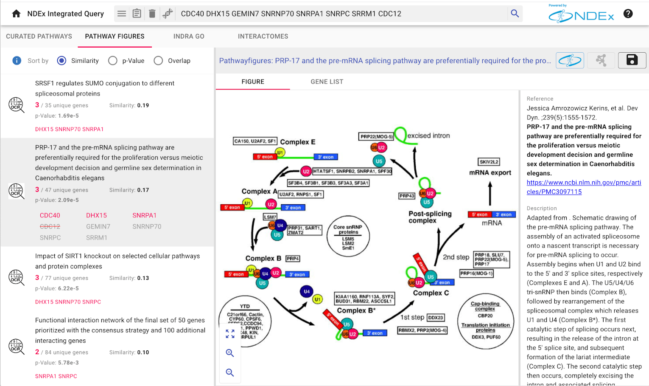
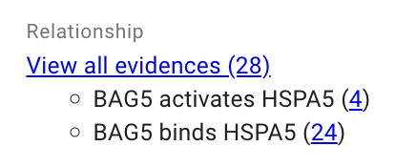
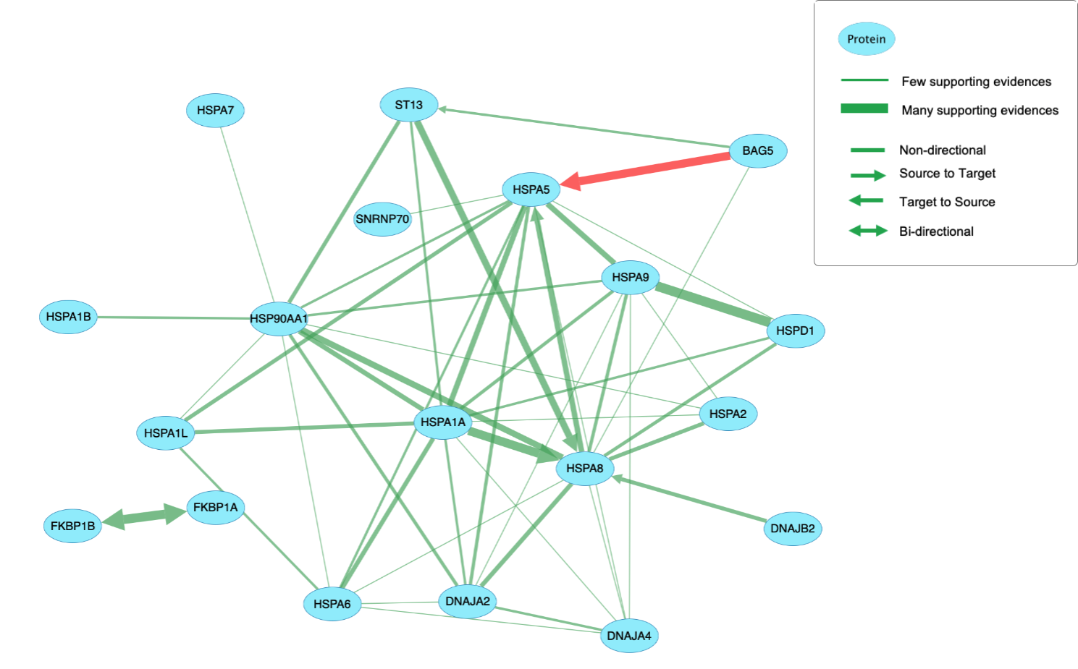
IQuery 1.4 – ndexbio.org/iquery gene set analysis with pathways and interaction networks from NDEx
New Interface
~30K Literature Figures via OCR mining
GO Biological Processes augmented
with text-mined relationships

