Slide 1

Predicting actionable cancer vulnerabilities enabled by mutant-directed protein-protein interactions
Andrey A. Ivanov, PhD
DDT Program, Winship Cancer Institute
Department of Pharmacology & Chemical Biology
and Emory Chemical Biology Discovery Center

Slide 2
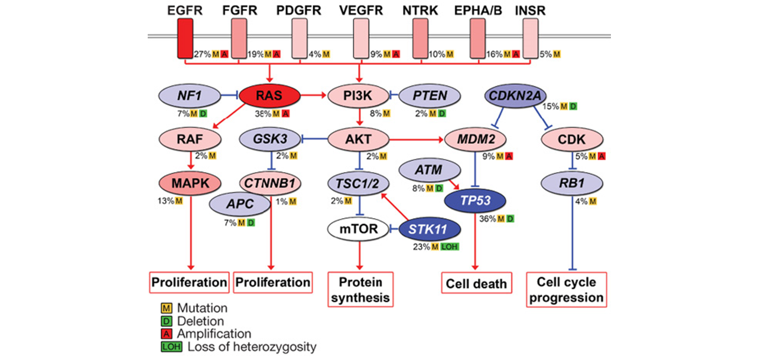
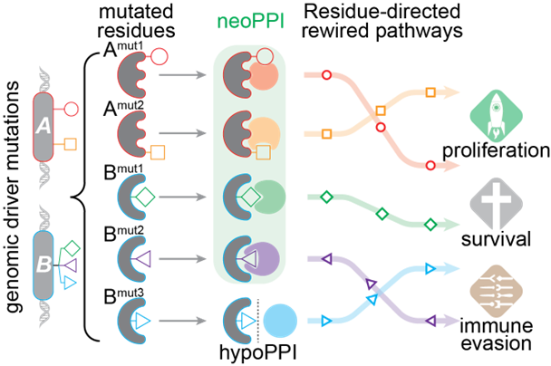


Genomic alterations promote tumorigenesis through rewired protein-protein interaction networks
Significantly mutated pathways in lung adenocarcinomas
Mutations in tumor driver genes lead to
Rewired PPI networks
Acquisition of cancer hallmarks
Drug resistance
Ding, L. et al, Nature 455, 1069–1075 (2008).
https://doi.org/10.1038/nature07423
A comprehensive experimental profiling of functional effects induced by mutant-directed PPIs in cancer patients is highly challenging
Our goal is to translate the landscape of oncogenic mutations into clinically actionable biological models for cancer target discovery by leveraging computational systems biology coupledwith high-throughput screening technologies

Slide 3
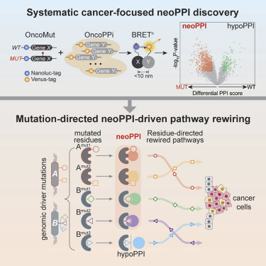
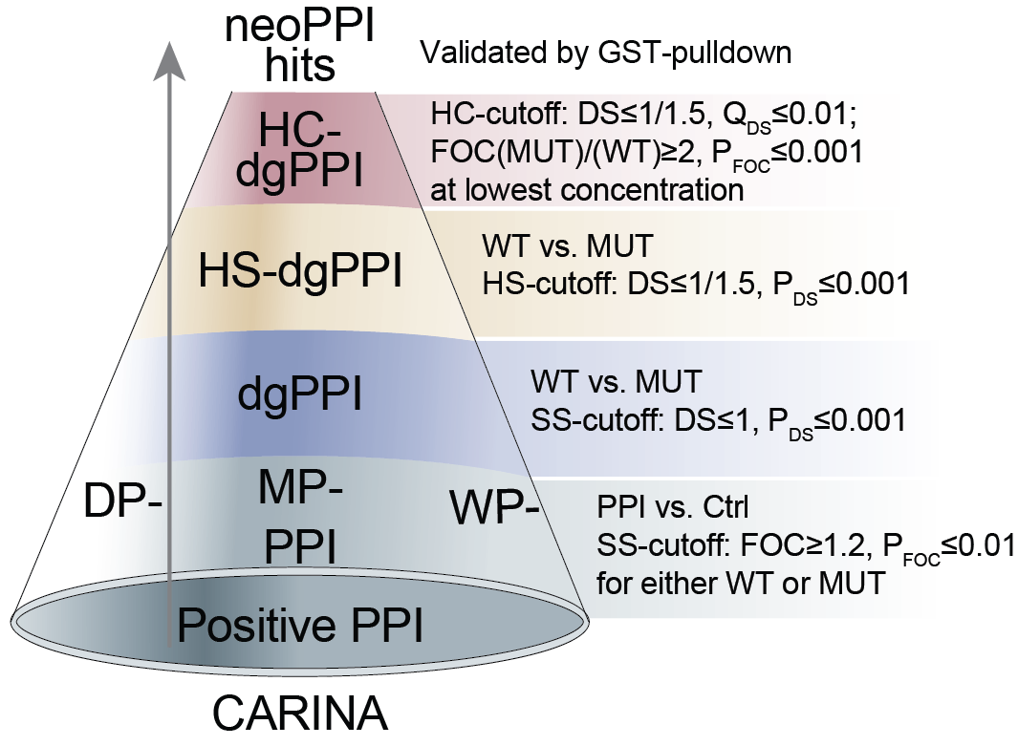
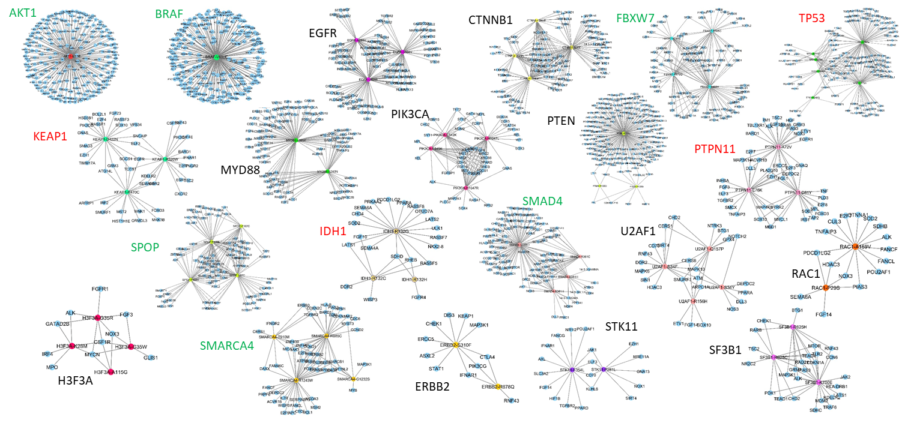


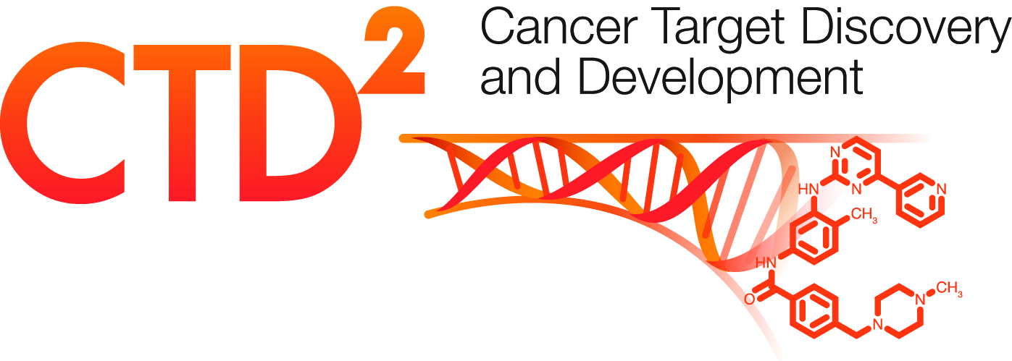
Quantitative high-throughput differential screening revealed hundreds of mutant-driven protein-protein interactions (NeoPPIs)
qHT-dS
CARINA
Differential PPI mapping at single residue resolution
Quantitative high-throughput differential screening
Comparative analysis of
rewired interactions algorithm
> 2M data points
Haian Fu, PhD
Mo X*, Niu Q*, Ivanov AA*,…, Fu H. Systematic discovery of mutation-directed neo-protein-protein interactions in cancer. Cell. 2022 Apr 27, PMID: 35512704. * - These authors contributed equally.
U01CA217875

Slide 4
Neoppis can be mediated by point mutations in both oncogene and tumor suppressor genes
Oncogene mutation-mediated neoPPIs
Tumor suppressor gene mutation-mediated neoPPIs

Slide 5
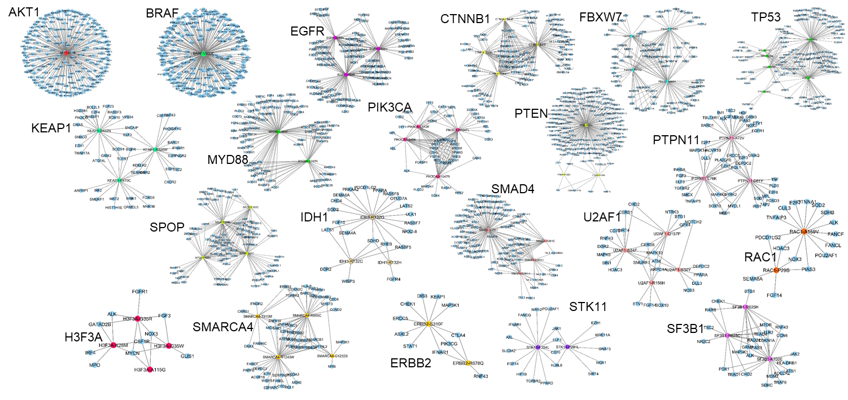

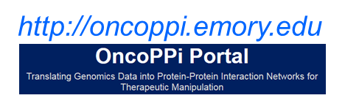





Widespread prevalence of neoPPI
Share discoveries with the scientific community
Dexter Pratt
Rudolph Pillich
How to uncover the most biologically and clinically significant mutant-directed PPIs as new targets?

Slide 6
ITCR R21: Predicting actionable cancer vulnerabilities enabled by mutant-directed protein-protein interactions
We hypothesize that neoPPI-regulated oncogenic pathways and actionable targets can be determined by leveraging the power of the computational systems biology approach.
Specific Aims
Aim 1: Develop methods to determine the neoPPI-regulated biological programs
Aim 2: Develop tools to determine actionable vulnerabilities in neoPPI-regulated pathways
Successful completion of this study will provide innovative informatics methods to determine therapeutically actionable oncogenic programs regulated by mutant-enabled protein-protein interactions and address a critical challenge of PPI-based target discovery in cancer.

Slide 7
Averon: informatics platform for discovering
Actionable Vulnerabilities Enabled by Rewired Oncogenic Networks

Slide 8
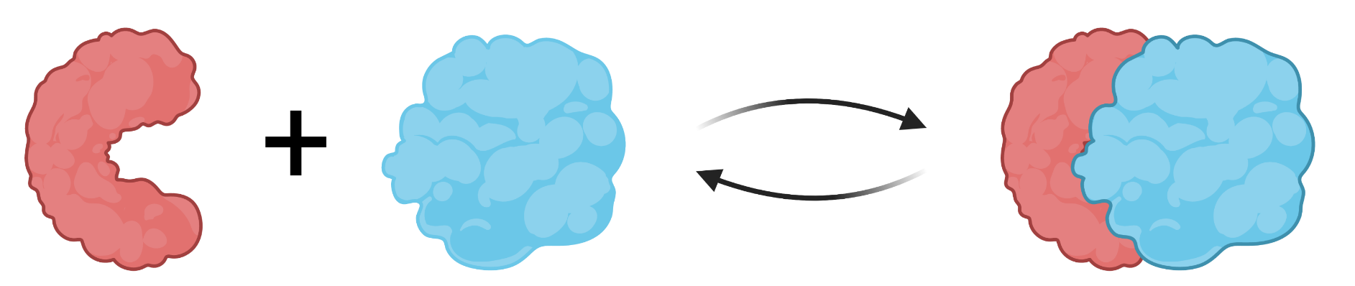
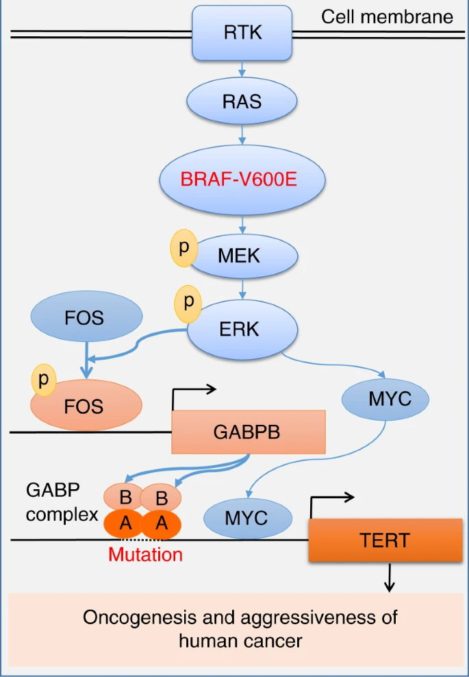
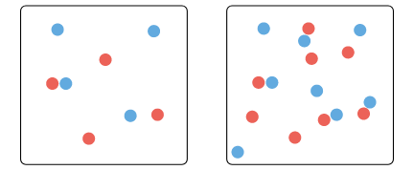


Estimation of protein complex levels in patient samples
Assumption 1:
The level of X-Y PPI correlates with averaged expression of X and Y genes
X
Y
X
Y
$$PPIscore=\frac{Expression\left(X\right)+Expression(Y)}{2}$$
Low expression
High expression
Colorectal Adenocarcinoma (TCGA, PanCancer Atlas)
Liu, R., Nat Commun 9, 579 (2018). https://doi.org/10.1038/s41467-018-03033-1

Slide 9

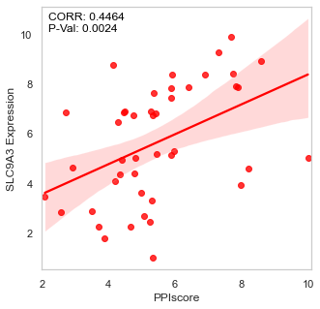
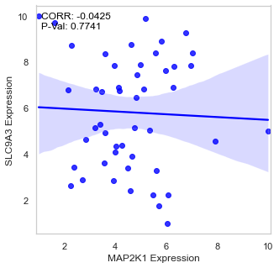
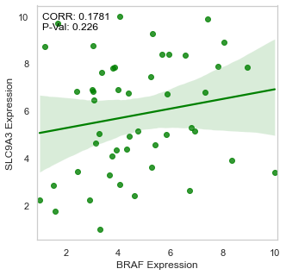

Identification of neoPPI-regulated genes
Assumption 2:
Expression of genes which are regulated by X-Y PPI correlates with X-Y PPI level
Colorectal Adenocarcinoma (TCGA, PanCancer Atlas)
$${PPIscore}_{i}^{mut}=\frac{X_{i}^{mut}+Y_{i}}{2}, i ∈{sample}_{mut}$$
BRAF^{V600E}
MEK1

Slide 10

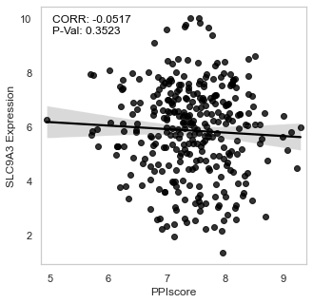

Identification of neoPPI-regulated genes
Assumption 3:
Expression of neoPPI-regulated genes correlates with neoPPI scores stronger than with WT PPI scores
Colorectal Adenocarcinoma (TCGA, PanCancer Atlas)
$${PPIscore}_{i}^{mut}=\frac{X_{i}^{mut}+Y_{i}}{2}, i ∈{sample}_{mut}$$
$${PPIscore}_{i}^{wt}=\frac{X_{i}^{wt}+Y_{i}}{2}, i ∈{sample}_{mut}$$
BRAF^{V600E}
BRAF
MEK1
MEK1

Slide 11
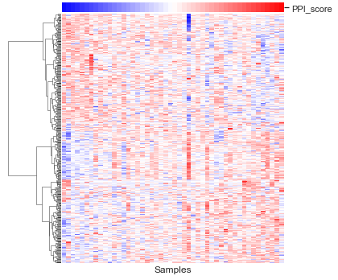
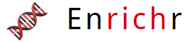

AVERON recapitulates myc activation by brafv600/mek1 ppi
BRAFV600E/MEK1 neoPPI-upregulated genes are enriched in MYC-target genes
BRAF^{V600}
MEK1
Negatively-regulated
genes
ERK
API
MYC
Positively-regulated
genes
Cell growth
Transformation

Slide 12
THE signature genes are NEOPPI specific
The correlation between newPPI scores
is limited
The size of signature gene sets varies
across different neoPPIs
The similarity between different neoPPI
signature gene sets is limited

Slide 13
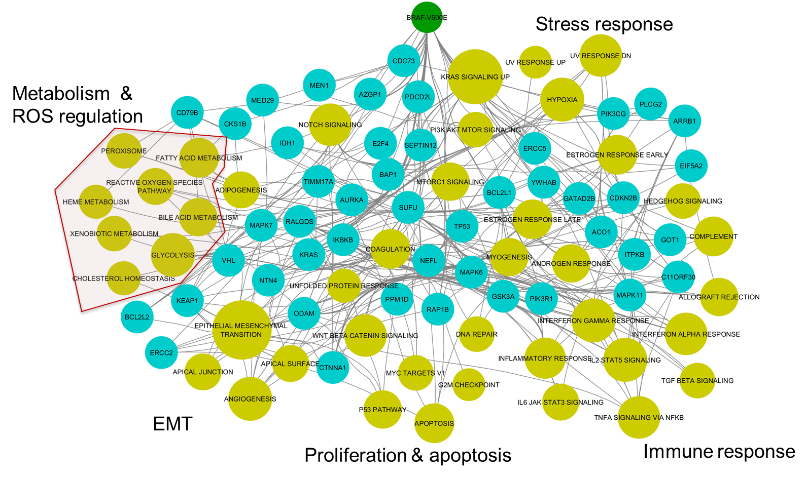
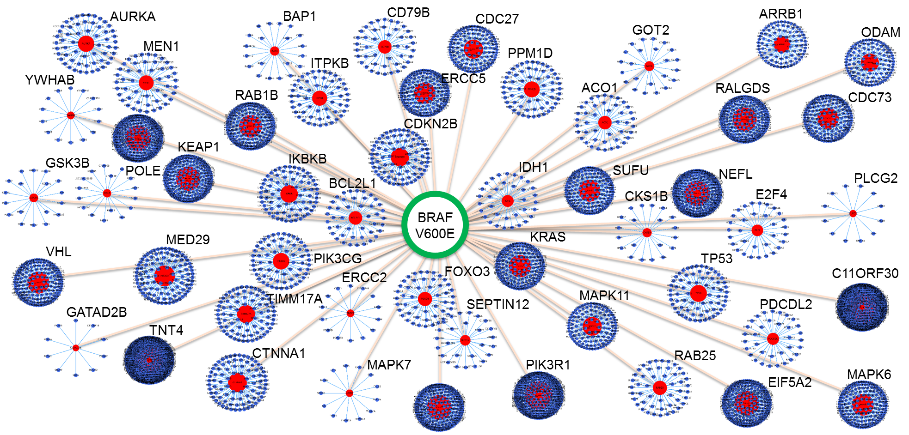
BRAF V600E neoPPIs can control multiple major oncogenic programs in skin melanoma patients
BRAF V600E neoPPIs-associated gene communities
BRAF V600E neoPPIs can control different oncogenic pathways
Pathway enrichment analysis
links neoPPI signature genes to defined biological pathways
Experimentally determined BRAF^{V600E} binding partner
BRAF^{V600E} binding partner
Computationally identified neoPPI-regulated gene
Pathways regulated by neoPPI signature genes

Slide 14
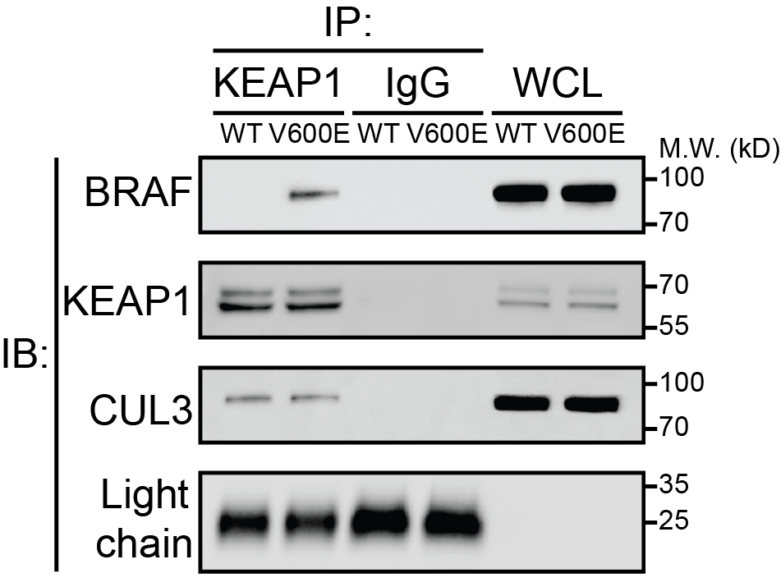
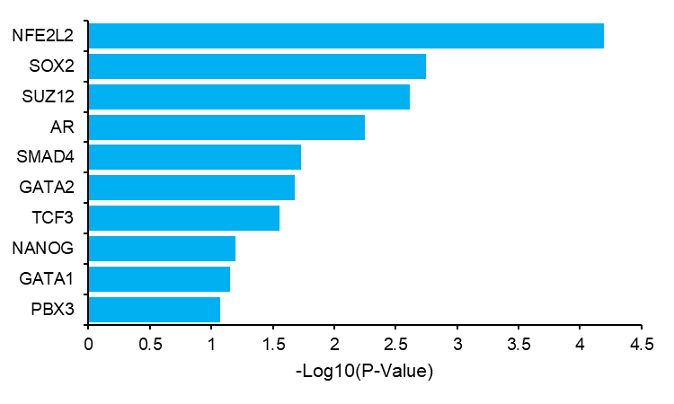
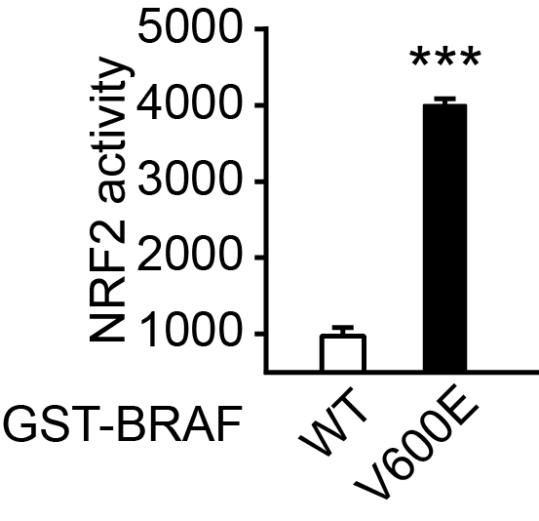
BRAF^{V600E}-KEAP1 neoPPI can activate nrf2
Endogenous co-IP
BRAFV600E/KEAP1 neoPPI-upregulated genes
are enriched in NRF2-target genes
ENCODE and ChEA Consensus TFs from ChIP-X
NRF2/ARE
reporter assay
BRAF^{V600E}-
KEAP1
API
NRF2
Cellular redox
state regulation

Slide 15
SUMMARY
AVERON enables a systematic discovery of biological programs and pathways regulated through mutant-directed protein-protein interactions in cancer
Using this workflow, we have reproduced well-defined mechanisms (e.g. BRAFV600E-MEK1-ERK-MYC) and uncovered new functional connectivity for newly discovered neoPPIs (e.g. BRAFV600E-KEAP1-NRF2)
Integration of experimental and computational approaches allows us to uncover new molecular mechanisms of oncogenic signaling and generate new hypotheses to inform new clinical strategies

Slide 16




Acknowledgements
ECBDC/PharmCB
Haian Fu, PhD
Yuhong Du, PhD
Xiulei Mo, Ph.D.
Qiankun Niu, PhD
Sofia West
Xuan (Novak) Yang, MS (Now Yale Graduate Sch)
Yoon Hyeun Oum, PhD
Dacheng Fan, Ph.D.
Kun Qian, PhD (Now Karolinska Institute, Sweden)
Kenny Ouyang
Hematology & Medical Oncology
Suresh Ramalingam, MD, FACP, FASCO
Mylin Torres, MD
Lily Yang, MD, PhD
Shi-Yong Sun, PhD
Taofeek Owonikoko, MD/PhD (Univ. of Pittsburgh)
ALL Members of Fu Lab & ECBDC!

