Slide 1
Advancing cancer benchmarking and data sharing through crowd-sourced challenges
ITCR PI Meeting
Aug 7 2020

Slide 2
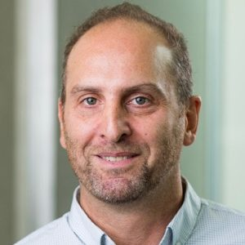
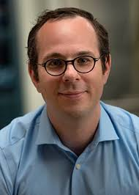
Leadership Team
Justin Guinney, PhD
VP Computational Oncology, Sage Bionetworks
Affiliate Associate Professor, University of WA
Paul C. Boutros, PhD
Director, Cancer Data Science, UCLA
Professor, Human Genetics, UCLA
Gustavo Stolovitzky, PhD
Director, Translational Systems Biology, IBM
Founder, DREAM Challenges

Slide 3
Problem Statements
“Self-assessment” has impeded the validation and dissemination of bioinformatics tools and methods.
New paradigms for data sharing and community engagement are needed to unlock critical datasets.
Translational and clinical tools require robust assessments of performance and generalizability on diverse patient cohorts.

Slide 4
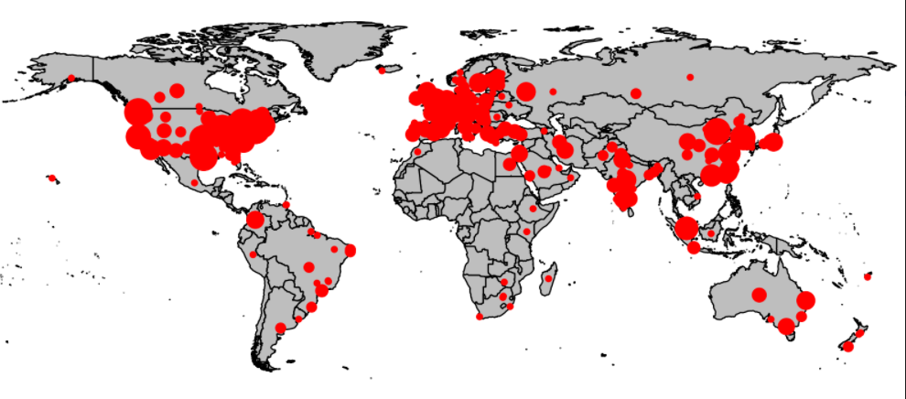
DREAM Challenges
Pioneer of biomedical challenges since 2006
Foster dialogue & collaboration amongst groups
Accelerate research
Provide objective assessment of methods & tools
60+ challenges
70+ papers

Slide 5
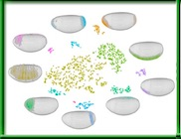
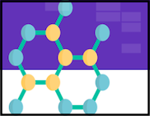
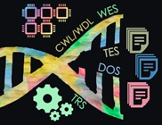
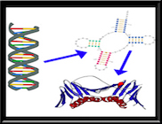
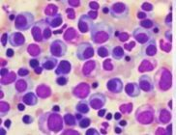
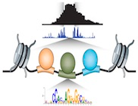
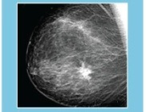
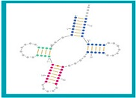
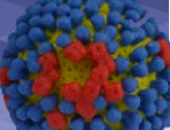
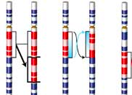
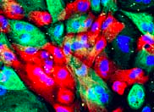
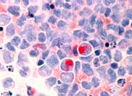
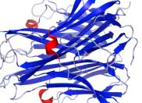
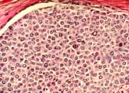
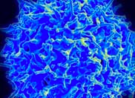
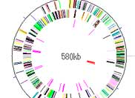
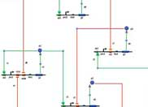
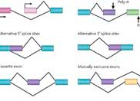
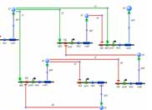
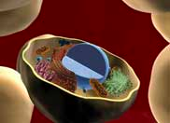
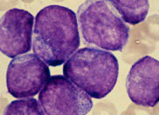
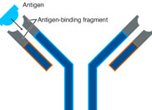
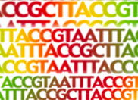
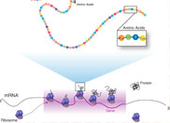
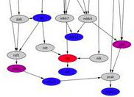
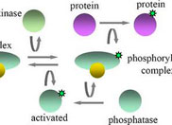
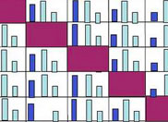
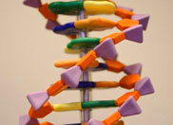
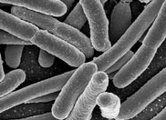

Slide 6
Problem #1: Fix the Self-Assessment Trap
“Self-assessment” has impeded validation and dissemination of computational methods.
Answer: challenges provide a rigorous framework for benchmarking tools
Nat Genetics, 2014; Nat Methods, 2015; Genome Bio, 2018
Nat Biotech, 2020; Nat Methods, in press

Slide 7
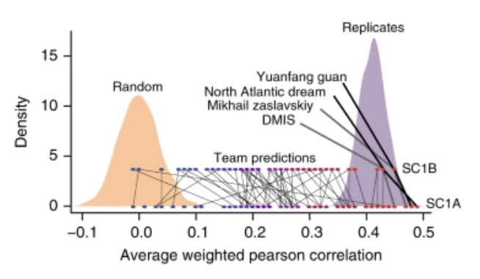
Problem #2: Unlock Hidden Data & Create Communities
New paradigms for data sharing and community engagement are needed to unlock understanding around critical datasets.
Answer: challenges provide innovative mechanism for data access & community participation
Nat Comm, 2019
Leukemia, 2020

Slide 8
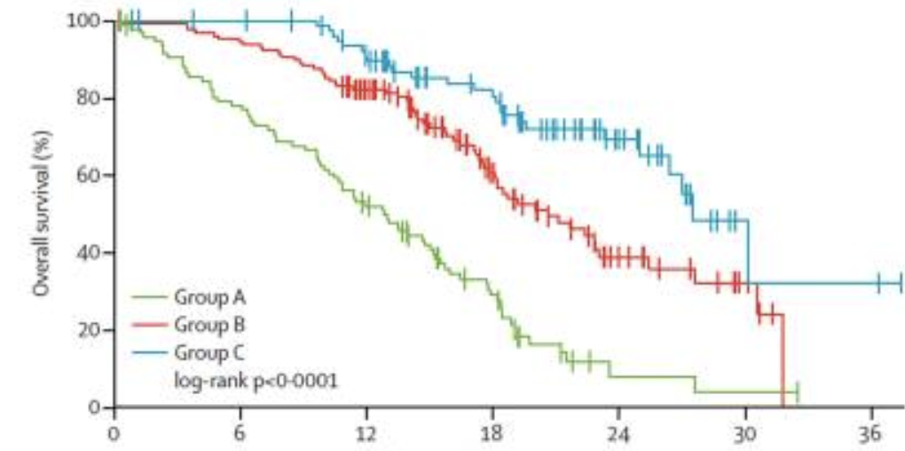
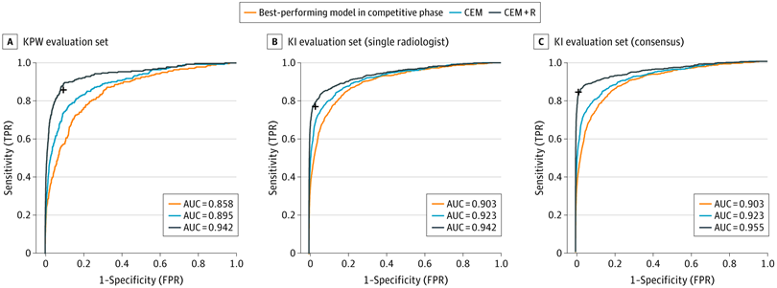
Problem #3: Robust Performance Assessment
Translational and clinical tools will require robust assessments of performance and generalizability on diverse patient cohorts.
Answer: challenges can define and assess clinical benchmarks
Lancet Oncology, 2017
JCO-Clinical Cancer Informatics 2017
JAMA Oncology, 2017
JAMA Network Open, 2020

Slide 9
Proposal Overview
Aim 1: Develop a community hub and benchmarking toolkit for biomedical Challenges.
Aim 2: Develop portable software and services for distributed benchmarking on sensitive and protected data.
Aim 3: Expand the Challenge community through improvements in education, outreach, and empowering the organization of independent challenges.

Slide 10
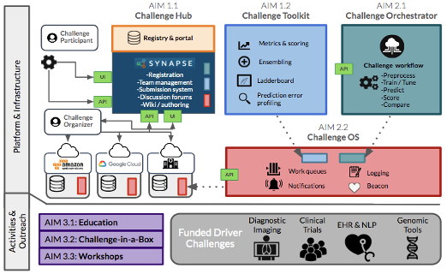
Overview

Slide 11
AIM 1
Develop a community hub and benchmarking toolkit for biomedical Challenges.
Develop schema, registry, and portal to enable discoverability and boost participation across the biomedical challenge community
Benchmarking toolkit
Metric and scoring toolbox
Automated ensemble generation & optimization
Leaderboards resilient to over-fitting
Algorithm-specific error profile analysis

Slide 12
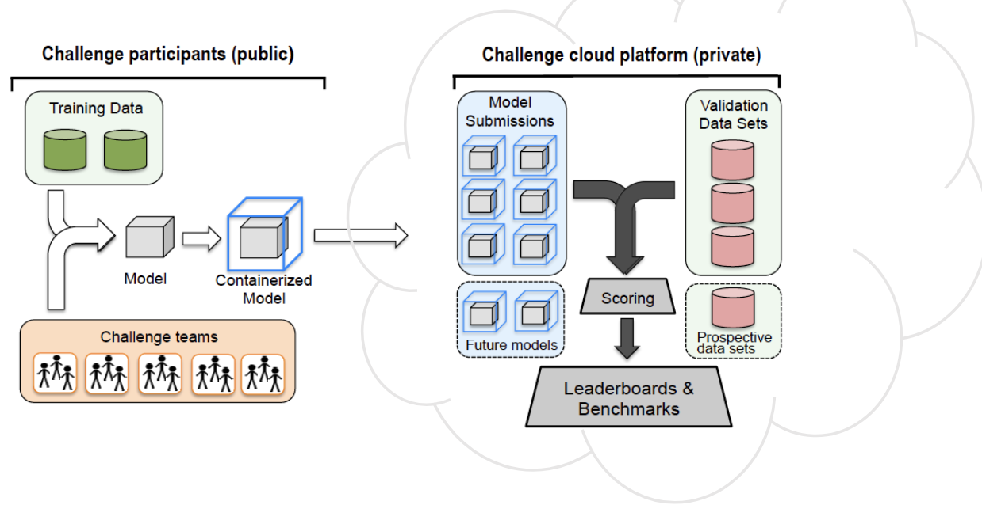
AIM 2
Develop portable software and services for distributed benchmarking on sensitive and protected data.
Nat Biotech, 2018
Genome Biol, 2019

Slide 13
AIM 3
Expand the Challenge & benchmarking community through improvements in education, outreach, and empowering the organization of independent challenges.
Biomedical imaging
Clinical algorithms
EHR & Real-world data
Precision oncology
Cancer informatics

Slide 14
Summary
Through our ITCR U24, we will ...
… provide platform & services to assist the community in benchmarking biomedical tools and methods
… host crowd-sourced challenges to address impactful questions in cancer
… collaborate with ITCR and cancer researchers to develop and support communities of interest

